Slide 1
矩阵论 习题讲解1.7
2024
ISEE

Slide 2
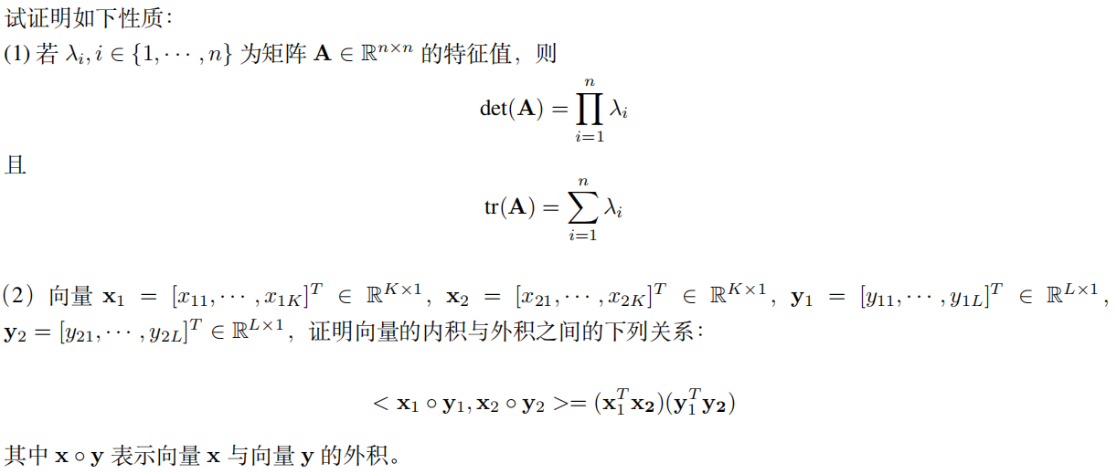
习题1.7

Slide 3
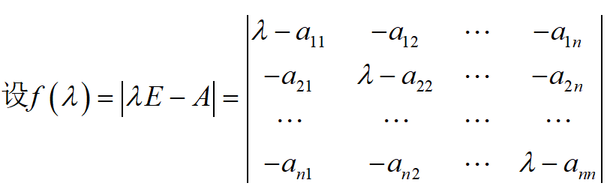




习题1.7
(1) 考虑矩阵A的特征多项式$f(λ)$
1 对于前两项，根据行列式的定义，均从主对角线相乘中产生
2 对于常数项，其值即为$f(0)$

Slide 4
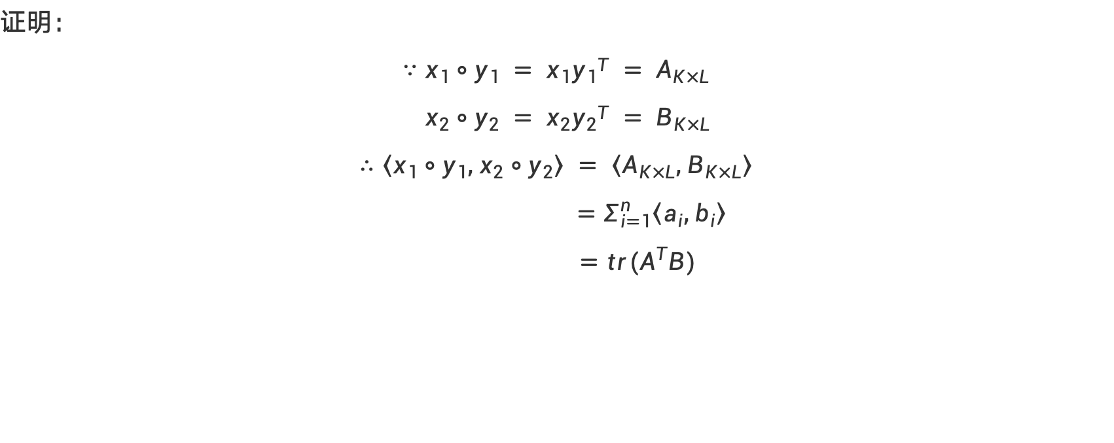
习题1.7
证明：
$$∵x_{1}∘y_{1} = x_{1}{y_{1}}^{T} = A_{K×L}$$
$$x_{2}∘y_{2} = x_{2}{y_{2}}^{T} = B_{K×L}$$
$$∴〈x_{1}∘y_{1}, x_{2}∘y_{2}〉 = 〈A_{K×L}, B_{K×L}〉$$
$$=Σ_{i=1}^{n}〈a_{i}, b_{i}〉$$
$$=tr(A^{T}B)$$

Slide 5
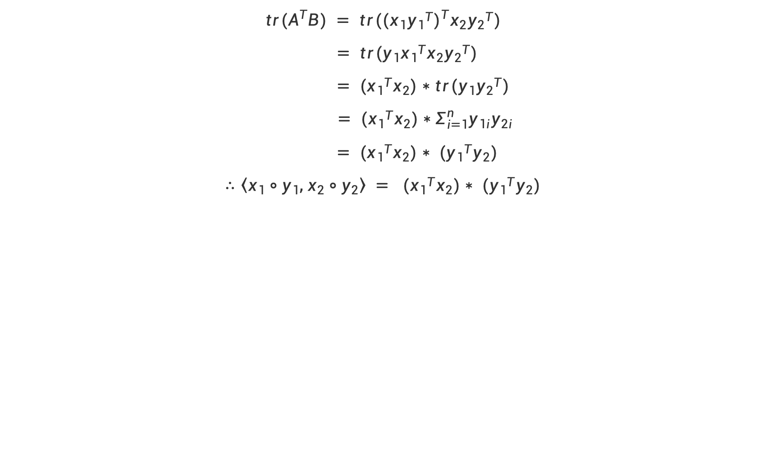
习题1.7
$$tr(A^{T}B) = tr({(x_{1}{y_{1}}^{T})}^{T}x_{2}{y_{2}}^{T})$$
$$= tr({y_{1}{x_{1}}^{T}x}_{2}{y_{2}}^{T})$$
$$= ({{x_{1}}^{T}x}_{2})∗tr({{y_{1}y}_{2}}^{T})$$
$$= ({{x_{1}}^{T}x}_{2})∗Σ_{i=1}^{n}{y_{1i}y}_{2i}$$
$$= ({{x_{1}}^{T}x}_{2})∗ ({{y_{1}}^{T}y}_{2})$$
$$∴〈x_{1}∘y_{1}, x_{2}∘y_{2}〉 = ({{x_{1}}^{T}x}_{2})∗ ({{y_{1}}^{T}y}_{2})$$

Slide 6
感谢观看
ISEE
2024
Thank you
演讲者：赵一锟

