Slide 1


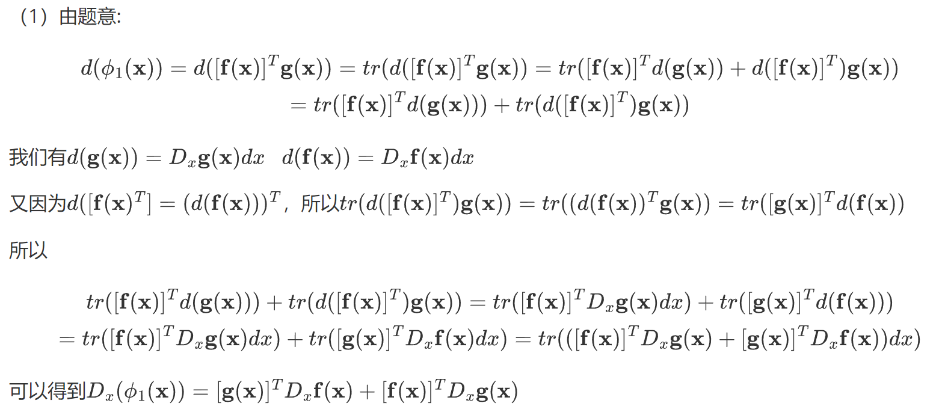

矩阵辨识
$$tr(A)=tr(A^{T})$$

Slide 2


