Slide 1
Advanced compiler techniques for exploring ILP

Slide 2
Why software pipeling ?
1 LD F0, 0(R1)
2 stall
3 ADDD F4, F0, F2
4 stall
5 stall
6 SD 0(R1), F4
7 SUBI R1, R1, #4
8 stall
9 BNEZ R1, LOOP
10 stall
1 LD F0, 0(R1)
2 ADDD F4, F0, F2
3 SD 0(R1), F4
4 SUBI R1, R1, #4
5 BNEZ R1, LOOP
Loop Parallelism lost !
2013Fall_Ad Computer Architecture

Slide 3
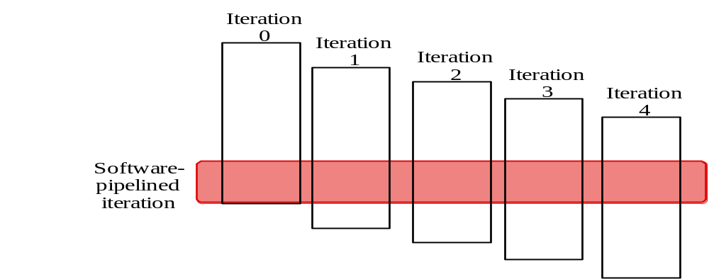
Software Pipelining
Observation: if iterations from loops are independent, then can get more ILP by taking instructions from different iterations
Software pipelining: reorganizes loops so that each iteration is made from instructions chosen from different iterations of the original loop (­ Tomasulo in SW)

Slide 4
Software Pipelining Example
Before: Unrolled 3 times
1 LD F0,0(R1)
2 ADDD F4,F0,F2
3 SD 0(R1),F4
4 LD F6,-8(R1)
5 ADDD F8,F6,F2
6 SD -8(R1),F8
7 LD F10,-16(R1)
8 ADDD F12,F10,F2
9 SD -16(R1),F12
10 SUBI R1,R1,#24
11 BNEZ R1,LOOP
After: Software Pipelined
1 SD 0(R1),F4 ; Stores M[i]
2 ADDD F4,F0,F2 ; Adds to M[i-1]
3 LD F0,-16(R1); Loads M[i-2]
4 SUBI R1,R1,#8
5 BNEZ R1,LOOP
SW Pipeline
overlapped ops
Time
Loop Unrolled
Symbolic Loop Unrolling
Maximize result-use distance
Less code space than unrolling
Fill & drain pipe only once per loop
vs. once per each unrolled iteration in loop unrolling
Time
5 cycles per iteration

Slide 5
Code after reorganized
1 LD F0,0(R1)
1 ADDD F4,F0,F2 start-up
2 LD F0, -8(R1)
Loop: 1 SD 0(R1),F4 ; Stores M[i]
2 ADDD F4,F0,F2 ; Adds to M[i-1]
3 LD F0,-16(R1); Loads M[i-2]
4 SUBI R1,R1,#8
5 BNEZ R1,LOOP
2 SD -8(R1), F4
1 ADDD F4,F0,F2 clear-up
1 SD -16(R1), F4
2013Fall_Ad Computer Architecture

Slide 6
Software Pipelining with loop unrolling in VLIW
Memory Memory FP FP Int. op/ Clock
reference 1 reference 2 operation 1 op. 2 branch
LD F0,-48(R1) ST 0(R1),F4 ADDD F4,F0,F2 1
LD F6,-56(R1) ST -8(R1),F8 ADDD F8,F6,F2 SUBI R1,R1,#24 2
LD F10,-40(R1) ST 8(R1),F12 ADDD F12,F10,F2 BNEZ R1,LOOP 3
Software pipelined across 9 iterations of original loop
  In each iteration of above loop, we:
    Store to m,m-8,m-16 (iterations I-3,I-2,I-1)
    Compute for m-24,m-32,m-40 (iterations I,I+1,I+2)
    Load from m-48,m-56,m-64 (iterations I+3,I+4,I+5)
9 results in 9 cycles, or 1 clock per iteration
Average: 3.3 ops per clock, 66% efficiency
Note: Need less registers for software pipelining
(only using 7 registers here, was using 15)

Slide 7
Global code motion
The loop unrolling and software pipelining work well with straight forward loop.
What about a loop with internal control flow ?
Global code scheduling : Effective scheduling of a loop body with internal control flow by moving instructions across branches.

Slide 8
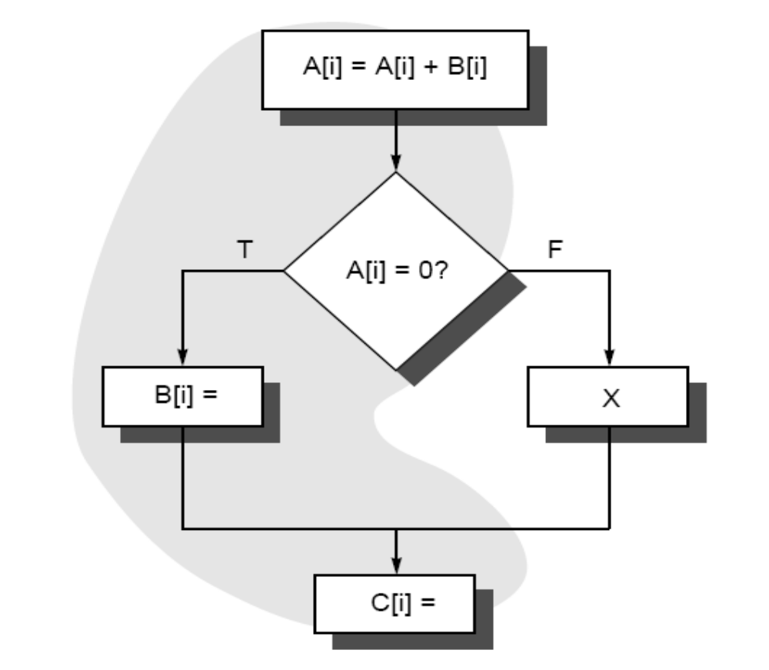
Constrains
Can B be moved above the branch ?
i : B[i] = …..
Can C be moved before ?
  Move into then-case
  Move before A is test
j : = B[i] …..

Slide 9
Tradeoff
The frequencies of the then-case and the else-case in the branch ?
How will the movement of B change the execution time for the then-case ?
Is B the best code fragment that can be moved ? How compared with moving C or other statements within the then-case ?
What’s the cost of compensation code ?

Slide 10
Trace Scheduling
Parallelism across IF branches vs. LOOP branches
Two steps:
  Trace Selection
    Find likely sequence of basic blocks (trace) of (statically
    predicted or profile predicted) long sequence of straight-line code
  Trace Compaction
    Squeeze trace into few VLIW instructions
    Need bookkeeping code in case prediction is wrong
This is a form of compiler-generated speculation
  Compiler must generate “fixup” code to handle cases
  in which trace is not the taken branch
  Needs extra registers: undoes bad guess by discarding
Subtle compiler bugs mean wrong answer
vs. poorer performance; no hardware interlocks

Slide 11
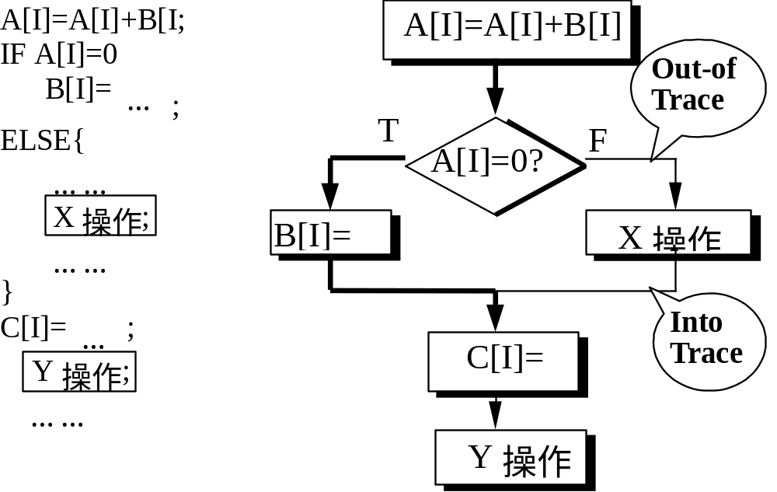
Example of Trace Scheduling

Slide 12
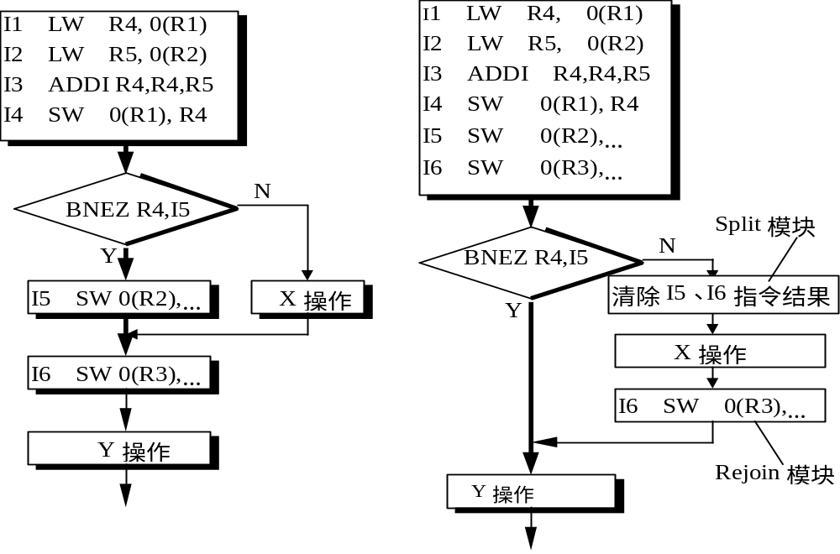
Example

Slide 13
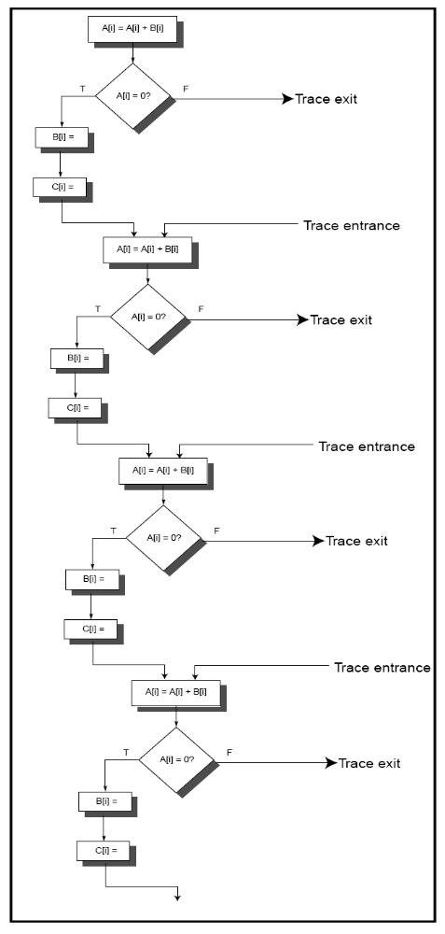
Oct.1 2008

Slide 14
Superblock
A form of extended basic block that are restricted to have a single entry point but allow multiple exits.
Easier to compact a superblock than a trace.

Slide 15
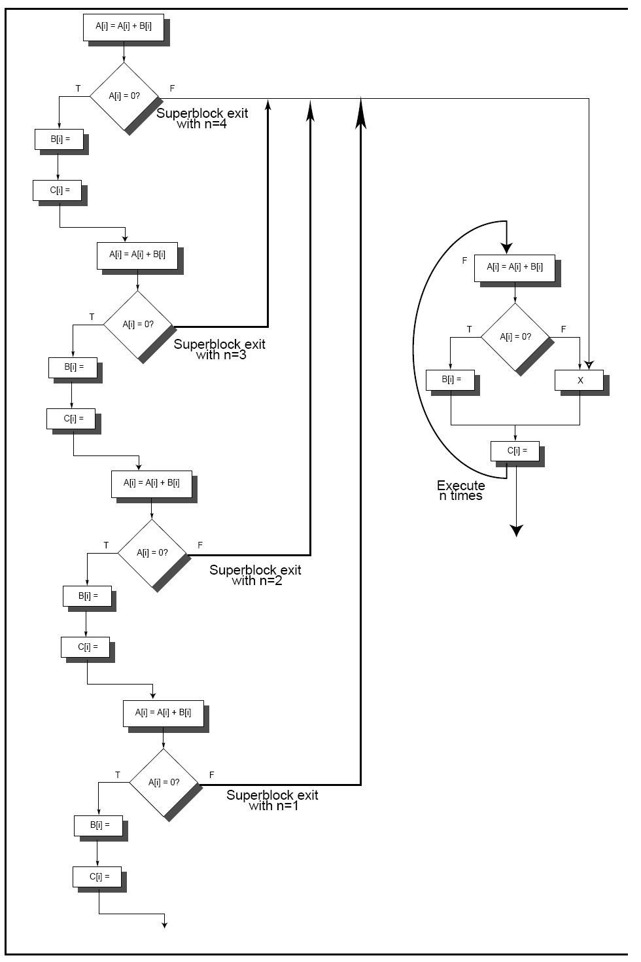
Oct.1 2008

Slide 16
Hardware Support for Expoilting ILP at compile time
Conditional Instruction (predicated instruction)
  A conditional instruction refers to a condition which is evaluated as part of the instruction execution,
  Example:
If (A==0) {S=T} BNEZ R1, L CMOV R2,R3, R1
  ADDU R2, R3, R0
  L: ……
  the CPU always executes the instruction but writes the result only if the condition is met.
  A conditional branch changes a control dependence into a data dependence.

Slide 17
Example: improving scheduloing performance using Conditional Inst.
1st inst.
2nd inst
LW R1, 40(R2) ADD R3, R4, R5
ADD R6,R3, R7
BEQZ R10, L
LW R8, 0(R10)
LW R9, 0(R8)

Slide 18
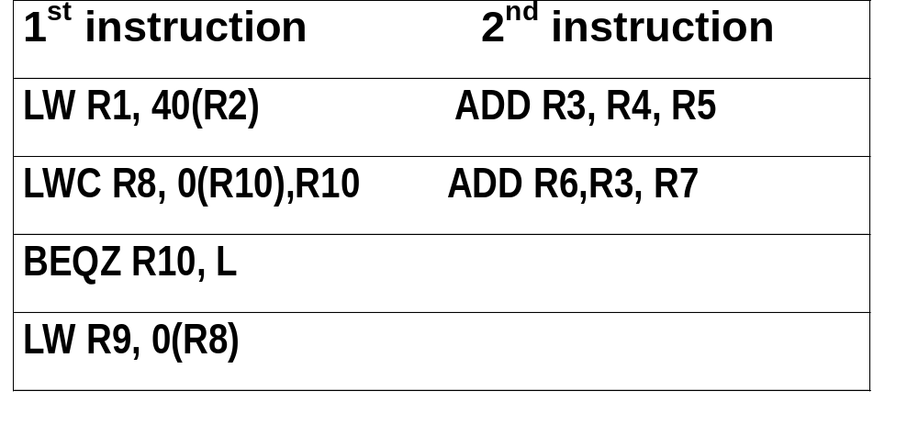
Using conditional instruction
LMC Rx, D(Ry), Rz
  Load Rx, D(Ry) if Rz != 0
  Nop if Rz == 0

Slide 19
limitations
If condition is false, still takes time to do nothing
Can’t use when the conditional branch has data dependence on other instruction,
More than two cases
Considering the overhead of conditional instruction

Slide 20
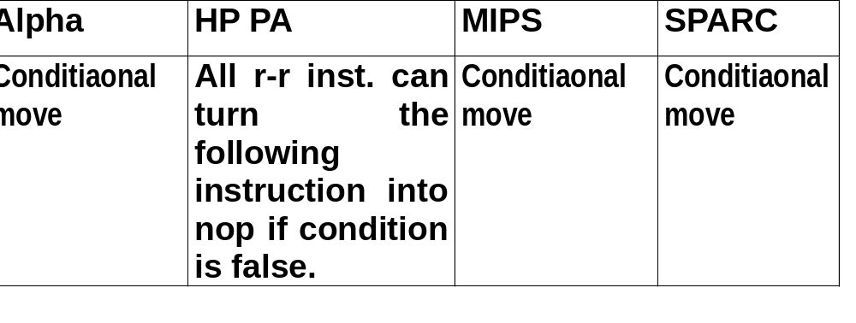
Conditional instructions in real computer

Slide 21
Predicated instructions
Full predictation
  The execution of all instruction is controlled by a predicate. When predicate is false, the instruction becomes a no-op
  Simply convert large blocks of code that are branch dependent.
  Eliminate nonloop branches
  Can be used to speculatively move an instruction that is time critical.

Slide 22
Compiler Speculation with Hardware Support
Move speculated instructions not only before the branch, but before the condition evaluation.
Four methods for supporting ambitious speculation
  Hardware and OS cooperatively ignore exceptions for speculative instructions.
  Speculative instructions that never raise exceptions are used.
  Poison bits are attached to the result registers written by speculative instructions.
  A mechanism is provided to indicate that an instruction is speculative, the hardware buffers the result until the instruction no longer speculative.

Slide 23
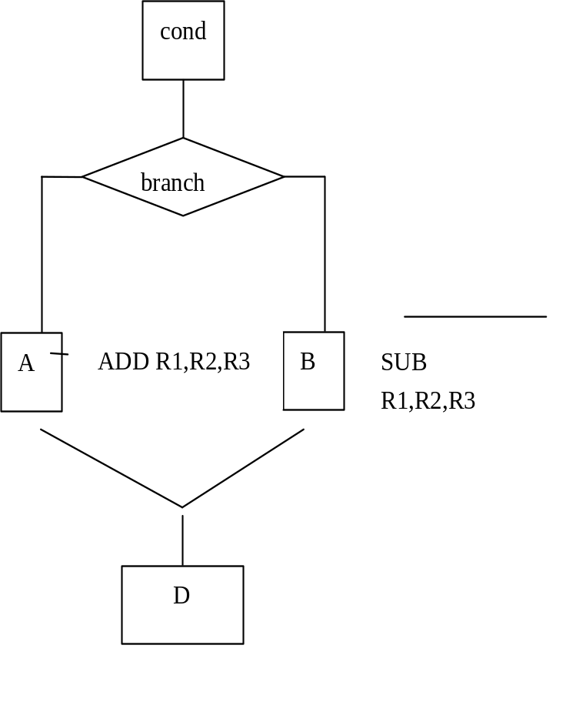
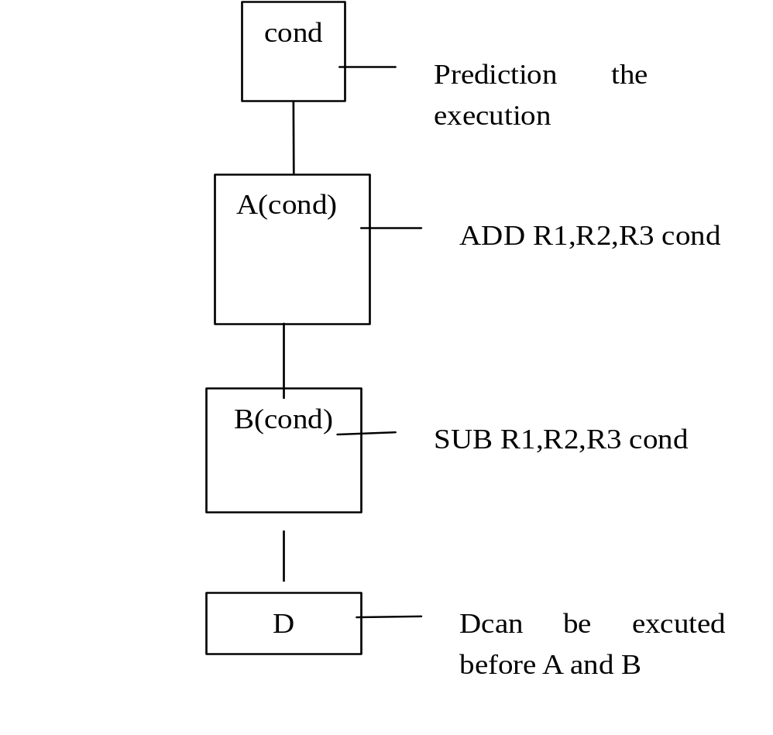
hyper block:
--super block + prediction
No branch ,No prediction No throw away ,But an extra source code field.

Slide 24
Trace Cache
Bring N instructions per cycle
  No I-cache misses
  No prediction miss
  No packet breaks !
  Because branch in each 5 instruction, so cache can only provide a packet in one cycle.

Slide 25
What’s Trace ?
Trace: dynamic instruction sequence
When instructions ( operations ) retire from the pipeline, pack the instruction segments into TRACE, and store them in the TRACE cache, including the branch instructions.
Though branch instruction may go a different target, but most times the next operation sequential will just be the same as the last sequential. ( locality )

Slide 26
Whose propose ?
Peleg Weiser (1994) in Intel corporation
Patel / Patt ( 1996)
Rotenberg / J. Smith (1996)
Paper: ISCA’98

Slide 27
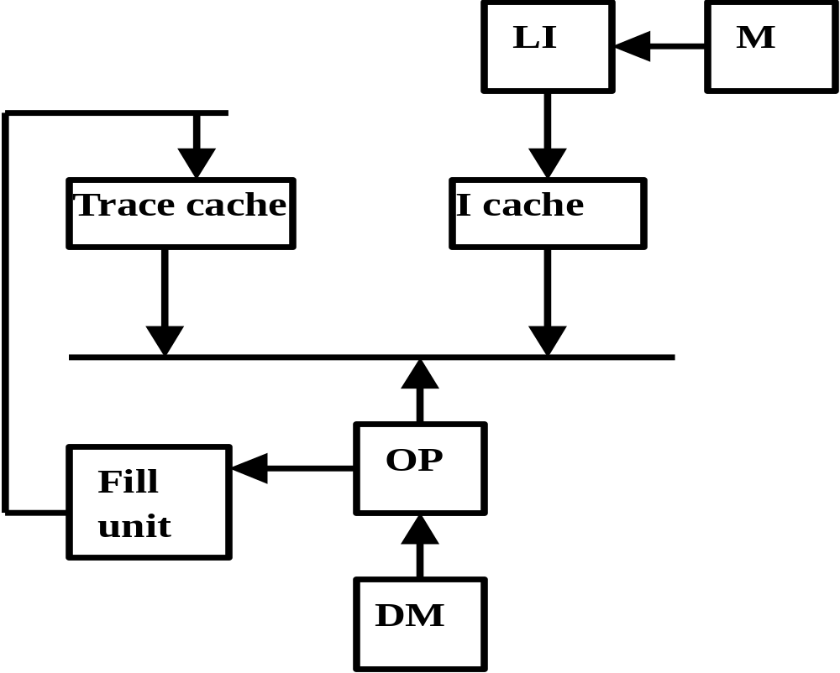
Trace in CPU

Slide 28
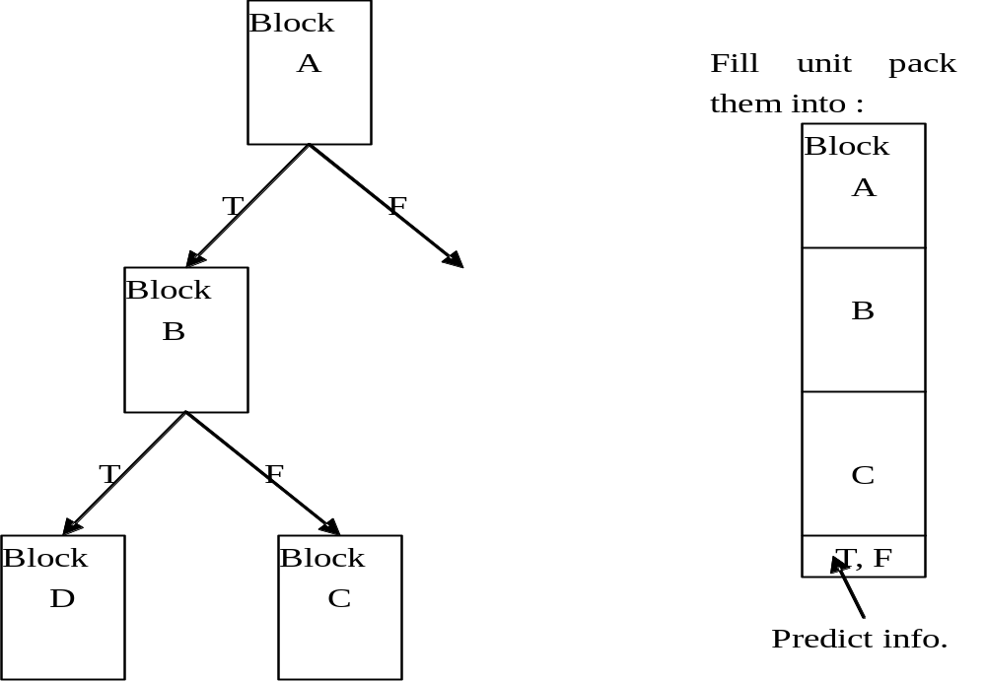
Instruction segment

Slide 29
Block-Structure
Basic idea:
  Block substitute instruction as atomic unit running in computer.
    One block is always executed in whole or entirely, but not just half or part of it.
  Additional mechanism need to solve the exception that happens in the middle of the basic block.
  If the intermediate result of the basic block is not used by other blocks, then we can use linkage within the block but not the register (that is used by the software) to connect the producer and consumer, which can save space and power.

Slide 30
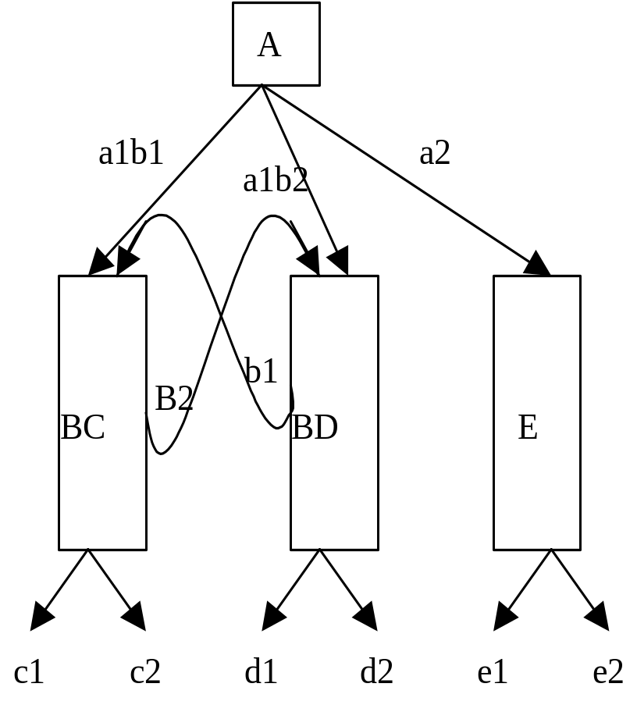
Block-Structure
Block is produced by a compiler as trace cache segment.
If an exception happens at the middle of the block, then all the block work have done will be throw away and go to another block.
The hardware can find more concurrency in one block.

Slide 31
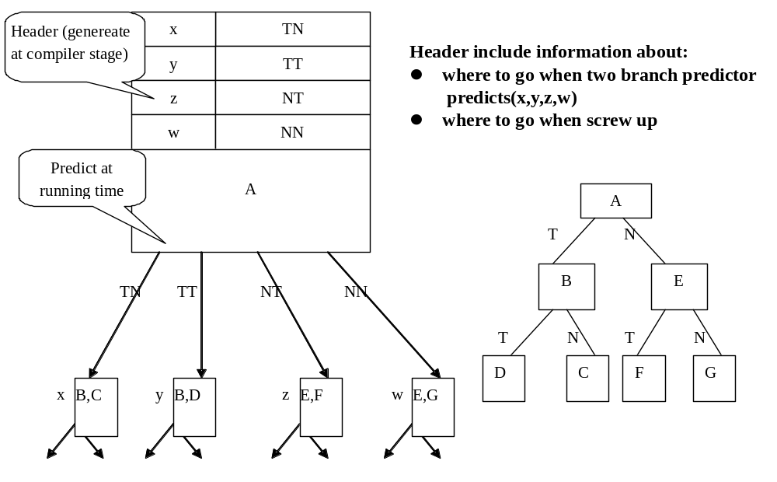
Block-structure: Example

Slide 32
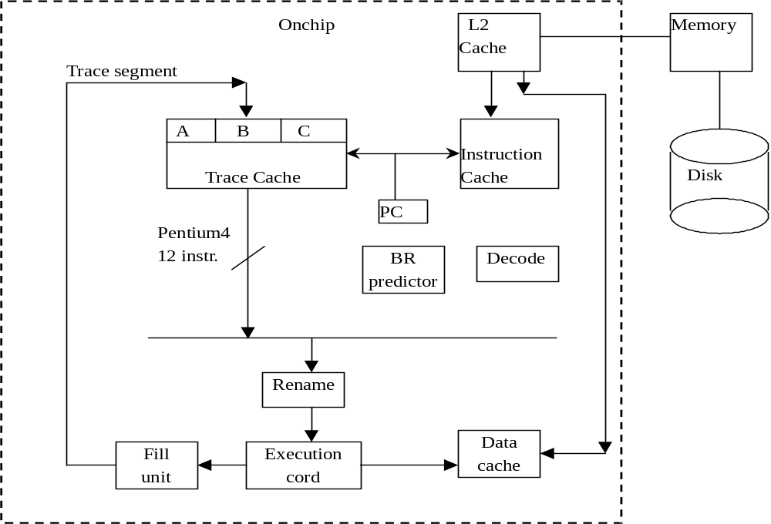
Pentium 4: trace cache, 12 instr./per cycle

Slide 33
How to do when “Partial Match”?
If A prediction correct and B prediction false, it is called “Partial match”.
  J.Smith: If don’t match, then go to I-Cache
  Patt: Take A & B then go I-cache to get D
    better get AB rather than none
    Cost: additional logic to differentiate “How” match
  Bring ABC but marking C as “inactive” issue
    When predict miss, then no need to bring C

Slide 34
Advantage
Trace cache segment are “after” decode.
If hit trace cache, then the segment fetched from the trace cache is no need to decoded again.
Decode is time-consuming, especially for CISC ISA.

