Slide 1
Lecture
Multiprocessors

Slide 2
Why Multiprocessors?
Application requirements
  Uniprocessor speed improving fast
  But there are things that need even more speed
Microprocessors as the fastest CPUs
  Collecting several much easier than redesigning one
Complexity of current microprocessors
  Do we have enough ideas to sustain 1.5X/yr?
  Can we deliver such complexity on schedule?
Slow (but steady) improvement in parallel software
  (scientific apps, databases, OS)

Slide 3
Opportunities for Applications
Scientific computing
  Nearly unlimited demand (Grand challenge)
  App Perf(GFLOPS) Memory (GB)
  72 hour weather 3 1
  Pharmaceutical design 100 10
  Global Change,Genome 1000 1000
Successes in some real industries:
  Petroleum reservoir modeling
  Automotive: crash simulation, drag analysis, engine
  Aeronautics: airflow analysis, engine, structural mechanics
  Pharmaceuticals: molecular modeling
  Entertainment: full length movies (“Toy Story”)
Commercial application
  Transaction processing, file servers, electronic CAD simulation,search engine
  Examples: IBM RS6000, Tandem (Compaq) Himilaya

Slide 4
Parallel Processing
Multiple processors working cooperatively on problems: not the same as multiprogramming
Goals/Motivation
  Performance: limits of uniprocessors
    ILP (branch prediction, RAW dependencies, memory)
  Cost Efficiency: build big systems with commodity parts
    (uniprocessors)
  Scalability: just add more processors to get more performance
  Fault tolerance: One processor fails you still can continue processing

Slide 5
Parallel Computers
Definition: “A parallel computer is a collection of processiong elements that cooperate and communicate to solve large problems fast.”
    Almasi and Gottlieb, Highly Parallel Computing ,1989
Questions about parallel computers:
  How large a collection?
  How powerful are processing elements?
  How do they cooperate and communicate?
  How are data transmitted?
  What type of interconnection?
  What are HW and SW primitives for programmer?
  Does it translate into performance?

Slide 6
Popular Flynn Taxonomy
Flynn’s Taxonomy of Parallel Machines
  How many Instruction streams?
  How many Data streams?
SISD (Single Instruction Single Data) ----Uniprocessors
MISD (Multiple Instruction Single Data) ---- Not used much
SIMD (Single Instruction Multiple Data)
  Each “processor” works on its own data, but execute the same instr.
  Examples: connection machine 2：65535个 1bit processors;
    Illiac IV： 64个 64bit processors;
  Ad: Simple programming model; Low overhead; Flexibility;
MIMD (Multiple Instruction Multiple Data)
  Each processor executes its own instr. and operates on its own data
  Examples: Sun Enterprise 5000, Cray T3D, SGI Origin
  Ad: Flexible; Use off-the-shelf microprocessors;
  Not superscalar, each node is superscalar, lessons will apply to multi-core

Slide 7
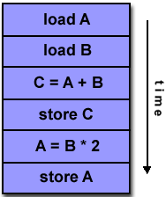
Program execute on SISD

Slide 8
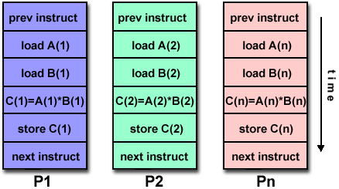
Program execute on SIMD

Slide 9
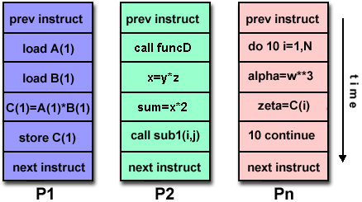
Program execute on MIMD

Slide 10
Catalogue the Parallel (MIMD) processors
Center on organization of main memory
  Shared vs. Distributed
Appearance of memory to hardware
  Q1: Memory access latency uniform?
  Shared : yes, doesn’t matter where data goes
  Distributed: no, makes a big difference
Appearance of memory to software
  Q2: Can processors communicate directly via memory?
  Shared (shared memory): yes, communicate via load/store
  Distributed (message passing): no, communicate via messages
Dimensions are orthogonal
  e.g. DSM: (physically) distributed, (logically) shared memory

Slide 11
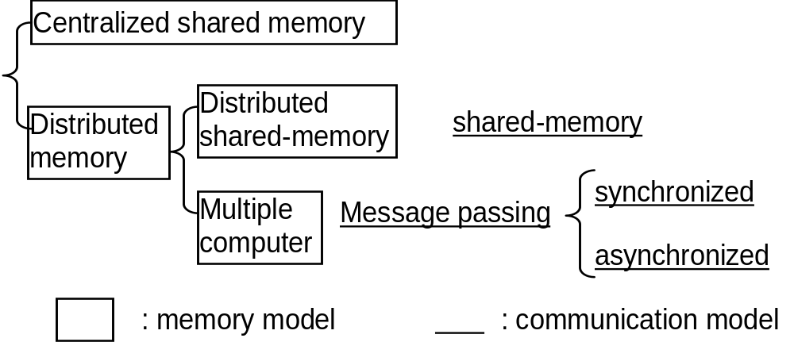
Dimensions are orthogonal
(SMP)/UMA
(DSM)/ NUMA

Slide 12
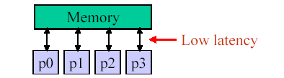
UMA vs. NUMA: Why it matters
Ideal model:
  Perfect (single-cycle) memory latency
  Perfect (infinite) memory bandwidth
Real systems:
  Latencies are long and grow with system size
  Bandwidth is limited
  Add memory banks, interconnect to hook up (latency goes up)

Slide 13
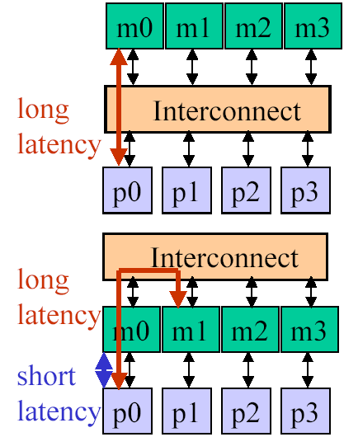
UMA vs. NUMA
UMA: uniform memory access
  From p0 same latency to m0-m3
  Data placement doesn’t matter
  Latency worse as system scales
  Interconnect contention restricts bandwidth
  Small multiprocessors only
NUMA: non-uniform memory access
  From p0 faster to m0 than m1-m3
  Low latency to local memory helps performance
  Data placement important (software!)
  Less contention => more scalable
  Large multiprocessor systems

Slide 14
Major MIMD Styles
Centralized shared memory ("Uniform Memory Access" time or "Shared Memory Processor")
Decentralized memory (memory module with CPU)
  get more memory bandwidth, lower memory latency
  Drawback: Longer communication latency
  Drawback: Software model more complex

Slide 15
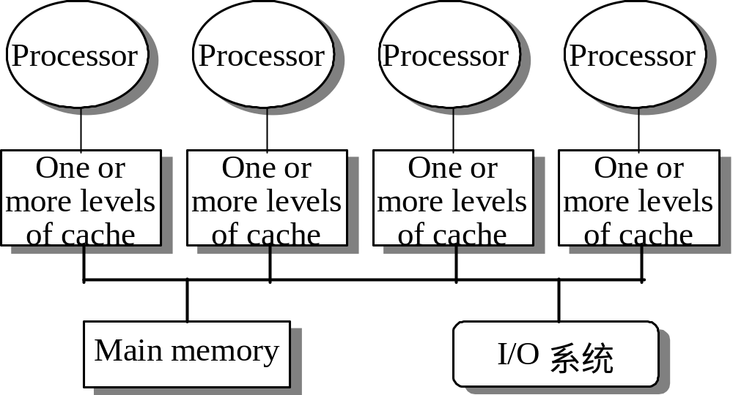
Structure of centralized shared-memory multiprocessor
< 100 processor nodes in 2006, normal few dozen
Feb.2008_jxh_Introduction

Slide 16
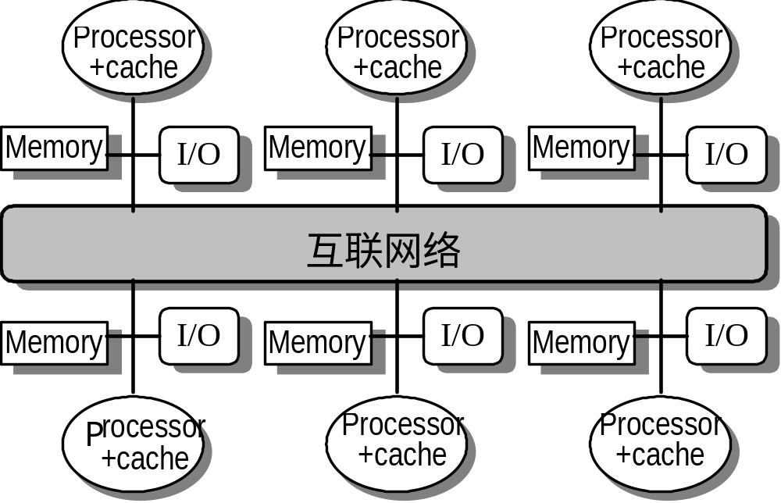
Structure of distributed-memory multiprocessor
Feb.2008_jxh_Introduction

Slide 17
Comparison in graph
Uniprocessor
Pipelined
Superscalar
VLIW
SMP(Symmetric)
or CSM(Centralized)
Distributed
P
M
P
M
M
P
M
P
M
N
E
T
P
M
M
Feb.2008_jxh_Introduction

Slide 18
Distributed-memory multiprocessor(1)
Distributed shared memory
（DSM or scalable shared memory)
  logical uniform address space but physical distributed memory, so any one of the processors can access any one of the memories.
  Shared memory means sharing the address space, which is different from centralized shared memory.

Slide 19
Distributed-memory multiprocessor(2)
multiple computers
  Address space consists of multiple private (separate) address spaces。A processor can NOT access the remote memory node directly.
  Every node (processor-memory pair）is a independent computer.
  NOW(Network of Workstation)is consisted of multiple node( PC or workstation) connected by LAN
  PC cluster

Slide 20
Parallel Architecture
Parallel Architecture extends traditional computer architecture with a communication architecture
  abstractions (HW/SW interface)
  organizational structure to realize abstraction efficiently

Slide 21
Parallel Framework
Programming Model:
    Multiprogramming : lots of jobs, no communication
    Shared address space: communicate via memory
    Message passing: send and recieve messages
    Data Parallel: several agents operate on several data sets simultaneously and then exchange information globally and simultaneously (shared or message passing)
Communication Abstraction:
    Shared address space: e.g., load, store, atomic swap
    Message passing: e.g., send, receive library calls

Slide 22
Shared Address Model-1
Each processor can name every physical location in the machine
Each process can name all data that shares with other processes
Data transfer via load and store
Data size: byte, word, ... or cache blocks
Uses virtual memory to map virtual space to local or remote physical space
Memory hierarchy model applies: now communication moves data to local processor cache (as load moves data from memory to cache)
  Latency, Bandwidth, scalability when communicate?
For distributed memory architecture, a layer (software or hardware) is generally added to allow transparent address mapping􀂉

Slide 23
Shared Address Model-2
Significant research has been conducted to make the translation transparent and scalable for many node􀂉
Handling data consistency and protection is typically a challenge
For multi-computer systems, address mapping has to be performed by software modules, typically added as part of the operating system􀂉
Latency depends on the underlined hardware architecture (bus bandwidth, memory access time and support for address translation)􀂉
Scalability is limited given that the communication model is so tightly coupled with process address space*

Slide 24
Message Passing Model-1
Whole computers (CPU, memory, I/O devices) communicate as explicit I/O operations
  Essentially NUMA but integrated at I/O devices vs. memory system
Send specifies local buffer + receiving process on remote computer
Receive specifies sending process on remote computer + local buffer to place data
  Usually send includes process tag
  and receive has rule on tag: match 1, match any
  Synch: when send completes, when buffer free, when request accepted, receive wait for send
Send + receive => memory-memory copy, where each supplies local address, AND does pairwise sychronization!

Slide 25
Message Passing Model-2
History of message passing:
  Network topology important because could only send to immediate neighbor
  Typically synchronous, blocking send & receive
  Later DMA with non-blocking sends, DMA for receive into buffer until processor does receive, and then data is transferred to local memory
  Later SW libraries to allow arbitrary communication
Example:
  IBM SP-2, RS6000 workstations in racks
  Network Interface Card has Intel 960
  8X8 Crossbar switch as communication building block
  40 MByte/sec per link

Slide 26
Shared Memory vs. Message Passing
Shared Memory (multiprocessors)
  One shared address space
  Processors use conventional load/stores to access shared data
  Communication can be complex/dynamic
  Simpler programming model (compatible with uniprocessors)
  Hardware controlled caching is useful to reduce latency contention
  Has drawbacks
    Synchronization (discussed later)
    More complex hardware needed

Slide 27
Shared Memory vs. Message Passing
MIMD (appearance of memory to software)
Message Passing (multicomputers)
  Each processor has its own address space
  Processors send and receive messages to and from each
  other
  Communication patterns explicit and precise
  Explicit messaging forces programmer to optimize this
  Used for scientific codes (explicit communication)
  Message passing systems: PVM, MPI, OpenMP
  Simple Hardware
  Difficult programming Model

Slide 28
Communication Models
Shared Memory
  Processors communicate with shared address space
  Easy on small-scale machines
  Advantages:
    Model of choice for uniprocessors, small-scale MPs
    Ease of programming
    Lower latency
    Easier to use hardware controlled caching
Message passing
  Processors have private memories, communicate via messages
  Advantages:
    Less hardware, easier to design
    Focuses attention on costly non-local operations
Can support either SW model on either HW base

Slide 29
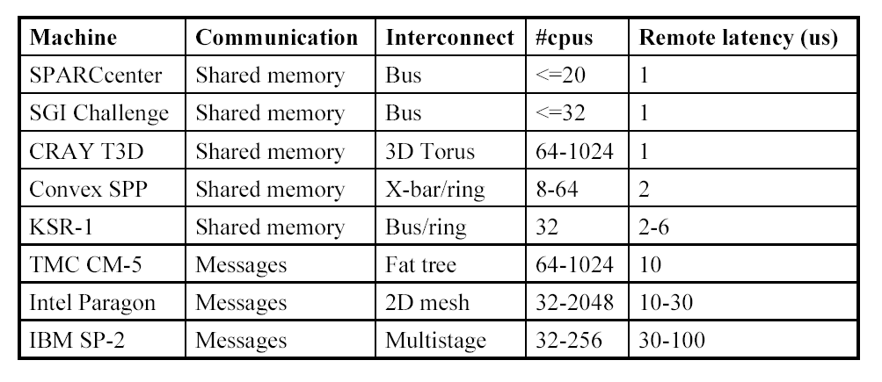
Parallel Systems (80s and 90s)

Slide 30
Multiprocessor Trends
Shared Memory
  Easier, more dynamic programming model
  Can do more to optimize the hardware
Small-to-medium size UMA systems (2-8 processors)
  Processor + memory + switch on single board (4x pentium)
  Single-chip multiprocessors (POWER4)
  Commodity parts soon – glueless MP systems
Larger NUMAs built from smaller UMAs
  Use commodity small UMAs with commodity interconnects (ethernet, myrinet)
  NUMA clusters

Slide 31
Fundamental Issues_1
Naming: how to solve large problem fast
  what data is shared
  how it is addressed
  what operations can access data
  how processes refer to each other
Choice of naming affects code produced by a compiler; via load where just remember address or keep track of processor number and local virtual address for message passing
Choice of naming affects replication of data; via load in cache memory hierarchy or via SW replication and consistency

Slide 32
Fundamental Issues_2
Global physical address space: any processor can generate, address and access it in a single operation
Global virtual address space: if the address space of each process can be configured to contain all shared data of the parallel program
memory can be anywhere: virtual address translation handles it
Segmented shared address space: locations are named <process number, address>
uniformly for all processes of the parallel program

Slide 33
Fundamntal Issues_3
Synchronization:
To cooperate, processes must coordinate
Message passing is implicit coordination with transmission or arrival of data
Shared address => additional operations to explicitly coordinate: e.g., write a flag, awaken a thread, interrupt a processor􀁰

Slide 34
Fundamntal Issues_4
Latency and Bandwidth
Bandwidth
  Need high bandwidth in communication
  Match limits in network, memory, and processor
  Challenge is link speed of network interface vs. bisection bandwidth of network
Latency
  Affects performance, since processor may have to wait
  Affects ease of programming, since requires more thought to overlap communication and computation
  Overhead to communicate is a problem in many machines
Latency Hiding
  How can a mechanism help hide latency?
  Increases programming system burdern
  Examples: overlap message send with computation, prefetch data, switch to other tasks

Slide 35
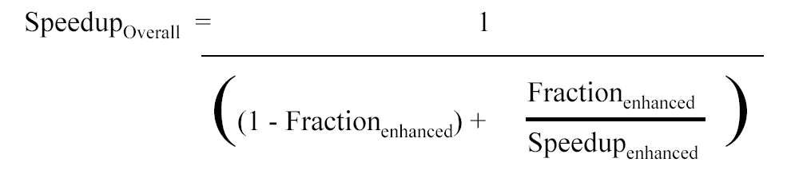
Challenge: limited program parallism
Example: Achieve speedup of 80 x using 100 processors
  80 = 1/[Fracparallel/100+1-Fracparallel]
  Frac parallel = 0.9975
  ==> only 0.25% of the work can be serial!
Can parallized part be imporved to 100 times considering the overheads ?

Slide 36
Challenge : long communication latency
Given： (P203)
  32-processor machine, with each processor cycle time=0.5ns (2GHz );
  remote reference time= 200ns;
  all references except those involving communication hit in local memory;
  base CPI=0.5 (all reference hit in the cache);
  Processors are stalled on a remote request.
  0.2% of the instructions involve a remote reference.
Answer:
  CPI = Base CPI + Remote request rate × Remote request cost =0.5 + 0.2% × Remote request cost
The remote request cost is:
CPI=0.5 + 0.8 = 1.3
The multiprocessor with all local references is 1.3/0.5 = 2.6 times faster.
Remote access cost
400ns
=400cycles
=
Cycle time
1ns

Slide 37
What can we do ?
Limited program parallelism
  New algorithm
Long communication latency
  HW: caching shared data to lower the remote access frequency
    Problem: cache coherence,
    cache consistence
  SW:
    restructuring the data to make more accesses local
    Synchronization
    latency hiding techniques

Slide 38
Homework assignment
Case study 4.2, 4.16

