Slide 1
Cache coherence
Snooping protocol
Directory protocol

Slide 2
Centralized Shared-Memory Architecture
Characteristics of SMP
  Limited processors nodes----small scale, share single physical memory connected by a shared bus.
  Large cache ----provide a sufficient amount of memory bandwidth.
    Increase bandwidth versus bus/memory
    Reduce latency of access
    Valuable for both private data and shared data
  UMA----uniform memory access time.

Slide 3
Major issues for Shared Memory
Cache coherence ( Value, same location)
  “Common Sense”
    P1 Read[X] => P1 Write[X] => P1 Read[X] will return X
    P2 Read[X] => P1 Write[X] => will return value written by P1
    P1 Write[X] => P2 Write[X] => Serialized (all processor see the writes in the same order)
Synchronization
  Atomic read/write operations
Memory consistency Model ( order, different locations)
  In what order must a processor observe the data writes of another processor ?
  What properties must be enforced among reads and writes to different locations by different processors?
These are not issues for message passing systems
  Why?

Slide 4
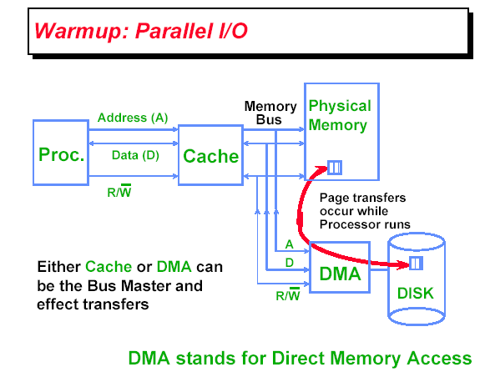
What is Multiprocessor Cache Coherence?

Slide 5
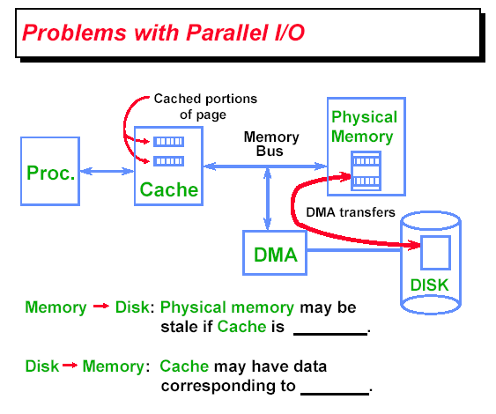
Cache coherence in uniprocessor

Slide 6
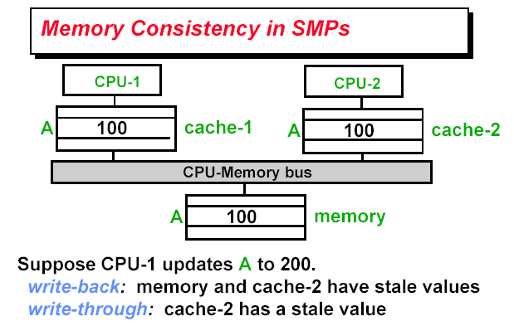
Cache Coherence in Multiprocessor
Write-through（直写模式）在数据更新时，同时写入缓存Cache和后端存储。
此模式的优点是操作简单；缺点是因为数据修改需要同时写入存储，数据写入速度较慢。
Write-back（回写模式）在数据更新时只写入缓存Cache。只在数据被替换出缓存时，
被修改的缓存数据才会被写到后端存储。此模式的优点是数据写入速度快，因为不需要写存储；
缺点是一旦更新后的数据未被写入存储时出现系统掉电的情况，数据将无法找回。

Slide 7
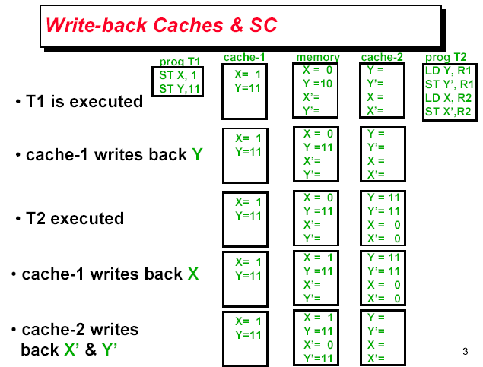
Cache incoherence due to write

Slide 8
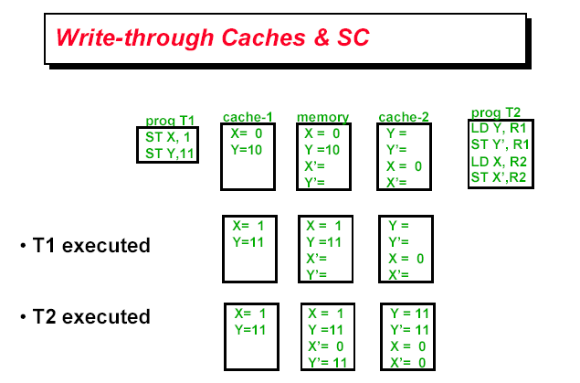
Cache incoherence due to write

Slide 9
What Does Coherency Mean?
Informally:
  “Any read must return the most recent write”
  Too strict and too difficult to implement
Better:
  “Any write must eventually be seen by a read”
  All writes are seen in proper order (“serialization”)
Two rules to ensure this:
  “If P writes x and P1 reads it, P’s write will be seen by P1 if the read and write are sufficiently far apart”
  Writes to a single location are serialized:
  seen in one order
    Latest write will be seen
    Otherewise could see writes in illogical order
    (could see older value after a newer value)

Slide 10
Definition of Cache coherence
Cache coherence
  P1 Read[X] => P1 Write[X] => P1 Read[X] will return X
  P2 Read[X] => P1 Write[X] => will return value written by P1
  P1 Write[X] => P2 Write[X] => Serialized (all processor see the writes in the same order)

Slide 11
HW Coherence Protocols
Snooping Solution (Snoopy Bus):
  Send all requests for data to all processors
  Processors snoop to see if they have a copy and respond accordingly
  Requires broadcast, since caching information is at processors
  Works well with bus (natural broadcast medium)
  Dominates for small scale machines (most of the market)
Directory-Based Schemes (discuss later)
  Keep track of what is being shared in 1 centralized place (logically)
  Distributed memory => distributed directory for scalability
  (avoids bottlenecks)
  Send point-to-point requests to processors via network
  Scales better than Snooping
  Actually existed BEFORE Snooping-based schemes

Slide 12
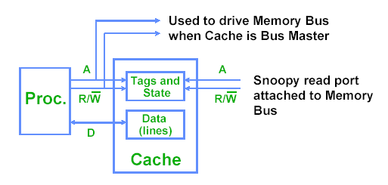
Snooping solution

Slide 13
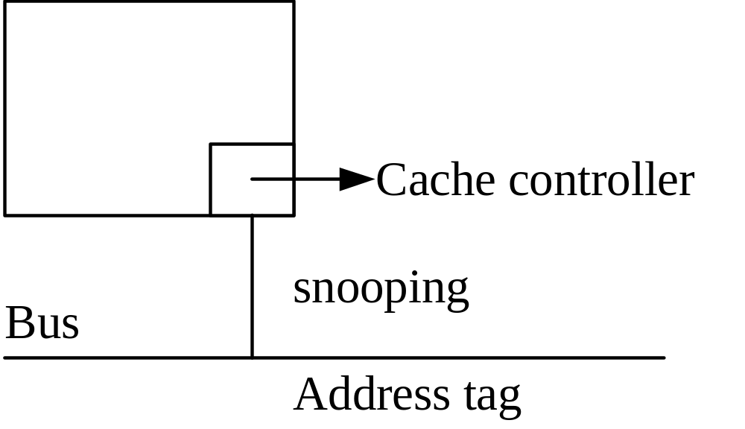
Snooping implementation
Every cache that has a copy of the data from a block of physical memory also has a copy of the sharing status of the block, but no centralized state is kept.
Feb.2008_jxh_Introduction

Slide 14
Basic Snoopy Protocols
Write Invalidate Protocol:
  Multiple readers, single writer
  Write to shared data: an invalidate is sent to all caches which snoop and invalidate any copies
  Read Miss:
    Write-through: memory is always up-to-date
    Write-back: snoop in caches to find most recent copy
Write Broadcast Protocol (typically write through):
  Write to shared data: broadcast on bus, processors snoop, and update any copies
  Read miss: memory is always up-to-date
Write serialization: bus serializes requests!
  Bus is single point of arbitration

Slide 15
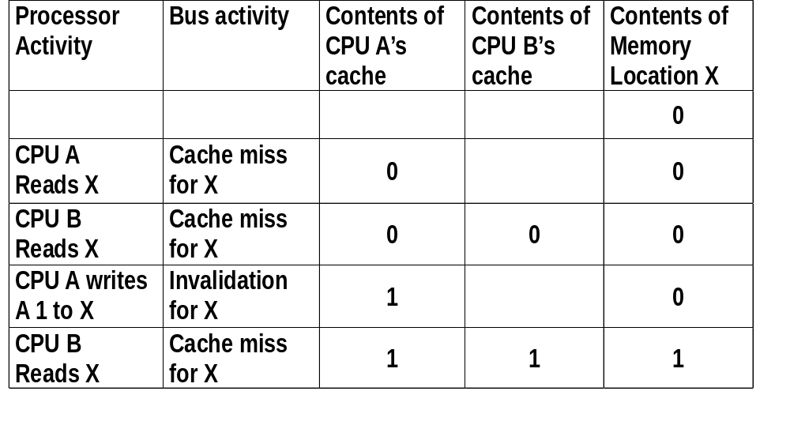
EX: write back Cache, write invalidate
Mechanics
  Broadcast address of cache line to invalidate
  All processor snoop, then invalidate if in local cache
  policy can be used to service cache misses in write-back caches

Slide 16
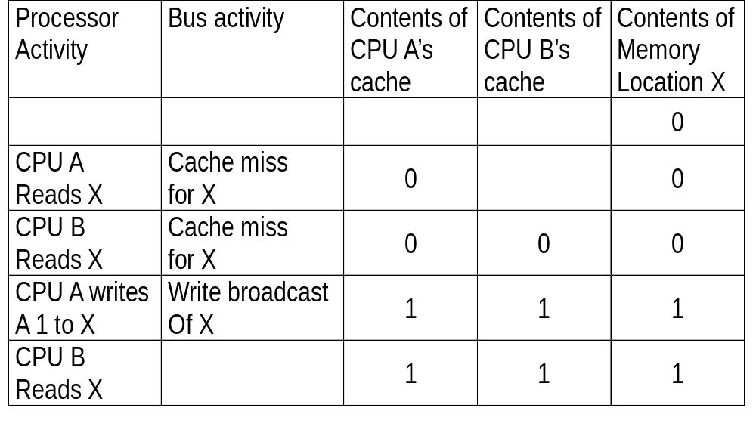
Ex: Write back Cache, update(Broadcast)

Slide 17
Bus-based protocols (Snooping)
Snooping
  All caches see and react to all bus events
  Protocol relies on global visibility of events (ordered broadcast)
  The serialization of access by the bus forces serialization of writes.
Events:
  Processor (events from own processor)
    Read (R), Write (W), Writeback (WB)
  Bus Events (events from other processors)
    Bus Read (BR), Bus Write (BW)

Slide 18
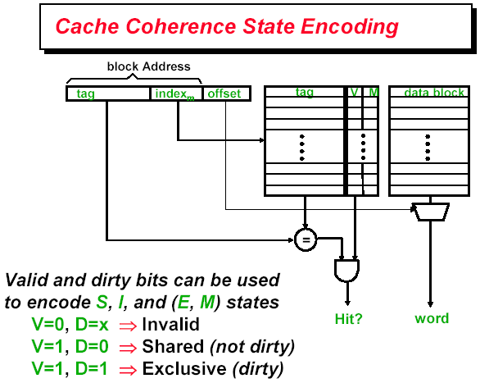

Slide 19
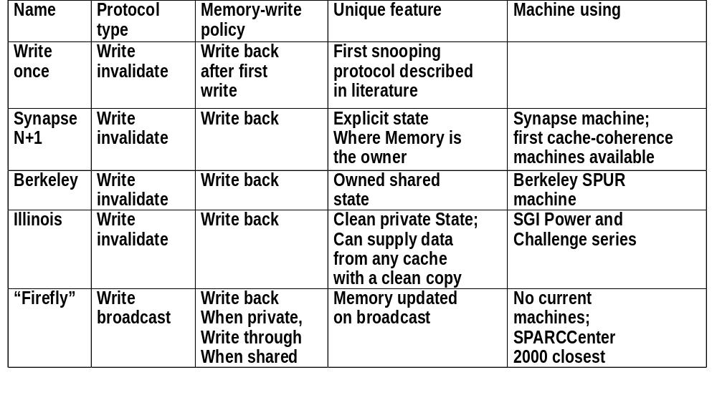
5 snooping protocols

Slide 20
Simple write-invalidate protocol
Three states
  Invalid, Shared, exclusive
Events
  CPU-R, CPU-W
  BUS-R, BUS-W

Slide 21
Snoopy-Cache State Machine-I
State machine
for CPU requests
for each
cache block
CPU Read hit
CPU Read
Shared
(read/only)
Invalid
Place read miss
on bus
CPU Write
Place Write
Miss on bus
CPU read miss
Write back block,
Place read miss
on bus
CPU Read miss
Place read miss
on bus
CPU Write
Place Write Miss on Bus
Cache Block
State
Exclusive
(read/write)
CPU read hit
CPU write hit
CPU Write Miss
Write back cache block
Place write miss on bus
Notes:
Invalid:
read => shared
write => dirty
shared looks the same

Slide 22
Snoopy-Cache State Machine-II
State machine
for bus requests
for each
cache block
Write miss
for this block
Invalid
Shared
(read/only)
Write miss
for this block
Write Back
Block; (abort
memory access)
Read miss
for this block
Write Back
Block; (abort
memory access)
Exclusive
(read/write)

Slide 23
Snoopy-Cache State Machine-III
CPU Read hit
Write miss
for this block
State machine
for CPU requests
for each
cache block and
for bus requests
for each
cache block
CPU Read
Shared
(read/only)
Invalid
Place read miss
on bus
CPU Write
Place Write
Miss on bus
Write miss
for this block
CPU read miss
Write back block,
Place read miss
on bus
CPU Read miss
Place read miss
on bus
Write Back
Block; (abort
memory access)
CPU Write
Place Write Miss on Bus
Read miss
for this block
Write Back
Block; (abort
memory access)
Cache Block
State
Exclusive
(read/write)
CPU read hit
CPU write hit
CPU Write Miss
Write back cache block
Place write miss on bus
Notes:
Invalid:
read => shared
write => dirty
shared looks the same

Slide 24
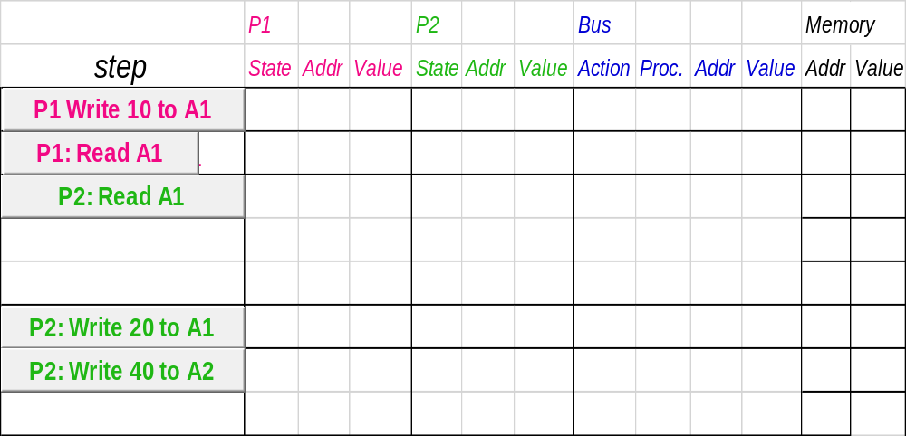
Example
Assumes A1 and A2 map to same cache block,
initial cache state is invalid

Slide 25
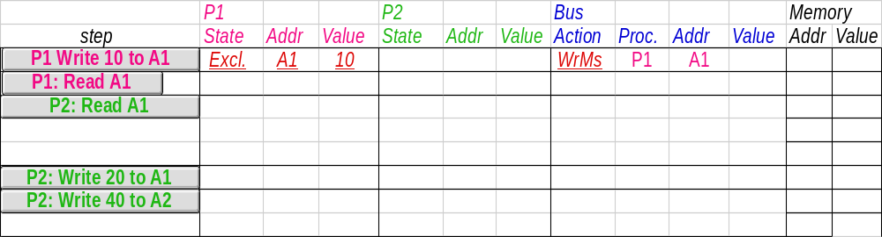
Example: step 1
Remote Write
CPU Read hit
Assumes initial cache state
is invalid and A1 and A2 map
to same cache block,
but A1 != A2.
Invalid
Shared
Read
miss on bus
Write
miss on bus
Remote
Write
Write Back
CPU Write
Place Write
Miss on Bus
Remote Read
Write Back
Exclusive
CPU read hit
CPU write hit
Notes:
Assumes initial cache state
is invalid and A1 and A2 map
to same cache block,
but A1 != A2.

Slide 26
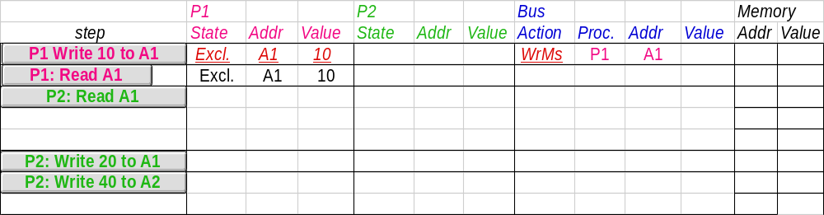
Example: step 2
Remote Write
CPU Read hit
Invalid
Shared
Read
miss on bus
Write
miss on bus
Remote
Write
Write Back
CPU Write
Place Write
Miss on Bus
Remote Read
Write Back
Exclusive
CPU Write Miss
Write Back
CPU read hit
CPU write hit

Slide 27
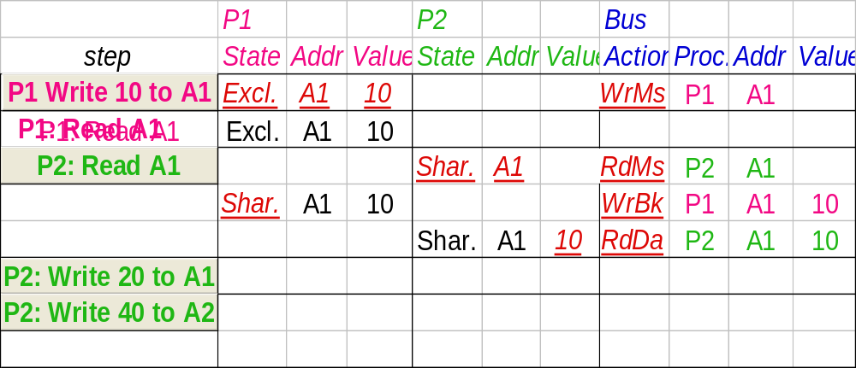
Example:step 3
Remote Write
CPU Read hit
Invalid
Shared
Read
miss on bus
Write
miss on bus
Remote
Write
Write Back
CPU Write
Place Write
Miss on Bus
Remote Read
Write Back
Exclusive
CPU read hit
CPU write hit
CPU Write Miss
Write Back

Slide 28
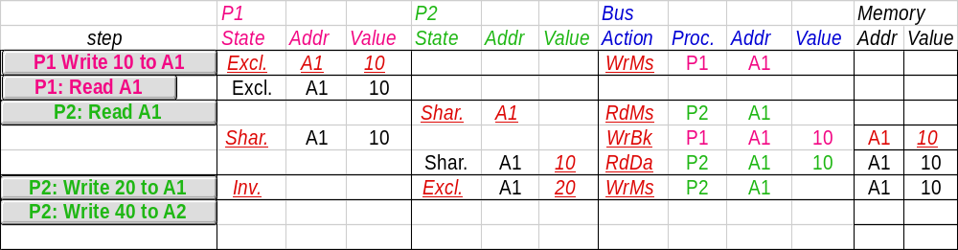
Example: step4
Remote Write
CPU Read hit
Invalid
Shared
Read
miss on bus
Write
miss on bus
Remote
Write
Write Back
CPU Write
Place Write
Miss on Bus
Remote Read
Write Back
Exclusive
CPU read hit
CPU write hit

Slide 29
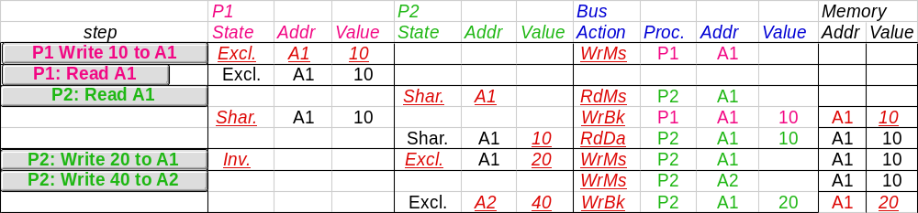
Example:step 5
Remote Write
CPU Read hit
Invalid
Shared
Read
miss on bus
Write
miss on bus
Remote
Write
Write Back
CPU Write
Place Write
Miss on Bus
Remote Read
Write Back
Exclusive
CPU read hit
CPU write hit
CPU Write Miss
Write Back
Notes:
Why write miss first?
Because in general, only write a piece of block, may need to read it first so that can have a full vblock; therefore, need to get
Write back is low priority event.

Slide 30
X 所在的block (w x y z)
I 所在的block ( h I j k )
写x, miss
取入整个 w x y* z

Slide 31
Snooping Cache Variations
Basic
Protocol
Exclusive
Shared
Invalid
Berkeley
Protocol
Owned Exclusive
Owned Shared
Shared
Invalid
Illinois
Protocol
Private Dirty
Private Clean
Shared
Invalid
MESI
Protocol
Modfied (private,!=Memory)
eXclusive (private,=Memory)
Shared (shared,=Memory)
Invalid
Owner can update via bus invalidate operation
Owner must write back when replaced in cache
If read sourced from memory, then Private Clean
if read sourced from other cache, then Shared
Can write in cache if held private clean or dirty

Slide 32
MESI (Illinois protocol) (write back cache)
CPU Read hit / CPU read miss
place read miss
on bus
CPU Read
Place read miss on Bus
Invalid
Shared
(read/only)
Remote Write
CPU read miss
Write back block
Place read miss on bus
Remote Read
Place Data on Bus
Remote Read
Write back
block
Remote Write
Write back block
Read-for-ownership
Place read miss on bus
Read-for-ownership
Place read miss on bus
Modified
(read/write)
Exclusive (read/only)
CPU read hit
CPU write hit
CPU Write
No need to Place Write Miss on Bus
CPU Write miss
Write back Place Write Miss on Bus
CPU Read hit

Slide 33
Directory-based Cache coherence

Slide 34
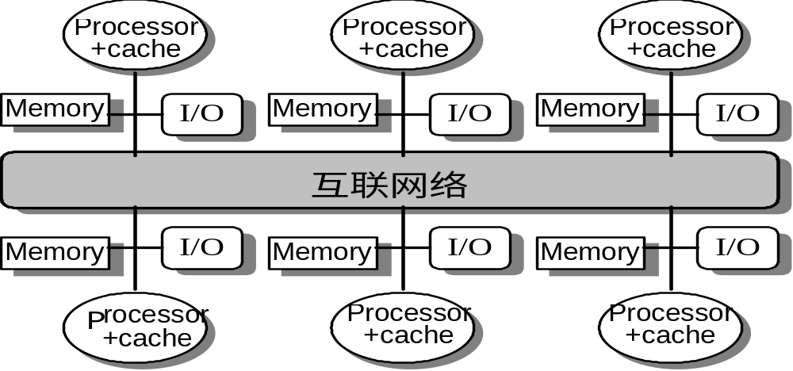
Distributed Shared Memory
Each node has a local memory and cache
Local or remote memory access via memory controller
Nov. 12 2008

Slide 35
Directory protocol
Directory: track state of every block in memory, and change the state of block in cache according to directory.
Information in directory
  Status of Every block: shared/uncached/exclusive
  Which processors have copies of the block: bit vector
  Whether the block is dirty or clean
Directory protocol can be implemented with a distributed memory
Directory protocol can be applied to a centralized memory organized into banks

Slide 36
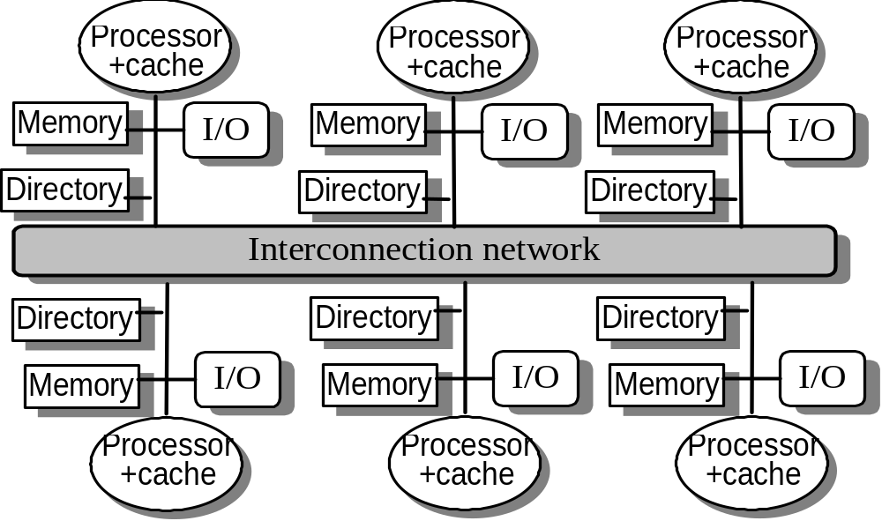
Distributed Directory MPs
Nov. 12 2008

Slide 37
Directory protocol implementation
Block status
  Shared: ≥ 1 processors have data, memory up-to-date
  Uncached (no processor hasit; not valid in any cache)
  Exclusive: 1 processor (owner) has data; memory out-of-date
Directory size = f (entry number * entry size)
  Each memory block has an entry in directory / only keep the entries for cached blocks
  Every processor has one bit / Limited processor bits in bit vector
Directory can be distributed along with the memory to avoid becoming the bottleneck
Assumptions to Keep it simple:
  Writes to non-exclusive data => write miss
  Processor blocks until access completes
  Assume messages received and acted upon in order as sent
Nov. 12 2008

Slide 38
Directory Protocol
No bus and don’t want to broadcast:
  Interconnect means no longer single arbitration point
  all messages have explicit responses
Terms: typically 3 processors involved
  Local node where a request originates
  Home node where the memory location
  of an address resides
  Remote node has a copy of a cache
  block, whether exclusive or shared
Example messages on next slide:
P = processor number, A = address
Nov. 12 2008

Slide 39
Message type Source Destination Msg Content
Read miss Local cache Home directory P, A
  Processor P reads data at address A;
  make P a read sharer and arrange to send data back
Write miss Local cache Home directory P, A
  Processor P has a write miss at address A;
  make P the exclusive owner and arrange to send data back
Invalidate Local cache Home directory A
  Request to send invalidates to all remote caches that are caching the block at address A
Invalidate Home directory Remote caches A
  Invalidate a shared copy at address A.
Fetch Home directory Remote cache A
  Fetch the block at address A and send it to its home directory
Fetch/Invalidate Home directory Remote cache A
  Fetch the block at address A and send it to its home directory; invalidate the block in the cache
Data value reply Home directory Local cache Data
  Return a data value from the home memory (read miss response)
Data write-back Remote cache Home directory A, Data
  Write-back a data value for address A (invalidate response)

Slide 40
State Transition Diagram for an Individual Cache Block in a Directory Based System
States identical to snoopy case; transactions very similar.
Transitions caused by read misses, write misses, invalidates, data fetch requests
Generates read miss & write miss msg to home directory.
Write misses that were broadcast on the bus for snooping => explicit invalidate & data fetch requests.
Note: on a write, a cache block is bigger, so need to read the full cache block

Slide 41
CPU -Cache State Machine
State machine
for CPU requests
for each
memory block
Invalid state
if in
memory
Shared
(read/only)
Invalid
CPU Read
Send Read Miss
Directory:
Uncached: Send Rp; S→ shared;
share = {p}
Shared: Send Rp;
share + = {p}
Exclusive: Send Fetch to R.N.
get reply back from R.N.
Send RP;
→ Shared
share + = {p}
Directory:
Uncached: Send Rp; S→ Exclusive
share = {p}
Shared: Send invalidate;
Send Rp;
S→ Exclusive
share = {p}
Exclusive: Send Fetch/invalidate to R.N.
get reply back from R.N.
Send RP to P; S→Exclusive
share = {p}
CPU Write:
Send Write Miss
to h.d.
Exclusive
(read/writ)
Notes:
Invalid:
read => shared
write => dirty
shared looks the same

Slide 42
CPU -Cache State Machine
CPU Read hit
State machine
for CPU requests
for each
memory block
Invalid state
if in
memory
Invalidate
Shared
(read/only)
Invalid
CPU Read
Send Read Miss
CPU read miss:
Send Read Miss
CPU Write:
Send Write Miss
to h.d.
CPU Write hit:Send
invalidate to home directory
CPU Write miss:Send
Write Miss to home directory
Exclusive
(read/writ)
Notes:
Invalid:
read => shared
write => dirty
shared looks the same

Slide 43
CPU -Cache State Machine
CPU Read hit
State machine
for CPU requests
for each
memory block
Invalid state
if in
memory
Invalidate
Shared
(read/only)
Invalid
CPU Read
Send Read Miss
CPU read miss:
Send Read Miss
CPU Write:
Send Write Miss
to h.d.
CPU Write hit:Send
invalidate to home directory
Fetch/Invalidate
Data Write Back
CPU Write miss:Send
Write Miss to home directory
Fetch: Data Write Back to home directory
CPU read miss:
Data Write Back and
Send read miss to home directory
Exclusive
(read/writ)
CPU read hit
CPU write hit
CPU write miss:
Data Write Back
and send Write Miss to home
directory
Nov. 12 2008
Notes:
Invalid:
read => shared
write => dirty
shared looks the same

Slide 44
CPU -Cache State Machine
CPU Read hit
State machine
for CPU requests
for each
memory block
Invalid state
if in
memory
Invalidate
Shared
(read/only)
Invalid
CPU Read
Send Read Miss
CPU read miss:
Send Read Miss
CPU Write:
Send Write Miss
to h.d.
CPU Write hit:Send
invalidate to home directory
Fetch/Invalidate
Data Write Back
CPU Write miss:Send
Write Miss to home directory
Are these write back
the same ?
Fetch: Data Write Back to home directory
CPU read miss:
Data Write Back and
Send read miss to home directory
Exclusive
(read/writ)
CPU read hit
CPU write hit
CPU write miss:
Data Write Back
and send Write Miss to home
directory
Notes:
Invalid:
read => shared
write => dirty
shared looks the same

Slide 45
State Transition Diagram for the Directory
Same states & structure as the transition diagram for an individual cache
2 actions: update of directory state & send msgs to statisfy requests
Tracks all copies of memory block.
Also indicates an action that updates the sharing set, Sharers, as well as sending a message.

Slide 46
Directory State Machine
State machine
for Directory requests for each
memory block
Uncached state
if in memory
Read miss:
Sharers = {P}
send Data Value
Reply
Shared
(read only)
Uncached
Write Miss:
Data Value Reply
Sharers = {P};
Exclusive
(read/writ)
Notes:
Invalid:
read => shared
write => dirty
shared looks the same

Slide 47
Directory State Machine
Read miss:
Data Value Reply
Sharers += {P};
State machine
for Directory requests for each
memory block
Uncached state
if in memory
Read miss:
Sharers = {P}
send Data Value
Reply
Shared
(read only)
Uncached
Write Miss:
Data Value Reply
Sharers = {P};
Write Miss/ Invalidate:
Send Invalidate to R.N;
Sharers = {P};
(Data Value Reply)
Exclusive
(read/writ)
Notes:
Invalid:
read => shared
write => dirty
shared looks the same

Slide 48
Directory State Machine
Read miss:
Data Value Reply
Sharers += {P};
State machine
for Directory requests for each
memory block
Uncached state
if in memory
Read miss:
Sharers = {P}
send Data Value
Reply
Shared
(read only)
Uncached
Write Miss:
Data Value Reply
Sharers = {P};
Write Miss/Invalid:
Invalidate ;
Sharers = {P};
Data Value Reply
Data Write Back:
Sharers = {}
Write Miss:
Fetch/Invalidate;
Receive Date from R.N
Data Value Reply
to local Node
Sharers = {P};
Read miss:
Send Fetch to R.N.;
Get Data from R. N.
Reply Back to local processor
Sharers += {P};
Exclusive
(read/writ)
Nov. 12 2008
Notes:
Invalid:
read => shared
write => dirty
shared looks the same

Slide 49
Directory State Machine
Read miss:
Data Value Reply
Sharers += {P};
State machine
for Directory requests for each
memory block
Uncached state
if in memory
Read miss:
Sharers = {P}
send Data Value
Reply
Shared
(read only)
Uncached
Write Miss:
Data Value Reply
Sharers = {P};
Write Miss:
Invalidate ;
Sharers = {P};
Data Value Reply
Data Write Back:
Sharers = {}
Read miss:
Fetch;
Data Value Reply
msg to remote cache
Sharers += {P};
Write Miss:
Fetch/Invalidate;
Data Value Reply
msg to remote cache
Sharers = {P};
Exclusive
(read/writ)
Nov. 12 2008
Notes:
Invalid:
read => shared
write => dirty
shared looks the same

Slide 50
Example Directory Protocol
Message sent to directory causes two actions:
  Update the directory
  More messages to satisfy request
Block is in Uncached state: the copy in memory is the current value; only possible requests for that block are:
  Read miss: requesting processor sent data from memory &requestor made only sharing node; state of block made Shared.
  Write miss: requesting processor is sent the value & becomes the Sharing node. The block is made Exclusive to indicate that the only valid copy is cached. Sharers indicates the identity of the owner.
Block is Shared => the memory value is up-to-date:
  Read miss: requesting processor is sent back the data from memory & requesting processor is added to the sharing set.
  Write miss: requesting processor is sent the value. All processors in the set Sharers are sent invalidate messages, & Sharers is set to identity of requesting processor. The state of the block is made Exclusive.

Slide 51
Example Directory Protocol
Block is Exclusive: current value of the block is held in the cache of the processor identified by the set Sharers (the owner) => three possible directory requests:
  Read miss: owner processor sent data fetch message, causing state of block in owner’s cache to transition to Shared and causes owner to send data to directory, where it is written to memory & sent back to requesting processor.
  Identity of requesting processor is added to set Sharers, which still contains the identity of the processor that was the owner (since it still has a readable copy). State is shared.
  Data write-back: owner processor is replacing the block and hence must write it back, making memory copy up-to-date
  (the home directory essentially becomes the owner), the block is now Uncached, and the Sharer set is empty.
  Write miss: block has a new owner. A message is sent to old owner causing the cache to send the value of the block to the directory from which it is sent to the requesting processor, which becomes the new owner. Sharers is set to identity of new owner, and state of block is made Exclusive.

Slide 52
Case Study: p1 write 888 to x
P1
P2
X=111
P3
X=111
Cache X: E, 888
Cache X: I
Cache:X: S
Cache:X: I
Cache:X: I
Cache: X: S
Direct: X: S, {P2,P3}
Direct: X: E, {P1}
P4
P5
X’HOME
111
P6
P1(local) P5(home) P2(remote) P3(remote)
WriteMiss X
Invalidate X
Invalidate X
Ack
Ack
Reply X=111

Slide 53
P2 write 999 to X
P1
X=888
P2
P3
X: I
X: E, 888
X: S
X: S
X: I
X: I
X: E, {P1}
X: S, {P2,P3}
P4
P5
X’HOME
111
P6
P1(remote) P5(home) P2(local) P3(remote)

Slide 54
Answer for P2 write 999 to X
P1
X=888
P2
P3
X: I
X: E, 888
X: I
X: S
X: S
X: I
X: E, 999
X: I
X: E, {P1}
X: S, {P2,P3}
X: E,｛P2}
P4
P5
X’HOME
111
P6
888
P1(remote) P5(home) P2(local) P3(remote)
WriteMiss
Fetch/Invalidate
How about P2 read x？
Write back X 888
Reply back X 888

Slide 55
More Cases for Cache Coherence of Directory Protocol

Slide 56
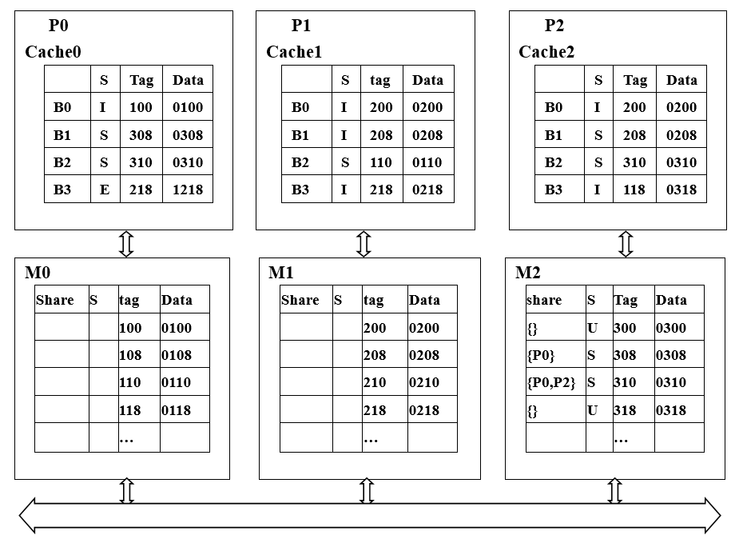
Could you feel the blanks to complete the directories ?

Slide 57
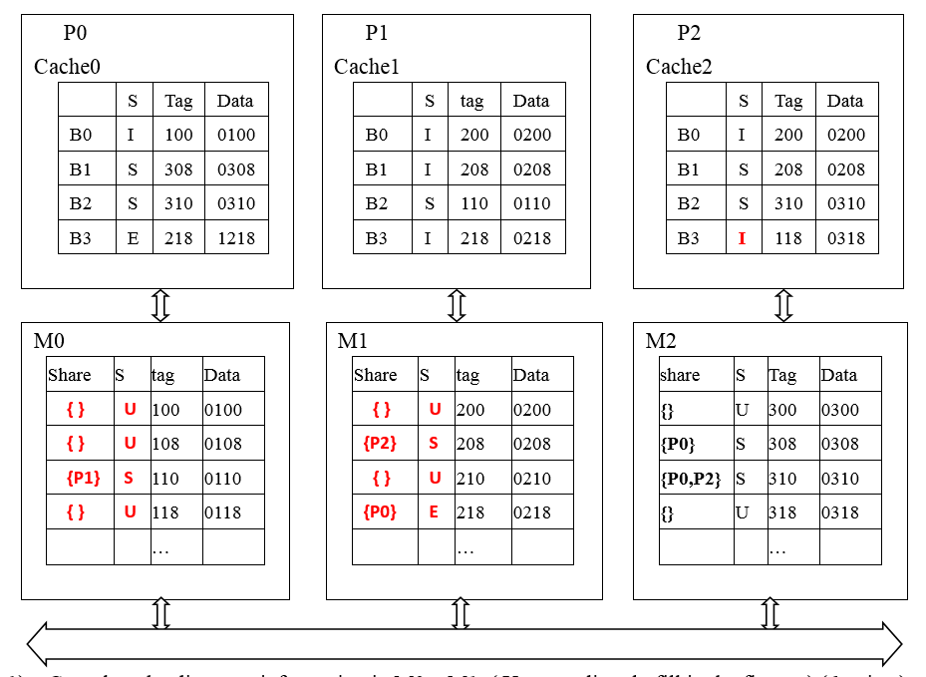
I
P0 read 300

Slide 58
ReadMiss 300
DataReply 300(0300)
S 300 0300
I
P0 read 300
{P0} S 300 0300
What operations will do when P0 read 300 ?

Slide 59
P0 read 300
P0(local node) P2(home node)
ReadMiss for Tag=300
M2, 300, {}, U → {P0}, S
DataReply 0300
Cach0,
B0: I, 100, 0100→
S, 300, 0300

Slide 60
Fetch(218)
ReadMiss(218)
Writeback 218(1218)
DataReply 218(1218)
I
S 218 1218
S
P0 read 300
{P0,P2} S 218 1218
Modify Directory
What operations will do when P2 read 218 ?

Slide 61
P2 read 218
P2(local node) P1(home node) P0(remote node)
ReadMiss for Tag=218
Fetch Tag=218
Cach0,
B3: E, 218, 1218→
S, 218, 1218
WriteBack218(1218)
M1,
218, {P0}, E, 0218→
{P1,P0}, S, 1218
DataReply 218(1218)
Cach2,
B3: I, 118, 0318→
S, 218, 1218

Slide 62
invalidate 310
ACK
invalidate 310
WriteMiss(310)
ACK
DataReply 310(0310)
E 310 0310
E 310 0888
I
I
I
P0 read 300
{P1} E
What operations will do when P1 write 0888 into 310 ?

Slide 63
P1 write 0888 into 310
P1(local node ) P2(home node) P0. P2 (remote node)
WriteMiss for Tag=310
Invalidate Tag=310
Cach0, Cache2
B2: S, 310, 0310→
I, 310, 0310
Ack
M2,
310,{P0,P2},S,0310→
{P1}, E, 0310
DataReply 0310
Cache1,
B2:S, 110, 0110→
E, 310, 0888
Anything UNcomfortable ?

Slide 64
WriteMiss(310)
I
{ } U
P0 read 300
The directory is outdated
with wrong info.
How to solve it?
What operations will do when P1 write 0888 into 310 ?

Slide 65
P1 write 0888 into 310
P1(local node ) P2(home node) P0(remote node)
Kickout 110
M0,
110,{P1},S,0110→
{ }, U, 0110
WriteMiss for Tag=310
Invalidate Tag=310
Cach0, {Cache2}
B2: S, 310, 0310→
I, 310, 0310
Ack
M2,
310,{P0,P2},S,0310→
{P1}, E, 0310
DataReply 0310
Cache1,
B2:S, 110, 0110→
E, 310, 0888

Slide 66
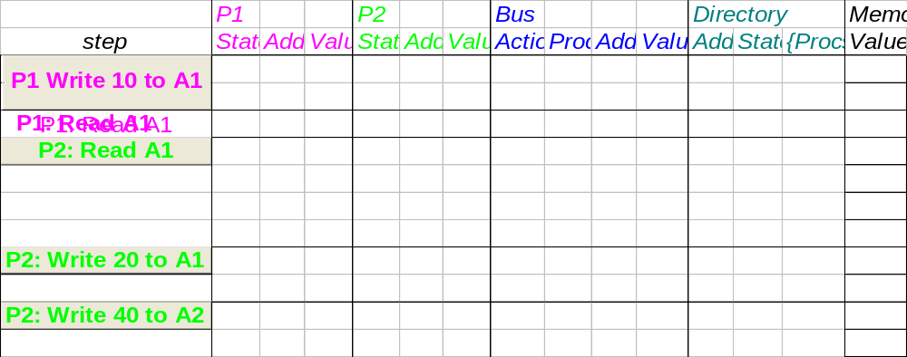
Example 1: initial
Processor 1
Processor 2
Interconnect
Directory
Memory
A1 and A2 map to the same cache block

Slide 67
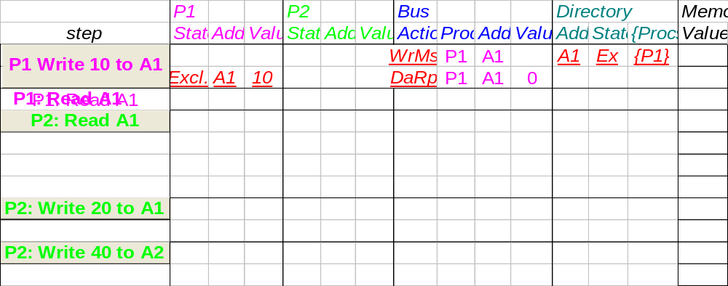
Example: P1 write 10 to A1
Processor 1
Processor 2
Interconnect
Directory
Memory
A1 and A2 map to the same cache block

Slide 68
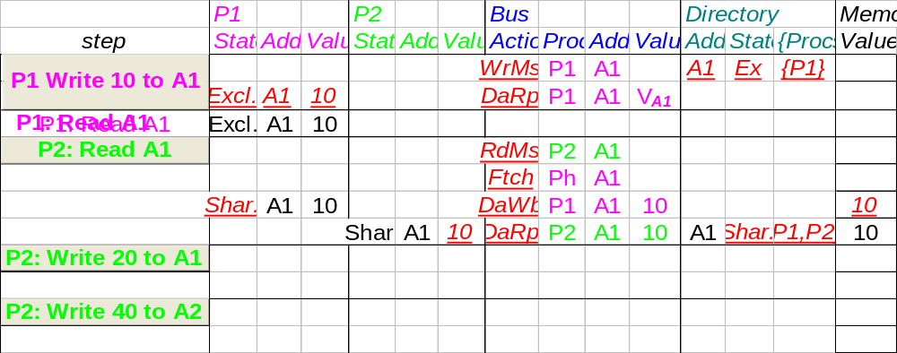
Example: P1 read A1, P2 read A1
Processor 1
Processor 2
Interconnect
Directory
Memory
A1 and A2 map to the same cache block

Slide 69
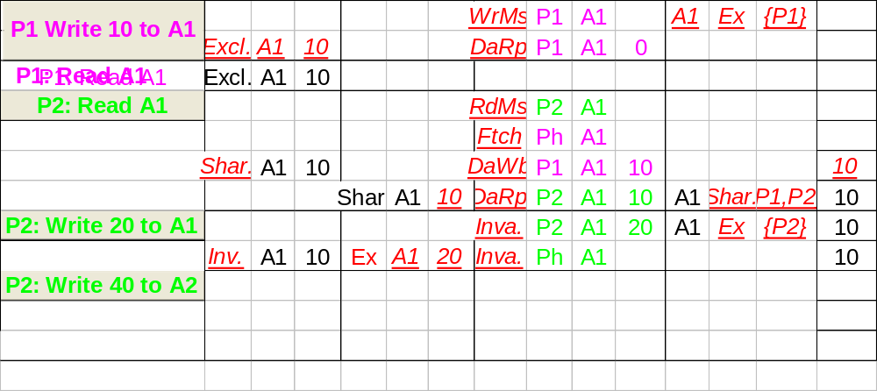
Example: P2 write 20 to A1
Processor 1
Processor 2
Interconnect
Directory
Memory
A1
A1 and A2 map to the same cache block

Slide 70
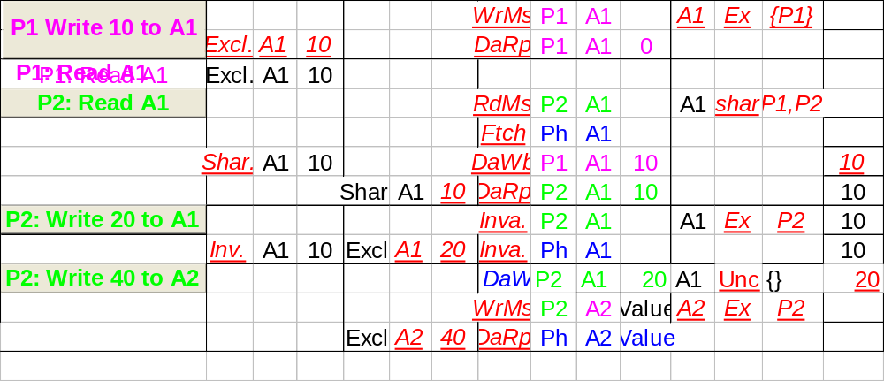
Example: P2 write 40 to A2
Processor 1
Processor 2
Interconnect
Directory
Memory
A1
A1 and A2 map to the same cache block

Slide 71
Implementation of Directory-base Coherence

Slide 72
Implementation issues
Nonatomic operations
Write serialization
Without Broadcast

Slide 73
Assumptions for implementation simplicity
Network provides point-to-point in-order delivery of message
Network has unlimited buffering
Network delivers all messages within a finite time.
Coherence controller is duplicated for each cache block.
A transition only completes when a message has been transmitted and a data value reply received.
  Omit the pending status
Outgoing message can be transmitted before the next incoming message is accepted.

Slide 74
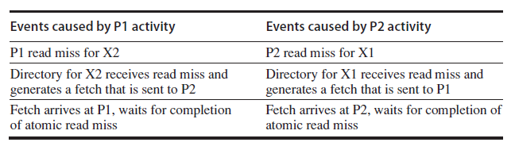
Deadlock example
Assume P1 and P2 each have exclusive copies of cache blocks X1 and X2 that have different home directories.
Resolve: duplicate coherence controller for each block

Slide 75
CPU -Cache State Machine
CPU Read hit
State machine
for CPU requests
for each
memory block
Invalid state
if in
memory
Invalidate
Shared
(read/only)
Invalid
CPU Read
Send Read Miss
CPU read miss:
Send Read Miss
CPU Write:
Send Write Miss
to h.d.
CPU Write hit:Send
invalidate to home directory
Fetch/Invalidate
Data Write Back
CPU Write miss:Send
Write Miss to home directory
Fetch: Data Write Back to home directory
CPU read miss:
Data Write Back and
Send read miss to home directory
Exclusive
(read/writ)
CPU read hit
CPU write hit
CPU write miss:
Data Write Back
and send Write Miss to home
directory
Notes:
Invalid:
read => shared
write => dirty
shared looks the same

Slide 76
How to assure write serialization ?
Serialization exclusive access by Home directory
  Buffer all the request (write miss/ invalidate );
  Process the request in order;
  Only start to process the new request until complete the previous one.

Slide 77
How to solve the “race” ?
How does the processor know who is the winner?
  Get acknowledgement message from home directory
    Date Reply (For write miss)
    Explicit ACK (For invalidate)
  About the loser:
    Simplest: home directory send a NAK to loser.
How to know the invalidations are completed?
  1. Directory collect and count ACK messages from remote nodes, and then send confirmation to requester.
  2. Home node collect and count ACK messages from remote nodes directly.

Slide 78
Buffer requirement
Large amount of buffers required
A write miss may produce a large amount invalidate message
Prefetch scheme might be used
Multiple outstanding misses
Limited buffer in practice

Slide 79
Avoid deadlock with limited buffering
Deadlock arises from three properties
  More than one resource is needed to complete a transaction
  Buffers for request, reply, and accept message
Resources are held until a nonatomic transaction completes
There is no global partial order on the acquisition of resource

Slide 80
Resolution
Strategy: Try to ensure that the resources will always be available.
  Separate network is used for request and replies.
  Every request need a reply allocate the space to accept reply when the request is generated.
    Replier can free the reply buffer.
  Any controller can reject any request with a NAK, but never NAK a reply.
  Any request that receives a NAK is simply retried.

Slide 81
Multithreaded directory to handle multiple blocks
Directory controller must be reentrant.
  Handle incoming requests for independent blocks before the previous one finished.
Control state need be saved and restored while a fetch(or fetch//invalidate) is outstanding
Owner node can provide the data directly to the requester as well as to the home node to reduce latency.
Can limit the outstanding transaction numbers via NAK to new requests.

Slide 82
How to deal with NAK ?
How to know which is the original transaction ?
  1. processor keep track of its outstanding requests
  2. Pack the original request into NAK.
  3. The buffer holding the return slot for the request can also hold info about the request.
So that when receives NAK, the processor know to resend the request.

Slide 83
Summary
Caches contain all information on state of cached memory blocks
Snooping and Directory Protocols similar; bus makes snooping easier because of broadcast (snooping => uniform memory access)
Directory has extra data structure to keep track of state of all cache blocks
Distributing directory => scalable shared address multiprocessor
=> Cache coherent, Non uniform memory access
Nov. 12 2008

Slide 84
How about write through cache with write invalidate?
PW
[ BW miss on bus]
BR, PR
PW
[send BW]
Valid
Invalid
PR
[ BR miss on bus]
BW
Nov. 12 2008

