Slide 1
Synchronization in Multiprocessor

Slide 2
Synchronization
Definition: the coordination of simultaneous threads or processes to complete a task in order to get correct runtime order and avoid unexpected race conditions
  Forks and Joins: in parallel programming a parallel process may want to wait until several events have occurred.
  Producer-Consumer: A consumer process must wait until the producer process has produced data.
  Exclusive use of a resource: Operating system has to ensure that only one process uses a resource at a given time.

Slide 3
Example:
Why Synchronize? Need to know when it is safe for different processes to use shared data
P1 P2 P3 P4
X
If each process executes x:=x+1,
then what will be final value of x?

Slide 4
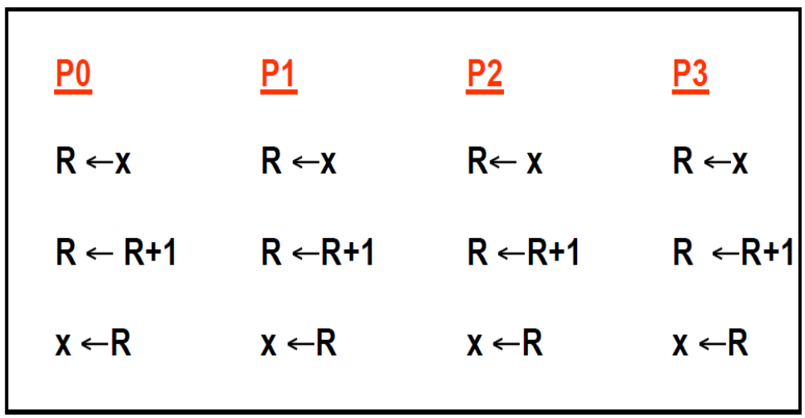
X could be 1, 2, 3, 4

Slide 5
How to implement Synchronization?
Hardware Primitive: Provide uninterruptable instruction to fetch and update memory (atomic operation); or instruction sequences that can retrieve and change a value atomically.
User level synchronization operation using this primitive;
For large scale MPs, synchronization can be a bottleneck; need techniques to reduce contention and latency of synchronization
Hardware Primitives → Synchronize routine →Contentions
→ Better Primitives → performance optimization

Slide 6
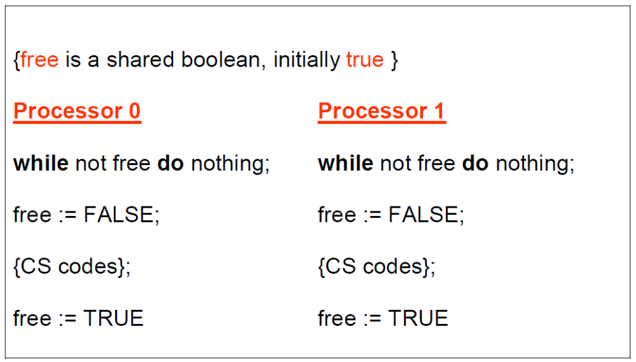
Try without a Hardware Primitive
P0, P1 both enter the Critical Section !

Slide 7
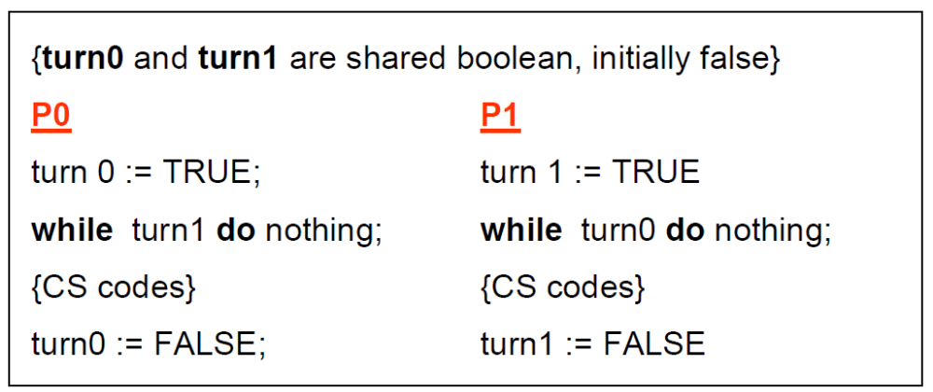
Try again without Hardware Primitive
Doesn’t work with Deadlock !

Slide 8
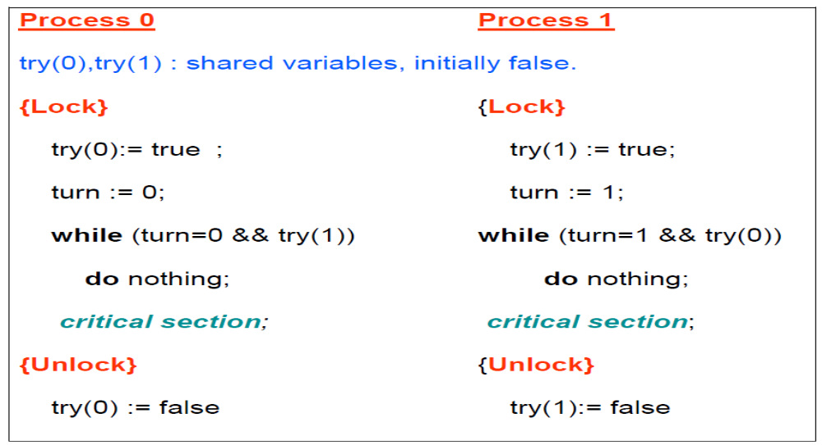
Simple solution by Gary Peterson(1979)
What if there are many processors ?

Slide 9
Uninterruptable Instruction to Fetch and Update Memory
Atomic exchange: interchange a value in a register for a value in memory location
  0 => synchronization variable is free
  1 => synchronization variable is locked and unavailable
Test-and-set: tests a value and sets it if the value passes the test
  0 => synchronization variable is free
  1 => synchronization variable is locked and unavailable
Fetch-and-increment: it returns the value of a memory location and atomically increments it

Slide 10
Implement Lock using Hardware Primitives
Using Atomic Exchange
  DADDUI R2, R0, #1
  lockit: EXCH R2, 0(R1)
  BNEZ R2, lockit
Using Test-and-Set
  lockit: T&S R2, 0(R1)
  BNEZ R2, lockit

Slide 11
Uninterruptable Instruction to Fetch and Update Memory
Hard to have read & write in 1 instruction:
  use 2 instead
Load linked (load locked) + store conditional
  Load linked returns the initial value
  Store conditional returns 1 if it succeeds (no other store to same memory location since proceeding load) and 0 otherwise
Advantage: separate read and write of shared data

Slide 12
Build atomic operations using LL&SC
Example doing atomic swap with LL & SC:
try: mov R3,R4 ; mov exchange value
ll R2,0(R1) ; load linked
sc R3,0(R1) ; store conditional
beqz R3,try ; branch store fails (R3 = 0)
mov R4,R2 ; put load value in R4
Example doing fetch & increment with LL & SC:
try: ll R2,0(R1) ; load linked
addi R2,R2,#1 ; increment (OK if reg–reg)
sc R2,0(R1) ; store conditional
beqz R2,try ; branch store fails (R2 = 0)

Slide 13
How to implement LL&SC ?
Link Register: keep track of the memory location address when execute LL.
Clear when other processor write into the same location
Match the SC address with the Link Register when SC. if not match or any exception, then failed, set return value=0; otherwise succeed.
Note: Only Regitser-Register instruction can be insert between LL & SC, why ?

Slide 14
User Level Synchronization—Operation Using the Primitives
Spin locks: processor continuously tries to acquire, spinning around a loop trying to get the lock
li R2,#1
lockit: exch R2,0(R1) ;atomic exchange
bnez R2,lockit ;already locked?
What about MP with cache coherency?
  Want to spin on cache copy to avoid full memory latency
  Likely to get cache hits for such variables
If with cache coherence, lock value can be in cache, otherwise is stored in memory.

Slide 15
Optimized Spin lock
Problem: exchange includes a write, which invalidates all other copies; this generates considerable bus traffic
Solution: start by simply repeatedly reading the variable; when it changes, then try exchange (“test and test&set”):
try: li R2,#1
lockit: lw R3,0(R1) ;load var
bnez R3,lockit ;not free=>spin
exch R2,0(R1) ;atomic exchange
bnez R2,try ;already locked?

Slide 16
Spin lock using LL&SC
lockit: LL R2,0(R1) ;load linked
BNEZ R2, lockit ;not free=>spin
Daddui R2, R0, #1 ;locked value
SC R2, 0(R1) ;atomic exchange
BEQZ R2, lockit ;already locked?

Slide 17
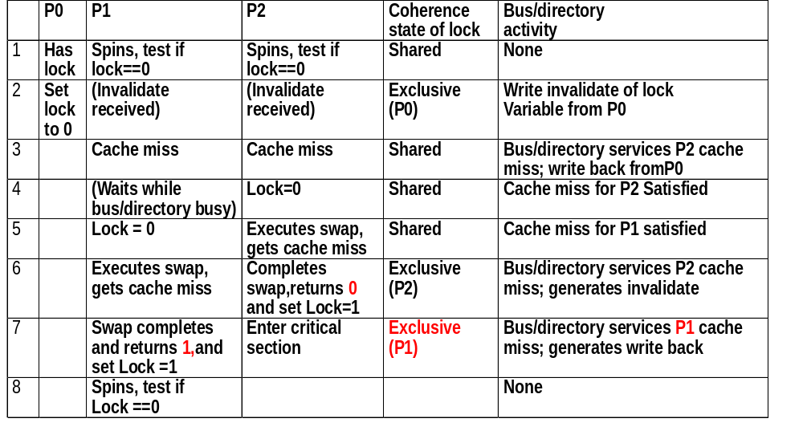
Cache-coherence steps and bus traffic for P0,P1,P2

Slide 18
Performance analysis of spin lock
Assume:
  that 10 processors content one spin lock at the same time.
  Each bus miss takes 100 clock cycles.
  No latency if hit in cache.
Question: How many cycles need to get the lock once for all the 10 processors ?
Answer: each n-i+1 iteration
  i processor read miss get lock = 0
  i processor write miss try to lock it.
  Write the lock to release
  Sum ( 2i + 1) (i=N,..1) = N² + 2N, total 12000 clock cycles

Slide 19
Barrier Synchronization
A barrier: forces all processes to wait until all the processes reach the barrier and then release all the processes to go forward.
How to implement ?
  Shared counter
  Spin waiting for release signal

Slide 20
Code for barrier
lock ( counterlock ); //ensure update atomic
if ( count == 0 ) release = 0; // first-->reset release
count = count +1; // count arrivals
unlock ( counterlock ); // release lock
if ( count == total ){ // all arrived
count = 0; // reset counter
release =1; // release processes
}
else { // more to come
spin(release ==1) ; // wait for arrivals
}
Is there anything wrong ?

Slide 21
Code for barrier (updated)
Is there any implicit error ?
{
lock ( counterlock ); //ensure update atomic
if ( count == 0 ) release = 0; // first-->reset release
count = count +1; // count arrivals
if ( count == total ){ // all arrived
count = 0; // reset counter
release =1; // release processes
}
unlock ( counterlock ); // release lock
spin(release ==1) ; // wait for arrivals
}
Slower processes may be trapped in barrier by the fastest process.
Final result: all trapped some where.

Slide 22
Alternatives to improve
Count again when leave the barrier
  Set another shared counter to count down the existing process in barrier
  Forbid any process reenter the barrier before every process leave the previous instance
  NO! Extra long latency !
Sense-reversing barrier
  Private variable Local_sense

Slide 23
Sense-reversing barrier
{
Local_sense = ! Local_sense; //toggle local_sence
lock ( counterlock ); //ensure update atomic
count = count +1; // count arrivals
if ( count == total ){ // all arrived
count = 0; // reset counter
release = local_sense; // release processes
}
unlock ( counterlock ); // release lock
spin( release == local_sense) ; // wait for signal
}
Slove the “trap” problem but still poor performance !

Slide 24
Performance analysis of barrier
Assume:
  that 10 processors each execute a barrier simultaneously.
  Each bus miss takes 100 clock cycles.
  No latency if hit in cache.
  Processors are equal fast, No worry about code outside barrier
  Lock is implemented using LL&SC
Question: How many cycles need to arrive the barrier then leave?

Slide 25
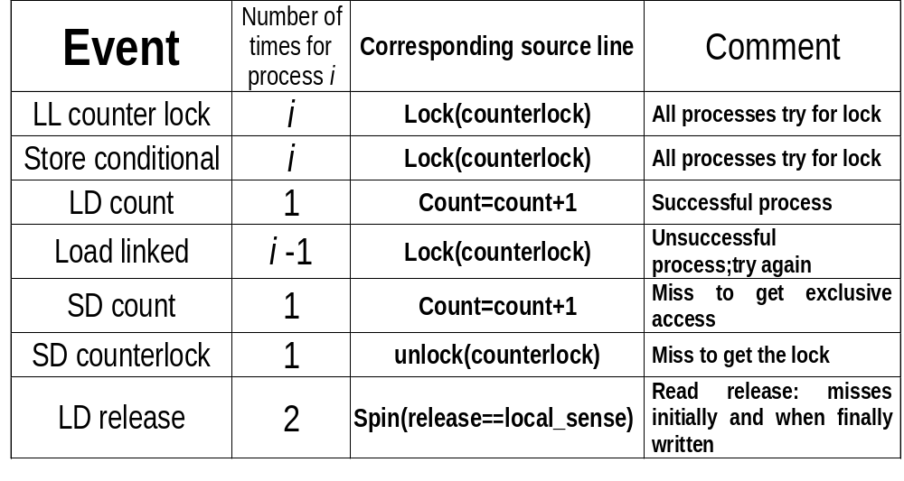
Analysis
???
???
i^{th} processor will have 3i+4 bus transactions
The last processor arrives will have only one bus transaction on LD release
Σ（3i +4）－1 =
3n²+11n
-1
20400 cycles
2

Slide 26
Performance Analysis
Two main factors
  Synchronization latency
    Spin with LL&SC: 2 bus transaction of 1 read &1 write
    Spin with EXCH: 1 bus transaction if lock is often free
  Contention due to serialization
    worse when scale up
What can do for synchronization on Large scale MP ?
  Decrease the latency when not much contention
  Try to minimize the contentions when higher possibility of comepetition
Software approach → Better hardware Primitives

Slide 27
Review the spin lock again
Assume:
  that 10 processors content one spin lock at the same time.
  Each bus miss takes 100 clock cycles.
  No latency if hit in cache.
Question: How many cycles need to get the lock once for all the 10 processors ?
Answer: each n-i+1 iteration
  i processor read miss get lock = 0
  i processor write miss try to lock it.
  Write the lock to release
  Sum ( 2i + 1) (i=N,..1) = N² + 2N, total 12000 clock cycles
  Unnecessary write contents !

Slide 28
Software implementation exponential back-off
DADDUI R3,R0,# 1 ;R3=initial delay
lockit: LL R2, 0(R2) ;load linked
BNEZ R2, lockit ;not available-spin
DADDUI R2, R2, #1 ;get locked value
SC R2, 0(R1) ;store conditional
BNEZ R2, gotit ;branch if store succeeds
DSLL R3, R3, #1 ;increase delay by 2
PAUSE R3 ;delays by value in R3
J lockit
gotit: use data protected by lock
Try to decrease the contentions when bad contention & obtain low latency when small contention.

Slide 29
Queuing Lock
Using array to keep track of the waiting processes
One Process only try to get the lock when it’s turn come up.
Every processor using a different address for the lock
Transfer the lock from one process to another explicitly.

Slide 30
Review the barrier again
i^{th} processor will have 3i+4 bus transactions
The last processor arrives will have only one bus transaction on LD release
Σ（3i +4）－1 =
3n²+11n
-1
20400 cycles
2

Slide 31
Software Approach: Combining tree barrier
Use predetermined n-ary tree structure
When k processes arrive at a child node, it report to its parent node. The processes will be released while arrived at the root.
Most Kth processors will content for lock at one node.
Sense reversing technique is used.

Slide 32
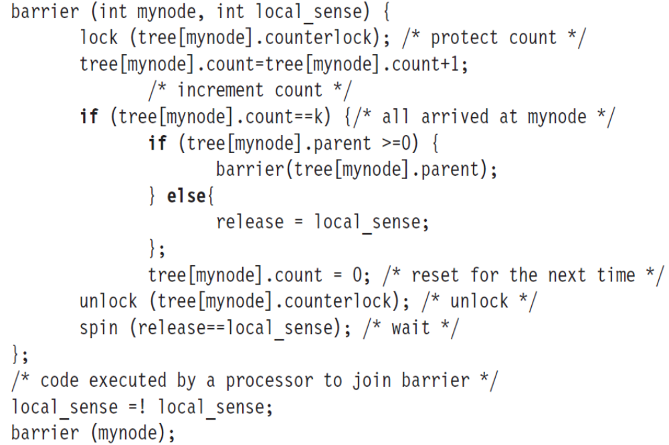
Software Approach: Combining tree barrier
Feb.2008_jxh_Introduction

Slide 33
Hardware Primitive
Two primitive
  Queuelock: for lock
  Fetch&Increment: for barrier
Difference with previous primitive
  Same latency but much less serialization

Slide 34
Queuing lock
Explicitly handing the lock from one waiting processor to the next
Synchronization is integrated with memory controller or directory controller
How does it work ?
  Miss is sent to synchronization controller on first miss
  If the lock is free: returned to the processor
  Else: create a record of node request;
  send back the locked value;
  While lock is available, pick one processor and update/invalidate the lock variable in the cache.

Slide 35
Performance of queuing lock
Question: How long does it take to have 10 processors lock and unlock the varialbe using a Queuing Lock ?
Answer:
  n: miss for the first access
  1: free the lock by the first processor who get
  2: receive the lock, free the lock for each processor of (n-1) .
  Total: n+1+2(n-1) = 3n-1, 2900 clock cycle

Slide 36
Key issues of implementing Queuing lock
Distinguish the initial access of the lock
Queue can be implemented by a bit vector like for the shared set
Capability of reclaim the queuing lock

Slide 37
Primitive: Fetch&Increment
Decreasing serialization
  For barrier: decrease serialization when collection.
  For combining tree: decrease serialization on every node.

Slide 38
Barrier using Fetch&Increment
{
Local_sense = ! Local_sense; //toggle local_sence
fetch_and_increment(count); //atomic update
if ( count == total ){ // all arrived
count = 0; // reset counter
release = local_sense; // release processes
}
else {
spin(release == local_sense) ; // wait for signal
}

Slide 39
Performance for improved barrier
Question: How long does it take to have 10 processors arrive and exit the barrier ?
Answer:
  n: fetch&increment of the count
  n: read miss for the count
  n: read miss for the release.
  Total: 3n, 3000 clock cycle

Slide 40
Conclusion
Efficient use of large scale multiprocessor is a big challenge.
  Synchronization performance
  Memory latency
  Potential load imbalance

