Slide 1
Lec 14
Models of Memory Consistency

Slide 2
Cache coherence
Cache coherence ( Value, same location)
  “Common Sense”
    P1 Read[X] => P1 Write[X] => P1 Read[X] will return X
    P2 Read[X] => P1 Write[X] => will return value written by P1
    P1 Write[X] => P2 Write[X] => Serialized (all processor see the writes in the same order)

Slide 3
Objective of Cache Coherence
Maintain the integrity of data in cache and memory
  What value can be returned by a read.
Keep the performance of multiple processors
Make cache transparent to the processors (not always true)
Haven’t solve the problem
  When must a processor see a value that has been updated by another processor ?

Slide 4
Memory Consistency
Definition:
  When must a processor see a value that has been updated by another processor ?
  What properties must be enforced among reads and writes to different locations by different processors ?

Slide 5
Example （ p243）
P1: A=0; P2: B=0;
… …
A=1; B=1;
L1: if ( B==0)… L2: if ( A==0)...
Assume: A,B are both cached by P1, P2 with the initial value of 0.
How about the if statement ?
Unknown, it depends !

Slide 6
Analyze the result:
P1: A=0; P2: B=0;
… …
A=1; B=1;
L1: if ( B==0)… L2: if ( A==0)...
If the write result can be seen immediately by other processors, then ….
If the write can be delayed, then …

Slide 7
Objectives of Memory Consistency Model
Defines the behavior and correctness of a program.
Impose ordering constraints
Balance programming complexity and performance

Slide 8
Sequential Consistency
Memory accesses executed by each processor were kept in order
Memory accesses among different processors were interleaved.
P1: A=0; P2: B=0;
… …
A=1; B=1;
L1: if ( B==0)… L2: if ( A==0)...
False True/false
True/false False
No way to see True Ture !

Slide 9
Sequential Consistency
Characteristic: Delay next memory access until the previous one is completed.
Simple programming paradigm
Long latency, bad performance
  Even write buffer is not permitted.
  Nonblocking cache ?

Slide 10
Performance analysis for Sequential Consistency
Assume
  50 cycles to establish ownership when write miss；
  10 cycles to issue each invalidation;
  80 cycles for an invalidation to complete and be acknowledged.
  4 other processors share a cache block.
Question：How long does a write miss stall the processor is SC is used？
Answer：
  50 +（10+10+10+10）+ 80 = 170 （CC）

Slide 11
How to improve performance ?
Latency-hiding techniques
Less restrictive memory consistency model

Slide 12
The programmer’s View
Simple programming model
High performance implementation
Simple Programming model:
  synchronized programs:
  All access to shared data are ordered by synchronization operations.
  A synchronized program will behave as if the hardware implemented sequential consistency.
  No Data Race !

Slide 13
Synchronized program
A program is synchronized if all access to shared data are ordered by synchronization operations.
For any shared data x,
write( Pi, x)
Release(Pi, x)
Acquire(Pj, x)
access(Pj, x)

Slide 14
Relaxed Consistency Model
Objective:
  simple programming & high performance
Key idea:
  allow read and writes to complete out of order, but to use synchronization operations to enforce ordering, so that a synchronized program behave as if the processor were sequentially consistent with a better performance.
Orders:
  R→W, R→R, W→ R, W→W
  Sa→R, Sa →W, Sr→R, Sr→W, S→S

Slide 15
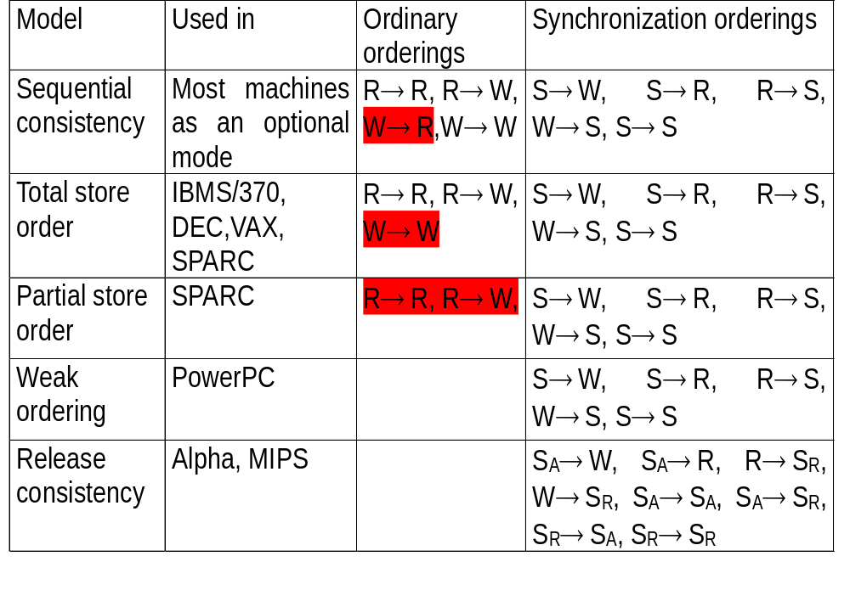
Memory consistency model
W→S_{A}, R→S_{A},
S_{R}→W,S_{R}→R

Slide 16
What to decide R.W order ?
If there is data dependence, then keep the sequential order
Otherwise decided by Memory Consistency Model

Slide 17
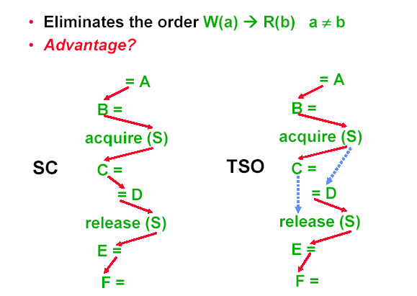
Total Store Order (IBM370)

Slide 18
TSO: FIFO write buffer
P1
P1
Store buffer
Store buffer
Memory

Slide 19
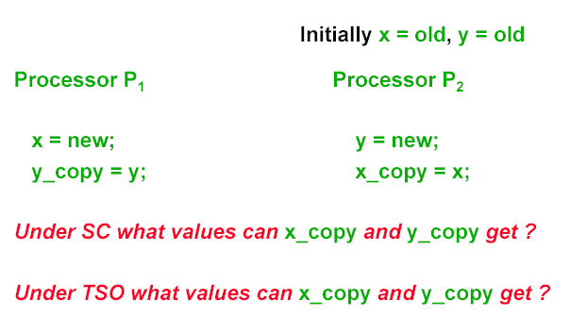
TSO vs. SC
TSO both can get old values
SC at least one has to get the value of new

Slide 20
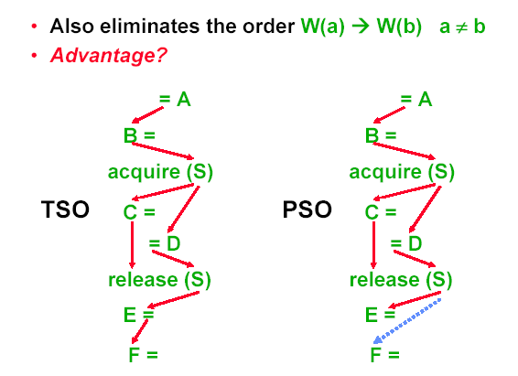
Partial Store Order (sparc)

Slide 21
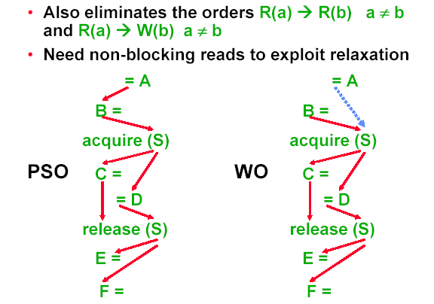
Weak ordering (PowerPC)

Slide 22
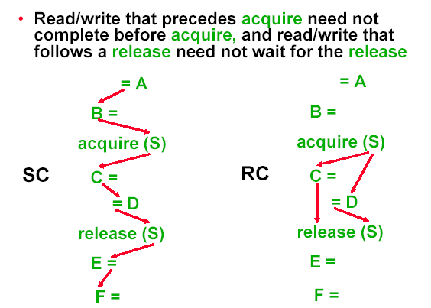
Release consistency (Alpha, MIPS)

Slide 23
Thank you !

