Slide 1
Lecture 5
ILP: Branch Prediction

Slide 2
Review
Structural Hazard
  Separate/replicate function unit, fully-pipelined function units
Data Hazard
  RAW: double-bump, forwarding path, simple compiler scheduling
  WAR, WAW: implicit register renaming
Control Hazard
  Resolve branch asap, Flushing, Predict-not-taken, Predict-taken, Delayed-Branch

Slide 3
Control Hazard (example P_{A-25})
Flushing: stall until the branch is resolved.
  Stall X cycles if delay slots=x
Predict-not-taken:
  Hardware takes all branches as not-taken, compiler need to put frequent case in the not-taken branch
  Stall 0 cycles if not-taken, stall X cycles if taken
Predict-taken:
  Hardware takes all branches as taken, can go forward only when get the branch target . Compiler need to put frequent case in the taken branch
  Stall y cycles waiting for branch target; stall X cycles if not taken.
Delayed Branch:

Slide 4
Static branch prediction
Stall for control hazards
= f (branch frequency, prediction accuracy, misprediction penalty )
Predict according to statistics: (predict taken)
  Mispredition: 9% ~ 59%, average 34%

Slide 5
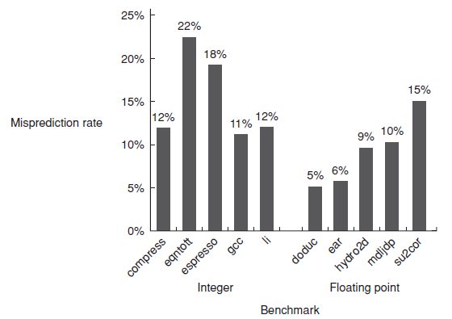
Predict based on profile information
  Average misprediction rate 9% for FP programs,
  Average misprediction rate 15% for integer programs

Slide 6
Dynamic Hardware Prediction
--reducing branch costs
1-bit Branch-Prediction Buffer
2-bit Branch-Prediction Buffer
Correlating Branch Prediction Buffer
Tournament Branch Predictor
Branch Target Buffer
Integrated Instruction Fetch Units
Return Address Predictors

Slide 7
1、1-bit Branch-Prediction Buffer
Performance = ƒ(accuracy, cost of misprediction)
Branch History Table: Lower bits of PC address index table of 1-bit values
  Says whether or not branch taken last time
  No address check (saves HW, but may not be right branch)
Problem: in a loop, 1-bit BHT will cause
2 mispredictions (avg 2/n iterations before exit):
  Only (n-2)/n accuracy even if loop (n-1)/n of the time
  0111……1110111… …1110111……1110111…

Slide 8
2、2-bit Branch-Prediction Buffer
Solution: 2-bit scheme where change prediction only if get misprediction twice:
  (Jim Smith, 1981, A study of branch prediction strategies)
Red: stop, not taken
Blue: go, taken
Adds hysteresis to decision making process
  01111111……111110111111…1110111111
T
NT
Predict Taken
Predict Taken
T
T
NT
NT
Predict Not
Taken
Predict Not
Taken
T
NT

Slide 9
An alternative 2-bit predictor
It can be implemented using a 2-bit counter
T
NT
Predict Taken
Surely
Predict Taken
T
T
NT
NT
Predict Not
Taken
Predict Not
Taken surely
T
NT

Slide 10
Generalize the 2-bit predictor to n-bit predictor
N-bit counter ( 0<x<2^{n}-1)
Predict taken X >= 2^{n-1}
Predict untaken X < 2^{n-1}
Counter + 1 when a taken branch
Counter – 1 when a not taken branch
Most system rely on 2-bit predictor rather than n-bit predictor.

Slide 11
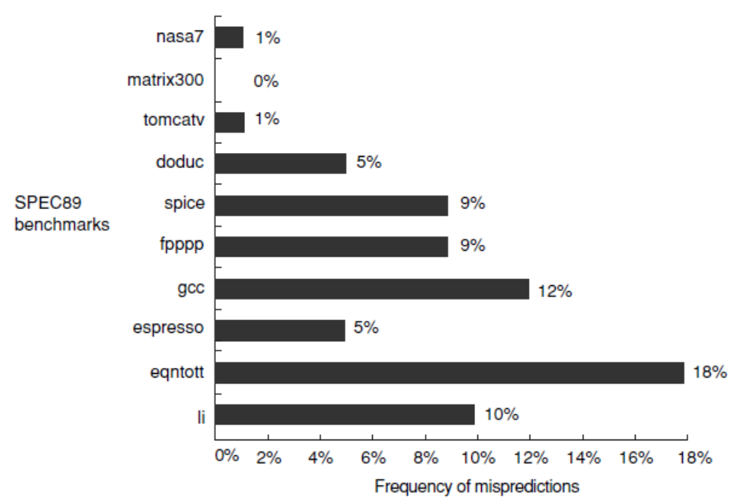
Accuracy of the 2-bit predictor
4096 entries, 2-bit predictor
SPEC89
Accuracy : 99%~82%
Misprediction: 1%~18%

Slide 12
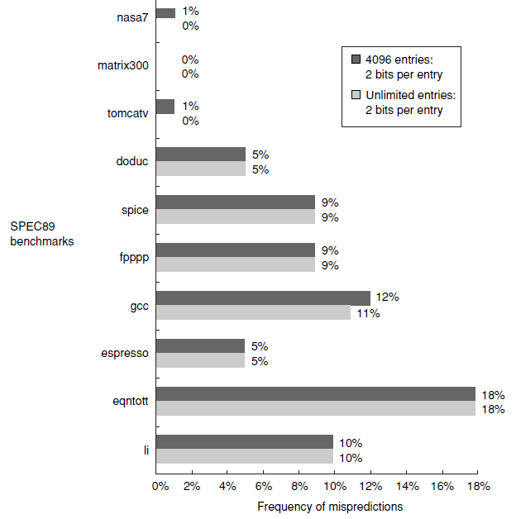
How about unlimited entries ?

Slide 13
How to improve accuracy ?
Analysize the branch behavior
IF ( aa == 2)
aa = 0;
IF ( bb == 2)
bb = 0;
IF (aa == bb ) {
……
}
SUBI R3, R1, #2
BNEZ R3, L1 ; br.b1 (aa!=2)
ADD R1, R0, R0 ; aa==0
L1: SUBI F3, R2, #2
BNEZ R3, L2 ; br.b2 (bb!=2)
ADD R2, R0, R0 ; bb==0
L2: SUB R3, R1, R2; R3=aa-bb
BEQZ R3, L3 ; br.b3 (aa==bb)

Slide 14
Conclusion from the example
B3 branch depends on b1 and b2. B3 is taken only when both b1 and b2 is untaken.
It’s impossible to predict B3 correctly only depending on its previous behavior.
A branch’s behavior not only rely on it’s previous behavior but also on recent behavior of other branches.

Slide 15
Let’s check an example
If (d==0)
d=1;
if (d==1){
…...
}
Assume Reg[R1] = d
BNEZ R1, L1 ; br b1, (d!=0)
DADDIU R1, R0, #1 ; d==0, so d=1
L1: DADDIU R3, R1, #-1 ;
BNEZ R3, L2 ; br b2, (d!=1)
……
L2:

Slide 16
Feature of the code:
d的 初值 | d==0? | B1 | 在b2以前的d值 | d==1? | b2
0 | Yes | Not taken | 1 | Yes | Not taken
1 | No | Taken | 1 | Yes | Not taken
2 | No | Taken | 2 | no | Taken
Conclusion: b2 will be not taken if b1 is not taken
So, we can get accurate prediction if using correlate predictor.

Slide 17
Always mispredict if using one-bit predictor
d=? | b1预测 | b1动作 | 新的b1预测 | b2预测 | b2动作 | 新的b2预测
2 | NT | T | T | NT | T | T
0 | T | NT | NT | T | NT | NT
2 | NT | T | T | NT | T | T
0 | T | NT | NT | T | NT | NT
预测与实际动作 预测与实际动作
总是相反 总是相反

Slide 18
Correlating predictor
Correlating predictor is composed of two parts ( two bits ):
  1st bit: prediction for previous br. is NT，
  2nd bit: prediction for previous br. Is T
Four combinations
预测 组合 | 上一次Br为NT,预测本次位(看第一位) | 上一次Br为T,预测本次为(看第二位)
NT/NT | NT | NT
NT/ T | NT | T
T /NT | T | NT
T / T | T | T
Note, previous Br might be a different br.

Slide 19
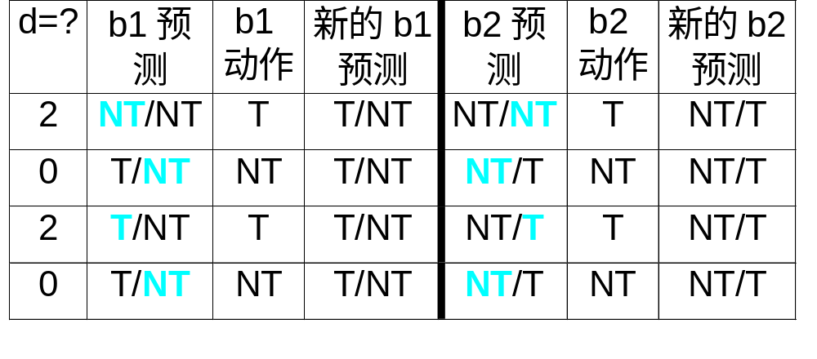
Prediction with correlating predictor (1,1) with initial value =NT/NT.
粗体字表示本次预测
预测出错 b1动作与b2预测值选用关系
预测正确 b2动作与b1预测值选用关系
新预测值
粗体字表示本次预测
预测出错 b1动作与b2预测值选用关系
预测正确 b2动作与b1预测值选用关系
新预测值

Slide 20
3.Correlating Branches prediction buffer
Idea: taken/not taken of recently executed branches is related to behavior of next branch (as well as the history of that branch behavior)
  Then behavior of recent branches selects between, say, 4 predictions of next branch, updating just that prediction
(2,2) predictor: 2-bit global, 2-bit local
  Branch address (4 bits)
2-bits per branch
local predictors
Prediction
2-bit global
branch history
(01 = not taken then taken)

Slide 21
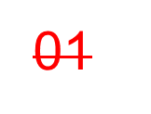
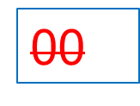
4.Correlating Branches prediction buffer
Assume branch history with branch i in blue box.
0 0 0 0 0 1 1 1 0 0 0 0 0 1 1 1 0 0 0 0 0 1 1 1
Predict: v v x
v v x v v v
00
00
00
00
11
Branch i
01
6次
3次
Branch history
11

Slide 22
(m, n) predictor
m: previous m branch instruction
2^{m}

Slide 23
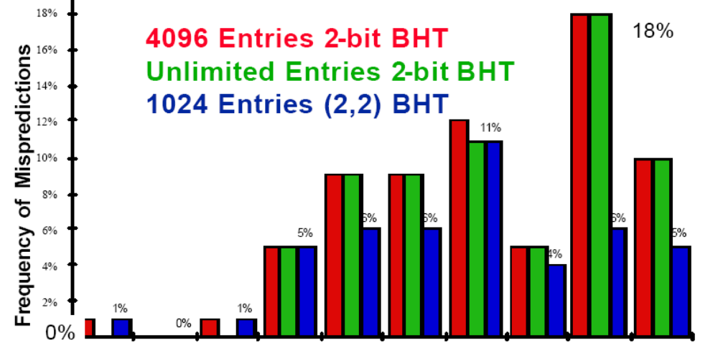
Comparision of 2-bit predictors

Slide 24
Accuracy analysis
Mispredict because either:
  Wrong guess for the branch
  Got branch history of wrong branch when index the table.

Slide 25
4、Tournament Predictors
Motivation for correlating branch predictors is 2-bit predictor failed on important branches; by adding global information, performance improved
Tournament predictors: use 2 predictors, 1 based on global information and 1 based on local information, and combine with a selector
Hopes to select right predictor for right branch

Slide 26
Tournament Predictor in Alpha 21264
4K 2-bit counters to choose from among a global predictor and a local predictor
Global predictor also has 4K entries and is indexed by the history of the last 12 branches; each entry in the global predictor is a standard 2-bit predictor
  12-bit pattern: ith bit 0 => ith prior branch not taken;
  ith bit 1 => ith prior branch taken;
00,10,11
00,01,11
1
2
4K × 2 bits
Use 1
Use 2
3
10
01
01
10
.
.
01
.
Use 1
Use 2
10
12
00,11
00,11

Slide 27
T-Predictor in Alpha 21264 （cont.)
Local predictor consists of a 2-level predictor:
  Top level a local history table consisting of 1024 10-bit entries; each 10-bit entry corresponds to the most recent 10 branch outcomes for the entry. 10-bit history allows patterns 10 branches to be discovered and predicted.
  Next level Selected entry from the local history table is used to index a table of 1K entries consisting a 3-bit saturating counters, which provide the local prediction
Total size: 4K*2 + 4K*2 + 1K*10 + 1K*3 = 29K bits! (~180,000 transistors)
1K × 10 bits
1K × 3 bits

Slide 28
% of predictions from local predictor in Tournament Prediction Scheme
0%
20%
40%
60%
80%
100%
nasa7
98%
matrix300
100%
tomcatv
94%
doduc
90%
spice
55%
fpppp
76%
gcc
72%
espresso
63%
eqntott
37%
li
69%

Slide 29
Accuracy of Branch Prediction
99%
tomcatv
99%
100%
95%
doduc
84%
97%
86%
fpppp
82%
Profile-based
98%
2-bit counter
88%
Tournament
li
77%
98%
86%
espresso
82%
96%
88%
gcc
70%
94%
fig 3.40
0%
20%
40%
60%
80%
100%
Profile: branch profile from last execution
(static in that is encoded in instruction, but profile)

Slide 30
Accuracy v. Size (SPEC89)
10%
9%
8%
Local - 2 bit counters
7%
6%
Conditional branch misprediction rate
5%
Correlating - (2,2) scheme
4%
3%
Tournament
2%
1%
0%
0
8
16
24
32
40
48
56
64
72
80
88
96
104
112
120
128
Total predictor size (Kbits)

Slide 31
5. Branch Target Buffer
Branch Target Buffer (Branch Target Cache):
  Address of branch index to get prediction AND branch address (if taken)
  Note: must check for branch match now, since can’t use wrong branch address
Branch PC
Predicted PC
PC of instruction
FETCH
=?
Yes: instruction is branch and use predicted PC as next PC
Extra
prediction state
bits
No: branch not
predicted, proceed normally
(Next PC = PC+4)

Slide 32
Branch Target “Cache”
Branch Target cache - Only predicted taken branches
“Cache” - Content Addressable Memory (CAM) or Associative Memory (see figure)
Use a big Branch History Table & a small Branch Target Cache
Branch PC
Predicted PC
PC
=?
Prediction state
bits (optional)
Yes: predicted taken branch found
No: not found

Slide 33
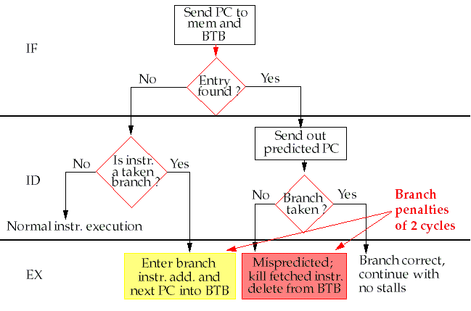
Steps in handling an instruction with a Branch-Target Buffer

Slide 34
Variations of
Branch Target Buffer
Instead of storing just the branch address, the BTB can store the actual instruction as well.
Storing both the branch address and the actual instruction in the buffer
Very big branch Target buffer to cache addresses or instructions from multiple paths, ex, the predicted and unpredicted direction

Slide 35
6. Integrated Instruction Fetch Units
Increasing the number of instructions executed per clock, instruction fetch will become an significant bottleneck.
Integrated instruction fetch unit:
  Integrated branch prediction
  Instruction prefetch
  (see P438 hardward prefetch &
  P483 ex. Instruction prefetcher )
  Instruction memory access and buffering

Slide 36
7、Return Address Predictors
Technique for predicting indirect jumps, whoes destination address varies at run time.
Register Indirect branch hard to predict address
SPEC89: procedure return account for 85% of the indirect jumps.
Branch-target buffer doesn’t work well for procedure return

Slide 37
Return Addresses Buffer
Since stack discipline for procedures, save return address in small buffer that acts like a stack:
  Caches the most recent return addresses.
  Push return address into stack at a call;
  pop an address off at a return
SPEC benchmark shows a stack with 8-16 entries works quite well. (fig-3.22)

Slide 38
Dynamic Branch Prediction Summary
Prediction becoming important part of scalar execution
Branch History Table: 2 bits for loop accuracy
Correlation: Recently executed branches correlated with next branch.
  Either different branches
  Or different executions of same branches
Tournament Predictor: more resources to competitive solutions and pick between them
Branch Target Buffer: include branch address & prediction
Predicated Execution can reduce number of branches, number of mispredicted branches
Return address stack for prediction of indirect jump

