Slide 1
Chapter 7
LC-2 Assembly Language

Slide 2
It’s hard to write code in 1’s & 0’s!
Assembly language makes it possible
to write Machine Language code
  each line of assembly language is translated
  into a single ML instruction
A program called the Assembler does the translation and provides useful tools:
  use of labels - symbolic names for address locations
  automatic conversion of binary / hex / decimal
  pseudo-ops

Slide 3
A sample program
      01 ;
      02 ; Program to multiply an integer by the number 6
      03 ;
      04 .ORIG x3050
      05 LD R1, SIX
      06 LD R2, NUMBER
      07 AND R3, R3, #0 ; clear R3 to hold the product
      08 ;
      09 ; The inner loop
      0A ;
      0B AGAIN ADD R3, R3, R2
      0C ADD R1, R1, #-1 ; keep track of iterations
      0D BRp AGAIN
      0E ;
      0F HALT
      10 ;
      11 NUMBER .BLKW 1
      12 SIX .FILL x0006
      13 ;
      14 .END

Slide 4
Assembly Language Instructions
Formats
  LABEL OPCODE OPERANDS ; COMMENTS
  LABEL PSEUDO-OPS ; COMMENTS
Opcode
  Symbolic name for the 4-bit ML opcode
Label
  Symbolic name for a memory location. It is used to:
    indicate the target of a branch instruction, e.g. AGAIN in location 0B
    indicate the location of a stored value or array, e.g. NUMBER and SIX
Comments
  intended for humans only: explanation of code, visual display

Slide 5
Pseudo-Ops …
  … are directives to the assembler
    they are not translated into ML instructions
  LC-3 Pseudo-Ops:
    .ORIG address Tells assembler where to locate the program in memory (starting address).
    .FILL value Store value in the next location in memory.
    .BLKW n Set aside a block of n words in memory.
    .STRINGZ string Store the string, one character per word, in memory. Add a word of x0000 after the string.
    .END Marks the end of the source program (not to be
    confused with the instruction HALT!)
    .EXTERNAL The label so indicated is allocated in another module.

Slide 6
A partial assembly sample
.ORIG x3000
AND R1, R1, #0
ADD R1, R1, #10
LD R2, Twenty
LD R3, Ess
HALT
Twenty FILL x0014
.BLKW 2
Ess .FILL “S” .STRINGZ “Hi”
.BLKW 3
.END
x3000: AND R1, R1, b0 0000
x3001: ADD R1, R1, b0 1010
x3002: LD R2, b0 0000 0010
x3003: LD R3, b0 0000 0100
x3004: TRAP b0010 0101
x3005: b0000 0000 0001 0100 ; x0014
x3006:
x3007:
x3008: b0000 0000 0101 0011 ; x0053
x3009: b0000 0000 0100 1000 ; x0048 = ‘H’
x300A: b0000 0000 0110 1001 ; x0069 = ‘i’
x300B: x0000 ; null terminator
x300C:
x300D:
x300E:

Slide 7
The Assembly Process
Objective
  Translate the AL (Assembly Language) program
  into ML (Machine Language).
  Each AL instruction yields one ML instruction word.
  Interpret pseudo-ops correctly.
Problem
  An instruction may reference a label.
  If the label hasn’t been encountered yet, the assembler
  can't form the instruction word
Solution
  Two-pass assembly

Slide 8
Two-Pass Assembly - 1
First Pass - generating the symbol table
  Scan each line
  Keep track of current address
    Increment by 1 for each instruction
    Adjust as required for any pseudo-ops
    (e.g. .FILL or .STRINGZ, etc.)
  For each label
    Enter it into the symbol table
    Allocate to it the current address
  Stop when .END is encountered

Slide 9
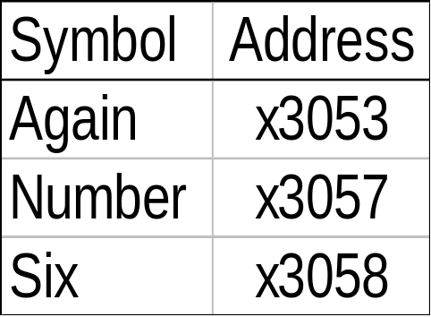
Symbol Table example
;
; Program to multiply a number by six
;
.ORIG x3050
x3050 LD R1, SIX
x3051 LD R2, NUMBER
x3052 AND R3, R3, #0
;
; The inner loop
;
x3053 AGAIN ADD R3, R3, R2
x3054 ADD R1, R1, #-1
x3055 BRp AGAIN
;
x3056 HALT
;
x3057 NUMBER .BLKW 1
x3058 SIX .FILL x0006
;
.END
  Using the earlier example:

Slide 10
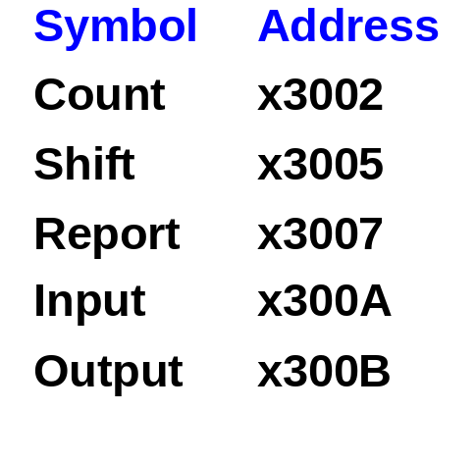
Another example - Parity checking
  Parity is a function that returns a 1 when the number of 1s
  in a word is odd and 0 when it is even.
.ORIG x3000
3000 AND R2, R2, x0 ; clear R2
3001 LDI R1, Input ; load word into R1
3002 Count BRz Report ; if 0, done counting
3003 BRp Shift ; if >0, skip ADD
3004 ADD R2, R2, x1 ; increment count
3005 Shift ADD R1, R1, R1 ; shift left 1 bit
3006 BRnzp Count ; go back up
3007 Report AND R3, R2, x1 ; LSB 1 or 0?
3008 STI R3, Output ; store results
3009 TRAP x25 ; halt program
300A Input .FILL x3200 ; address of input
300B Output .FILL x3201 ; address of output

Slide 11
Two-Pass Assembly - 2
Second Pass - generating the ML program
  Scan each line again
  Translate each AL instruction into ML
    Look up symbols in the symbol table instruction
    Ensure that labels are no more than +256 / -255 lines from instruction
    Determine operand field for the instruction
  Fill memory locations as directed by pseudo-ops
  Stop when .END is encountered

Slide 12
Assembled code
  Using the earlier example:
x3050 0010 001 0 0000 0111 ; LD R1, SIX
x3051 0010 010 0 0000 0101 ; LD R2, NUMBER
x3052 0101 011 011 1 00000 ; AND R3, R3, #0
x3053 0001 011 011 0 00 010 ; ADD R3, R3, R2
x3054 0001 001 001 1 11111 ; ADD R1, R1, #-1
x3055 0000 001 1 1111 1101 ; BRp AGAIN
x3056 1111 0000 0010 0101 ; HALT
x3057 ; .BLKW 1
x3058 0000 0000 0000 0110 ; .FILL x0006

Slide 13
Object File
Each source file is translated into an object file
  a list of ML instructions including the symbol table.
A complete program may include several source and/or object files:
  Source files written in Assembly by the programmer
  Library files provided by the system (OS or other)
  Compiled HLL libraries
The object files must be linked
  One object file will be the “main”
  All cross-referenced labels in symbol tables will be resolved

Slide 14
The end result …
… is the executable image (.exe file)
  this is a file (“image”) of the finalized list of ML instructions,
  with all symbolic references resolved
  it is loaded by copying the list into memory, starting at the
  address specified in the .ORIG directive
  it is run by copying the starting address to the PC

