Slide 1
Compile Principle and Technology

Slide 2
Chapter 8 Code Generation
the characteristics of the source language
information about the target architecture
the structure of the runtime environment
the operating system running on the target machine.
a compiler typically breaks up this phase into several steps, involving various intermediate data structures, often including some form of abstract code called intermediate code.

Slide 3
8.1 Intermediate Code and Data Structures for Code Generation
A data structure that represents the source program during translation is called an intermediate representation, or IR, for short.
Such an intermediate representation that resembles target code is called intermediate code.
Intermediate code can be very high level, representing all operations almost as abstractly as a syntax tree, or it can closely resemble target code.
Intermediate code can also be useful in making a compiler more easily re-targetable

Slide 4
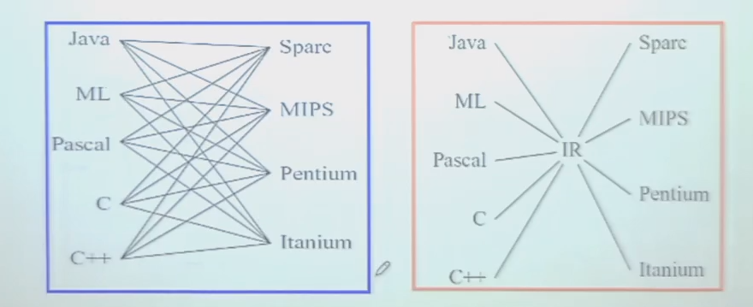

Slide 5
8.1.1 (At most) Three-Address Code
Basics: represent the evaluation of arithmetic expressions x = y op z
e.g. 2*a + (b-3)
the corresponding three-address code is as follow
  T1 = 2 * a
  T2 = b – 3
  T3 = T1 + T2
T1, T2 and T3 are temporaries. ~ LLVM virt reg
  assigned to registers
  kept in activation records.

Slide 6
example
Figure 8.1 Sample TINY program
{ sample program
in TINY language --
computes factorial
}
read x ; { input an integer }
if 0 < x then
{ don’t compute if x <= 0 }
fact:=1;
repeat
fact:=fact*x;
x:=x-1
until x=0;
write fact { output factorial of x }
end
Figure 8.2 Three-address code for
the TINY program of Figure 8.1
read x
t1=x>0
if_false t1 goto L1
fact = 1
label L2
t2 = fact * x
fact = t2
t3 = x - 1
x = t3
t4 = x==0
if_false t4 goto L2
write fact
label L1
halt

Slide 7
8.1.2 Data Structures for the Implementation of Three-Address Code
four fields are necessary: +one op
Such a representation of three-address code is called a quadruple.
those instructions that need fewer than three addresses, one or more of the address fields is given a null or “empty” value.
The entire sequence of three-address instructions is implemented as an array or linked list. 表

Slide 8
8.1.2 Data Structures for the Implementation of Three-Address Code
Address: an integer constant or a string (name of a temporary or a variable).
These names must be entered into a symbol table, and lookups are to be performed during further processing.

Slide 9
8.1.2 Data Structures for the Implementation of Three-Address Code
An alternative to keeping names in the quadruples is to keep pointers to symbol table entries.
(good for implementing nested scope)
A different implementation of three-address code is to use the instructions themselves to represent the temporaries, ~llvm::instruction. Such an implementation of three-address code is called a triple.

Slide 10
8.1.2 Data Structures for the Implementation of Three-Address Code
(op, src1, src2, dst)
Quadruple implementation for the three-address code of Figure 8.2.
    (rd, x , _ , _ )
    (gt, x, 0, t1 )
    (if_f, t1, L1, _ )
    (asn, 1,fact, _ )
    (lab, L2, _ , _ )
    (mul, fact, x, t2 )
    (asn, t2, fact, _ )
    (sub, x, 1, t3 )
    (asn, t3, x, _ )
    (eq, x, 0, t4 )
    (if_f, t4, L2, _)
    (wri, fact, _, _ )
    (lab, L1, _ , _ )
    (halt, _, _, _ )
Figure 8.2 Three-address code for
the TINY program of Figure 8.1
read x
t1=x>0
if_false t1 goto L1
fact = 1
label L2
t2 = fact * x
fact = t2
t3 = x - 1
x = t3
t4 = x==0
if_false t4 goto L2
write fact
label L1
halt

Slide 11
8.1.2 Data Structures for the Implementation of Three-Address Code
Typedef enum { rd, gt, if_f, asn, lab, mul, sub, eq, wri,
halt, …} OpKind;
Typedef enum { Empty, IntConst, String } AddrKind;
Typedef struct
{ AddrKind kind;
Union
{ int val;
char * name;
} contents;
} Address;
Typedef struct
{ OpKind op;
Address addr1, addr2,addr3;
} Quad;

Slide 12
8.1.2 Data Structures for the Implementation of Three-Address Code
(op, src1, src2, dst)
Triple implementation for the three-address code of Figure 8.2.
    (0) (rd, x , _ )
    (1) (gt, x, 0)
    (2) (if_f, (1), (11) )
    (3) (asn, 1, fact )
    (4) (mul, fact, x )
    (5) (asn, (4), fact )
    (6) (sub, x, 1 )
    (7) (asn, (6), x )
    (8) (eq, x, 0 )
    (9) (if_f, (8), (4) )
    (10) (wri, fact, _ )
    (11) (halt, _, _ )
Figure 8.2 Three-address code for
the TINY program of Figure 8.1
read x
t1=x>0
if_false t1 goto L1
fact = 1
label L2
t2 = fact * x
fact = t2
t3 = x - 1
x = t3
t4 = x==0
if_false t4 goto L2
write fact
label L1
halt
Triples have one major drawback: any movement of their positions becomes difficult.

Slide 13
8.1.3 P-Code
P-code began as a standard target assembly code produced by a number of Pascal compilers of the 1970s and early 1980s.
It was designed to be the actual code for a hypothetical stack machine, called the P-machine.
an interpreter was written on various actual machines.
The P-machine consists of a code memory, an unspecified data memory for named variables, and a stack for temporary data, together with whatever registers are needed to maintain the stack and support execution.

Slide 14
8.1.3 P-Code
2*a+(b-3)
ldc 2 ; load constant 2 (pushes 2 onto the stack)
lod a ; load value of variable a (pushes a onto the stack)
mpi ; integer multiplication (pops these two values from the stack, multiplies them (in reverse order), and pushes the result onto the stack.)
lod b ; load value of variable b
ldc 3 ; load constant 3
sbi ; integer subtraction (subtracts the first from the second)
adi ; integer addition

Slide 15
8.1.3 P-Code
x:= y+1
lda x ; load address of x
lod y ; load value of y
ldc 1 ; load constant 1
adi
sto ; store top to address below top & pop both

Slide 16
8.2 Basic Code Generation Techniques
8.2.1 Intermediate Code or Target Code as a Synthesized Attribute
codeGen as an attribute computation:
  directly during parsing
  by a postorder traversal of the syntax tree.

Slide 17
8.2.1 Intermediate Code or Target Code as a Synthesized Attribute
exp → id = exp | aexp
aexp → aexp + factor | factor
factor → (exp) | num | id
1) P-Code
  The existence of embedded assignments is a complicating factor.
  stn : stores the value to the address but leaves the value at the top of the stack, while discarding the address.
  ++: instructions are to be concatenated with newlines inserted between them.
  ||: when a single instruction is being built and a space is to be inserted.
2) Three-Address Code
  Requires the attribute grammar include a new name attribute for each node.

Slide 18
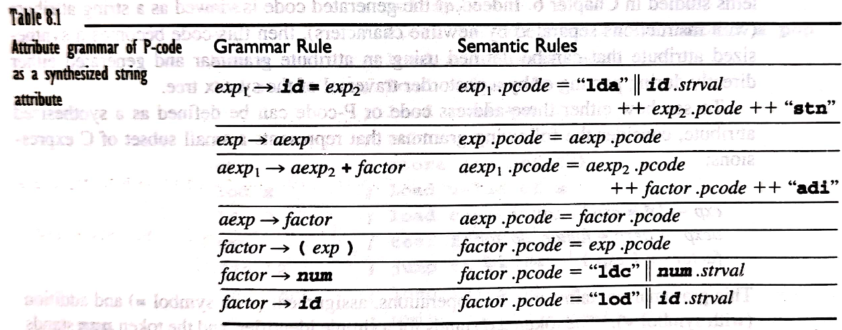
8.2.1 Intermediate Code or Target Code as a Synthesized Attribute
(x=x+3)+4
  lda x
  lod x
  ldc 3
  adi
  stn
  ldc 4
  adi

Slide 19
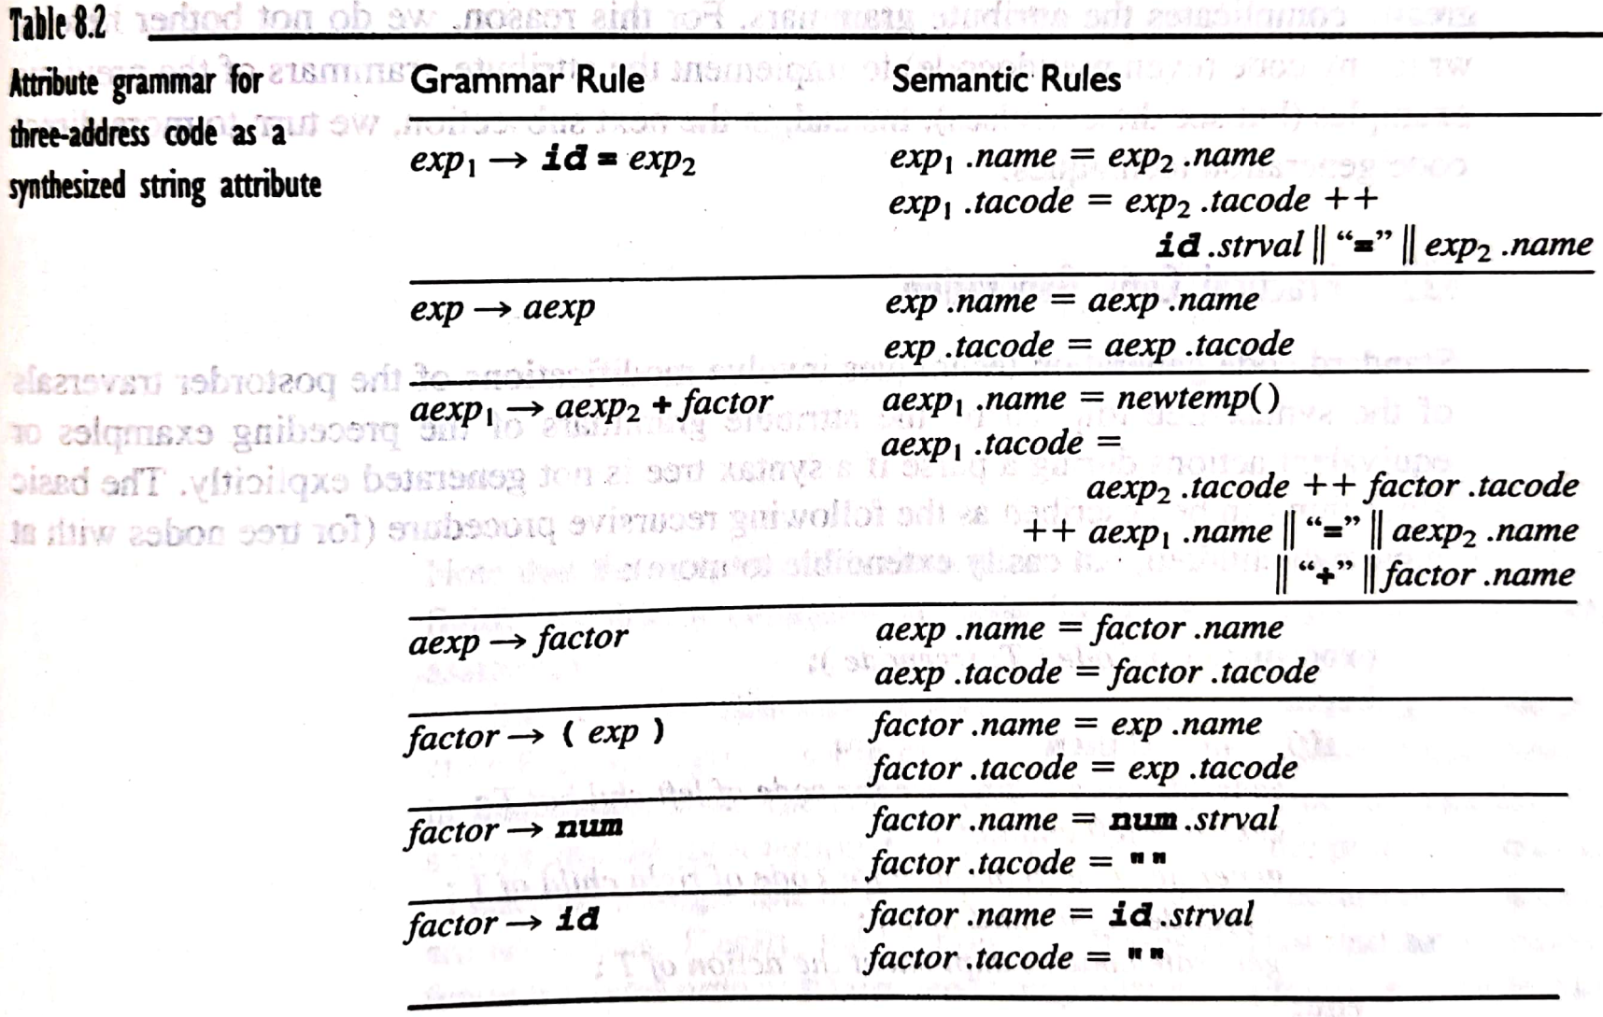
8.2.1 Intermediate Code or Target Code as a Synthesized Attribute

Slide 20
8.2.2 Practical Code Generation
The basic algorithm :
  Procedure gencode (T: treenode); // postorder
  Begin
  If T is not nil then
  Generate code to prepare for code of left child of T;
  Gencode(left child of T);
  Generate code to prepare for code of right child of T;
  Gencode(right child of T);
  Generate code to implement the action of T;
  End;

Slide 21
8.2.2 Practical Code Generation
typedef enum {Plus, Assign} optype;
typedef enum {OpKind, ConstKind, IdKind} NodeKind;
typedef struct streenode
{ NodeKind kind;
Optype op; /* used with OpKind */
struct streenode *lchild, *rchild;
int val; /* used with ConstKind */
char * strval;
/* used for identifiers and numbers */
} STreenode;
typedef STreenode *syntaxtree;

Slide 22
8.2.2 Practical Code Generation
first: the standard C function sprintf to concatenate strings into the local temporary codestr.
Second: the procedure emitcode : generate a single line of P-code, either in a data structure or an output file.
Third: the two operator cases (plus and Assign ) require two different traversal orders.
  plus needs only postorder.
  Assign requires some preorder and some postorder processing.

Slide 23
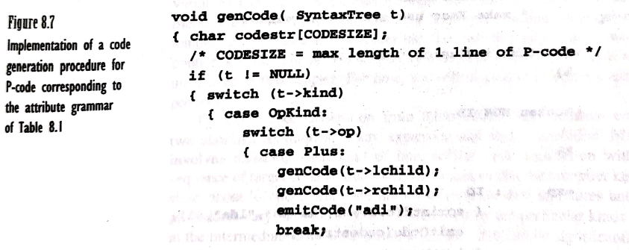
8.2.2 Practical Code Generation

Slide 24
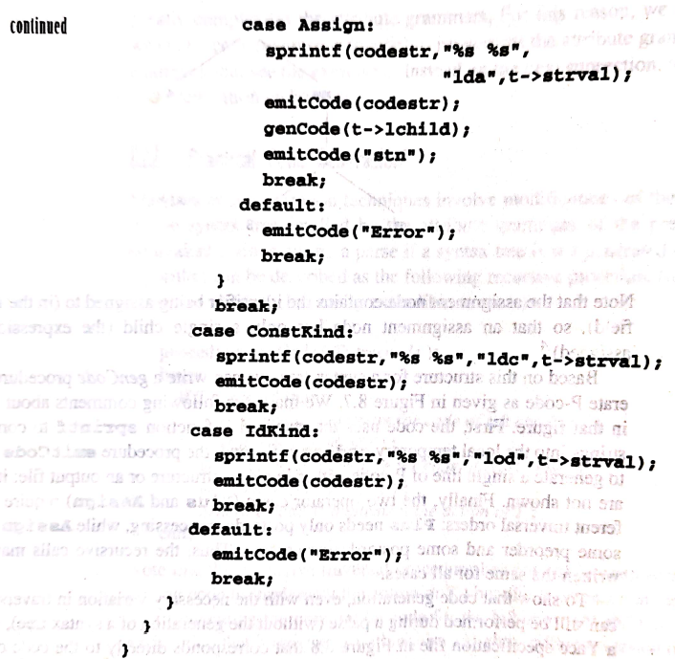
8.2.2 Practical Code Generation

Slide 25
8.2.2 Practical Code Generation
%{
#define YYSTYPE char *
/* make Yacc use strings as values */
/* other inclusion code … */
%}
%token NUM ID
%%
exp : ID
{ sprintf (codestr, “%s %s”, “lda”, $1);
emitCode ( codestr); }
‘ = ‘ exp
{ emitCode (“stn”); }
| aexp
;
aexp : aexp ‘+’ factor { emitCode(“adi”); }
| factor
;
factor : ‘(’ exp ‘)’
| num { sprintf(codestr, “%s %s”, “ldc”, $1);
emitCode(codestr); }
| ID { sprintf(codestr, “%s %s”, “lod”, $1);
emitCode(codestr); }
；
%%
/* */

Slide 26
8.2.3 Generation of Target Code from Intermediate Code
the final code generation pass must supply
  all the actual locations of variables and temporaries
  the code necessary to maintain the runtime environment.

Slide 27
8.2.3 Generation of Target Code from Intermediate Code
Code generation from intermediate code involves either or both of two standard techniques:
  macro expansion
  static simulation.

Slide 28
8.2.3 Generation of Target Code from Intermediate Code
1. Macro expansion
replacing each kind of intermediate code instruction with an equivalent sequence of target code instructions.
2. Static simulation
a straight-line simulation of the effects of the intermediate code and generating target code to match these effects.

Slide 29
S. Generation of TAcode from Pcode
(x=x+3)+4
lda x
lod x
ldc 3
adi
stn
ldc 4
adi
t1 = x+3
x = t1
t2 =t1 + 4

Slide 30
The adi operation is processed , the three-address instruction t1=x+3 is generated .
3
X
Address of x

Slide 31
The stn instruction then causes the three-address instruction x=t1
t1
Addrss of x
t1

Slide 32
Finally, the adi instruction causes the three address indtruction
t2=t1+4
4
t1

Slide 33
a = b+c
Lda a
Lod b
Lod c
Adi
sto

Slide 34

lda t1
lod x
ldc 3
adi
sto
lda x
lod t1
sto
lda t2
lod t1
ldc 4
adi
sto
t1 = x+3
x = t1
t2 =t1 + 4

Slide 35
8.3 Code Generation of Data Structure References
8.3.1 Address Calculations
1、Three-Address Code for Address Calculations
to store the constant value 2 at the address of the variable x plus 10 bytes.
  t1 = &x +10
  *t1 = 2
The implementation of these new addressing modes requires that the data structure for three-address code contain a new field or fields.
the quadruple data structure of Figure 8.4 (page 403) can be augmented by an enumerated AddrMode field with possible values None, Address, and Indirect.

Slide 36

8.3.1 Address Calculations
2、 P-Code for Address Calculations
  ind i (“ indirect load”)
  ixa s (“indexed address”)
a
ind i
*(a+i)

Slide 37
8.3.2 Array References
Each address must be computed :
  the base address of a (its starting address in memory)
  an offset that depends linearly on the value of the subscript.

Slide 38
8.3.2 Array References
The offset is computed from the subscript value as follows.
1. an adjustment must be made to the subscript value if the subscript range does not begin at 0.
2. the adjusted subscript value must be multiplied by a scale factor .
3. the resulting scaled subscript is added to the base address to get the final address of an array element.

Slide 39
8.3.2 Array References
The address of an array element a[t]
  base _ address (a) + (t - lower_bound (a)) * element_size (a)
  IR codeGen:
  &a in three-address code is the same as base-address(a)
  lda a loads the base address of a onto the P-machine stack.
  elem-size(a): the element size of array a on the target machine.
  Since this is a static quantity ( assuming static typing), this expression will be replaced by a constant at compile time.

Slide 40
8.3.2 Array References
1、Three-Address Code for Array References
introduce two new operations, one that fetches the value of an array element
t2= a[t1]
a[t2]= t1
these could be given the symbols =[] and []=
a[i+1] = a [j*2]+3
translate into the three-address instructions
t1 = j * 2
t2 = a [t1]
t3 = t2 + 3
t4 = i + 1
a [t4] = t3

Slide 41
8.3.2 Array References
we may also write out the address computations of an array element directly in three-address code.
  t2 = a[t1]
  t3 = t1 * elem_size(a)
  t4 = &a +t3
  t2 = *t4
  a[t2] = t1 can be written as
  t3 = t2 * elem_size(a)
  t4= &a + t3
  *t4 = t1

Slide 42
8.3.2 Array References
a[i+1] = a[j*2] + 3
  t1 = j * 2
  t2 = t1 * elem_size(a)
  t3 = &a + t2
  t4 = *t3
  t5 = t4 + 3
  t6 = i + 1
  t7 = t6 * elem_size (a)
  t8 = &a + t7
  *t8 = t5

Slide 43
8.3.2 Array References
2、 P-Code for Array References
  use the new address instructions ind and ixa.
  t2 = a[t1] is written in P-code as
  lda t2
  lda a
  lod t1
  ixa elem-size(a)
  ind 0
  sto

Slide 44
8.3.2 Array References
a[t2] = t1 is written in P-code as
lda a
lod t2
ixa elem-size(a)
lod t1
sto

Slide 45
8.3.2 Array References
Finally a[i+1] = a[j*2] + 3 translates to the following P-code instructions:
  lda a
  lod i
  ldc 1
  adi
  ixa elem_size(a)
  lda a
  lod j
  ldc 2
  mpi
  ixa elem_size(a)
  ind 0
  ldc 3
  adi
  sto

Slide 46
8.3.2 Array References
3、A Code Generation Procedure with Array References
exp -> subs = exp | aexp
aexp ->aexp + factor | factor
factor-> (exp) | num | subs
subs-> id | id[exp]
typedef enum { Plus, Assign, Subs } Optype;

Slide 47
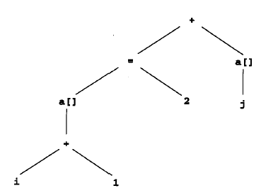
8.3.2 Array References
( a [ i + 1 ] = 2 ) + a [ j ]
P-code :
  lda a
  lod i
  ldc 1
  adi
  ixa elem_size(a)
  ldc 2
  stn ; value left on top
  lda a
  lod j
  ixa elem_size(a)
  ind 0
  adi

Slide 48
8.3.3 Record Structure and Pointer References
1、 the base address of the structure variable is computed.
2、 the (usually fixed) offset of the named field is found
3、 the two are added to get the resulting address.

Slide 49
8.3.3 Record Structure and Pointer References
1) Three-Address Code for Structure and Pointer References
  use the three-address instruction
  t1 = &x + field_offset (x, j)
  x.j = x.i; is translated into
  t1 = &x + field_offset (x, j)
  t2 = &x + field_offset (x, i)
  *t1 = *t2

Slide 50
8.3.3 Record Structure and Pointer References
the indirection of pointers interacts with field address computations
  typedef struct treeNode
  { int val;
  struct treeNode * lchild, * rchild;
  } TreeNode;
  . . .
  TreeNode *p;

Slide 51
8.3.3 Record Structure and Pointer References
p -> lchild = p;
p = p -> rchild;
  translate into the three-address code
  t1 = p + field_offset ( *p, lchild )
  *t1 = p
  t2 = p + field_offset ( *p, rchild )
  p = *t2

Slide 52
8.3.3 Record Structure and Pointer References
P-Code for Structure and Pointer References
x.j = x.i
translated into the P-code
        lda x
        lod field_offset (x,j)
        ixa 1
        lda x
        ind field_offset (x,i)
        sto

Slide 53
8.3.3 Record Structure and Pointer References
*x = i (x declared as an int *)
translates into the P-code
  lod x
  lod i
  sto

