Slide 1
Chapter 5
Bottom-Up Parsing

Slide 2
5.3 SLR(1) Parsing
Definition:
  The SLR(1) parsing algorithm.
  1. If state s contains any item of form A → α·Xβ, then the action is to shift the current input token X onto the stack, and the new state to be pushed on the stack is the state containing the item A → αX·β.
  2. If state s contains the complete item A → γ·, and the next token in the input string is in Follow(A), then the action is to reduce by the rule A → γ.

Slide 3
5.3.1 The SLR(1) Parsing Algorithm
  A reduction by the rule S' →S, where S' is the start state, this will happen only if the next input token is $.
  Pop, back up in the DFA to the state from which the construction of γ began. This state must contain an item of the form B → α·Aβ. Push A onto the stack, and push the state containing the item B → αA·β.
  (Same to LR(0))
3. error if the next input token isn’t covered by any of the above cases

Slide 4
5.3.1 The SLR(1) Parsing Algorithm
A grammar is an SLR(1) grammar if the SLR(1) parsing rules result in no ambiguity.
To be specific, iff. for any state s:
No shift-reduce conflict: For any item A → α·Xβ in s with X a terminal, there is no complete item B → γ. in s with X in Follow(B).
No reduce-reduce conflict: For any two complete items A→α· and B→β· in s, Follow(A) ∩ Follow(B) is empty.
Notes:
Reduce-reduce conflict

Slide 5
5.3.1 The SLR(1) Parsing Algorithm
Example 5.10
  This grammar is not LR(0), but it is SLR(1).
  Follow(E') ={$} and Follow(E) = { $, +}.
  + is not in Follow(E') ☺
LR(0) s-r conflict
E′→• E
E→ • E +n
E→ • n
E
E′→ E•
E→ E • +n
0
1
n
+
E→ n •
E→ E + • n
n
E→ E + n •
2
3
4

Slide 6
5.3.1 The SLR(1) Parsing Algorithm
Example 5.11
the grammar of balanced parentheses, Follow(S') = {$} and Follow(S)={$,)}.
  Non-LR(0) states 0, 2, and 4 have s-r conflicts
  Shifting ( and S
S' → •S
S → •(S)S
S → •
S
S' → S •
1
0
(
S → (S •)S
S
3
S → (• S)S
S → •(S)S
S → •
)
2
(
(
S → (S) • S
S → •(S)S
S → •
S
S → (S)S •
5
4

Slide 7
5.3.1 The SLR(1) Parsing Algorithm
Note text p162 to see how the stack continues to grow until the final reductions.
This is characteristic of bottom-up parsers in the presence of right-recursive rules such as S → (S)S.
Right recursion can cause stack overflow, and so is to be avoided if possible.

Slide 8
5.3.2 Disambiguating Rules for Parsing Conflicts
in SLR(1) parsing
  shift-reduce conflicts
  reduce-reduce conflicts.
In the case of shift-reduce conflicts, there is a natural disambiguating rule
  always prefer the shift over the reduce.
The case of reduce-reduce conflicts is more difficult
  such conflicts often (but not always) indicate
  an error in the design of the grammar.

Slide 9
5.3.2 Disambiguating Rules for Parsing Conflicts
Example 5. 1 2
  statement →if-stmt| other
  if-stmt → if (exp) statement
  |if (exp) statement else statement
  exp→0|1
  S→I| other
  I→if S | if S else S

Slide 10
5.3.2 Disambiguating Rules for Parsing Conflicts
S′→• S
S→• I
S →• other
I →• if S
I→• if S else S
S
S′→S•
1
I
S→ I•
2
0
I
I
if
other
other
I → if • S
I→ if • S else S
S→• I
S →• other
I →• if S
I→• if S else S
I→ if S else • S
S→• I
S →• other
I →• if S
I→• if S else S
S→ other•
3
if
4
6
if
else
S
S
I → if S •
I→ if S • else S
other
5
I→ if S else S •
7
The conflict occurs in states 5 of the DFA.
A disambiguating rule: prefers the shift over the reduce.

Slide 11
5.3.3 Limits of SLR(1) Parsing Power
SLR(1) parsing is not quite powerful enough
  Example 5.13 :the statements extracted and simplified from Pascal (a similar situation occurs in C)
  stmt → call-stmt | assign-stmt
  call-stmt → identifier
  assign-stmt → var :=exp
  var →var [ exp ] | identifier
  exp → var | number

Slide 12
5.3.3 Limits of SLR(1) Parsing Power
S → id | V := E
V→ id
E → V | n
  S’ → ·S
  S → ·id
  S → ·V := E
  V→ ·id
This state has a shift transition on id to the state
  S → id·
  V → id·
  Follow(S)={$} Follow(V)={:=, $}
the SLR(1) parsing algorithm calls for a reduction:
the rule S → id and the rule V→ id under input symbol $.
(This is a reduce-reduce conflict.)

Slide 13
5.4 General LR(1) and LALR(1) Parsing
The difficulty with the SLR(1) method :
  applies lookaheads after the construction of the DFA of LR(0) items ☹
The power of the general LR(1) method :
  It uses a new DFA that has the lookaheads built into its construction from the start.
an LR(1) item is a pair consisting of an LR(0) item and a lookahead token.

Slide 14
5.4.1 Finite Automata of LR(1) Items
We write LR(1) items using square brackets as
  [A → α.β, a]
where A → α.β is an LR(0) item and a is a token (the lookahead).
The major difference between the LR(0)and LR(1) automata:
  the circumstances of ε-transitions

Slide 15
5.4.1 Finite Automata of LR(1) Items
Definition of LR(1) transitions (part 1: shift).
Given an LR(1) item [A→α·Xγ, a], where X is any symbol (terminal or nonterminal), there is a transition on X to the item [A→ αX·γ, a]
Definition of LR(1) transitions (part 2).
Given an LR(1) item [A→α·Bγ, a], where B is a nonterminal, there are ε-transitions to items [B→·β,b] for every production
B →βand for every token b in First(γa).
The start state: w/ kernel item [S’ →.S, $]

Slide 16
5.4.1 Finite Automata of LR(1) Items
Example 5.14
Consider the grammar :A→(A) | a
A’→.A, $
A →.(A), $
A →.a, $
A
A’→A ., $
a
(
A→ a., $
A → (.A), $
A → .(A), )
A →.a, )
A
)
A → (A .), $
A → (A) ., $
a
A→ a., )
(
a
(
A → (.A), )
A → .(A), )
A →.a, )
A
)
A → (A .), )
A → (A) ., )

Slide 17
5.4.2 The LR(1) Parsing Algorithm
The General LR(1) parsing algorithm :
  Let s be the current state (on the top of the parsing stack). Then actions are defined as follows:
  1. shift: any LR(1) item of the form [A→α·Xβ, a], and X is the next input token
  2. reduce (pop): the complete LR(1) item [A→α·, a], and a is the next input token
  3. If the next input token is such that neither of the above two cases applies, an error is declared.

Slide 18
5.4.2 The LR(1) Parsing Algorithm
A grammar is an LR(1) grammar :
  if the application of the above general LR(1) parsing rules results in no ambiguity.
a grammar is LR(1) iff. for any state s, the following two conditions are satisfied:
  1. For any item [A→α·Xβ,a] in s with X a terminal, there is no item in s of the form [B→γ·,X] (otherwise there is a shift-reduce conflict).
  2. There are no two items in s of the form [A→α·, a] and [B→β·,a] (otherwise, there is a reduce-reduce conflict).

Slide 19
5.4.2 The LR(1) Parsing Algorithm
Example 5.15 (1) A→(A)
(2) A→a
State | Input |  |  |  | Goto
 | ( | a | ) | $ | A
0 | s2 | s3 |  |  | 1
1 |  |  |  | accept
2 | s5 | s6 |  |  | 4
3 |  |  |  | r2
4 |  |  | s7
5 | s5 | s6 |  |  | 8
6 |  |  | r2
7 |  |  |  | r1
8 |  |  | s9
9 |  |  | r1

Slide 20
5.4.2 The LR(1) Parsing Algorithm
Example 5.16
S → id | V := E
V→ id
E → V | n
S′→• S, $
S→• id, $
S→• V := E, $
V→• id, :=
S
S′→S• , $
1
id
S→id• , $
V→ id•, :=
0
2
V
:=
S→V := • E, $
E→• V,$
E →• n,$
V→• id, $
S→ V• := E, $
3
E
4
S→ V := E •, $
5
id
V
n
E→ V•,$
E →n• ,$
V→ id• , $
6
7
8

Slide 21
5.4.3 LALR(1) Parsing
Motivation: the size of the DFA of LR(1) is too large
the same set of first components
differing only in their second components (the lookahead symbols).

Slide 22
5.4.3 LALR(1) Parsing
The LALR(1) parsing algorithm : it makes sense to identify all such states and combine their lookaheads.
LALR(1) parsing retains some of the benefit of LR(1) parsing over SLR(1) parsing, preserving the smaller size of the DFA of LR(0) items.

Slide 23
5.4.3 LALR(1) Parsing
FIRST PRINCIPLE OF LALR(1) PARSING
  The core of a state of LR(1) is the set of LR(0) items (i.e. the 1st component or LHS) in that state.
SECOND (Combine) PRINCIPLE:
  Two LR(1) states s₁ and s₂ that share the same core. Suppose there is a transition on the symbol X from s₁ to state t₁. Then there is also a transition on X from state s₂ to state t₂, and t₁ and t₂ share the same core.

Slide 24
5.4.3 LALR(1) Parsing
these two principles allow us to construct the DFA of LALR(1) items
  identifying all states that have the same core
  forming the union of the lookahead symbols for each LR(0) item.

Slide 25
5.4.3 LALR(1) Parsing
Example 5.17 Consider the grammar of Example 5.14. (1) A→(A) (2) A→a
A’→.A, $
A →.(A), $
A →.a, $
A
A’→A ., $
1
0
a
(
A→ a., $/ )
a
3
A → (.A), $/ )
A → .(A), )
A →.a, )
)
A → (A .), $/ )
A → (A) ., $/ )
A
4
5
2
(

Slide 26
5.4.3 LALR(1) Parsing
A grammar is an LALR(1) grammar if no parsing conflicts arise in the LALR(1) parsing algorithm.
If a grammar is LR(1), then the corresponding LALR(1) parsing table is free from shift-reduce conflicts.
There might be reduce-reduce conflicts, e.g. ↓
[A → α. a]
[B → α. b]
[A → α. b]
[B → α. a]
[A → α. a/b]
[B → α. a/b]

Slide 27
5.4.3 LALR(1) Parsing
If a grammar is SLR(1), then it certainly is LALR(1)
LALR(1) parsers often do as well as general LR(1) parsers in removing typical conflicts that occur in SLR(1) parsing.
Ability: LR(0) < SLR(1) < LALR(1) < LR(1)

Slide 28
5.4.3 LALR(1) Parsing
If the grammar is already LALR(1), the only consequence of using LALR(1) parsing over general LR parsing as following. in the presence of errors, some spurious reductions may be made before error is declared.
E.g. for input a)$ ,
LALR(1) has no problem with the reduction in state 3
A’→.A, $
A →.(A), $
A →.a, $
A
A’→A ., $
0
a
1
(
A→ a., $/ )
a
3
A → (.A), $/ )
A → .(A), )
A →.a, )
)
A → (A) ., $/ )
A → (A .), $/ )
(
A
4
5
2

Slide 29
5.4.3 LALR(1) Parsing
compute the DFA of LALR(1) items directly from the DFA of LR(0) items through a process of propagating lookaheads.

Slide 30
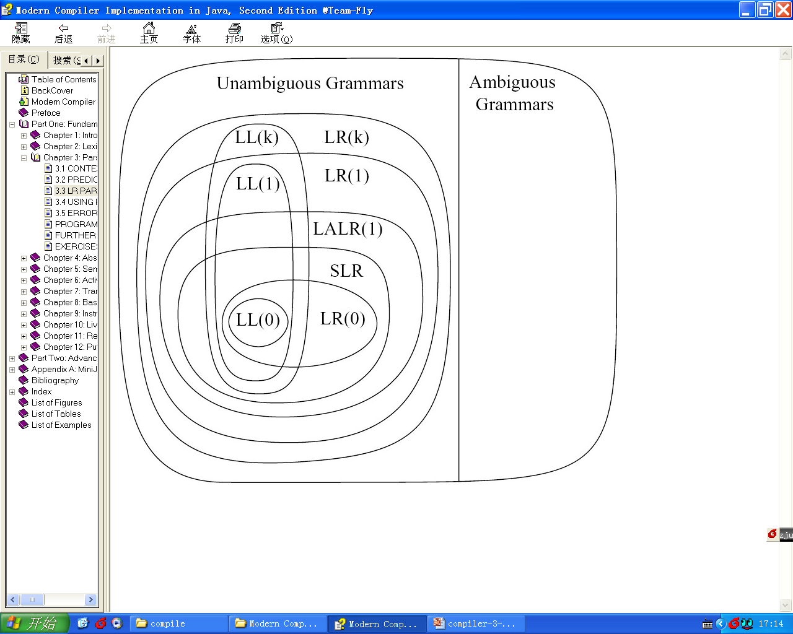
Hierarchy of Grammar Classes
the relationship between several classes of grammars.
Example:
All SLR grammars are LALR(1)
but not vice versa.

Slide 31
5.7 ERROR RECOVERY IN BOTTOM-UP PARSERS
A parser should detect an error ASAP
A bottom-up parser detects an error when met w/ a blank entry in the parsing table.
  AMAP blank entries in the parsing table
  E.g. spurious reductions of LALR(1)
  An LR(1) parser detects errors earlier than an LALR(1) or SLR(1) parser, which in turn detect errors earlier than an LR(0) parser.
Conflict with an equally important goal: reducing the size of the parsing table.

Slide 32
5.7 ERROR RECOVERY IN BOTTOM-UP PARSERS
A good error recovery in bottom-up parsers: removing symbol from either the parsing stack or the input or both.
There are three possible alternative actions:
  1. Pop from the parsing stack.
  2. Pop tokens from the input until a token is seen from which we can resume parsing.
  3. Push a new state onto the stack.

Slide 33
5.7 ERROR RECOVERY IN BOTTOM-UP PARSERS
1. Motivation: Error occurs during the recognition of a struct
// in case of error: as if processed normally
To where or which struct? A state w/ goto entry is the target of some reduction!
→ Pop states from the parsing stack until ~
After that, try to resume parsing. Also, that state may have many goto entries.
2. check the current input token, traverse those goto states:
If there is an entry on the token in one of the goto states ☺,
push that state onto the stack and resume parsing.
(choosing from available states: prefer shift over reduce; reduce to extraordinary nt;
3. If there is no legal entry on the current input token,
advance the input (throwing tokens).
ref E.g. 5.19

Slide 34
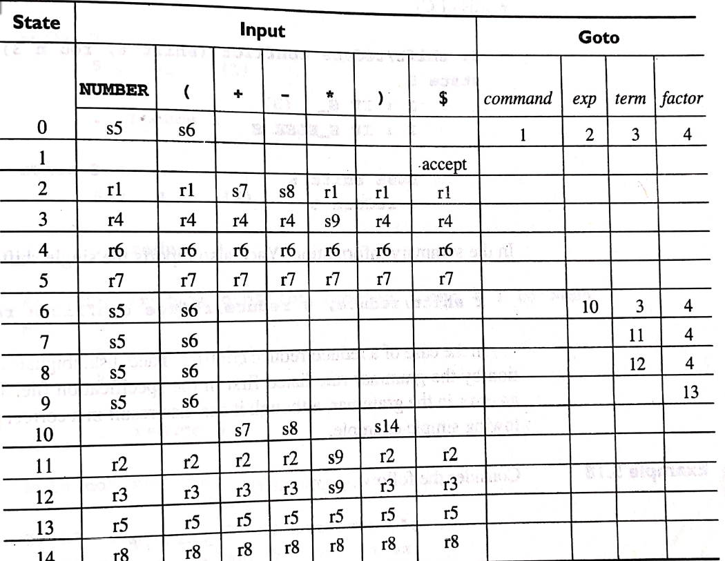
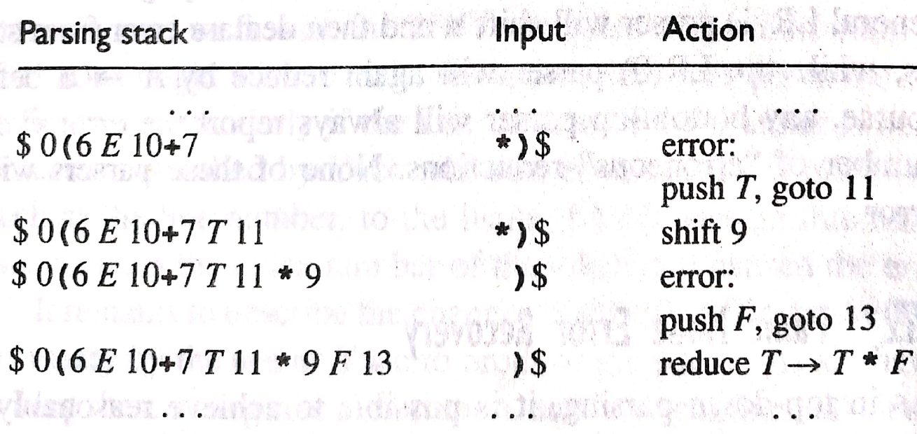
5.7 ERROR RECOVERY IN BOTTOM-UP PARSERS
for the input (2+*)

Slide 35
5.7 ERROR RECOVERY IN BOTTOM-UP PARSERS
possible solutions to prevent infinite loop
1、 insist on a shift action from a Goto state in step 2. (too restrictive)
2、 If the next legal move is a reduction, to set a flag that causes the parser to keep track of the sequence of states during the following reductions. If the same state recurs, to pop stack states until the original state is removed.

