Slide 1
Chapter 4
Top-Down Parsing

Slide 2
Outline
Top-down parsing
• LL(k) grammars
• Transforming a grammar into LL form
• Recursive-descent parsing

Slide 3
4.3 FIRST AND FOLLOW SETS
The LL(1) parsing algorithm is based on the LL(1) parsing table.
The LL(1) parsing table construction algorithm involves the First and Follow sets.

Slide 4
4.3.1 First Sets
gen
Definition:
Let X be a grammar symbol ( a terminal or non-terminal) or ε. Then First(X) is a set of terminals or ε, which is defined as follows:
  1. If X is a terminal or ε, then First(X) = {X};
  2. If X is a non-terminal, then for each production choice X→X₁ X₂ … X_{n}, First(X) contains First(X₁)-{ε}.
  if for some i<n, all the sets First(X₁)….First(X_{i}) contain ε ,then First(X) also contains First(X_{i+1})- {ε}.
  If all the set First(X₁)….First(X_{n}) contain ε, the First(X) contains ε.

Slide 5
4.3.1 First Sets
Let α be a string of terminals and non-terminals, X₁X₂…X_{n}. First(α) is defined as follows:
  1.First(α) contains First(X₁)-{ε};
  2.For each i=2,…,n, if for all k=1,..,i-1, First(X_{k}) contains ε, then First(α) contains First(X_{i})-{ε}.
  3. If all the set First(X₁)..First(X_{n}) contain ε, the First(α) contains ε.

Slide 6
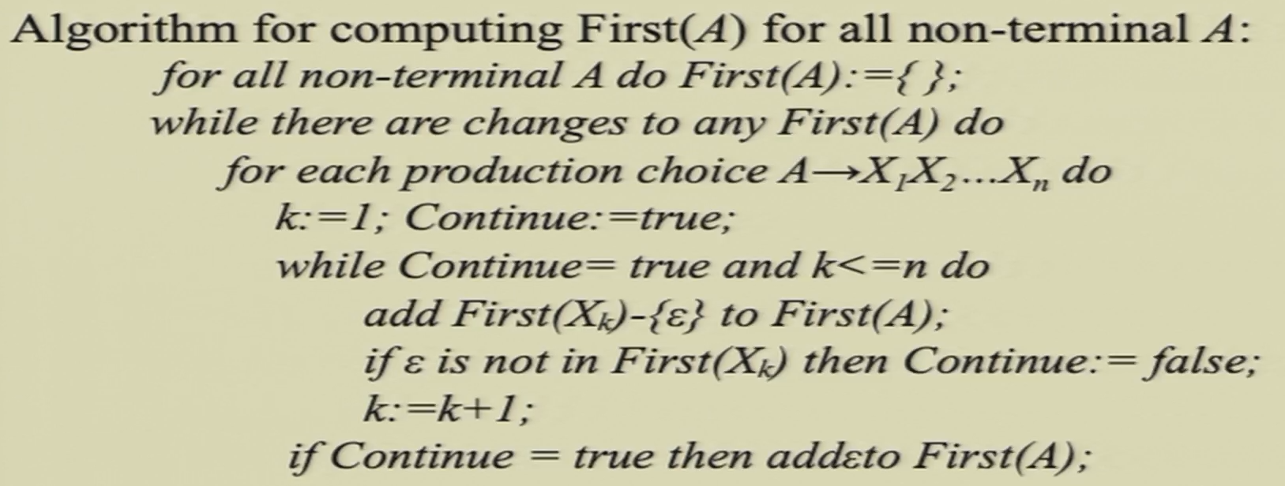
4.3.1 First Sets

Slide 7
4.3.1 First Sets
Simplified algorithm in the absence of ε-production.
For all non-terminal A do First(A):={ };
While there are changes to any First(A) do
For each production choice A→X₁X₂…X_{n} do
Add First(X₁) to First(A);

Slide 8
4.3.1 First Sets
Definition:
  A non-terminal A is nullable if there exists a derivation A=>*ε.
Theorem:
  A non-terminal A is nullable if and only if First(A) contains ε.

Slide 9
4.3.1 First Sets
Grammar for statement sequences:
stmt-sequence →stmt stmt-seq’
stmt-seq’ →; stmt-sequence|ε
stmt→s
list the production choices individually:
stmt-sequence →stmt stmt-seq’
stmt-seq’ →; stmt-sequence
stmt-seq’ →ε
stmt→s
The First sets are as follows:
First(stmt-sequence)={s}
First(stmt-seq’)={;, ε}
First(stmt)={s}

Slide 10
4.3.2 Follow Sets
follow: right next to
Definition:
Given a non-terminal A, the set Follow(A) is defined as follows.
  (1) if A is the start symbol, the $ is in the Follow(A).
  (2) if there is a production B→ α A γ, then First(γ)-{ε} is in Follow(A).
  (3) if there is a production B→α A γ, such that ε in First(γ), then Follow(A) contains Follow(B).
In the beginning: A$
Talks about what if A=>*ε , 哪些终结符可能跟在后边
imagine when the cur_nt is A: possibly derived from B=>*αA
when the cur_nt is B: context where B is derived

Slide 11
4.3.2 Follow Sets
Note:
  (1) The symbol $ is used to mark the end of the input.
  (2) Follow sets are defined only for non-terminal.
  (3) Elements of Follow(A) are terminals, NOT including empty “pseudo token” ε.
Starting context: $ 兜底

Slide 12
4.3.2 Follow Sets
context <-> possibility
Follow sets work “on the right” in production while First sets work “on the left” in the production.
Given a grammar rule A→αB, Follow(B) will contain Follow(A), the opposite of the situation for first sets, if A→Bα, First(A) contains First(B), except possibly for ε.

Slide 13
4.3.2 Follow Sets
Algorithm for the computation of follow sets:
  Follow(start-symbol):={$};
  For all non-terminals A≠start-symbol do follow(A):={ };
  While there’re changes to any follow sets do
  For each production A→X₁X₂…X_{n} do
  For each X_{i} that is a non-terminal do
  Add First(X_{i+1}X_{i+2}…X_{n}) – {ε} to Follow(X_{i})
  If ε is in First(X_{i+1}X_{i+2}…X_{n}) then
  Add Follow(A) to Follow(X_{i})
☹
Ex. follows

Slide 14
4.3.2 Follow Sets
nullable
  – only S’ is nullable
• FIRST
  – FIRST( ES’ ) = {num,(}
  – FIRST( +S ) = {+}
  – FIRST( num ) = {num}
  – FIRST( (S) ) = {(}, FIRST(S’) = {+, ε}
• FOLLOW
  – FOLLOW(S) = {),$}
  – FOLLOW(S’) = {),$}
  – FOLLOW(E) = {+,),$}
S → ES’
S’ → ε | +S
E → num | (S)

Slide 15
4.3.2 Follow Sets
(1) stmt-sequence →stmt stmt-seq’
(2) stmt-seq’ →; stmt-sequence
(3) stmt-seq’ →ε
(4) stmt→s
Example:
The First sets :
First(stmt-sequence)={s}
First(stmt)={s}
First(stmt-seq’)={;, ε}
the Follow sets:
Follow(stmt-sequence)={$}
Follow(stmt)={;,$} ( it’s wrong on the book)
Follow(stmt-seq’)={$}

Slide 16
4.3.2 Follow Sets
Example: the simple expression grammar.
(1) exp → exp addop term (2) exp → term
(3) addop → + (4) addop → -
(5) term → term mulop factor (6) term → factor
(7) mulop →* (8) factor →(exp )
(9) factor →number
The First sets:
First(exp)={(,number}
First(term)={(,number}
First(factor)={(,number}
First(addop)={+,-}
First(mulop)={*}
The Follow sets:
Follow (exp)={ $,+,-,) }
Follow (addop)={(,number}
Follow (term)={$,+,-,*,)}
Follow (mulop)={(,number}
Follow (factor)={$,+,-,*,)}

Slide 17
4.3.2 Follow Sets
Example:
The simplified grammar of if-statements:
(1) Statement → if-stmt
(2) Statement → other
(3) If-stmt → if (exp) statement else-part
(4) Else-part → else statement
(5) Else-part →ε
(6) Exp → 0
(7) Exp → 1
The First sets:
First(statement)={if,other}, First(if-stmt)={if}
First(else-part)={else,ε}, First(exp)={0,1}
the Follow sets:
Follow(statement)={$,else},
Follow(if-stmt)={$,else}
Follow(else-part)={$,else},Follow(exp)={)}

Slide 18
4.3.3 Constructing LL(1) Parsing Tables
Ref 4.2.2
Construct LL(1) parsing table w/ acquired First(α) and Follow(A) sets:
  for each production choice A→α:
1. For each token a in First(α), add A→α to the entry M[A,a].
2. If ε is in First(α), for each token a of Follow(A), add A→α to M[A,a].

Slide 19
4.3.3 Constructing LL(1) Parsing Tables
Theorem:
A grammar in BNF is LL(1) if the following conditions are satisfied.
  1. For every production A→α₁|α₂|…|α_{n}, First(α_{i})∩First(α_{j}) is empty for all i and j, 1≦i,j≦n, i≠j.
  2. For every non-terminal A such that First(A) contains ε, First(A)∩Follow(A) is empty.
1. For token a in the intersection, M[A,a] has 2 rules A→α_{i}|α_{j}
2. For token a in the intersection, M[A,a] has 2 rules A→ε | A→α s.t. α=>*aβ

Slide 20
4.3.3 Constructing LL(1) Parsing Tables
needed: algorithm for automatically generating a predictive parse table from a grammar
Ref. 4.2.1 我们推迟了做决定的时间
num + ( ) ∃
S → ES’
S’ → ε | +S
E → num | (S)
S
S’
E
ES’ ES’
+S ε ε
num (S)
Ex. follows

Slide 21
4.3.3 Constructing LL(1) Parsing Tables
Example: The simple expression grammar.
  exp →term exp’ exp’→addop term exp’|ε
  addop →+ | - term →factor term’
  term’→mulop factor term’|ε mulop→*
  factor→(exp) ∣number
First Sets
First(exp) = { (,number}
First(exp’) = { +,-,ε }
First(term)= {(,number}
First(term’) = { *, ε }
First(factor)= {(,number }
First(addop)={ + ,- }
First(mulop)={ * }
Follow Sets
Follow(exp) = {$, )}
Follow (exp’) = {$, )}
Follow (term)= {$,+,-,)}
Follow (term’) = {$,+,-,)}
Follow (factor)= {$,+,-,*,)}
Follow (addop)={ (,number }
Follow (mulop)={(,number }

Slide 22
4.3.3 Constructing LL(1) Parsing Tables
M[N,T] | ( | number | ) | + | - | * | $
exp | exp→ term exp’ | exp→ term exp’
exp’ |  |  | exp’ → ε | exp’ → addop term exp’ | exp’ → addop term exp’ |  | exp’→ ε
addop |  |  |  | addop→+ | addop→ -
term | term→ factor term’ | term→ factor term’
term’ |  |  | term’→ ε | term’ → ε | term’ → ε | term’ → mulop factor term’ | term’ → ε
mulop |  |  |  |  |  | mulop→*
factor | factor→(exp) | factor→ number

Slide 23
4.3.3 Constructing LL(1) Parsing Tables
Example: The simplified grammar of if-statements
Statement → if-stmt | other If-stmt → if (exp) statement else-part
Else-part → else statement | ε Exp → 0 | 1
The First sets:
First (statement)={if,other},
First (if-stmt)={if}
First (else-part)={else,ε},
First (exp)={0,1}
the Follow sets:
Follow(statement)={$,else},
Follow(if-stmt)={$,else}
Follow(else-part)={$,else},
Follow(exp)={)}
M[N,T] | if | other | else | 0 | 1 | $
statement | statement → if-stmt | statement → other
if-stmt | if-stmt → if (exp) statement else-part
else-part |  |  | else-part → else statement else-part →ε |  |  | else-part →ε
exp |  |  |  | exp→0 | exp→1

Slide 24
4.3.3 Constructing LL(1) Parsing Tables
Example: Consider the following grammar with left factoring applied.
(1) stmt-sequence →stmt stmt-seq’
(2) stmt-seq’ →; stmt-sequence|ε (3) stmt→s
The First sets :
First(stmt-sequence)={s}
First(stmt)={s}
First(stmt-seq’)={;, ε}
the Follow sets:
Follow(stmt-sequence)={$}
Follow(stmt)={;}
Follow(stmt-seq’)={$}
M[N,T] | s | ; | $
stmt-sequence | stmt-sequence→ stmt stmt-seq’
stmt | stmt→s
stmt-seq’ |  | stmt-seq’→ stmt-sequence | stmt-seq’→ε

Slide 25
4.5 Error Recovery in Top-Down Parsers
different levels of response to errors.
  (1)Give a meaningful error message;
  determine as closely as possible the location where that error has occurred.
  (2)Some form of error correction; (error repair)
  the parser attempts to infer a correct program from the incorrect one given.
Most of the techniques for error recovery are ad hoc, and general principles are hard to come by.
最小距离校正的难点：e.g. 左括号少敲多敲

Slide 26
4.5 Error Recovery in Top-Down Parsers
Some important considerations that apply are the following:
  (1) To determine that an error has occurred ASAP.
  (2) After an error has occurred
  pick a likely place to resume the parse
  try to parse as much of the code as possible
  (3) To avoid the error cascade problem.
  (4) To avoid infinite loops on error.

Slide 27
4.5 Error Recovery in Top-Down Parsers
Some goals conflict with each other
Trade-offs
Panic mode:
  A standard form of error recovery in recursive-decent parsers
  The error handler will consume a possibly large number of tokens in an attempt to find a place to resume parsing;
e.g. while 循环内出错，panic 跳过整个循环

Slide 28
4.5 Error Recovery in Top-Down Parsers
The basic mechanism of panic mode:
  A set of synchronizing tokens are provided to each recursive procedure;
  If an error is encountered, the parser scans ahead, throwing away tokens until one of the synchronized tokens is seen in the input, whence parsing is resumed.

Slide 29
4.5 Error Recovery in Top-Down Parsers
The important decisions to be made in this error recovery method:
  (1) What tokens to add to the synchronizing set at each point in the parse.
  Follow sets are important candidates
  (2) First sets:
  prevent the error handler from skipping important tokens that begin major new constructs
  detect errors early in the parse.

Slide 30
4.5 Error Recovery in Top-Down Parsers
Check-input procedure: performs the early look-ahead checking
Procedure Checkinput(Firstset, Followset)
Begin
If not (token in firstset) then
Error;
Scanto(firstset∪followset)
End if;
end
Scanto procedure:
Procedure scanto(synchset)
Begin
While not (token in synchset∪{$}) do
Gettoken;
End scanto
Error handler: 跳过 tokens
Firstset: 稍微少跳过些 e.g. if %^@! while () { … }
After token: token in firstset∪followset

Slide 31
4.5 Error Recovery in Top-Down Parsers
( for recursive descent
Procedure exp(synchset)
  Begin
  Checkinput({(,number},synchset}
  If not (token in synchset) then
  Term(synchset);
  While token=+ or token=- do
  Match(token);
  Term(synchset);
  End while
  Checkinput(synchset,{(,number});
  End if;
  End exp;
// Normal processing
expect token a in synchset following
otherwise
// in case of error: as if processed normally

Slide 32
4.5 Error Recovery in Top-Down Parsers
Procedure factor(synchset);
Begin
Checkinput({(,number},synchset};
If not (token in synchset) then
Case token of
( : match( ( );
exp( { ) });
match());
number:
match(number);
else error;
end case;
checkinput(synchset,{ (,number});
end if;
end factor;
// Normal processing

Slide 33
4.5 Error Recovery in Top-Down Parsers
Note: checkinput is called twice in each procedure
  (1) once to verify that a token in the First set in the next token in the input;
  (2) a second time to verify that a token in the Follow set is the next token on exit.
This form of panic mode will generate reasonable errors.
For example, (2+-3)*4-+5 will generate exactly two error messages,
(1) one at the first minus sign, and
(2) one at the second plus sign.

Slide 34
4.5 Error Recovery in Top-Down Parsers
Note:
  in general, synchset is to be passed down in the recursive calls, with new synchronizing tokens added as appropriate.
  As a exception, in the case of factor, exp is called with right parenthesis only as its follow set (synchset is discarded)
  The kind of ad hoc analysis accompanies panic mode error recovery.

Slide 35
4.5.2 Error Recovery in LL(1) Parsers
Panic mode error recovery - adaptation
  Iterative alg. => A new stack is required to keep the synchset parameters;
  A call to checkinput must be scheduled by the algorithm before each generate action of the algorithm;
The primary error situation
Due to the look-ahead before generation.
M[A, a] 的规则无法推导（考虑 First 和可能的 Follow ）以 match a
pop: assumed ε-production
But table compression might cause some trouble.

Slide 36
4.5.2 Error Recovery in LL(1) Parsers
An alternative to the use of an extra stack mentioned above is:
Build synchset directly into the LL(1) parsing table, together with the corresponding actions that checkinput would take.

Slide 37
4.5.2 Error Recovery in LL(1) Parsers
Given that error situation, the parser has three possible options:
  Pop A from the stack.
  Successively pop tokens from the input until a token on which it can resume parsing is seen.
  Push a new non-terminal onto the stack

Slide 38
4.5.2 Error Recovery in LL(1) Parsers
alternative 1 (Pop)
if the current input token is $ or is in Follow(A);
alternative 2 (scan)
if the current input token is not $ and is not in First(A)∪Follow(A)

Slide 39
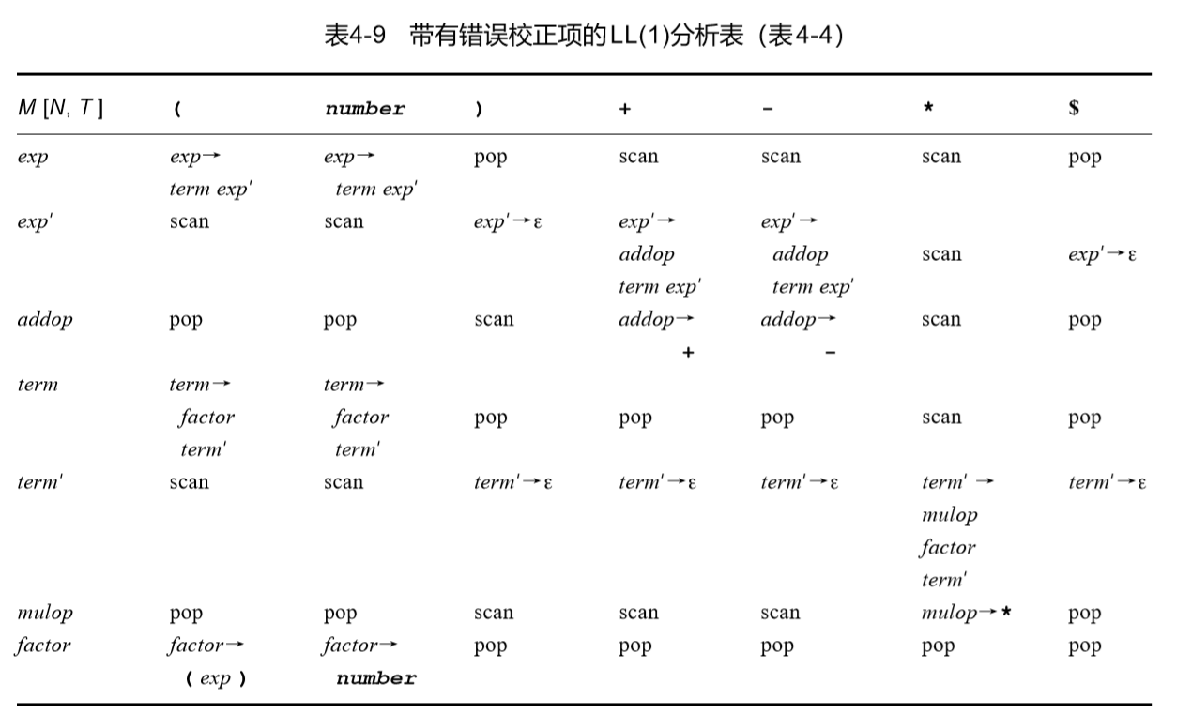
Impl: what to do w/ empty table entries M[N, T]

Slide 40
4.5.2 Error Recovery in LL(1) Parsers
(2+*)
Parsing stack | Input | Action
$E’T’)E’T | *)$ | scan(error)
$ E’T’)E’T | )$ | pop(error)
$ E’T’)E’ | )$ | E’ → ε
$ E’T’) | )$ | match
$ E’T’ | $ | T’ → ε
$ E’ | $ | E’ → ε
$ | $ | accept

