Slide 1

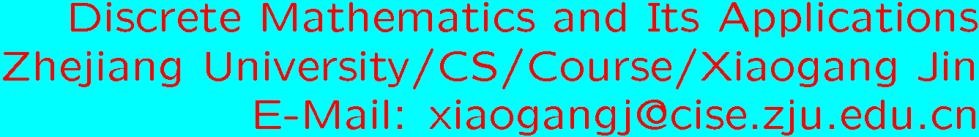
Review : Theory of Computation

Slide 2

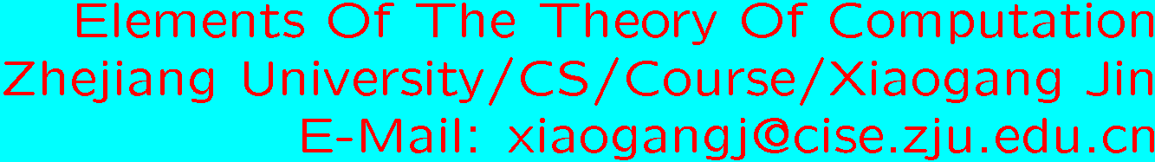


Contents
Regular Language and Finite Automata
Context-free Language and Pushdown Automata
Turing Machine and Recursive Enumerable Language
Undecidablity
and Problems
− Complete Problems

Slide 3
Regular Language and Finite Automata
Regular Expression
Deterministic finite automata (DFA)
Non-deterministic finite automata (NFA)
Closure properties and Pumping Theorem
State Minimization (graduated course)

Slide 4

Questions:
Give a DFA or NFA Regular Expression (Example 2.3.2 P 81)
Give a Regular Expression DFA or NFA (Theorem 2.3.1 P 75)
Show a given language be regular or non-regular?
Yes, regular expression, DFA, NFA and closure property No, pumping theorem or closure property

Slide 5
Context-free Language and Pushdown Automata
Context-free Grammar
Pushdown automata
Closure properties and Pumping Theorem

Slide 6
Questions:
Give a context-free language Context-free Grammar
Give a context-free language PDA
Give a context-free grammar PDA (Lemma 3.4.1, Example 3.4.1 P 136)
Show a given language be context-free or non-context free?

Slide 7
Turing Machine and Recursive Enumerable Language
Turing Machine
Grammar
Numerical Functions
Basic Functions, composition, function defined recursively; primitiverecursive functions,primitive recursive predicate; minimalizable, μ-recursive

Slide 8
Questions:
Design a Turing Machine to compute a function or decide (semidecide ) a language
Given a TM function
Show a function be a primitive recursive function

Slide 9





Undecidablity
Church-Turing Thesis
Chomsky hierarchy
Universal Turing Machine
Halting Problem
Some Undecidable problems
Reduction
Let be languages. A reduction from to
is a recursive function such that

Slide 10
Turing-enumerable and lexicographically Turing enumerable
Chomsky hierarchy
Questions:
Show a given language be recursive enumerable
Show a given language be not recursive

Slide 11


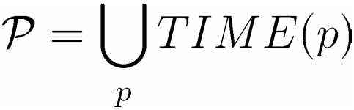
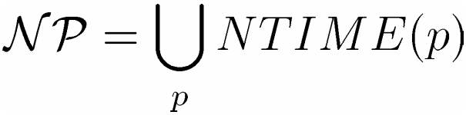
and Problems
Problems
, where p is a polynomial
Problems
, where p is a polynomial
Question:
Show a given language be Problem or Problem

Slide 12












- Completeness

Slide 13


Slide 14





Definition: is complete iff
1.
2. is hard --- that is, every language in is
reducible to in polynomial time.
Facts: If is -complete:
is -complete.
Question:
Show a given language be –complete by reduction

