Slide 1
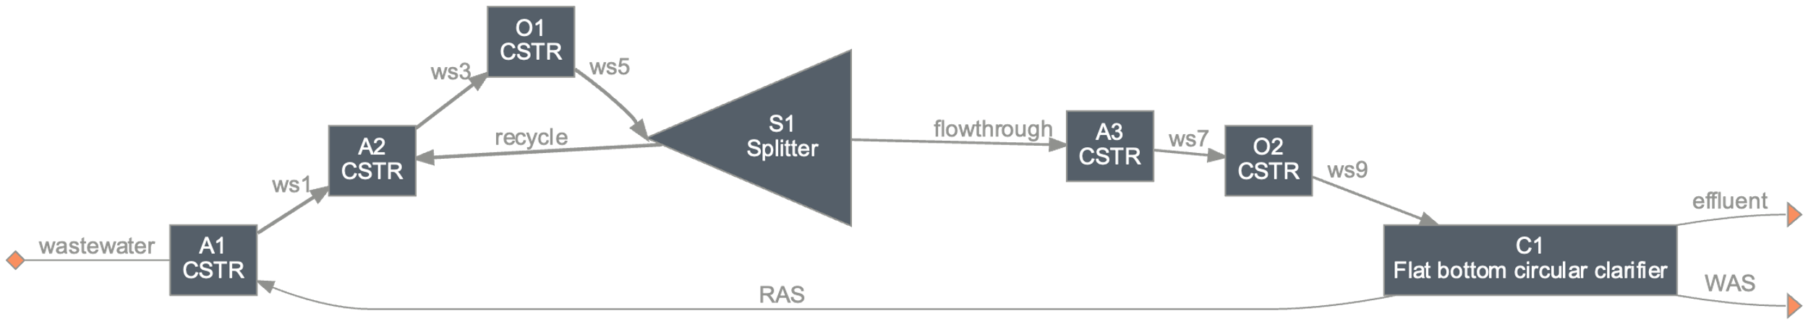
WRRF in Beijing
Plant A
Columbia’s WRRF configuration
QSDsan’s WRRF configuration
(process flows and sizing based on
Metcalf & Eddy)

Slide 2
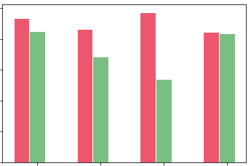
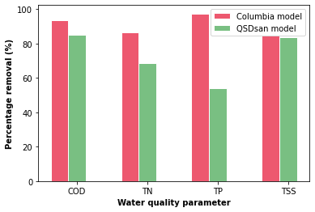
Comparative analysis of Beijing WRRF models
100
80
60
Percentage removal (%)
40
20
0
COD
TN
TP
TSS
Water quality parameter

Slide 3
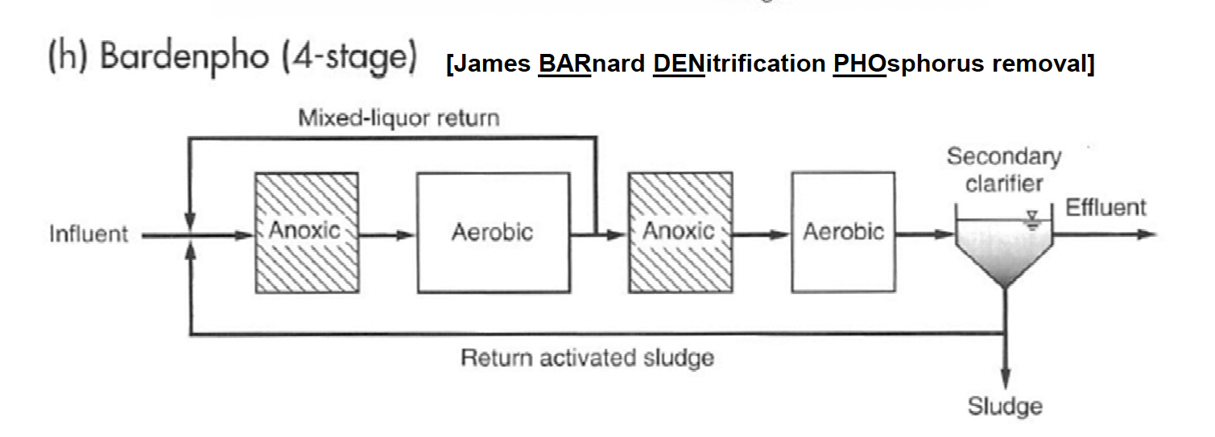
From Metcalf and Eddy

Slide 4
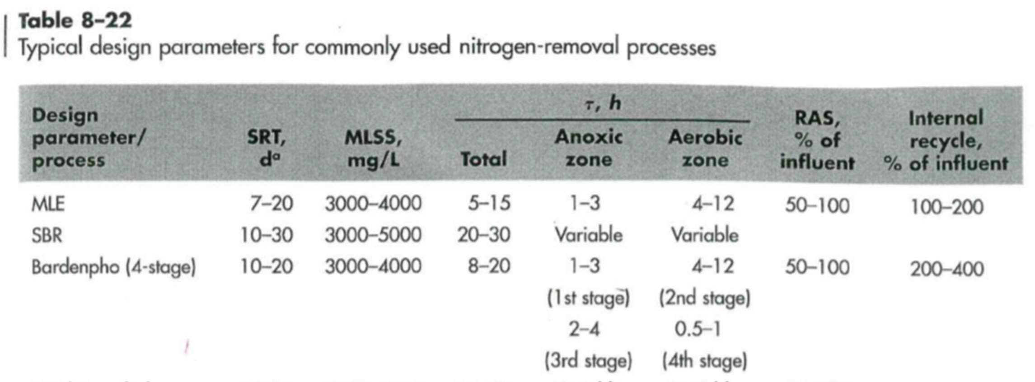
From Metcalf and Eddy

