Slide 1

RTK Bootcode

Slide 2
Agenda
Build Boot loader
On-Chip Recovery mode
Upgrade Boot loader
Rescue System
Dual Firmware Boot
Customize kernel boot arguments
Customize reserved memory for transcoding

Slide 3
Build Boot loader RTD1619 SPI
U-Boot
Path: SDKRelease/Bootcode/U-Boot64
Build script: build.sh
Usage:
./build.sh RTD129x_spi
Output:
Bootcode/U-Boot64/DVRBOOT_OUT/RTD129x_spi
(1) Bootloader with burning program
$(CHIP_VER) RTD1295_hwsetting_$(DDR)-nas-RTD1295_spi.bin
(2) HWsetting
hw_setting/$(CHIP_VER) RTD1295_hwsetting_BOOT$(DDR).bin

Slide 4
Build Boot loader RTD1619 eMMc
U-Boot
Path: SDKRelease/Bootcode/U-Boot64
Build script: build.sh
Usage:
./build.sh RTD129x_emmc
Output:
Bootcode/U-Boot64/DVRBOOT_OUT/RTD129x_emmc
(1) Bootloader with burning program
$(CHIP_VER) _hwsetting_$(DDR)-nas-$(CHIP)_spi.bin
(2) HWsetting
hw_setting/$(CHIP_VER) _hwsetting_BOOT$(DDR).bin

Slide 5
Build Boot loader – RTD1619 SPI
U-Boot
Path: SDKRelease/Bootcode/U-Boot64
Build script: build.sh
Usage: ./build.sh RTD16xx_emmc
Output:
SDKRelease/Bootcode/U-Boot64/DVRBOOT_OUT/RTD16xx_emmc/
(1) Bootloader with burning program
A01-RTD161x_hwsetting_BOOT_2DDR4_8Gb_s2666-nas-RTD16xx_emmc.bin
(2) Bootloader
1. A01-Recovery-uda-RTD161x_hwsetting_BOOT_2DDR4_8Gb_s2666-nas-RTD16xx_emmc.bin
2. A01-Recovery-boot-RTD161x_hwsetting_BOOT_2DDR4_8Gb_s2666-nas-RTD16xx_emmc.bin
(3) HWsetting
hw_setting/0001-RTD161x_hwsetting_BOOT_2DDR4_8Gb_s2666-nas-RTD16xx_emmc.bin

Slide 6
Build Boot loader – RTD1619 eMMC
U-Boot
Path: SDKRelease/Bootcode/U-Boot64
Build script: build.sh
Usage: ./build.sh RTD16xx_emmc
Output:
SDKRelease/Bootcode/U-Boot64/DVRBOOT_OUT/RTD16xx_emmc/
(1) Bootloader with burning program
A01-RTD161x_hwsetting_BOOT_2DDR4_8Gb_s2666-nas-RTD16xx_emmc.bin
(2) Bootloader
1. A01-Recovery-uda-RTD161x_hwsetting_BOOT_2DDR4_8Gb_s2666-nas-RTD16xx_emmc.bin
2. A01-Recovery-boot-RTD161x_hwsetting_BOOT_2DDR4_8Gb_s2666-nas-RTD16xx_emmc.bin
(3) HWsetting
hw_setting/0001-RTD161x_hwsetting_BOOT_2DDR4_8Gb_s2666-nas-RTD16xx_emmc.bin

Slide 7
Ctrl+q
BOOT UP
On-Chip Recovery Mode
ESC
Boot loader
Upgrade Boot loader
USB/TFTP
Rescue system
TAB
Built-in Rescue system
Boot into System

Slide 8
On-Chip Recovery mode – RTD 129x SPI
This mode is used for bootloader recovery when the bootloader inside is corrupted
Hyperterm is recommended to use
Press ctrl+q when booting up until following console appear
d/g/r>
Press h and then transfer Hwsetting(3) by y-modem
hw_setting/$(CHIP)_hwsetting_BOOT_$(DDR).bin
Press s, then enter
98007058
01500000
Press d and then transfer bootloader(2) by y-modem
$(CHIP_VER)_hwsetting_BOOT_$(DDR)-nas-$(CHIP)_spi.bin
Press g to start recovery process

Slide 9
On-Chip Recovery mode – RTD129x eMMC
This mode is used for bootloader recovery when the bootloader inside is corrupted
Hyperterm is recommended to use
Press ctrl+q when booting up until following console appear
d/g/r>
Press h and then transfer Hwsetting(3) by y-modem
hw_setting/$(CHIP)_hwsetting_BOOT_$(DDR).bin
Press s, then enter
98007058
01500000
Press d and then transfer bootloader(2) by y-modem
$(CHIP_VER)_hwsetting_BOOT_$(DDR)-nas-$(CHIP)_emmc.bin
Press g to start recovery process

Slide 10
On-Chip Recovery mode – RTD 16xx SPI
This mode is used for bootloader recovery when the bootloader inside is corrupted
Hyperterm is recommended to use
Press ctrl+q when booting up until following console appear
d/g/r>
Press h and then transfer Hwsetting(3) by y-modem
hw_setting/0001-RTD161x_hwsetting_BOOT_2DDR4_8Gb_s2666-nas-spi.bin
Press d and then transfer bootloader(2) by y-modem
A01-Recovery-RTD161x_hwsetting_BOOT_2DDR4_8Gb_s2666-nas-spi.bin
Press g to start recovery process

Slide 11
On-Chip Recovery mode – RTD16xx eMMC
This mode is used for bootloader recovery when the bootloader inside is corrupted
Hyperterm is recommended to use
Press ctrl+q when booting up until following console appear
d/g/r>
Press h and then transfer Hwsetting(3) by y-modem
hw_setting/0001-RTD161x_hwsetting_BOOT_2DDR4_8Gb_s2666-nas-RTD16xx_emmc.bin
Press d and then transfer bootloader(2) -1 by y-modem
A01-Recovery-uda-RTD161x_hwsetting_BOOT_2DDR4_8Gb_s2666-nas-RTD16xx_emmc.bin
Press g to start recovery process
Press d and then transfer bootloader(2) -2 by y-modem
A01-Recovery-boot-RTD161x_hwsetting_BOOT_2DDR4_8Gb_s2666-nas-RTD16xx_emmc.bin
Press b1 to start recovery process
Press b2 to start recovery process

Slide 12
Upgrade Boot loader
This is for boot loader upgrade when current boot loader is workable
Press ESC when booting up to enter U-Boot console
Realtek>
Transfer bootloader with burning program(1) to DRAM
By USB
usb start
fatload usb 0:1 0x1500000 A01-RTD161x_hwsetting_BOOT_2DDR4_8Gb_s2666-nas-RTD16xx_spi.bin or RTD161x_hwsetting_BOOT_2DDR4_8Gb_s2666-nas-RTD16xx_emmc.bin
go 0x1500000
By tftp
tftp 0x1500000 A01-RTD161x_hwsetting_BOOT_2DDR4_8Gb_s2666-nas-RTD16xx_spi.bin or RTD161x_hwsetting_BOOT_2DDR4_8Gb_s2666-nas-RTD16xx_emmc.bin
go 0x1500000

Slide 13
Rescue system
This is used to install install.img onto RTD129x/RTD1619
There are 2 ways to boot into rescue system
1. use built-in rescue system
2. use rescue system from USB or TFTP
1. For build-in rescue system, just press TAB when booting up, then the built-in rescue system is used
Once booting into rescue system, put install.img in USB top directory and plug into RTD129x/RTD1619, the install process will start automatically

Slide 14
Rescue system
2. For rescue system from USB or TFTP, we should copy following 3 files to USB or TFTP directory
path: SDKRelease/OpenWRT-LEDE/target/linux/realtek/image/rtk-imagefile/workspace/rescue/
1. spi.uImage
2. rescue.spi.dtb
3. rescue.root.spi.cpio.gz_pad.img
USB: press ESC into U-Boot console mode with USB attached and then press ‘gor’
TFTP: press ESC and then input following command
tftp $kernel_loadaddr spi.uImage;tftp $fdt_loadaddr rescue.spi.dtb;tftp $rootfs_loadaddr rescue.root.spi.cpio.gz_pad.img;go k
put install.img in USB top directory and plug into RTD129x/RTD1619, the install process will start automatically

Slide 15
TFTP configuration
TFTP is configurable in boot loader console mode
Press ESC into console mode and then edit tftp related environment variables
Realtek> env set ipaddr 192.168.0.9
Realtek> env set serverip 192.168.0.56
Realtek> env set gatewayip 192.168.0.254
Realtek> env set netmask 255.255.255.0
Realtek> env save
ping command can be used to test network
Realtek> ping 192.168.0.56

Slide 16
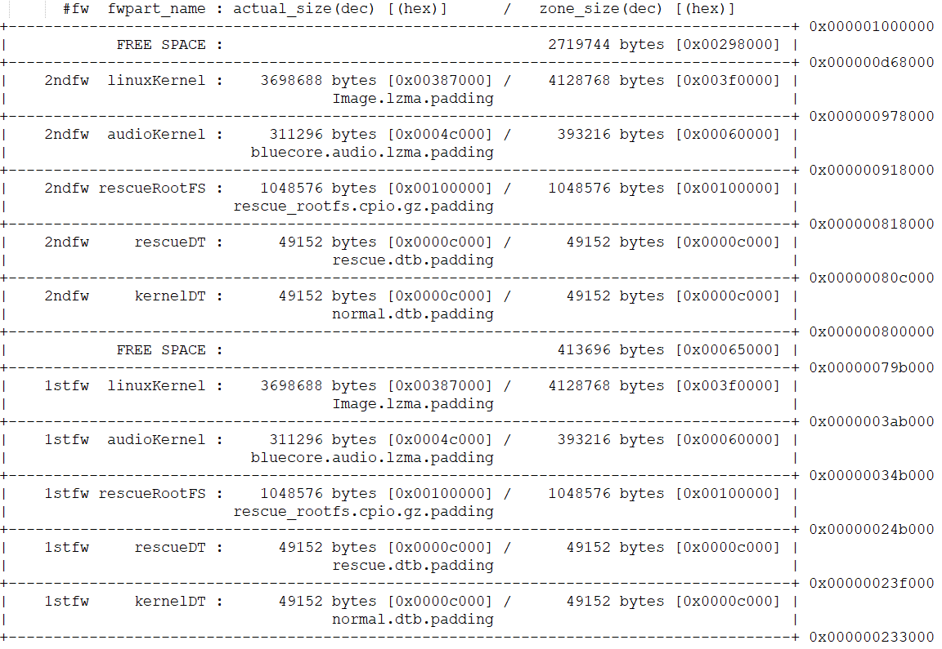
Dual Firmware Boot

Slide 17
Dual Firmware Boot
There are 2 copies of firmware table and images (kernel, dtb, rescue rootfs…etc) installed in RTD129x/RTD1619
Each firmware table has a sequence number (0-255)
Boot loader will choose the latest (bigger) firmware table to bootup
Once the latest firmware table or its content is corrupted, another firmware table will be chosen to bootup

Slide 18
Customize kernel boot arguments
Path: arch/arm/lib/bootm.c
Function: set_custom_boot_args()
This function provides room to append programmable boot arguments.
For example, the path of boot device might be "/dev/mmcblk0p0" or "/dev/mmcblk0p1", depending on circumstances. This can be done by adding conditional statement in this function to control boot arguments.
The parameter "custom_boot_args" of this function is combined with kernelargs, and finally become part of kernel boot arguments.

Slide 19
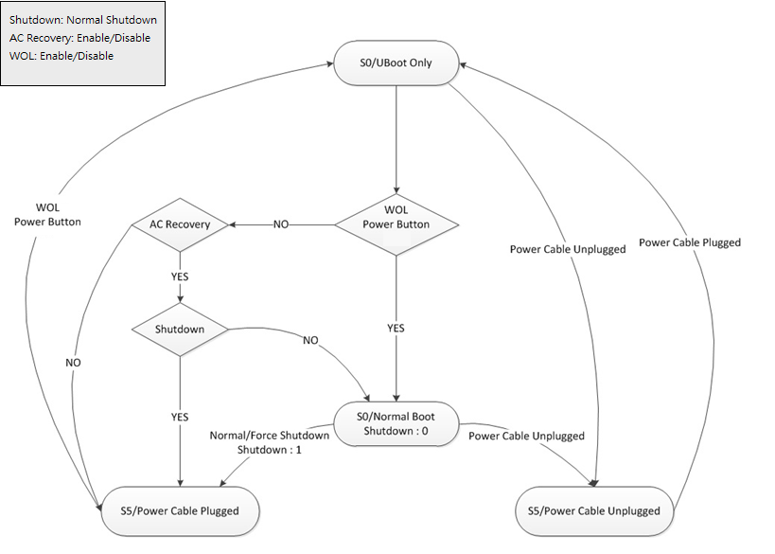
Customize Bootflow: AC-Recovery

Slide 20
Customize Bootflow: AC-Recovery
Add Config
./Bootcode/U-Boot64/configs/rtd161x_qa_nas_rtk_defconfig
CONFIG_CUSTOMIZE_FEATURES=y
CONFIG_CUSTOMIZE_BOOTFLOW_1=y
CONFIG_CUSTOMIZE_BOOTFLOW_1_PHASE_1=y
./Bootcode/U-Boot64/common/customized_bootflow_rtd161x.c
#define PWR_KEY_IGPIO 2 (check you board before set)
#define ACRECOVERY_PATH FACTORY_HEADER_FILE_NAME"ACRECOVERY"
#define POWER_STAT_PATH FACTORY_HEADER_FILE_NAME"SHUTDOWN"
#define WAKE_ON_LAN_PATH FACTORY_HEADER_FILE_NAME"WAKEONLAN”
./rtd-1619-mmnas-megingjord-2GB.dts
rtk_iso_gpio: rtk_iso_gpio@98007100 {
wakeup-gpio-list = <&rtk_iso_gpio 2 0 1>; /*rtk_gpio gpio# direction value*/
/*direction: 0=input, 1=output; when direction=0=input, set value is useless */
wakeup-gpio-enable = <1>; /*0=disable, 1=enable*/
wakeup-gpio-activity = <0>;/*0=active low, 1=active high*/

Slide 21
Customize Bootflow: AC-Recovery
Flag name: ACRECOVERY, SHUTDOWN, WAKEONLAN
User can set AC-recovery, Shutdown & WOL enable/disable by factory tool in user space.
Enable: factory flag flag-name
Disable: factory unflag flag-name
As flowchart, shutdown flag will be set to 0(disable) in every normal boot.
When WOL is enable, be noted that WOL flag of gMAC also needs to set enable before shutdown.
echo 1 > /proc/net/eth0/r8169/wol_enable

Slide 22
Customize reserved memory for transcoding
The following u-boot environment variables can be used to configure the reserved memory size for transcoding.
ion_media_heap0_size
ion_media_heap1_size
Usage
Set a positive integer for the size of ion media heap 0 or 1 (unit: MB)
If the value exceeds the max. allowable memory size, it will prompt error message and reset the heap size to default value when booting into kernel.
Realtek> env set ion_media_heap0_size 199 Realtek> env set ion_media_heap1_size 414
Set the size of ion media heap 0 & 1 to zero
Disable transcode
Free the reserved memory for transcoding
The board has to restart for this change to take effect.
Realtek> env set ion_media_heap0_size 0 Realtek> env set ion_media_heap1_size 0

Slide 23
Customize reserved memory for transcoding
Usage
If the board is configured as pure NAS function (that is, there is no reserved memory for transcoding), attempting to set ion_media_heap0_size or ion_media_heap1_size will prompt error message and abort.
Realtek> env set ion_media_heap0_size 10 Error: env ion_media_heap0_size is reserved for adjusting the memory size of ion media heap memreserve for ion media heap is not found.
To enable the transcode function again, delete the environment variable ion_media_heap0_size & ion_media_heap1_size.

Slide 24
Customize reserved memory for transcoding
0xFFFFFFFF
0x2FD00000
ION Media Heap 1
0x16200000
0x0FE00000
Audio Firmware
0x0F900000
ION Media Heap 0
0x03200000
0x00100000
Bootcode
0
Memory Layout

