Slide 1
Realtek NAS SDK
Image-Builder

Slide 2
Image-Builder
Build Realtek SoC Image file
Prepare Files for Rescue System
Customization
Specify Firmware Layout in Storage
Edit feed.conf to descript storage layout
Support Customer’s Root Filesystem
Edit feed.conf to descript content of root partition
Easy to Set
Kernel Boot Argument
MAC Address
IP information for Bootcode
Edit file, bootargs.conf.{spi,emmc,nand}

Slide 3
install.img
Realtek SoC Image file which contains
Bluecore.audio
Kernel Image
DTB for Normal Boot up
DTB for Rescue Boot up
Root Filesystem for Rescue System
Root Filesystem for Normal Boot up (if eMMc or NAND)
Layout description file, config.txt
Storage Writer, installer

Slide 4
Directories
build_image.sh
Build Script
arm_bin/
arm binary files for running in rescue system
x86_bin/
X86 binary files for creating install.img

Slide 5
Directories
rescue-rootfs/
Rescue Root File System.
Use initramfs.sh to compress/decompress rescue root filesystem image.
Size limit is 1 MB (1048576 bytes)
If exceeding the limit, change CONFIG_ROOTFS_RESCUE_SIZE in Bootcode's U-Boot64/include/configs/rtd161x_qa_{board}.h as in device tree
For example, define CONFIG_ROOTFS_RESCUE_SIZE as 0x200000 in rtd161x_qa_spi_64.h when device tree has initrd-start=<0x02200000> and initrd-end=<0x02400000> where initrd start and end are defined in kernel source's include/soc/realtek/memory.h as ROOTFS_RESCUE_START and ROOTFS_RESCUE_END respectively
feed/
Gather Firmware Files
Edit feed.conf to descript storage layout
Three example files, feeds.conf.emmc, feeds.conf.spi, feeds.conf.nand

Slide 6
feed.conf Content
storage
Define storage type
storage_size
Define size of storage in unit of bytes
storage_align
Define the alignment of storage block in unit of bytes
storage_eraseblock_size (NAND only)
Define the size of erase block in unit of bytes
storage_start_address
The start address of available are for storing firmware. DO NOT CHANGE!
lzma
Use LZMA to compress bluecore.audio and kernel. Recommend for SPI

Slide 7
feed.conf Content
bootargs
Insert U-Boot variables
Configuration File
bootargs.conf.emmc, bootargs.conf.spi, bootargs.conf.nand
Content of bootargs.conf.{emmc,spi,nand}
ethaddr=00:10:20:30:40:50
gatewayip=192.168.100.254
ipaddr=192.168.100.1
netmask=255.255.255.0
SPI Kernel Arguments
kernelargs=mtdparts=RtkSFC:1024k(U-Boot)ro,64k(FWtbl)ro,128k(Factory),10944k(FW)ro,4096k(Free),128k(oops) init=/etc/init root=/dev/sda1 rootfstype=ext4 rootwait loglevel=8
eMMc Kernel Arguments
kernelargs=init=/etc/init root=/dev/mmcblk0p1 rootfstype=squashfs rootwait loglevel=8
NAND Kernel Arguments
kernelargs=init=/etc/init overlay=/dev/ubi1_0 overlayfs=ubifs rootwait loglevel=8
For NAND, build_image.sh script will generate necessary arguments (i.e., mtdparts=, ubi.mtd=, root=, and rootfstype=) according to feeds.conf, and append them to kernelargs

Slide 8
feed.conf Content/bootargs
Content of bootargs.conf.{emmc,spi,nand}
ethaddr
Device MAC address
gatewayip ➔Bootcode ifconfig
ipaddr ➔Bootcode ifconfig
netmask ➔Bootcode ifconfig
Kernelargs
Part of kernel boot arguments
Kernel boot arguments is combined with kernelargs and bootargs in DTB files
Bootargs = bootargs in dtb + kernelargs
Kernelargs could be edited in bootcode and easy to change
Init=/et/init or /lib/systemd
root=/mmcblk0px
rootfstype=squashfs or ext4
loglevel

Slide 9
feed.conf Content
update_1stfw, update_2ndfw
Image-Builder Supports Dual Firmware Updating.
Set to ‘y’ to update the set of firmwares.
Set to ‘n’ to ignore the set of firmwares while burning the storage.
seqnum_1stfw, seqnum_2ndfw
Firmware version
Bootcode compares sequnum to decide the latest firmware set. Bigger number is the latest firmware.

Slide 10
feed.conf Content
kerneldtb_file
Filename of DTB for normal booting
kerneldtb_zone
The size of a storage area for storing the kerneldtb_file
kerneldtb_1stfw_addr, kerneldtb_2ndfw_addr
The start add of first/second kerneldtb_zone
ALL values MUST aligned by storage_align, in unit of bytes.

Slide 11
feed.conf Content
rescuedtb_file
Filename of DTB for rescue system booting
rescuedtb_zone
The size of a storage area for storing the rescuedtb_file
rescuedtb_1stfw_addr, rescuedtb_2ndfw_addr
The start add of first/second rescuedtb_zone
ALL values MUST aligned by storage_align, in unit of bytes.

Slide 12
feed.conf Content
rescuefs_file
Filename of initramfs image for rescue system booting
The example file is rescue-rootfs/rescue_rootfs.cpio.gz
rescuefs_zone
The size of a storage area for storing the rescuedtb_file
rescuefs_1stfw_addr, rescuefs_2ndfw_addr
The start add of first/second rescuefs_zone
ALL values MUST aligned by storage_align, in unit of bytes.

Slide 13
feed.conf Content
bluecore_file
Filename of bluecore.audio
The example file is Packages/fw/bluecore.audio/bluecore.audio.zip
Unzip it first
bluecore_zone
The size of a storage area for storing the bluecore_file
bluecore_1stfw_addr , bluecore_2ndfw_addr
The start add of first/second bluecore_zone
ALL values MUST aligned by storage_align, in unit of bytes.

Slide 14
feed.conf Content
kernel_file
Filename of kernel image
The file is kernel/arch/arm64/boot/Image
kernel_zone
The size of a storage area for storing the kernel_file
kernel_1stfw_addr , kernel_2ndfw_addr
The start add of first/second kernel_zone
ALL values MUST aligned by storage_align, in unit of bytes.

Slide 15
feed.conf Content
bootlogo_file
Filename of boot logo image
For videoplayback configuration only
bootlogo_zone
The size of a storage area for storing the kernel_file
bootlogo_1stfw_addr , bootlogo_2ndfw_addr
The start address of bootlogo_zone
By default, there is only one bootlogo file will be placed in the storage. Therefore, addr. of bootlogo in two fw. entries are the same.
For more information about customizing bootlogo, please read the readme file for boot logo.(readme.bootlogo.pdf)
ALL values MUST aligned by storage_align, in unit of bytes.

Slide 16
feed.conf Content
bootpart_dir
Directory name of root filesystem
For eMMc and NAND only
Customer can build rootfs by themselves
bootpart_type
For eMMc, support squashfs only; for NAND, support squashfs and ubifs
bootpart_zone
The size of a storage area for storing the boot partition
bootpart_addr
The start address of bootpart_zone
bootpart_name and bootpart_ini (NAND only)
MTD partition name and configuration ini-file for ubinize, respectively
ALL values MUST aligned by storage_align, in unit of bytes.

Slide 17
feed.conf Content (EMMC and NAND only)
normalpart_count
Count of normal partitions which decides how many normal partitions will be created (MAX=3)
normalpartX_type (X=1 or 2 or 3)
normal partition could be treated as swap, overlay or general purpose partition according to this value (swap, overlay, or ext4 for eMMC; ubifs for NAND)
overlay: specify this overlay partition in kernelargs
normalpartX_file
if normalpartX_type is ext4, this will be the filename of ext4 image which will be write on storage
normalpartX_zone
Partition size of normalpartX
normalpartX_addr
Starting address of normalpartX
normalpartX_name, normalpartX_dir, normalpart1_ini (NAND only)
MTD partition name, the directory for UBIFS filesystem, and configuration ini-file for ubinize, respectively
ALL values MUST aligned by storage_align, in unit of bytes.

Slide 18
feed.conf Content (spi only)
initramfs_file
File name of initramfs cpio compressed image
initramfs_zone
The size of storage area for storing initramfs_file
initramfs_addr
The starting address of initramfs_zone
ALL values MUST aligned by storage_align, in unit of bytes.

Slide 19
How to Use Image-Builder
Prepare Firmwares
Kernel
arch/arm64/boot/Image
Rescue System DTB
arch/arm64/boot/dts/realtek/rtd16xx/rtd-1619-nas-qa-rescue.dtb
Normal Opernation DTB
arch/arm64/boot/dts/realtek/rtd16xx/rtd-1619-nas-mjolnir-2GB.dtb
Bluecore.audio
Packages/fw/bluecore.audio/bluecore.audio.zip, unzip it
Rescue System Root Filesystem
Image-Builder/rescue-rootfs/rescue_rootfs.cpio.gz
Root Filesystem
OpenWRT-LEDE/build_dir/target-aarch64_cortex-a55_glibc/root-realtek
Copy Firmwares to Image-Builder/feed

Slide 20
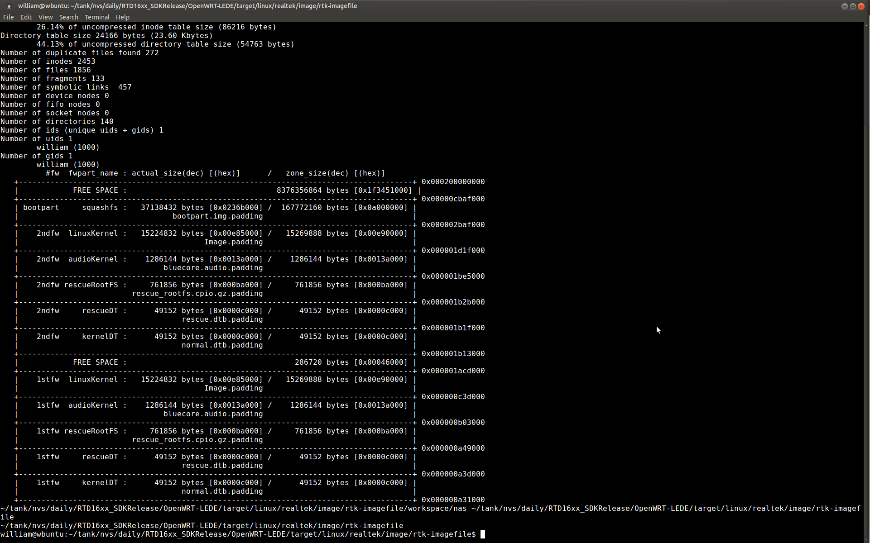
How to Use Image-Builder
Edit feed/feed.conf
Reference files, feed.conf.{spi,emmc, nand}
In Image-Builder
Run command./build-image.sh feed
X86/storage_layout/ layout-checker helps to check the position of each firmware zone.

Slide 21
How to Use Image-Builder--Output
Image-Builder/install.img
Rescue system use install.img to upgrade firmwares
Image-Builder/workspace/rescue
Rescue system files
{spi,emmc,nand}.uImage
rescue.{spi,emmc,nand}.dtb
rescue.root.{spi,emmc,nand}.cpio.gz_pad.img

Slide 22
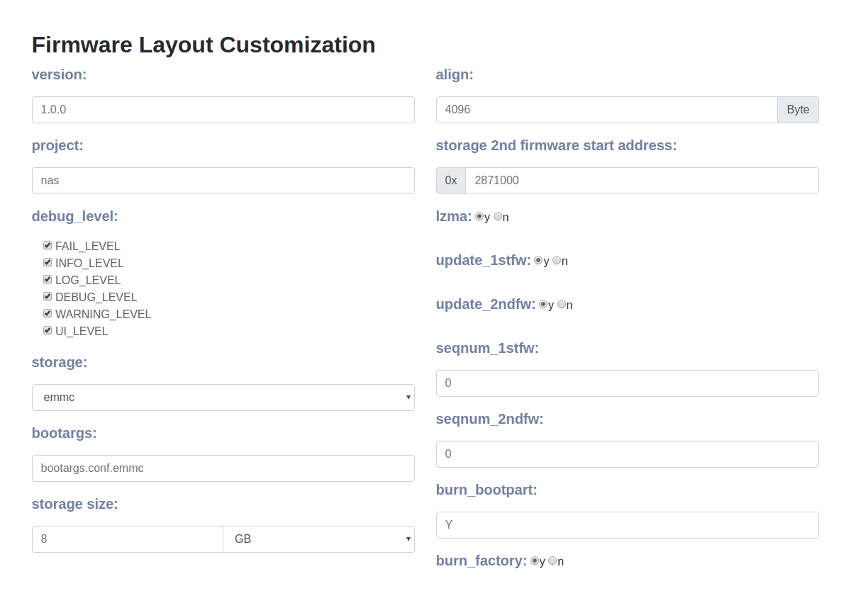
How to use WebUI to build config
Open Image-Builder/StorageLayoutUI/index.html
Choose the storage type
Emmc
Spi
And corresponding settings
Bootargs
Storage size
Storage align
Supports Dual Firmware Updating
Storage 2nd firmware address
Update firmware
Seqnum firmware

Slide 23
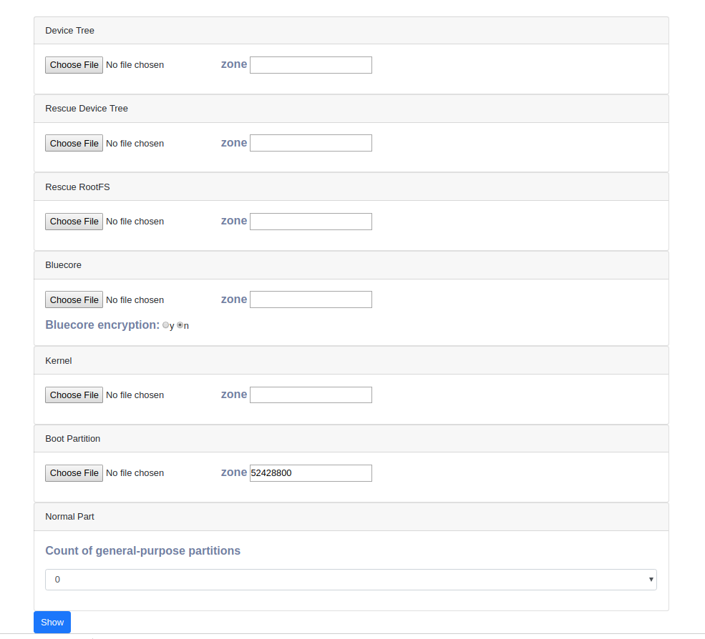
How to use WebUI to build config
Choose six files
Device Tree
Rescue Device Tree
Rescue RootFS
Bluecore
Kernel
Boot Partition (only emmc)
Zone MUST aligned by storage_align
Customization Normal Part
Emmc: 0, 1, 2, 3
Spi: none

Slide 24
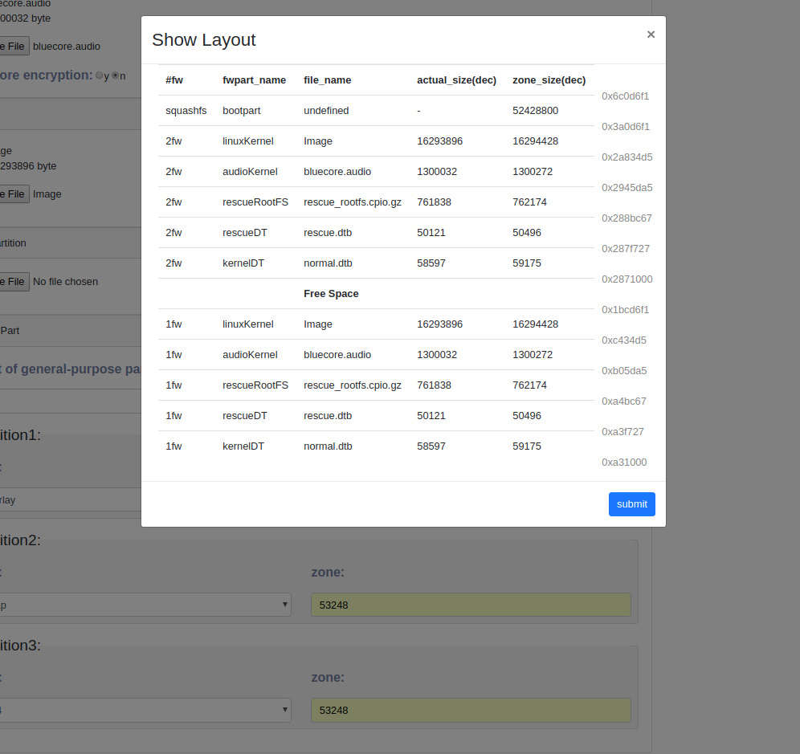
How to use WebUI to build config
Click “OK”
You can review the layout
click “submit”
It can produce feed.conf.{spi, emmc}
In /home/Downloads
Copy feed.conf.{spi, emmc} to
RTD16xx_SDK_Develop/Image-Builder/feed

