Slide 1

Automating Drupal Development with Patterns: introducing 7.x-2.x
David Rozas and many others

Slide 2
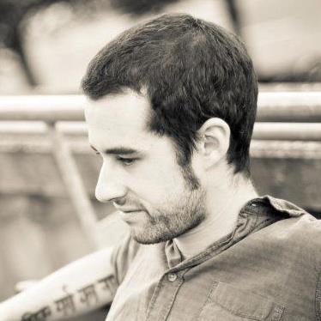
A brief presentation ...
David Rozas Domingo (@drozas)
Almost 3 years working with Drupal.
Recently joined CRESS (Centre for Research in Social Simulation) at University of Surrey (UK).
Interest areas: free software, education and technology, distributed systems programming, CSCW, collaborative learning, socially intelligent information systems, …
+info: http://www.davidrozas.com
02-03-2013
DrupalCamp London 2013
www.qlectives.eu

Slide 3
the others…
Stefano Balietti (ETH)
Liao Hao (Uni Fribourg)
Xiao Rui 肖锐 (Uni Science & Tech. China)
Dengcheng Yan 颜登程 (Uni Science & Tech. China)
Matus Medo (Uni Fribourg)
Zhou Yanbo 周艳波 (Uni Fribourg)
Dirk Helbing (ETH)
Vahe Tshitoyan (ETH)
Vahan Hovhannisyan (ETH)
Christoph Schwirzer (ETH)
Christian Schulz (ETH)
Sasa Tomic (ETH)
Mark Jelasity (Uni Szeged)
Kornél Csernai (Uni Szeged)
Tamas Kojedzinszky (Uni Szeged)
Nigel Gilbert (Uni Surrey)
Maria Xenitidou (Uni Surrey)
02-03-2013
DrupalCamp London 2013
www.qlectives.eu

Slide 4
Outline
The big picture: QLectives and QScience
Patterns overview: components and Patterns files
Patterns 7.x-1.x
Introducing Patterns 7.x-2.x new features
02-03-2013
DrupalCamp London 2013
www.qlectives.eu

Slide 5
Outline
The future: CM in Drupal 8
A bit of code: making a module “Patterns Ready”
Future Work
Demo
Q&A
02-03-2013
DrupalCamp London 2013
www.qlectives.eu

Slide 6
The big picture: QLectives
What is quality?
If half a million people give a YouTube video the thumbs up, does that mean it is good?
Perhaps... but you would probably rather watch a recommendation from a friend
Can we do it in a “P2P” way?
02-03-2013
DrupalCamp London 2013
www.qlectives.eu

Slide 7
The big picture: QLectives
Take features of social networking to help groups of people share resources: from home videos to scientific papers
Quality ratings in a distributed way
02-03-2013
DrupalCamp London 2013
www.qlectives.eu

Slide 8
The big picture: QLectives
Two application domains:
QMedia: P2P media distribution fully decentralized - http://www.tribler.org
QScience: distributed platform for scientists allowing them to locate or form new communities and quality reviewing mechanisms
02-03-2013
DrupalCamp London 2013
www.qlectives.eu

Slide 9
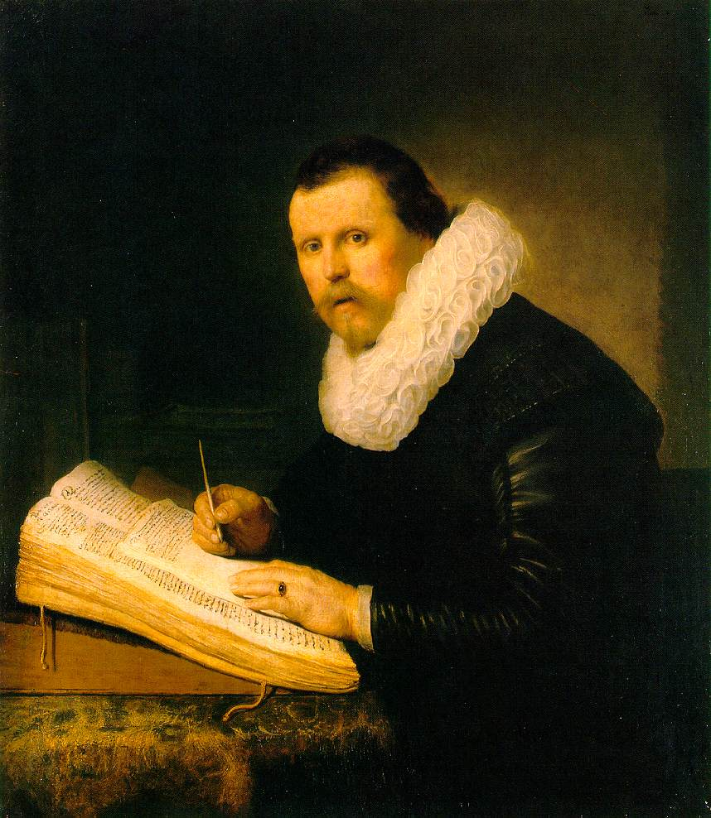
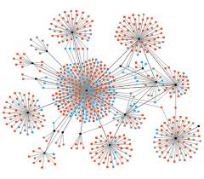



QScience: Science today
From...
Rembrandt, “A Scholar” (1631)
To...
Community
Networks
Big Data
02-03-2013
DrupalCamp Spain 2012
www.qlectives.eu

Slide 10
Can we have it all?
Many software packages are available that fit one (or more) of those needs, but not all.
QScience is an attempt to pull them all together in a modular fashion: a Drupal distribution
02-03-2013
DrupalCamp London 2013
www.qlectives.eu

Slide 11
QScience: contributing back
Patterns: configuration management
D2D (DrupalToDrupal): secure exchange of information between different Drupal instances in a P2P network.
QTR: Implements a Quality Trust and Reputation algorithm to rate contents (e.g.: academic publications) in Drupal.
Living Science: Drupal based search and visualization tool.
02-03-2013
DrupalCamp London 2013
www.qlectives.eu

Slide 12

Patterns
What we want: reuse and share configuration.
The main issue: configuration and data are mixed up in the DB.
Patterns allows developers to take control of it.
02-03-2013
DrupalCamp London 2013
www.qlectives.eu

Slide 13
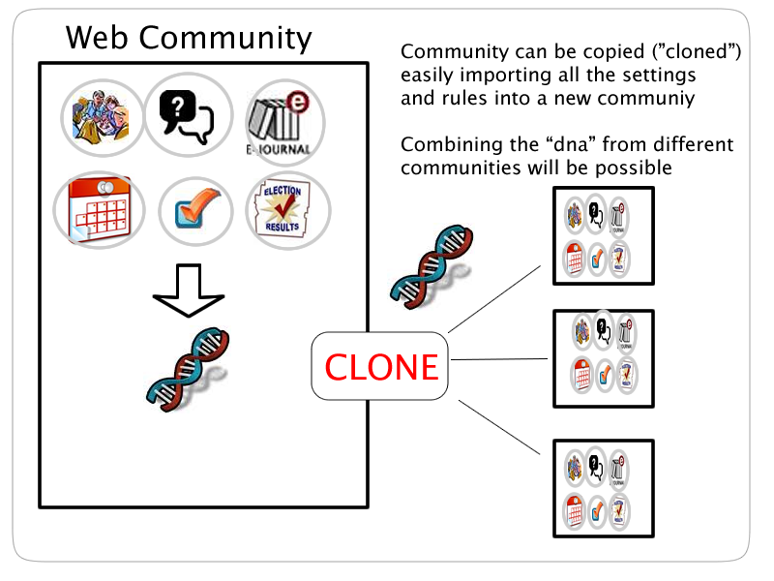
Patterns
02-03-2013
DrupalCamp London 2013
www.qlectives.eu

Slide 14

Patterns
Patterns is built to bypass this bottleneck by managing and automating site configuration
Patterns' approach to solve it:
  Components (“Software driver concept”)
  Store the configuration in files – decoupled architecture
Node
Taxonomy
…
…
User
Variables
02-03-2013
DrupalCamp London 2013
www.qlectives.eu
…

Slide 15
Patterns Components
Each Drupal module can have a corresponding component, e.g. Blocks, Nodes, Taxonomy, Users, System settings.
The component handles tasks directed at the module, acts much like a software driver.
02-03-2013
DrupalCamp London 2013
www.qlectives.eu

Slide 16
Patterns Components
Defines a set of hooks which are accessed by the Patterns core during the different phases: prepare, validate, callbacks, execution, cleanup...
Actions are preprocessed and reformatted so that they can be the input of one or more Drupal forms.
02-03-2013
DrupalCamp London 2013
www.qlectives.eu

Slide 17
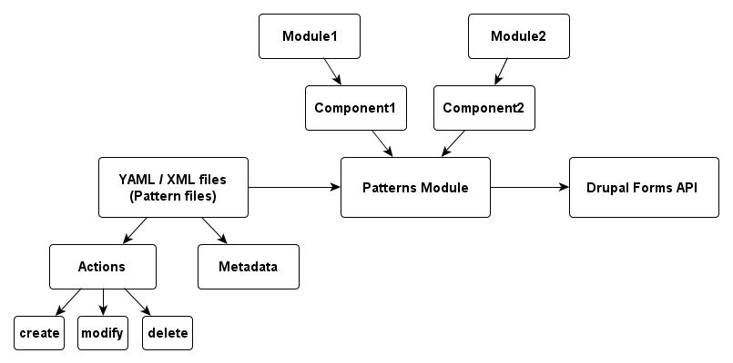
Patterns Overview
02-03-2013
DrupalCamp London 2013
www.qlectives.eu

Slide 18
Patterns Files
Store configuration in files
There is not any dependency with any specific format: hook_patterns_parser(): http://drupal.org/node/1545346
Currently supported formats
  YAML: easy to read and write (human-readable data serialization format)
  XML: interoperability
  PHP arrays: performance
02-03-2013
DrupalCamp London 2013
www.qlectives.eu

Slide 19
Patterns Files: structure
Divided in sections:
  Metadata: author, category, version, description, etc.
  Sub-sections:
    Actions: create, modify, delete, include
02-03-2013
DrupalCamp London 2013
www.qlectives.eu

Slide 20
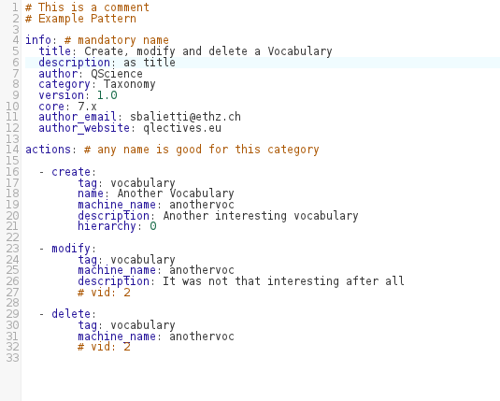
Patterns Files
02-03-2013
DrupalCamp London 2013
www.qlectives.eu

Slide 21
Patterns 7.x-1.x
  Write or re-use patterns using the already developed components (content types, menus, blocks, users, permissions, roles, etc.)
  Make your module “Patterns Ready”
  Export configuration automatically (in a more “raw” way than the new version)
02-03-2013
DrupalCamp London 2013
www.qlectives.eu

Slide 22
Introducing Patterns 7.x-2.x
Major new release: 7.x-2.0-rc1 (26th Feb 2013)
  Syntantic and Semantic validation: assistance to solve conflicts.
  Automatic extraction of the configuration improved.
  Patterns server/client: new (sub)modules to allow pushing/pulling patterns.
02-03-2013
DrupalCamp London 2013
www.qlectives.eu

Slide 23
Patterns 7.x-2.x: syntactic and semantic validation
Similar approach to name collision and dependencies resolution of compilers.
Two separated layers and different type of warnings/errors:
  Already Defined Element
  Element Undefined
  Unmet Dependency
  Not Unique Alias
  ...
02-03-2013
DrupalCamp London 2013
www.qlectives.eu

Slide 24
Patterns 7.x-2.x: syntactic and semantic validation
Rule of thumb:
  Syntactic errors/warnings: wrong grammar statements.
  Semantic warnings: related to the meaning of that pattern itself in certain “context”.
  Inclusive relationship: “a pattern semantically valid will always be syntactically valid, but not the other way around”.
02-03-2013
DrupalCamp London 2013
www.qlectives.eu

Slide 25
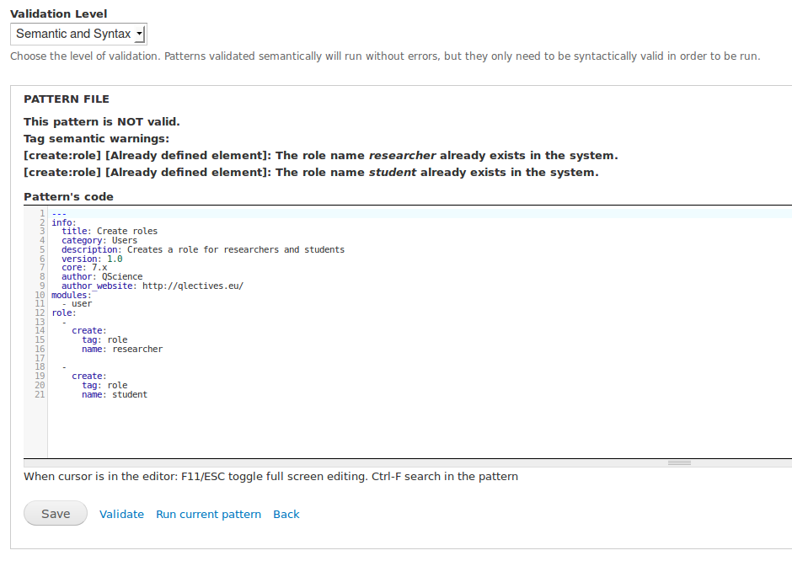
Patterns 7.x-2.x: syntactic and semantic validation
Example: Roles name collision (semantic warning)
02-03-2013
DrupalCamp London 2013
www.qlectives.eu

Slide 26
Patterns 7.x-2.x: export functions
All the main core components possess now automatic export capabilities.
Options to choose the type of actions generated:
    CREATE actions: intended for the creation of patterns for “fresh installation”.
    MODIFY actions: intended for the creation of patterns to override the current settings (i.e.: to deploy changes from test to stage).
Depends on the component: certain actions might not make sense in some cases: “create colour”?
02-03-2013
DrupalCamp London 2013
www.qlectives.eu

Slide 27
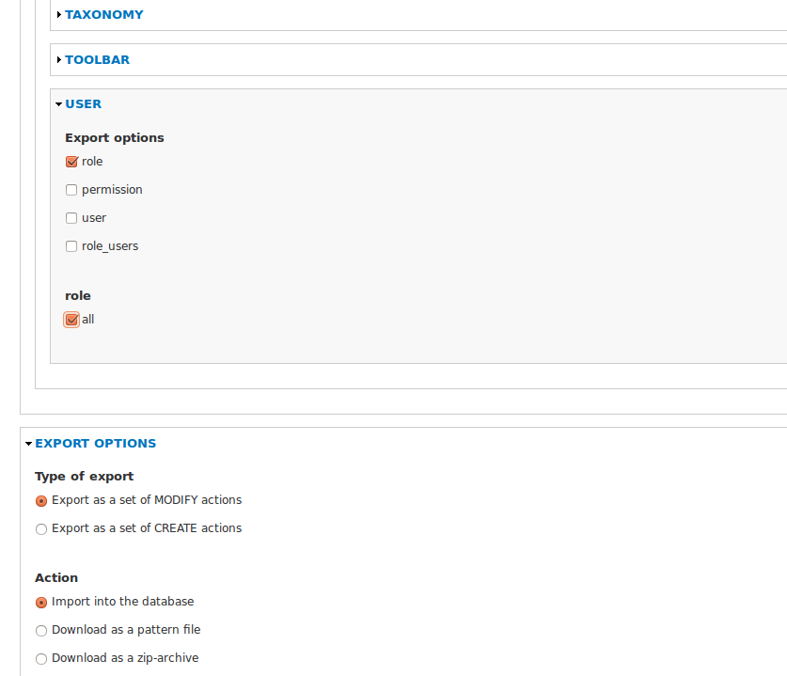
Patterns 7.x-2.x: export functions
02-03-2013
DrupalCamp London 2013
www.qlectives.eu

Slide 28
Patterns 7.x-2.x: server/client
Act as a HUB to share Patterns between Drupal users using a secure channel.
Pushed via UI / Drush
Implemented as a module: anyone can set up his/her own server
Provides functionalities to search patterns, generate statistics, etc.
“Default Patterns Server”: drupal-patterns.org (coming soon)
02-03-2013
DrupalCamp London 2013
www.qlectives.eu

Slide 29
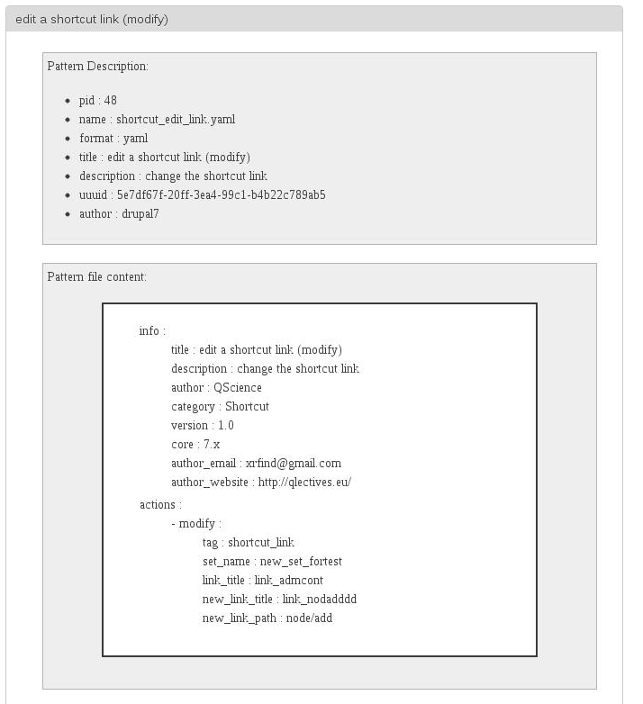
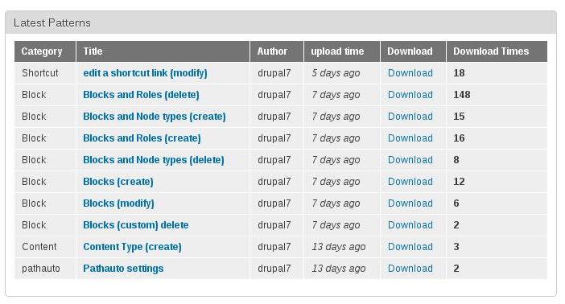
Patterns 7.x-2.x: server/client
02-03-2013
DrupalCamp London 2013
www.qlectives.eu

Slide 30
So, what ¡s the difference
between Patterns and...?
Distribution/Installation Profile:
  Granularity: the configuration can be split into smaller definitions
  Simplicity: easier to write YAML files than an installation profile
  Can be used in existing sites
02-03-2013
DrupalCamp London 2013
www.qlectives.eu

Slide 31
So, what ¡s the difference
between Patterns and...?
Features+Strongarm:
  Paradigm: Features is more 'use case oriented', Patterns is more 'CM oriented'
  (Interesting blog post from Tom Friedhof about this at http://activelamp.com/blog/new-way-manage-configuration-your-site)
02-03-2013
DrupalCamp London 2013
www.qlectives.eu

Slide 32
So, what ¡s the difference
between Patterns and...?
Features+Strongarm:
  Storage: Features stores the configuration in Drupal modules, patterns stores it in files as D8 will
  (see D8 Config Management Initiative)
02-03-2013
DrupalCamp London 2013
www.qlectives.eu

Slide 33
So, what ¡s the difference
between Patterns and...?
Features+Strongarm:
  Implementation: Features uses module specific APIs (e.g: Views API), Patterns uses mostly FAPI (although can use specific ones as well).
    The “trick” is drupal_form_submit()
    Advantage: Validation for free!
    Disadvantage: Performance
02-03-2013
DrupalCamp London 2013
www.qlectives.eu

Slide 34
The future?
02-03-2013
DrupalCamp London 2013
www.qlectives.eu

Slide 35
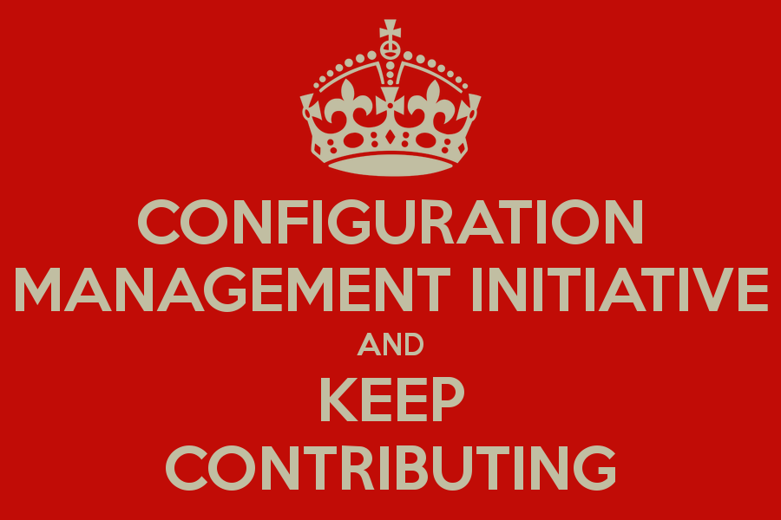
The future?
02-03-2013
DrupalCamp London 2013
www.qlectives.eu

Slide 36
CM in Drupal 8
Two issues to address:
#1: Save configuration data into files (in core!): CMI
[!] @alexpott's presentation tomorrow: “Drupal 8
Configuration System for Coders”
#2: Bundle functionality into a “package” that can be re-used in another site: Features v3.x, Patterns v3.x?
Patterns (as features) currently combines #1 & #2
Features' maintainers contacted to collaborate since we are working on the same direction
02-03-2013
DrupalCamp London 2013
www.qlectives.eu

Slide 37
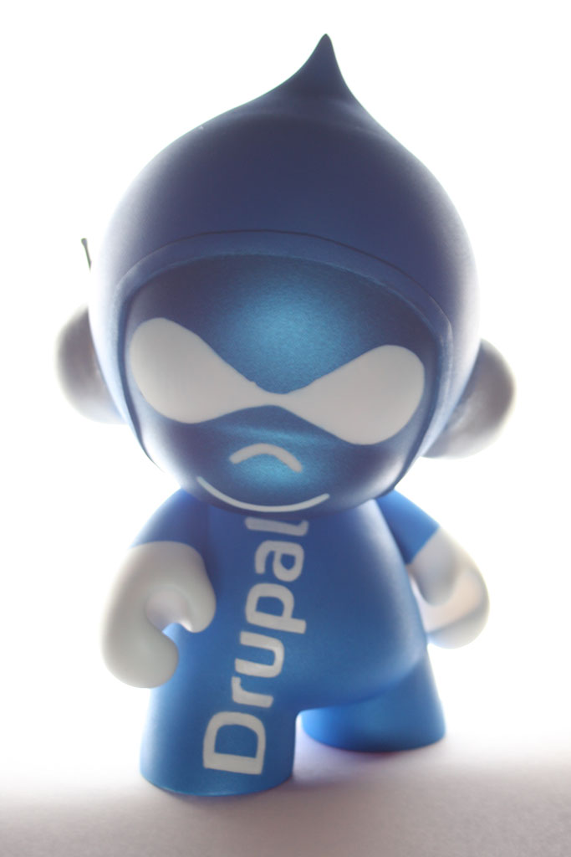
Getting a bit
“teckie”...
“How to create your own Drupalicon Munny”, by Andre Molnar
(http://becircle.com/how_create_your_own_custom_drupalicon_munny)
02-03-2013
DrupalCamp London 2013
www.qlectives.eu

Slide 38
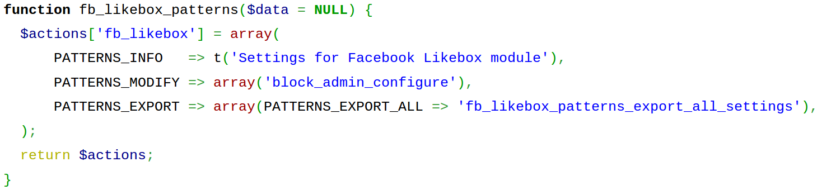
How to make my module “Patterns Ready”?
You need to implement hook_patterns() to declare which actions your module is able to handle:
02-03-2013
DrupalCamp London 2013
www.qlectives.eu

Slide 39
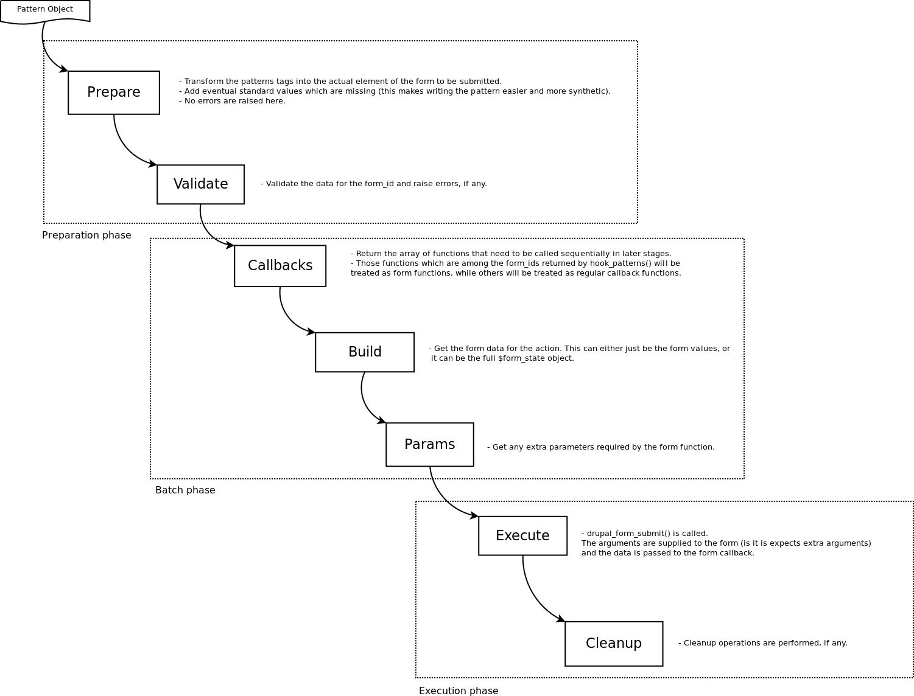
How to make my module “Patterns Ready”?
Hooks available to interact
on each phase:
hook_patterns_prepare($action, $tag, &$data)
hook_patterns_validate($action, $tag, &$data)
hook_patterns_callbacks($action, $tag, &$data)
hook_patterns_build($action, $form_id, &$data, &$action_state)
hook_patterns_params($action, $form_id, &$data &$action_state)
hook_patterns_cleanup($action, $tag, &$data)
Source:
https://github.com/QScience/patterns-flowcharts/blob/master/running-pattern-workflow.dia
02-03-2013
DrupalCamp London 2013
www.qlectives.eu

Slide 40
How to make the settings of my module automatically exportable?
You need to declare in hook_patterns() a function that will gather the data
Write that function: can be more or less complex depending on the component
02-03-2013
DrupalCamp London 2013
www.qlectives.eu

Slide 41
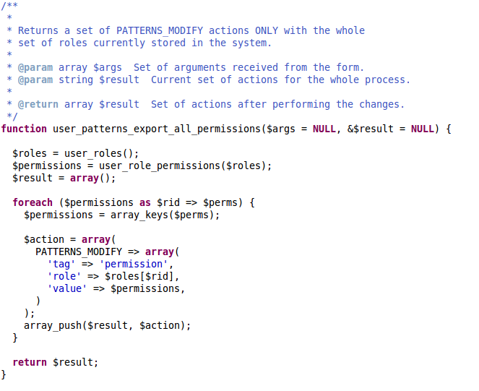
How to make the settings of my module automatically exportable?
02-03-2013
DrupalCamp London 2013
www.qlectives.eu

Slide 42
Future Work
Create new sites based on QScience: CRESS, QLectives, ...
Improve compatibility with Patterns Server, D2D modules.
Write components for QScience custom modules and for the most important contrib modules: Views, Rules, OG, Context, …
Try to contribute in the future of CM for D8.
02-03-2013
DrupalCamp London 2013
www.qlectives.eu

Slide 43
Future Work
Documentation (D7):
  More than 30 pages already published at Drupal.org: http://drupal.org/node/1464118
  Extend documentation for Patterns 7.x-2.x
  Video tutorials
02-03-2013
DrupalCamp London 2013
www.qlectives.eu

Slide 44
Ideas
Thanks for your ideas/suggestions/patches!
Patterns group at: http://groups.drupal.org/patterns
02-03-2013
DrupalCamp London 2013
www.qlectives.eu

Slide 45
Links
Patterns (http://drupal.org/project/patterns):
  Documentation: http://drupal.org/node/346509
  Group: http://groups.drupal.org/patterns
Qlectives :
  QScience Repository: https://github.com/QScience
  Deliverable 4.2.4 (Patterns 7.x-2.x):
  http://www.qlectives.eu/docs/D4.3.1.pdf (to be officially published very soon)
  Deliverable 4.2.3 (Patterns 7.x-1.x):http://www.qlectives.eu/wiki/images/9/91/Qd4-2-3.pdf
  Econophysics Forum (use case): http://physpc140.unifr.ch/drupal-7.14/
02-03-2013
DrupalCamp London 2013
www.qlectives.eu

Slide 46

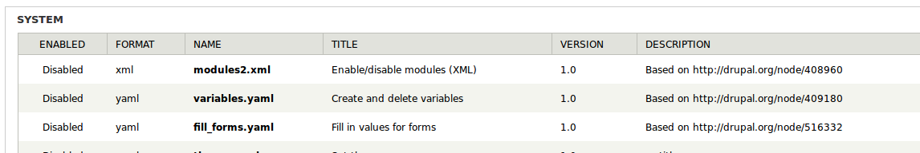
Time for the demo!
02-03-2013
DrupalCamp London 2013
www.qlectives.eu

Slide 47
Thanks!
¡Gracias!
謝謝
Merci!
Danke!
Grazie!
This work is licensed under the Creative
Commons Attribution 3.0 Unported License.
To view a copy of this license, visit
http://creativecommons.org/licenses/by/3.0/.
02-03-2013
DrupalCamp London 2013
www.qlectives.eu

