Slide 1
ROP image analysis
Last update: 4/2/16

Slide 2
Data available
Classification
Users classified images as normal, pre-plus, plus
~20% of the images were repeat (for test-retest)
Pairwise comparison
Users performed pairwise comparisons for the same sets of images as the classification
Reference standard diagnosis
Clinical diagnosis

Slide 3
Classification
Set of 34
Set of 100 (1)
Set of 25 (subset of set of 100)
Set of 10 (ignored for now)

Slide 4
Files available
34Images.txt
100Images.txt
25Images.txt
results_icsfy_set34_rev3_2015_12_6
results_icsfy_icsfy_100_2015_12_6
results_icsfy_select25_rev1_2015_12_6
diagnoses for image sets (so 9-30-15)

Slide 5
Set of 34
34 images previously used of inter-rater agreement studies
Typically more severe cases
Mostly pre-plus or plus
Have readings from (2015)
Mariana, Phil, Jim, Pete, Kim, Jason, Paul, testuser Karyn, Mike, Nina, testuser4, Susan, MikeR, Kelly, mikeS (ranked by average score)
Pretty low inter-rater agreement

Slide 6
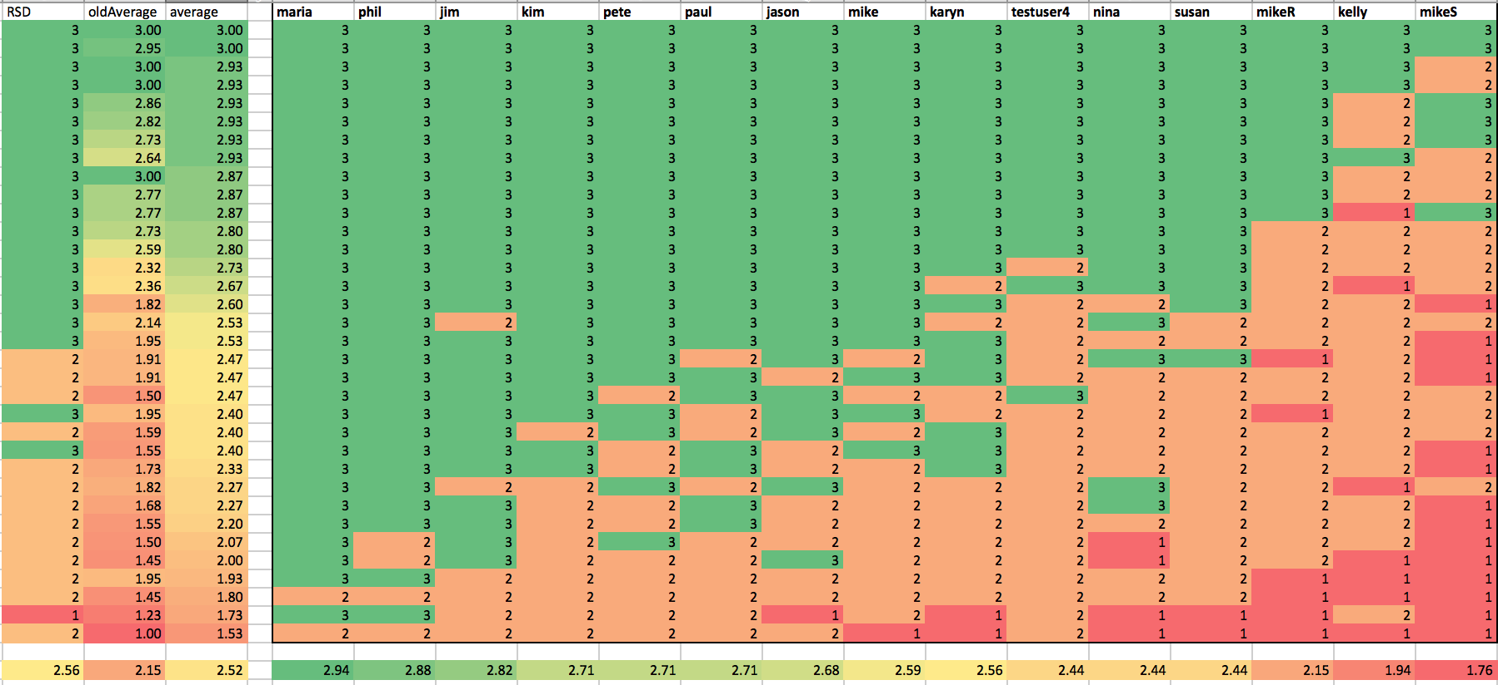
Ratings for 34 images (2015)
Highly variable
Systematic bias

Slide 7
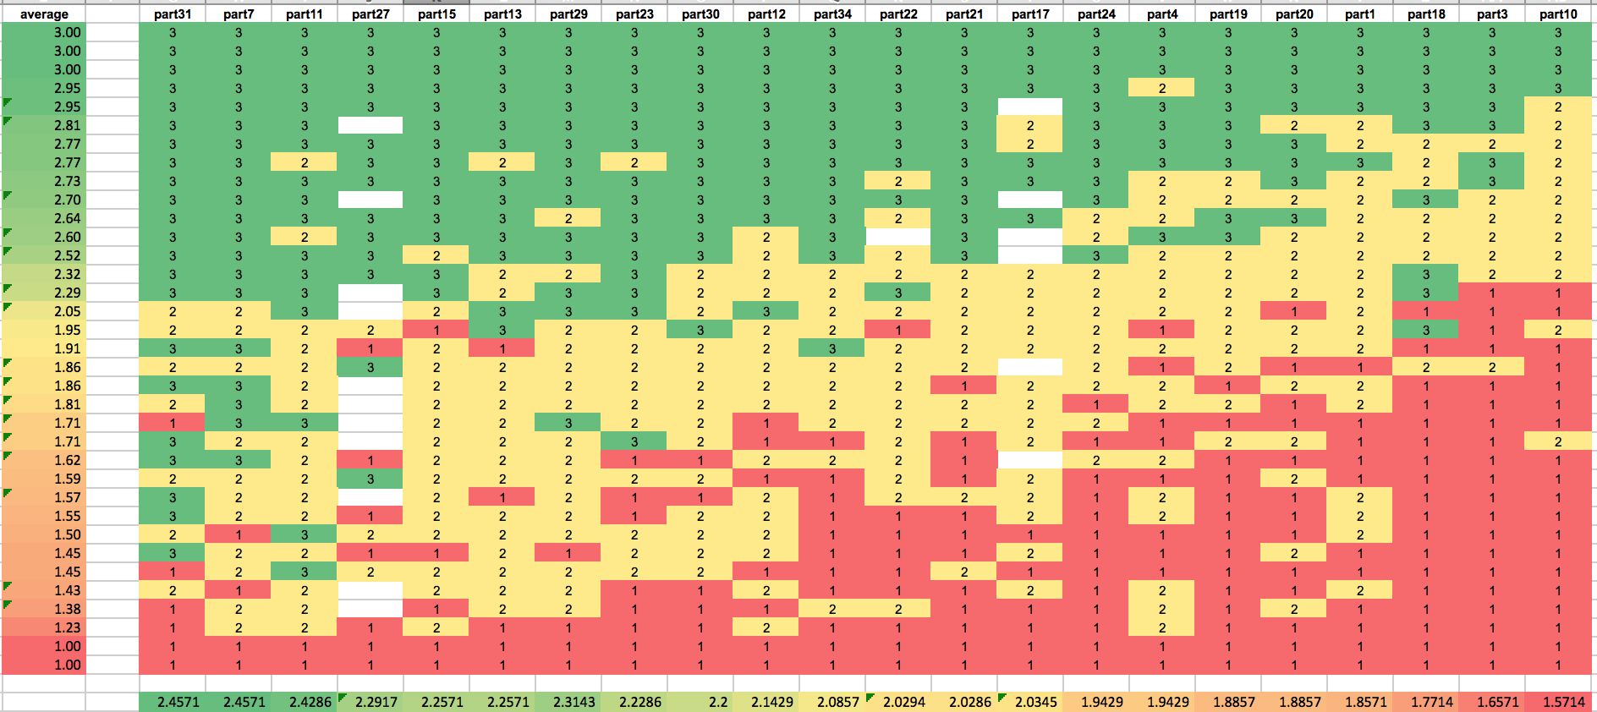
Ratings for 35 images (2007)

Slide 8
Bias/accuracy
Mostly, errors (compared to RSD) are systematic
Typically off by 1 step
Accuracy varies from 29% to 91%
Expert | Average Rtg | accuracy | bias
maria | 2.94 | 0.65 | 0.38
phil | 2.88 | 0.71 | 0.32
jim | 2.82 | 0.68 | 0.26
pete | 2.71 | 0.79 | 0.15
paul | 2.71 | 0.79 | 0.15
kim | 2.71 | 0.85 | 0.15
jason | 2.68 | 0.82 | 0.12
mike | 2.59 | 0.91 | 0.03
karyn | 2.56 | 0.76 | 0.00
testuser4 | 2.44 | 0.76 | -0.12
nina | 2.44 | 0.71 | -0.12
susan | 2.44 | 0.82 | -0.12
mikeR | 2.15 | 0.62 | -0.41
kelly | 1.94 | 0.38 | -0.62
mikeS | 1.76 | 0.29 | -0.79

Slide 9
ANOVA
Predict score as a function of image and user
Highly significant for both

Slide 10
ANOVA models
Set 100
Multiple R-squared: 0.8306, Adjusted R-squared: 0.8096
F-statistic: 39.46 on 106 and 853 DF, p-value: < 2.2e-16
Set 34

Slide 11
Two-way Anova +Tukey HSD
Score highly predicted by image and rater
Adjusted R-squared: 0.6327 , p-value: < 2.2e-16

Slide 12
Comparison of results between 2007 and 2015 studies
Highly correlated, suggesting similar perception of severity

Slide 13
Comparison of results between 2007 and 2015 studies
Correlated, with offset

Slide 14
Observations
High variability among users
Similar results compared to older study
Ratings are generally more “plus” than first study
Accuracy compared to RSD varies from 29-91%
In general, bias is the issue not random errors
Bias varies from +0.38 to -0.71
Generally repeatable results between studies few years apart
Ranks are highly correlated
Overall higher averages (more “plus”) now compared to previous study

Slide 15
Hypothesis
There is a continuous scale of image severity that most experts can agree on
However, thresholds for separation between normal, pre-plus and plus are different between experts
This leads to an apparent systematic bias between experts
Proposal: finer severity scale

Slide 16
Pairwise comparisons to assess image severity ranking
Experts were presented pairs of image and asked to assess which one was most severe
Pairwise comparisons were converted to rank
Better agreement (compared to 3 class classification) between experts in
Which image is more severe
Subsequent image rank

Slide 17
Preliminary ranking results
Elo ranking system was used to convert pairwise results to ranks
Used in chess and other tournament setting
Considered all users to create overall image severity rank
These ranks correlate highly with ranks generated from classification results
Users are generally internally consistent

Slide 18
Ranking vs. RSD
Relatively consistent

Slide 19
Classification score vs. Elo rank
Well correlated

Slide 20
Comparison rank vs. classification rank
Well correlated

Slide 21
Consistency of ranks from pairwise comparisons
91% vs 29% accuracy compared to RSD
Maybe (??) more consistent

Slide 22
Reason for optimism?
Almost either ends of spectrum

Slide 23
Or not…
Some people see the world differently!

Slide 24
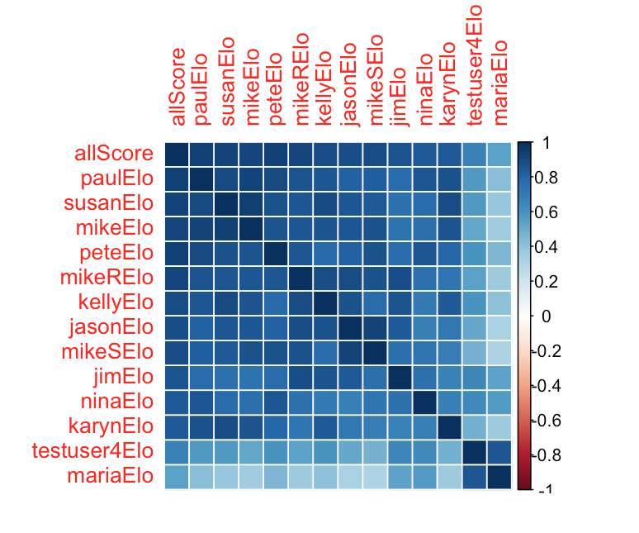
Correlation between ranks
In general, pretty ranks are pretty well correlated between users
Maria Ana
Test user4 (wei?)

Slide 25
Agreement vs. rank difference
Lower agreement when closer together

Slide 26
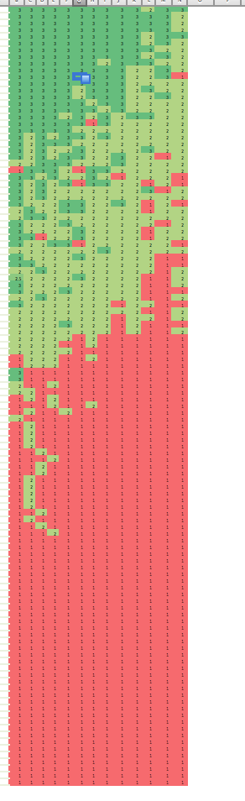
Set of 100 compare
Similar analysis and results compared to set 34
Good agreement that Most images are normal

Slide 27
ANOVA model for set 100
Multiple R-squared: 0.83, Adjusted R-squared: 0.8169
F-statistic: 63.67 on 111 and 1448 DF, p-value: < 2.2e-16

Slide 28
Comparing users (set 34, set 100)
Users are roughly in the same order between the two exercises
set100_Ranking | set34_ranking
maria | maria
jim | phil
phil | jim
kim | kim
pete | pete
jason | paul
paul | jason
mike | mike
karyn | karyn
susan | susan
kelly | mikeR
mikeR | kelly
mikeS | mikeS

Slide 29
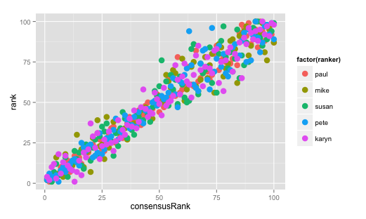
Rank agreement between users
Hard to separate “normal” images
55 images were “normal” by at least 11/12 raters

Slide 30
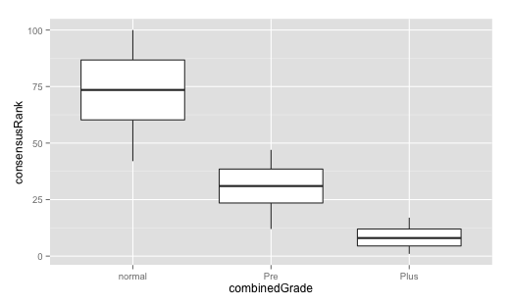
Ranking vs. plusness (overall)

Slide 31
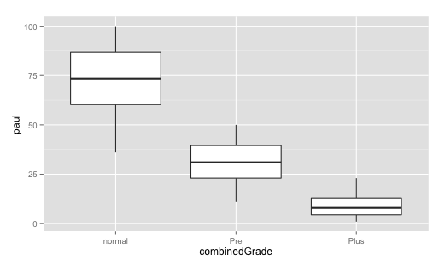
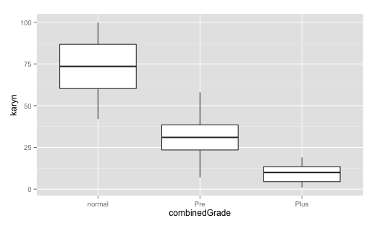
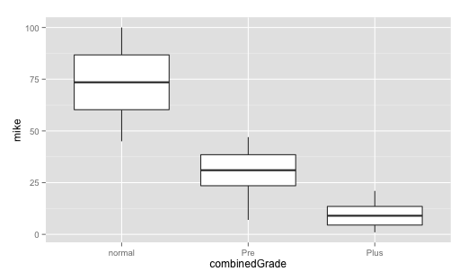
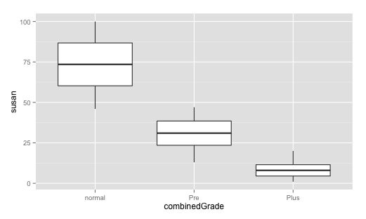
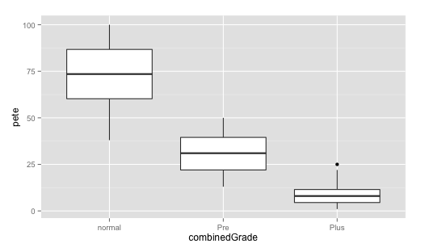
Ranking vs. plusness (user)

Slide 32
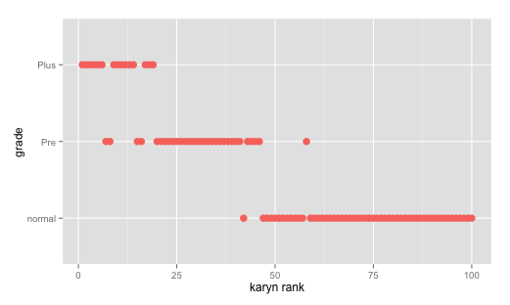
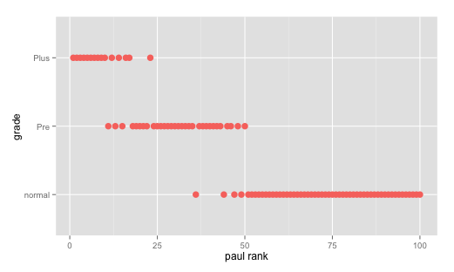
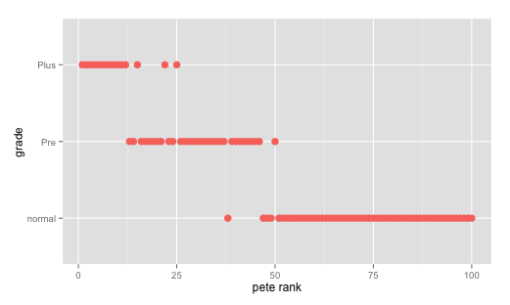
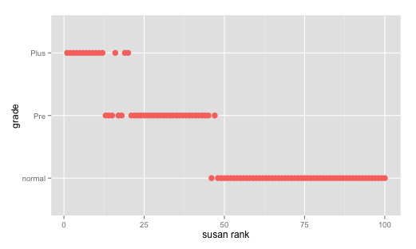
Ranking vs. grade (all users)

Slide 33
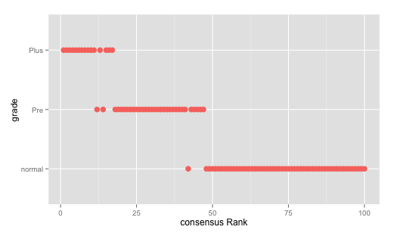
Ranking vs. grade (all users)

Slide 34
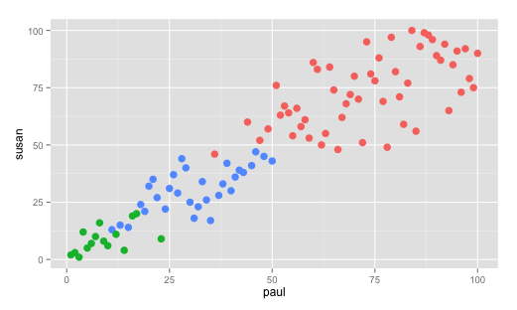
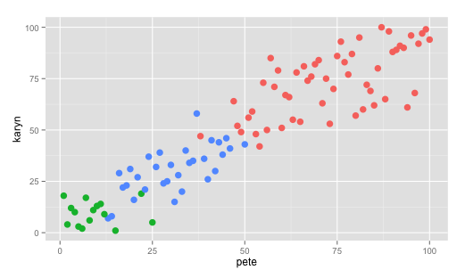
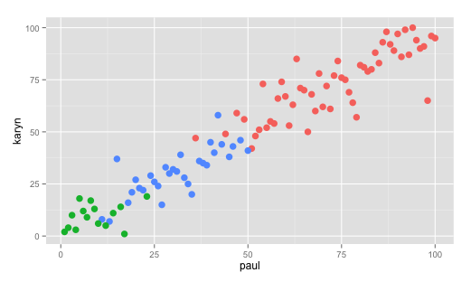
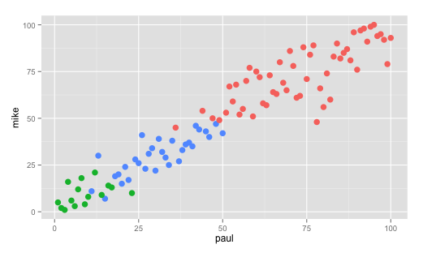
Scatter Plot for user ranks

Slide 35
Summary results
High variability among experts in categorization is primarily bias not random variation
Ranking of users is consistent across datasets
Two way ANOVA model models bias
Severity of plus disease appears to be a spectrum, not categorical
Image classification
Set 100, Set34, Set 34 (old) –number of users in each category seems to vary continuously
Rank of images in old set 34 and new 34 correlate highly despite different users

Slide 36
Summary results
Pairwise comparison to rank images has less variability than 3 class categorization
Ranks of users on either end of spectrum are highly correlated

Slide 37
Still to add to ppt
Analysis of set 100 classification
ANOVA, bias by user
Compare bias by user between 34 and 100
Need weighting per distribution?
Generate set 25 for all users
Correlation heat map of ranks for
Set 34
Set 100
Set 25
Per task error rate vs. difference in ranks
User rank to user class

