Slide 1
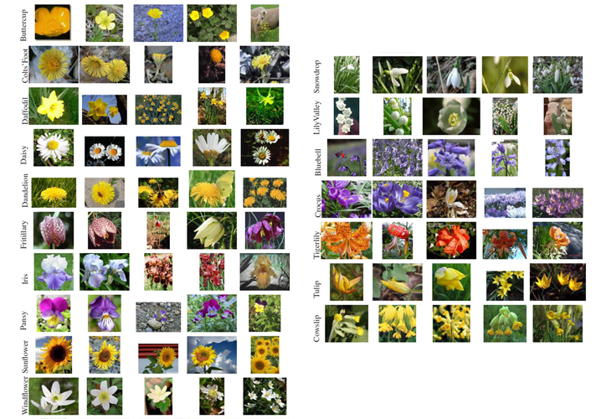
Using Python for Deep Learning
Predicting Flower Species Using Convolutional Neural Networks

Slide 2
Getting Started
Class GitHub Link
See all of today’s class materials on our class Github at..
http://tinyurl.com/QTIM-ML-Class
Clone the repository to your local computer. You can do this via the “Clone or download” button on the site itself, or via the command line script below:
git clone https://github.com/QTIM-Lab/QTIM_Classwork

Slide 3
Getting Started
Python Installation
Easiest method – Install Python from the Anaconda distribution. Anaconda is a distribution of Python that comes pre-configured with many of Python’s most frequently-used pacakges, and makes it easier to install python packages.
http://tinyurl.com/class-anaconda
Alternate method – Install Python from the Python website. Keras and Thenao, the libraries we will use today, will run MUCH slower on Windows if installed outside of Anaconda.
http://tinyurl.com/class-standard-python

Slide 4
Getting Started
Machine Learning Package Installation
Install the machine learning libraries Keras & Theano, and the image-reading library Pillow. If you have installed the Anaconda distrubtion, type into your terminal:
conda install theano Pillow
Then type the following command to install keras:
pip install keras
Note that keras should be installed with pip after theano is installed with conda, or else theano and keras will be very slow. This is because conda installs certain dependencies for theano that help it run more effeciently, whereas pip does not. Because theano is a pip dependency of keras, this slower version of theano will be installed with pip if theano is not already installed with conda. Complicated, I know!

Slide 5
Getting Started
Configuring keras with theano
After installing your Python packages, you will need to change the keras configuration file to work with theano. You can find this configuration file in a folder titled “.keras” in your user’s home directory. This folder is created after you run keras in a Python script for the first time – if it’s not there, you may want to try running one of the example scripts from this class to create it. In the “keras.json” file, you will need to change the line:
“backend”: “tensorflow”
to:
“backend”: “theano”

Slide 6
Getting Started
Running Python scripts.
You should be all ready to run a python script! Python scripts are run from the command line by typing in the command “python” and then typing the name of the script you want to run. For example:
python /MyDocuments/My_Example_Script.py
The script should either run correctly, or a Python error should read out. Happy coding!

