Slide 1
Measuring K_{trans} A love story

Slide 2
CED and NHX Studies
N = 45 patients, aged 22-74 years (mean: 56 years). DCE-MRI and anatomical imaging.
Two baselines visits 3-5 days apart with no intervening treatment.
TE = 2.73ms, TR = 6.8ms, FA = 10°, Dose = 1 mmol/kg, Scan time = 6m, Temporal Resolution = 6s, Injection Time = 3m, Scanner = 3T Siemens

Slide 3
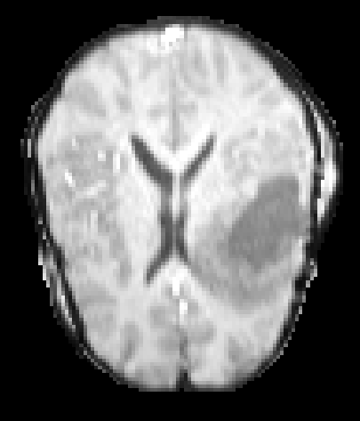
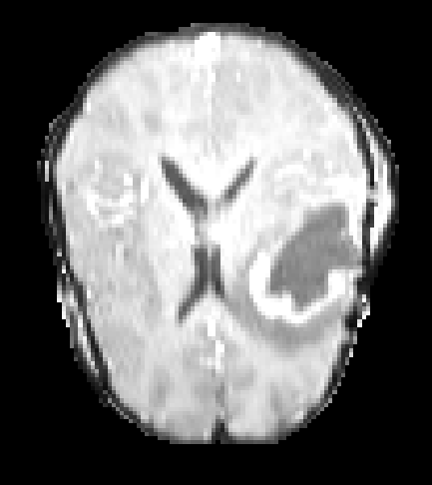
Sample Data – DCE-MRI

Slide 4
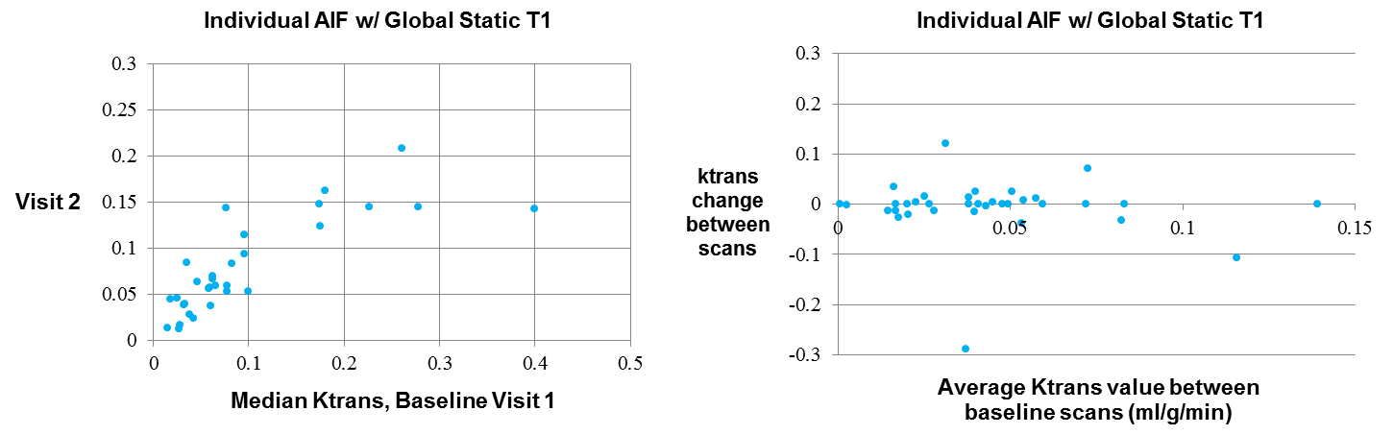
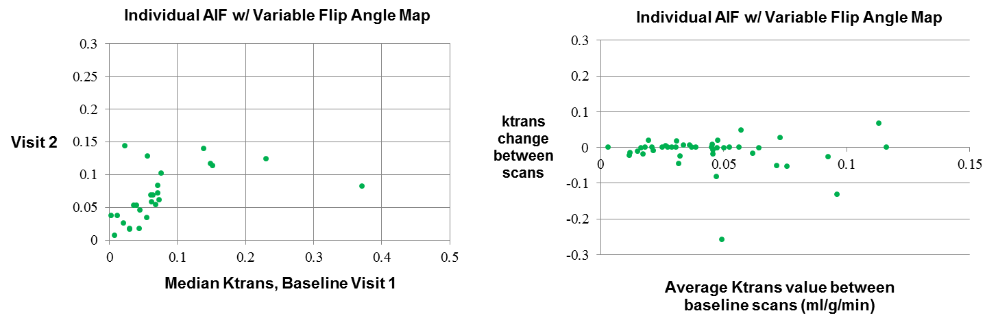
Repeatabilty, Different Methods

Slide 5
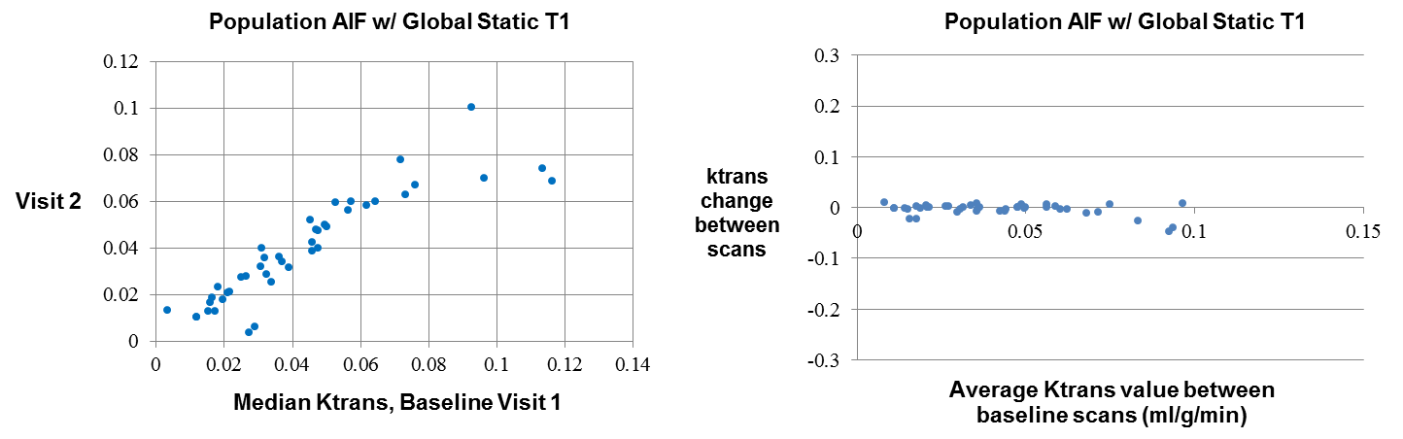
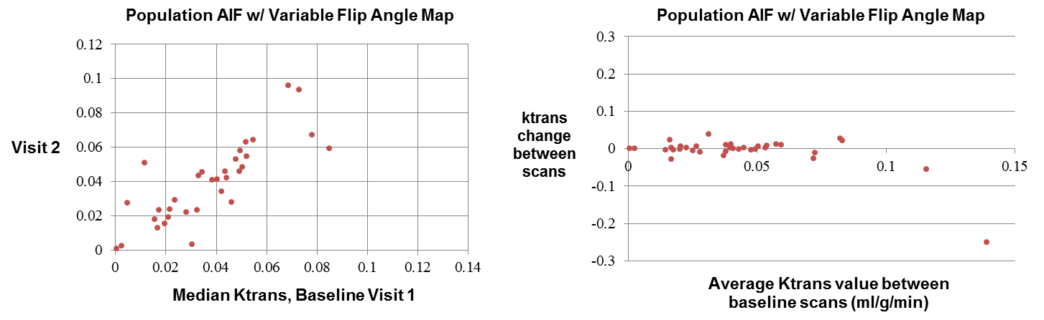
Repeatabilty, Different Methods

Slide 6
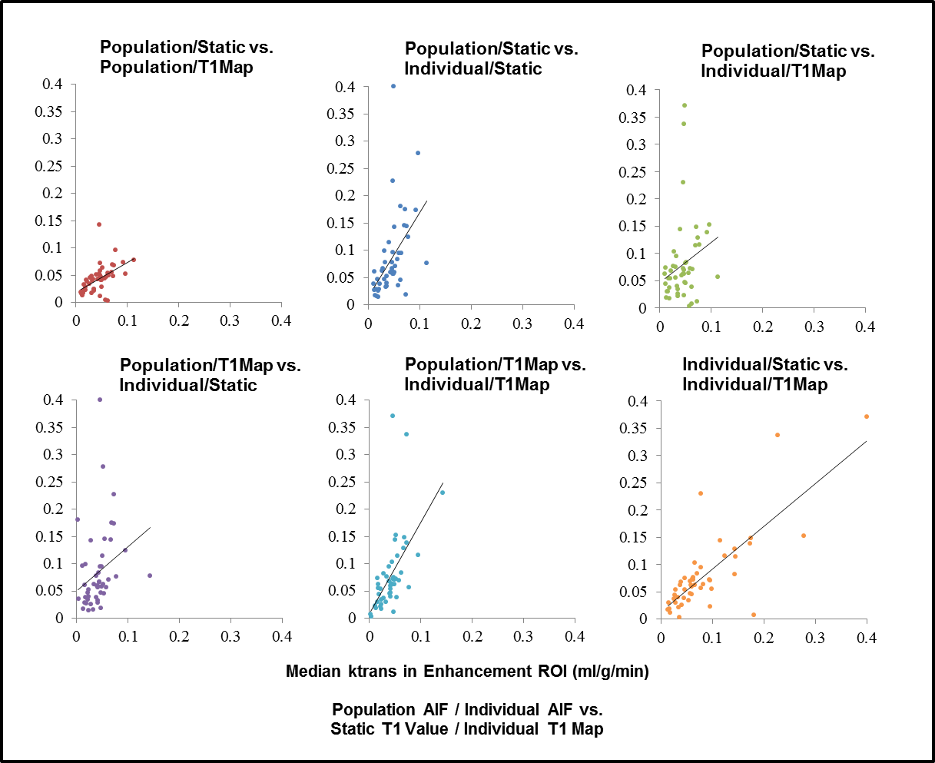
Correlation, Different Methods

Slide 7
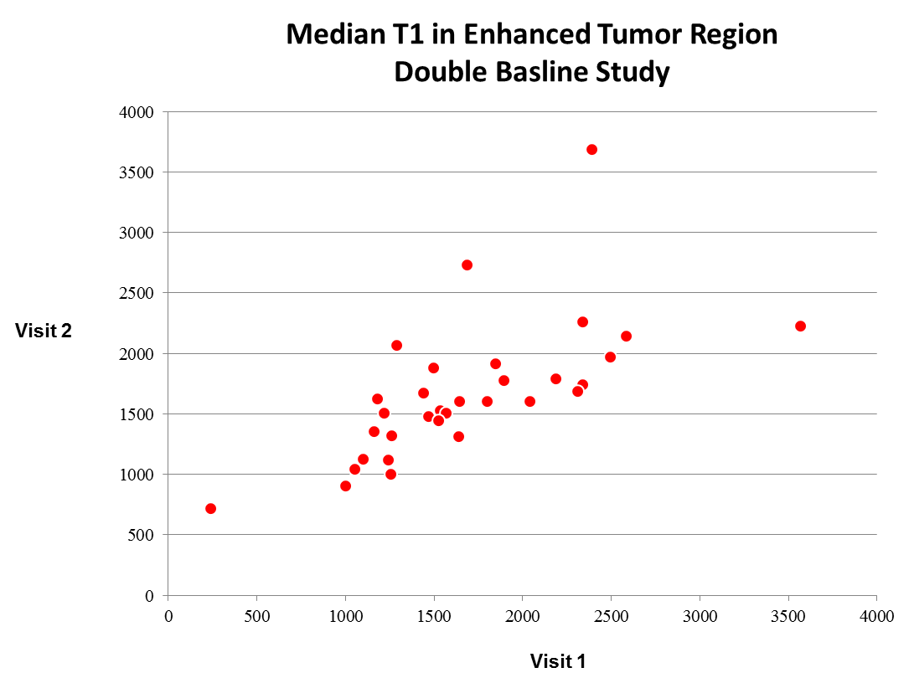
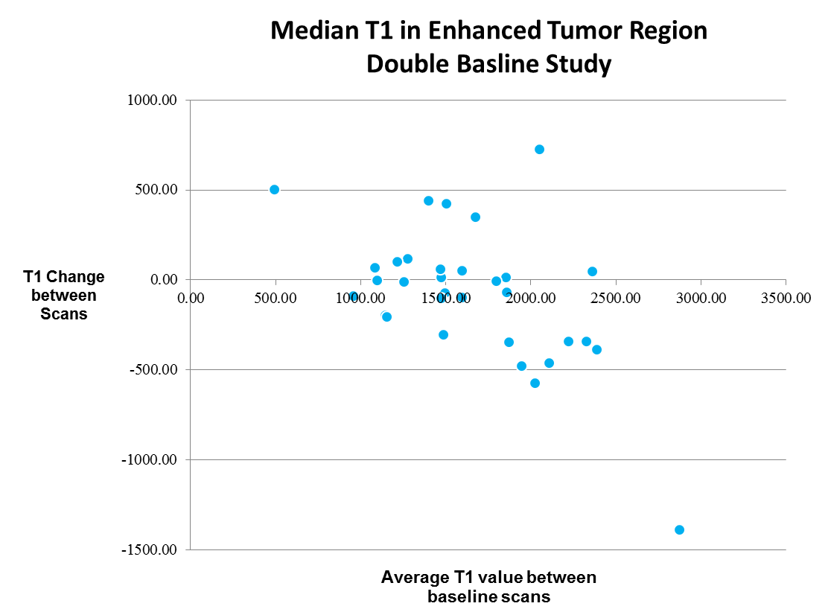
Repeatability, VFA T1 Mapping

Slide 8
Conclusion..
Population AIF with a static T1 results is the most reproducible method of extracting ktrans values from an enhancing tumor ROI.

Slide 9


Multi-Site DRO Phantom Study
When tested several sites DCE processing scripts on a phantom of fixed ktrans and ve values…
Expected ktrans map
Expected ve map
.01
.02
.05
.1
.2
.35
.01 .05 .1 .2 .5

Slide 10

Multi-Site DRO Phantom Study
… we found that 3/4 sites had an unexpected correlation between generated ktrans and ve values.
Expected ktrans Map
Generated ktransmap
.01
.02
.05
.1
.2
.35

Slide 11
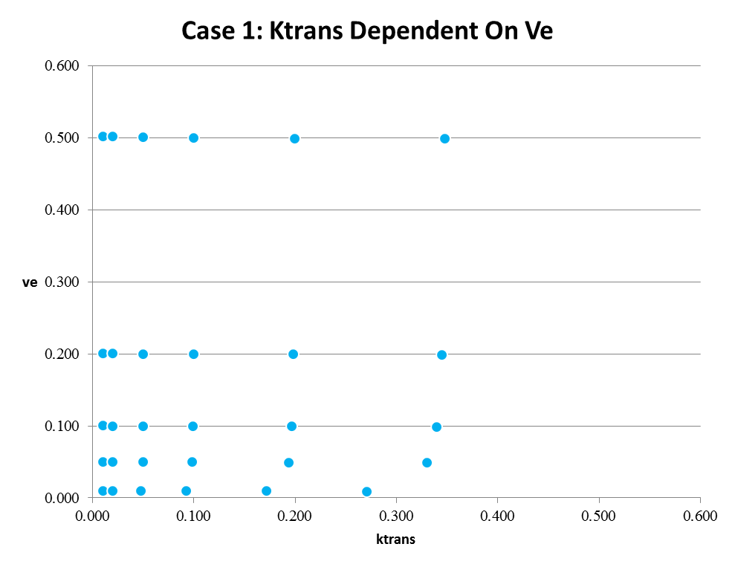
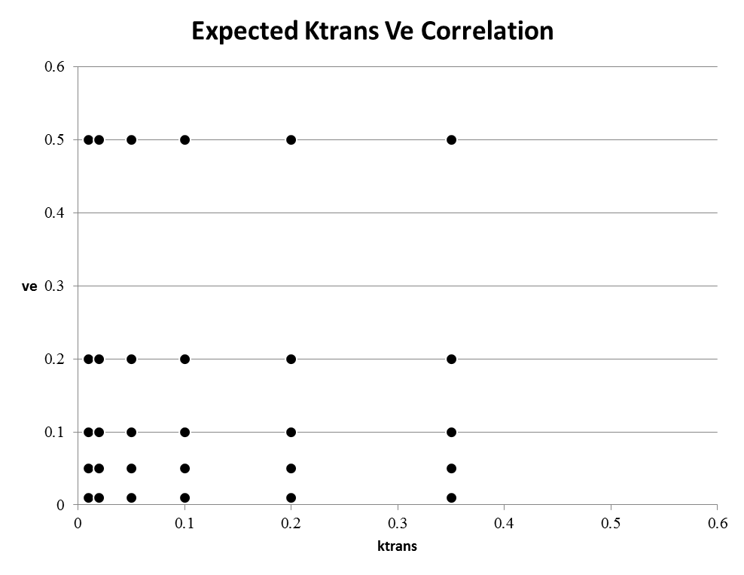
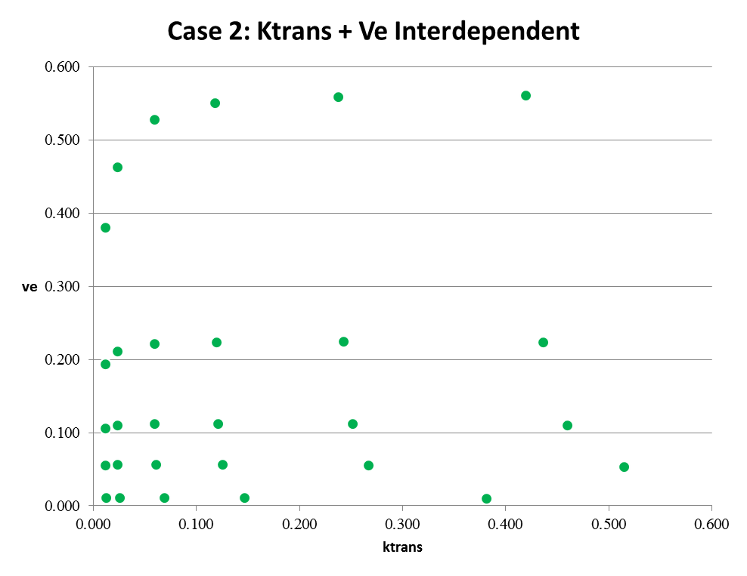
Multi-Site DRO Phantom Study
Correlations were both positive and negative, bidirectional and unidirectional.

Slide 12


Gradient DRO Phantom
To see where these correlations came from, we created a gradient version of the DRO phantom using a script that achieved perfect results on the gridded phantom.
Expected ktrans Map
Expected ve Map
.01
[…]
.35
.01 ----------> .5

Slide 13





Gradient Phantom Error Maps
Generated Ktrans Error Maps
70% AIF Peak Height
Overestimated Tissue T1
Underestimated Blood T1
Wrong Flip Angle
Noisy AIF
.01
[…]
.35
Error from expected
-.5 0 .5

Slide 14


Gradient Phantom Error Maps
Parameter errors may be responsible for processing errors in multi-site study…
Expected ktrans Map
Systematic overestimation
Generated ktransmap
.01
[…]
.35
+
=

Slide 15
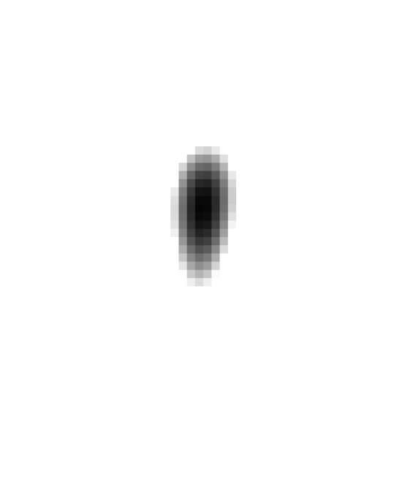
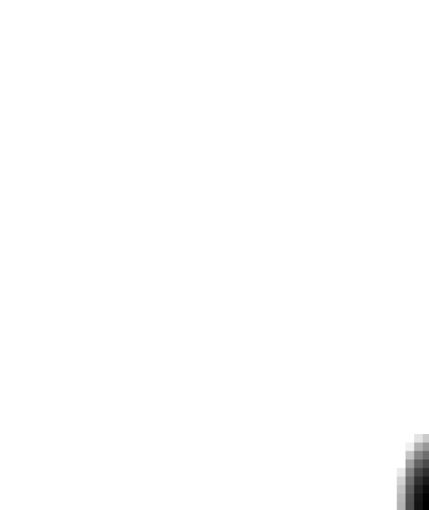
Uncertainty in Fitting…
Some regions of the DRO are easy to fit with a gradient descent algorithm…
Ktrans = .15, Ve = .25
Ktrans = .35, Ve = .5

Slide 16
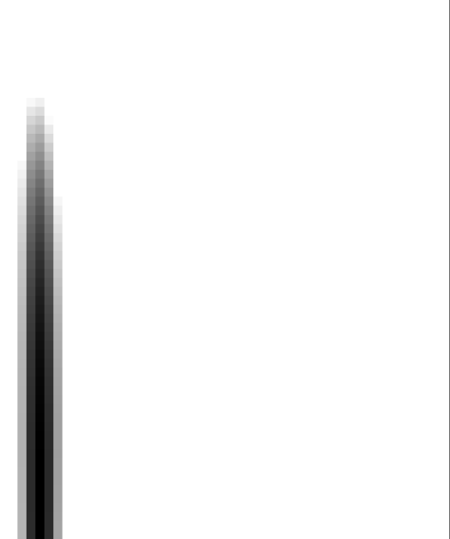
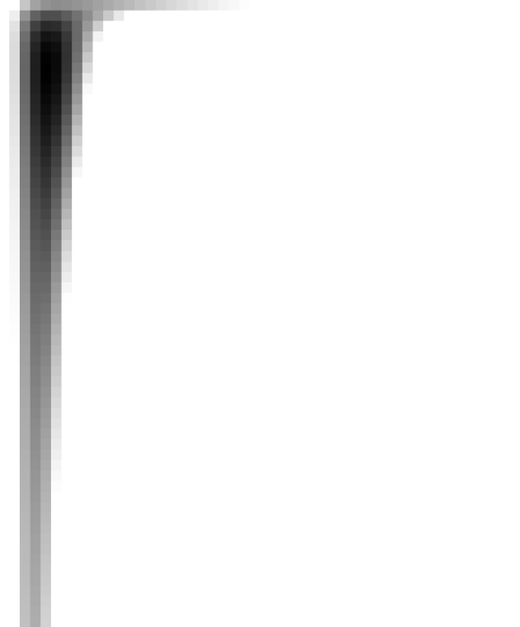
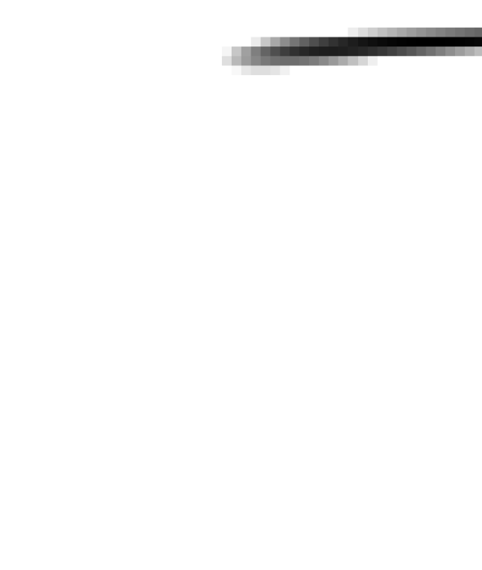
Uncertainty in Fitting…
Other regions are more difficult to fit, and my be more sensitive to small fluctuations caused by noise.
Ktrans = .32, Ve = .05
Ktrans = .03, Ve = .05
Ktrans = .03, Ve = .45

Slide 17
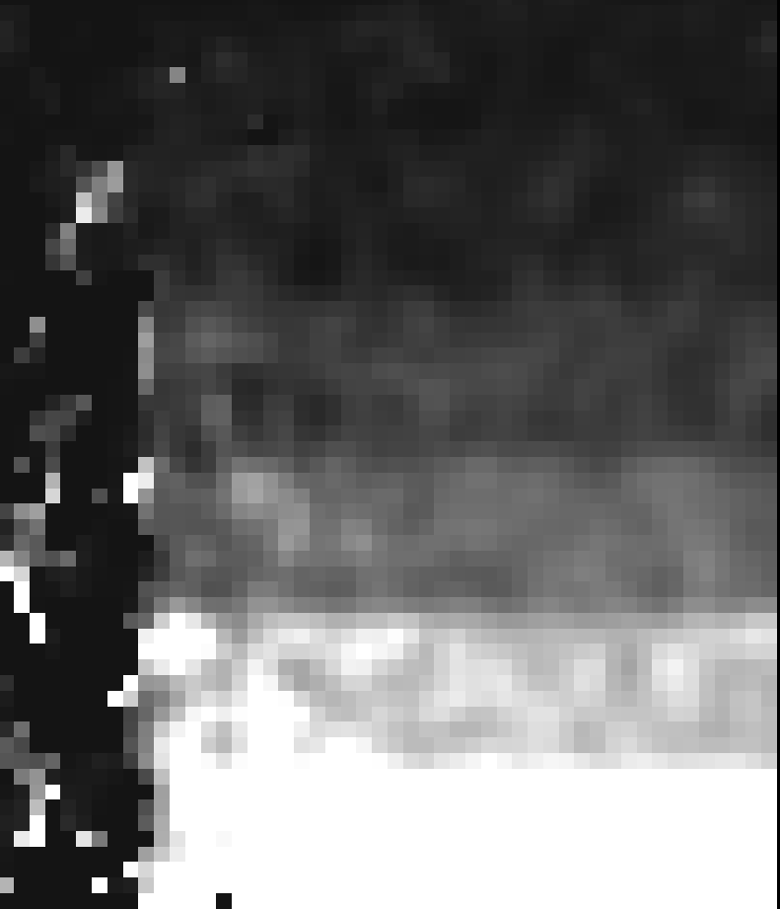
Uncertainty in Fitting…
Other regions are more difficult to fit, and my be more sensitive to small fluctuations caused by noise.
Ktrans Results Noisy Phantom (v9 Tofts)
Ktrans = .32, Ve = .05, Errormap

