Slide 1
Measurement and Analysis of Private Key Sharing in the HTTPS Ecosystem
Presented by: Abeer Ziad AlMarridi 201107191
Computer Security CMPT 542 Fall 2016

Slide 2
Outline
The Problem
Questions need Answer!
How to answer the questions ?
Background
Approaches to support multiple customers‘ HTTPS content
How are keys shared?
Datasets
Methodology
Trust
Certificate Management
Conclusion

Slide 3
The problem
HTTPS content is often hosted by third parties like CDNs.
To do this, websites share their private keys which:
Violates the basic assumptions of the PKI
Creates a centralized target for attackers
Notes:
CDN: content delivery network
PKI L private key infrastructure
CA certificates authorities

Slide 4
Questions need Answer!
The paper aims to answer these two questions
To what extent do websites trust third parties with their private keys?
What implications does key sharing have on the management of the certificates?

Slide 5
How to answer the questions ?
Propose a novel techniques that apply a confluence of datasets to obtain a clearer picture of
Who owns "whether two domains belong to the same organization”
Who serves
Who manages which certificates “is it third party provider or first party provider”

Slide 6
Background
SSL certificated
An SSL certificate is a signed attestation binding a subject to a public key.
Subject is contained in the Common Name” might be the domain name”
SAN list and SNI extensions X.509 certificate specification
SAN : allows a certificate to specify multiple alternate domain names
SNI: extension to the TLS protocol allows a client to specify which domain it is trying to contact before the server presents its certificate.
Hosting providers
CDN
Web hosting services
Notes:
SSL Certificates are small data files that digitally bind a cryptographic key to an organization’s details Issued by CA

Slide 7
Approaches to support multiple customers‘ HTTPS content
One customer per IP address
1 customer certificate→ 1 IP address
Multiple certificates per IP address
Using SNI
Many customer can’t access these websites
“Cruise-liner" certificates
SAN list contain domain name for multiple customers
1 certificate → 1 IP address→ no need to SNI
Many customers → 1 IP address

Slide 8
How the keys are shared?
Upload keys to provider
Delegate key generation to the provider

Slide 9
Datasets
SSL certificate
74 Full IPv4 certificate scans observing 38,514,130 unique SSL certificates.
Reverse DNS
full IPv4 reverse DNS scans
Not always available
AS Number and Organization
using the combination of different data sets to obtain a mapping from an IP address to the organization.
WHOIS
Used to check domain ownership

Slide 10
Determining who owns a domain
Certificate scans → Not enough
one organization that maps to multiple domains, and each of those domains may map to multiple certificates. “makes the scan hard”
Many certificates contain more than one organization.” cruise-liner”
Information from WHOIS
if two domains share a contact email address, then they are likely administered by the same organization→ filtering needed

Slide 11
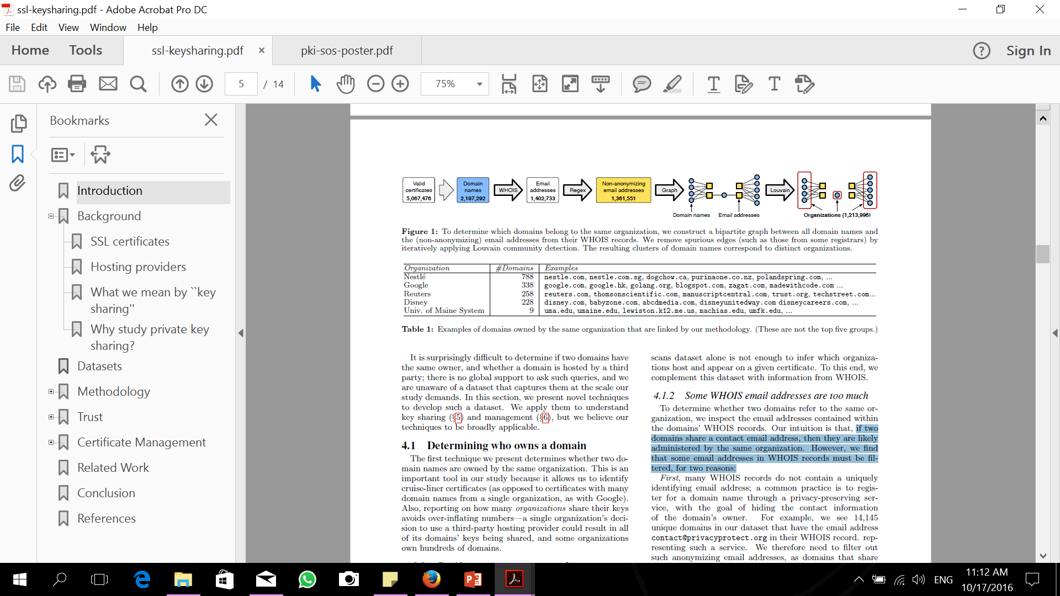
Determining who owns a domain
WHOIS extraction
Filtering
Graph construction
Community detection →Louvain community detection algorithm

Slide 12
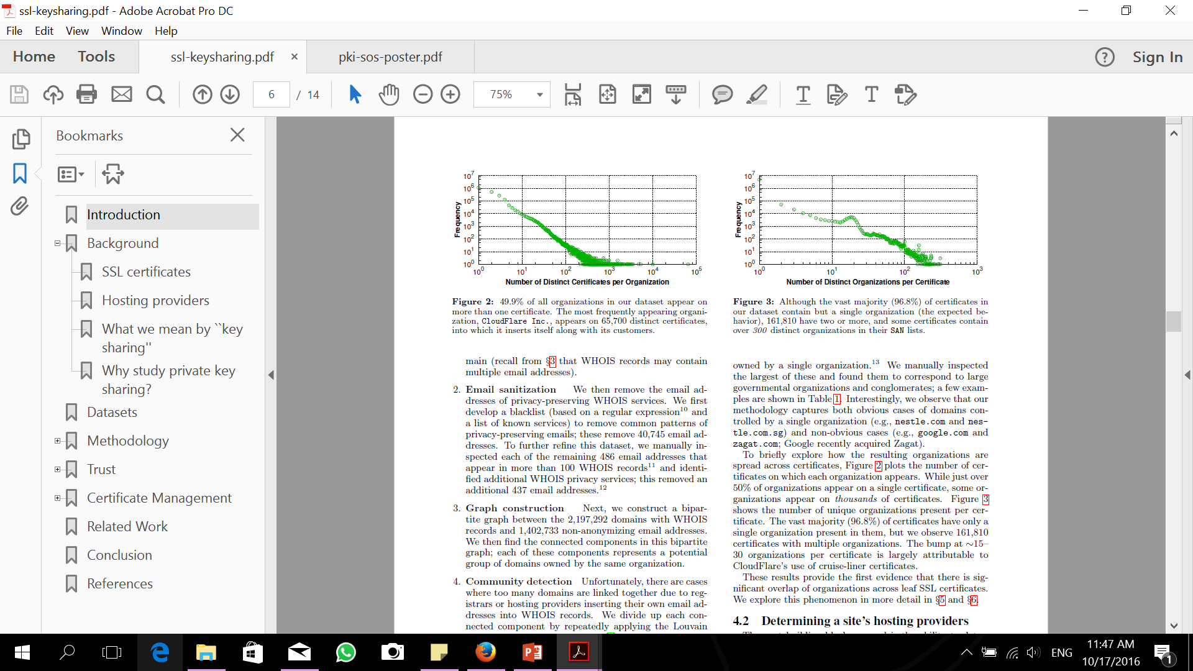
Applying on the data set
the number of certificates on which each organization appears.
Just over 50% of organizations appear on a single certificate.
Some organizations appear on thousands of certificates.

Slide 13
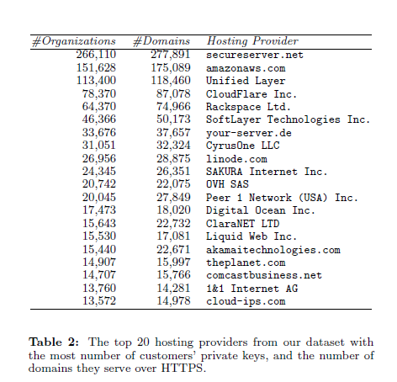
Determining a site’s hosting providers

Slide 14
First- vs. third-party hosting
The answer of Who Owns →The organizations stored in each certificate, in the form of clusters of domain names,
The answer of Who serve→The name of an organization that owns an IP address, either in the form of a domain name or an AS Organization Name.
Combine both to determine if a certificate is first- or third-party hosted.

Slide 15

The Extent of Sharing

Slide 16
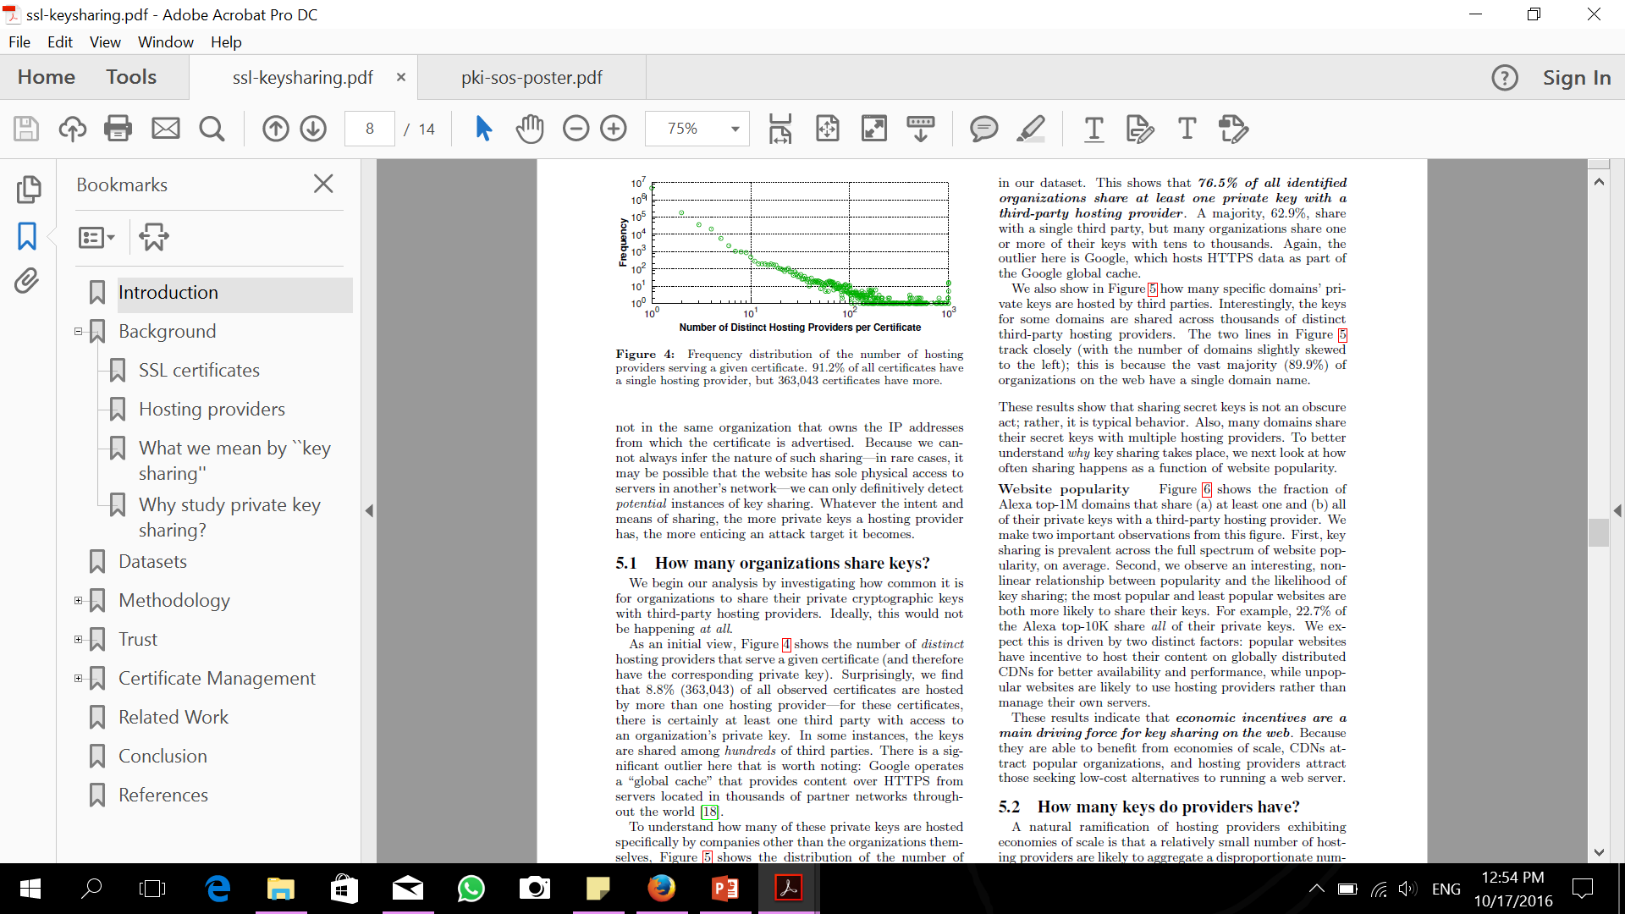
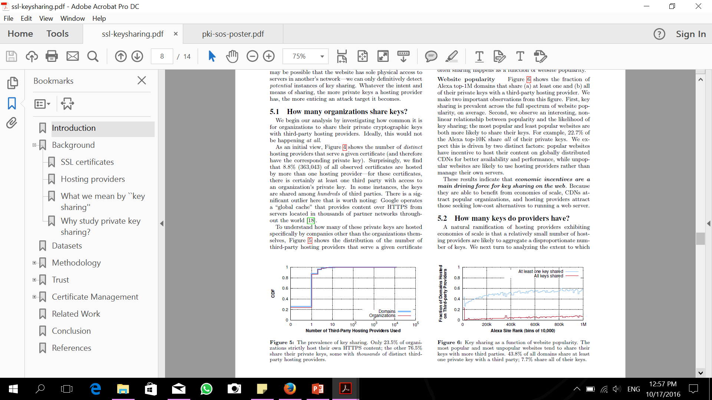
How many organizations share keys?
The number of distinct hosting providers that serve a given certificate.
76.5% of all identified organizations share at least one private key with a third-party hosting provider.

Slide 17

How many keys do providers have?
For each hosting provider, the number of organizations for which it has at least one of their private keys.

Slide 18

Certificate Management
The results shows that third-party management is common across all levels of popularity
Over 33% of all domains have their HTTPS certificates managed by another organization.
Popular websites outsource certificate management more often. BUT they would still maintain control over certificate management.
Third- party are able to manage certificate revocation and reissue faster and better that self-managed
Third-party hosting providers are slower to react to events, but ultimately more detailed

Slide 19
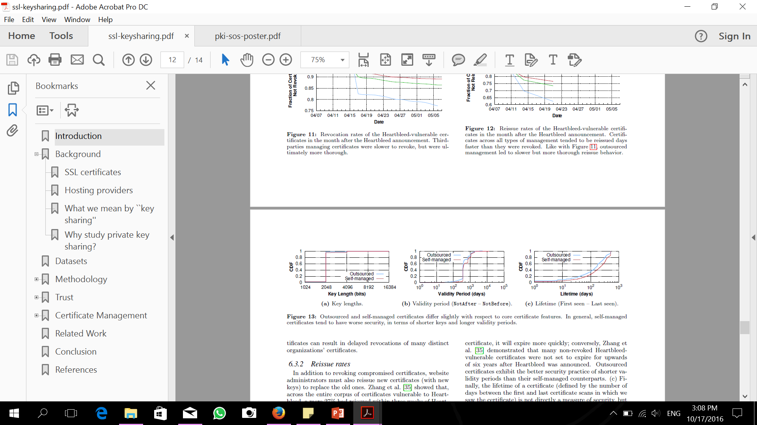
Certificate quality
Revoking and reissuing certificates are not the only acts that third-party hosting providers tend to do better; they also tend to create better certificates, as well.

Slide 20
Conclusion
76.5% of all organizations on the web that we identified share at least one private key with a third-party hosting provider.
Third parties are slower to re-act to large-scale vulnerabilities but eventually react more carefully.
Hosting providers are prime targets for attack
Future Work : new techniques that enable providers to serve content without access to private keys.

Slide 21
Thanks ☺

