Slide 1
Assembling Line Balancing Dataset
27.06.2023
Regensburg

Slide 2
Use Cases – Assembly Line Balancing
Problem statement Assembly Line Balancing
Tactical planning problem in the automotive and supplier industry
Ensure efficient production, e.g. minimum number of stations
Assignment of tasks to stations and meet all restrictions
Time per station: 66
36
36
24
A
B
G
12
54
12
H
I
J
30
30
24
C
D
E
F
30
source: assembly-line-balancing.de

Slide 3
Basic Problem Description (SALBP)
General Parameters
Number of Tasks n | Total number of tasks to be assigned to stations
Order Strength | Indicates the degree of connection between the tasks; Calculated by dividing the number of direct and indirect (transitive) connections by the number of possible connections
Precedence Relations (i,j) | Restrictions on the order in which tasks are performed (j must not be planned before i); Only direct precedence relations should be included
Cycle Time c | One cycle time is available per station
Task Parameters
Time t_{i} | Time needed to complete task i

Slide 4
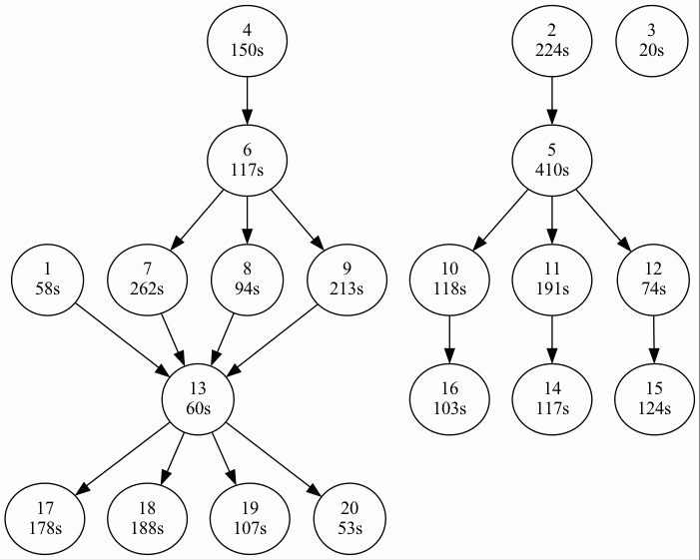
ALB Format
<number of tasks> 20 <cycle time> 1000 <order strength> 0,3 <task times> 1 58 2 224 3 20 … <precedence relations> 1,13 2,5 …

Slide 5
ALB Format
 | 1 | 2 | 3 | 4 | 5 | 6 | 7 | 8 | 9 | 10 | 11 | 12 | 13 | 14 | 15 | 16 | 17 | 18 | 19 | 20
1
2
3
4
5 |  | x
6 |  |  |  | x
7 |  |  |  | x |  | x
8 |  |  |  | x |  | x
9 |  |  |  | x |  | x
10 |  | x |  |  | x
11 |  | x |  |  | x
12 |  | x |  |  | x
13 | x |  |  | x |  | x | x | x | x
14 |  | x |  |  | x |  |  |  |  |  | x
15 |  | x |  |  | x |  |  |  |  |  |  | x
16 |  | x |  |  | x |  |  |  |  | x
17 | x |  |  | x |  | x | x | x | x |  |  |  | x
18 | x |  |  | x |  | x | x | x | x |  |  |  | x
19 | x |  |  | x |  | x | x | x | x |  |  |  | x
20 | x |  |  | x |  | x | x | x | x |  |  |  | x
order strength = 57 / 190 = 0.3

Slide 6
Possible Extension (ARALBP)
General Parameters
Number of Tasks n | Total number of tasks to be assigned to stations
Order Strength | Indicates the degree of connection between the tasks; Calculated by dividing the number of direct and indirect (transitive) connections by the number of possible connections
Precedence Relations (i,j) | Restrictions on the order in which tasks are performed (j must not be planned before i); Only direct precedence relations should be included
Cycle Time c | One cycle time is available per station
Number of Task Attributes | Number of additional attributes per task
Linked Tasks (i,j) | Tasks i and j need to be planned on the same station
Incompatible Tasks (i,j) | Tasks i and j must not be planned on the same station
Station Parameters
Attribute Bounds per Station | Upper bound for task attribute per station
Task Parameters
Time t_{i} | Time needed to complete task i
Attribute Values | Values per additional attribute
Notes:
Example for task attributes: space restrictions for placing machines or material boxes next to the assembly line
-> the paper describes additonal restrictions (task-to-station assignments, distance restrictions) and claims to have produced data sets for them

Slide 7
Possible Extension (SDALBP)
General Parameters
Number of Tasks n | Total number of tasks to be assigned to stations
Order Strength | Indicates the degree of connection between the tasks; Calculated by dividing the number of direct and indirect (transitive) connections by the number of possible connections
Precedence Relations (i,j) | Restrictions on the order in which tasks are performed (j must not be planned before i); Only direct precedence relations should be included
Cycle Time c | One cycle time is available per station
Task Parameters
Time t_{i} | Time needed to complete task i
Sequence Dependent Task Time Increment sd_{ij} | Executing task i before task j prolongs j’s execution time by sd_{ij}
Notes:
Ex.: mounting the parking brake will be complicated when the front seats are already installed in the car
-> note that only the order of the tasks is relevant, they do not have to be executed in direct succession

Slide 8
Possible Extension (SUALBSP)
General Parameters
Number of Tasks n | Total number of tasks to be assigned to stations
Order Strength | Indicates the degree of connection between the tasks; Calculated by dividing the number of direct and indirect (transitive) connections by the number of possible connections
Precedence Relations (i,j) | Restrictions on the order in which tasks are performed (j must not be planned before i); Only direct precedence relations should be included
Cycle Time c | One cycle time is available per station
Task Parameters
Time t_{i} | Time needed to complete task i
Sequence Dependent Forward Setup Time fsu_{ij} | Executing task i and j at the same station prolongs execution time by fsu_{ij}
Sequence Dependent Backward Setup Time bsu_{ij} | Executing task i and j on two succeeding stations prolongs execution time by bsu_{ij}
Notes:
New Parameter: Sequence Dependent Setup Time for every task pair -> models walking times, tool changes, material handling necessary to execute the tasks in this order
Newer Dataset distinguishes between forward setup times (extra time needed to execute j after i at the same station) and backward setup times (extra time needed when i is the last task of a station and j is executed at the beginning of the next station, e.g. to walk between the stations)

Slide 9
Possible Extension (ASALBP)
General Parameters
Number of Tasks n | Total number of tasks to be assigned to stations
Order Strength | Indicates the degree of connection between the tasks; Calculated by dividing the number of direct and indirect (transitive) connections by the number of possible connections
Precedence Relations (i,j) | Restrictions on the order in which tasks are performed (j must not be planned before i); Only direct precedence relations should be included
Cycle Time c | One cycle time is available per station
OR-nodes (i,j) | Choose one production path (among multiple alternatives) between i and j
Task Parameters
Time t_{i} | Time needed to complete task i
Notes:
Used to model flexibility in performing a set of tasks. Example: a part might be connected to a workpiece by glueing, screwing or riveting;
Note „that it is not necessarily optimal to choose the production process with minimal total task time“

Slide 10
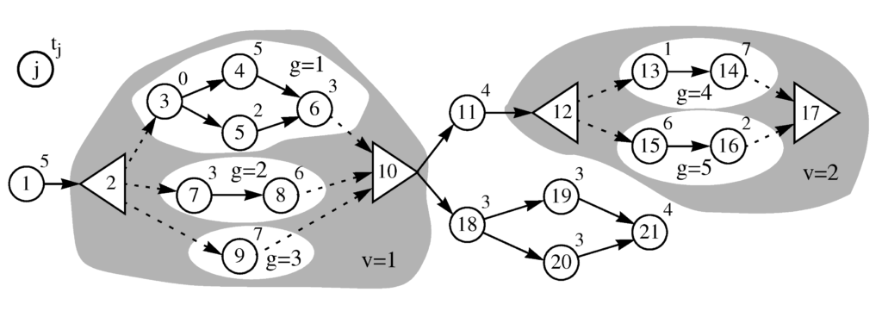
Example ASALBP
Cycle time: c = 10
OR-nodes: 2,10 and 12,17
Dummy node: 3
Picture taken from: Scholl, A.; Boysen, N.; Fliedner, M. (2009): Optimally solving the alternative subgraphs assembly line balancing problem. Annals of Operations Research 172/1, 243-258.
Notes:
„To keep the presentation lucid, it is moreover defined that each alternative subgraph must have a unique start and end node. If this is not already the case, dummy nodes with time 0 will be introduced."

Slide 11
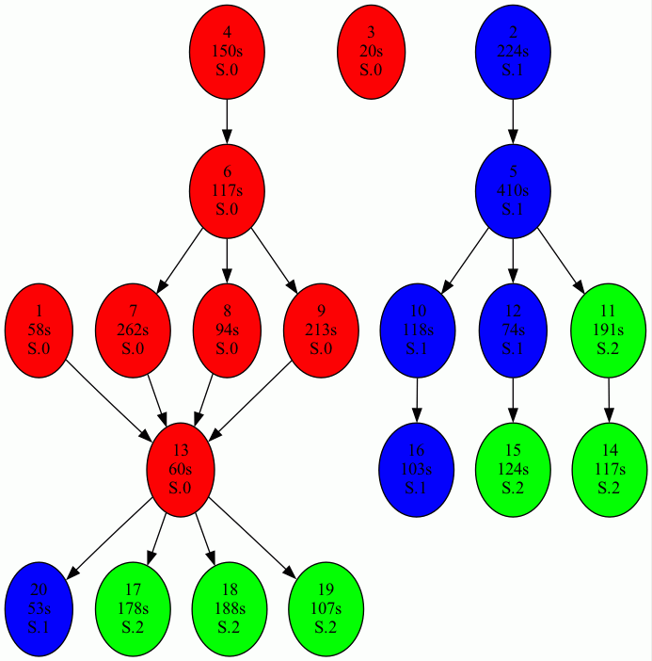
Solve SALBP as MIP Model

Slide 12
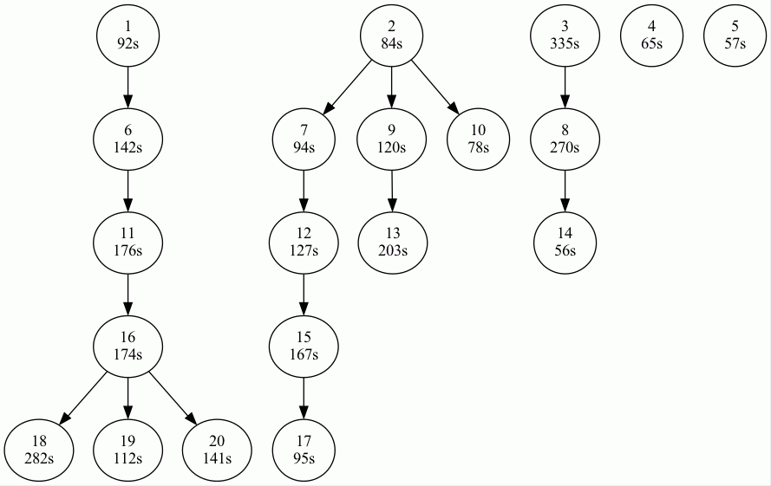
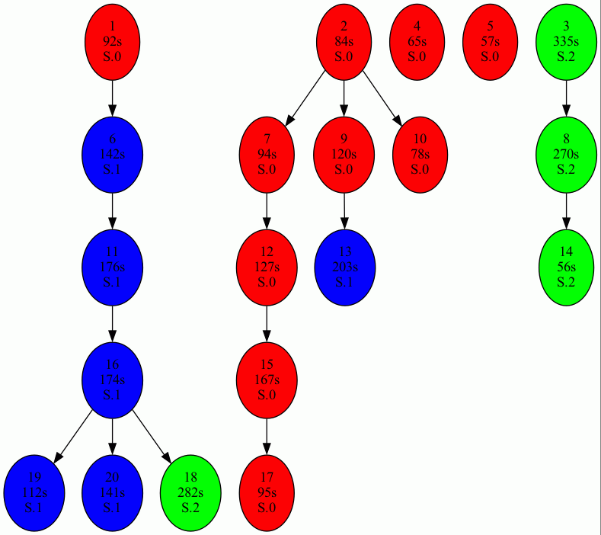
Solve SALBP as MIP Model

