Slide 1
Unternehmenspräsentation 2021

Slide 2
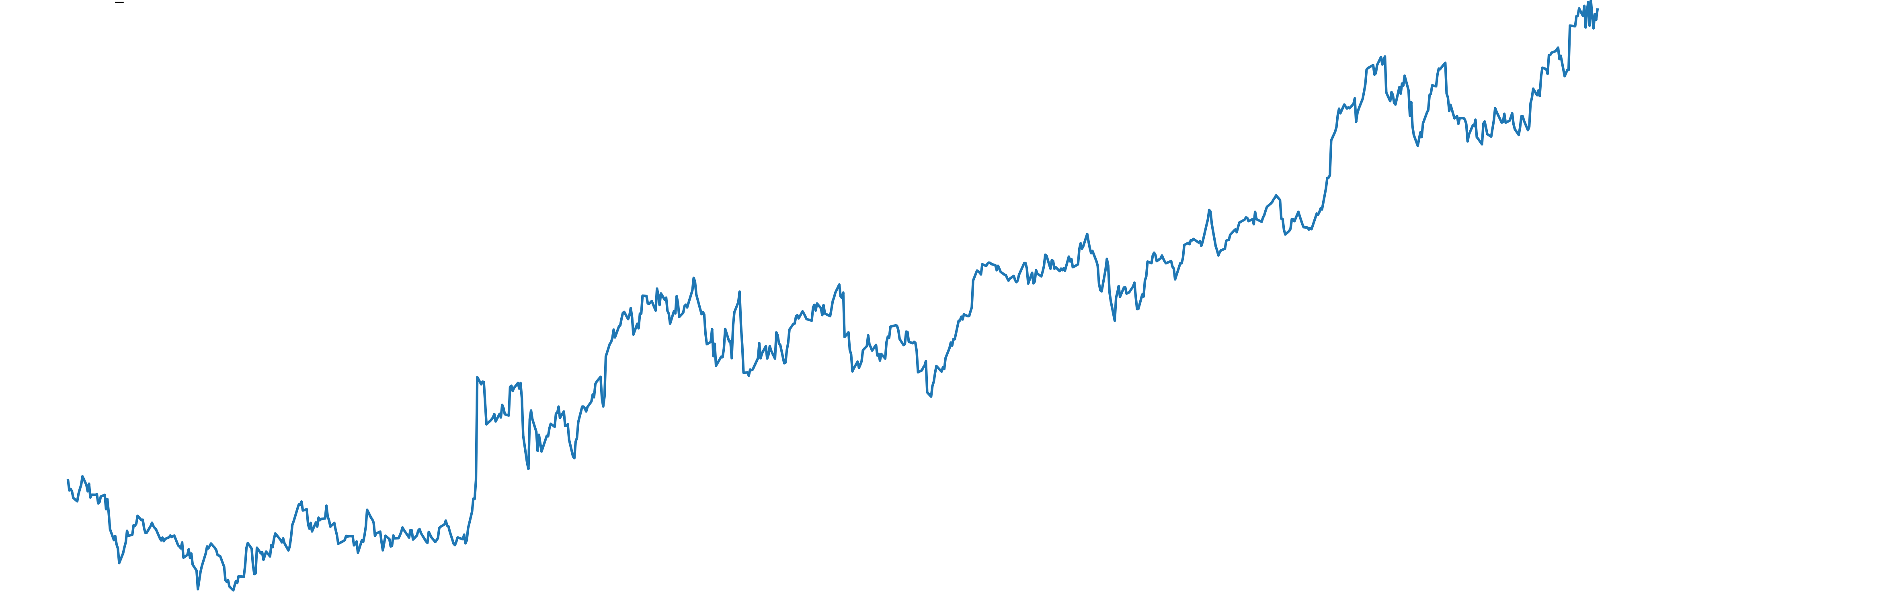
Introduction
Methods for calculating an optimal stock portfolio still focus on historic data of stock returns and additionally have difficulties capturing non-linearities of the timeseries when quantifying risk.
This talk addresses this problem using deep learning methods.
A basic knowledge of deep learning and portfolio management is required.

Slide 3





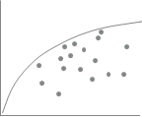

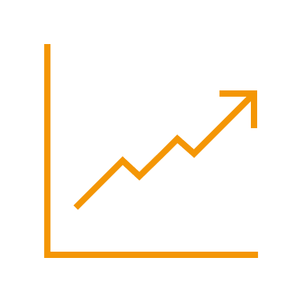
Introduction
Focus, forecast and clean.
Which stocks to analyze? Focus on stocks that move the market to decrease computation time!
Does forecasting improve the portfolio? Don’t forecast too far. A forecast is only a strong indicator.
How to improve the risk calculation of a stock? Try to capture non-linearities in the time series.
How to calculate an optimal portfolio? Don’t trust the in-sample results. Look at the out-of-sample results.

Slide 4
Literature Review

Slide 5
Literature Review
Heaton et.al
(Deep Portfolio)
Timeline of portfolio selection methods
Degree of applicability
Ledoit & Wolf, 2003
(Shrinkage)
Black-Litterman
McKibbon
and Rose
(APT)
Markowitz, Sharpe (CAPM)
Markowitz
1952
1964
1973-1976
1991
2002
2016

Slide 6
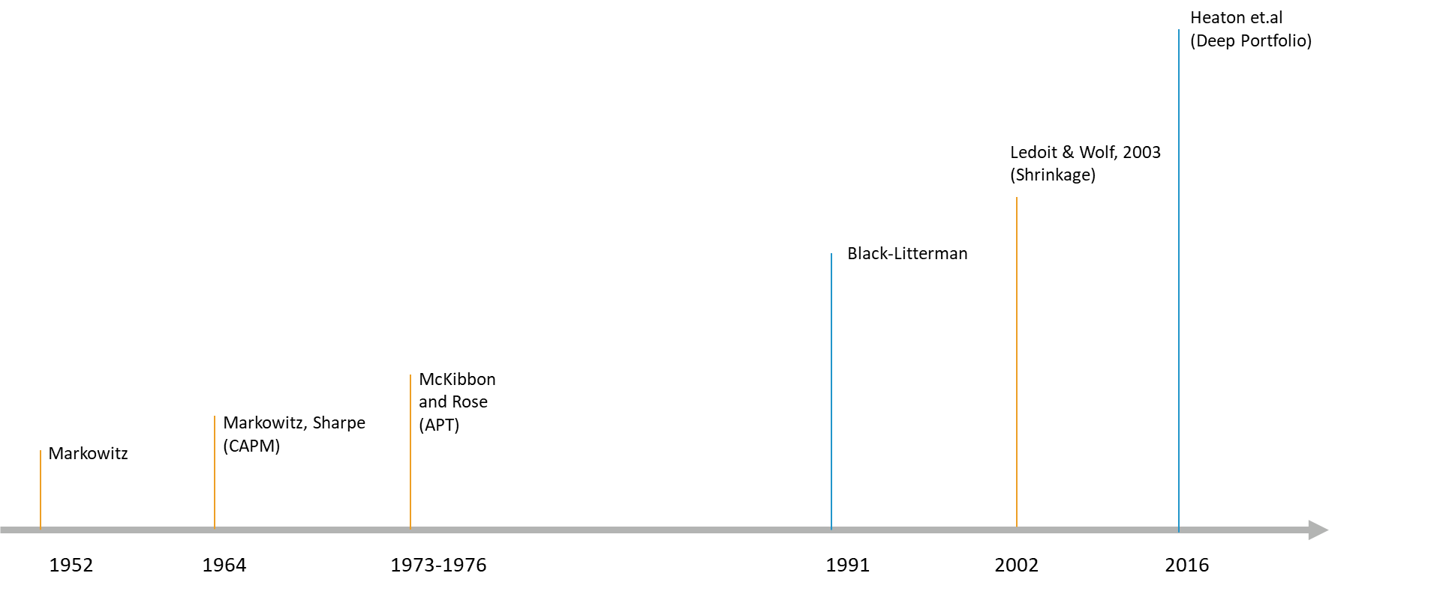
Literature Review
LSTMs
(Hochreiter, 1997)
Timeline of deep learning methods
Degree of applicability
Autoencoder
(Goodfellow et al., 2016)
Backpropagation (Werbos, 1974)
RNN
(Jordan, 1986)
BBT
(Werbos, 1990)
Timeline of deep learning methods

Slide 7
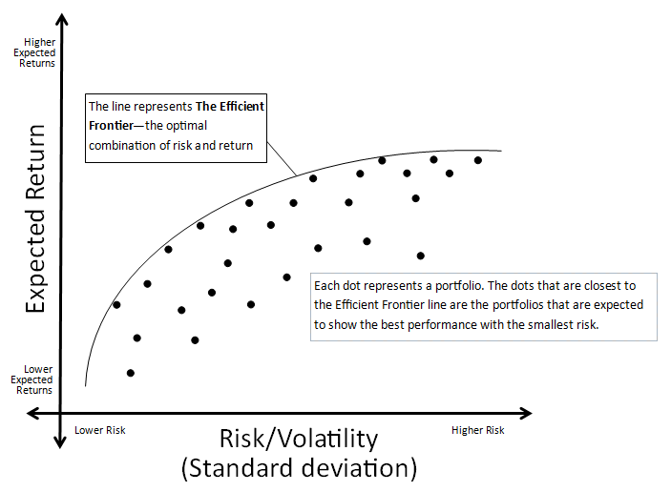
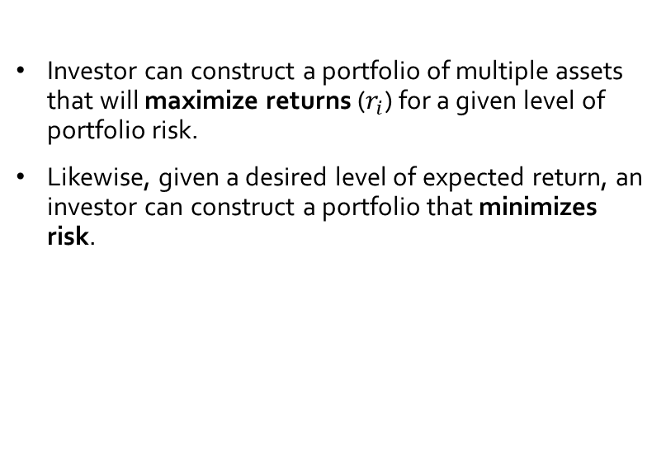
Literature Review
Modern portfolio theory (MPT) (Markowitz, 1952)
What is MPT?
Investor can construct a portfolio of multiple assets that will maximize returns ($r_{i}$) for a given level of portfolio risk.
Likewise, given a desired level of expected return, an investor can construct a portfolio that minimizes risk.
Efficient frontier: Source: http://www.alamedafinancialgroup.com/Our-Investment-Phiosophy.5.htm

Slide 8
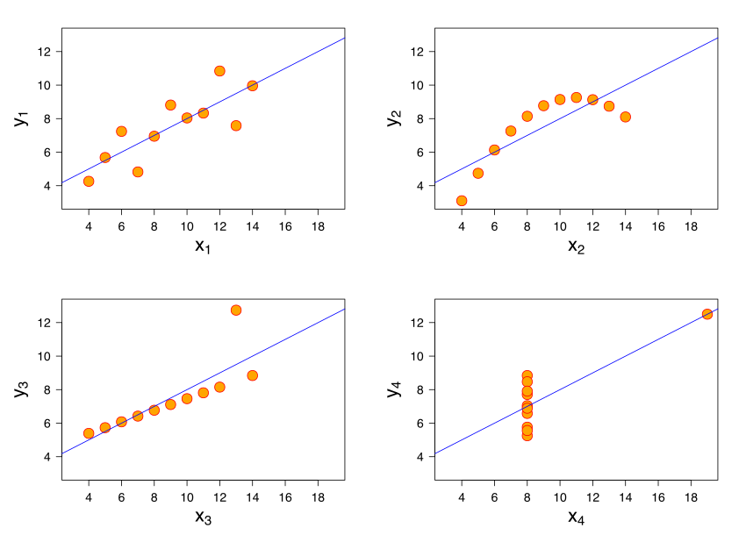
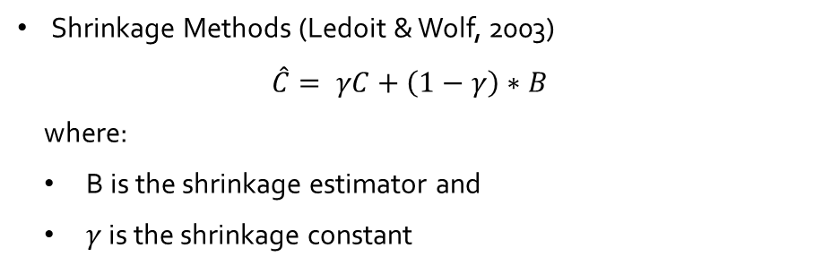
Literature Review
Modern portfolio theory (MPT) (Markowitz, 1952)
Pitfalls of covariance
The covariance indicates a linear relationship between two variables. Hence it can be fallacious in situations where two variables have a relationship, but it is nonlinear.
Covariance is strongly influenced by outliers.
Solutions
Shrinkage Methods (Ledoit & Wolf, 2003)
$$\hat{C}= γC+\left(1−γ\right)∗B$$
where:
B is the shrinkage estimator and
$γ$ is the shrinkage constant
Anscombe's quartet: All four sets are identical when examined using simple summary statistics but vary considerably when graphed.

Slide 9

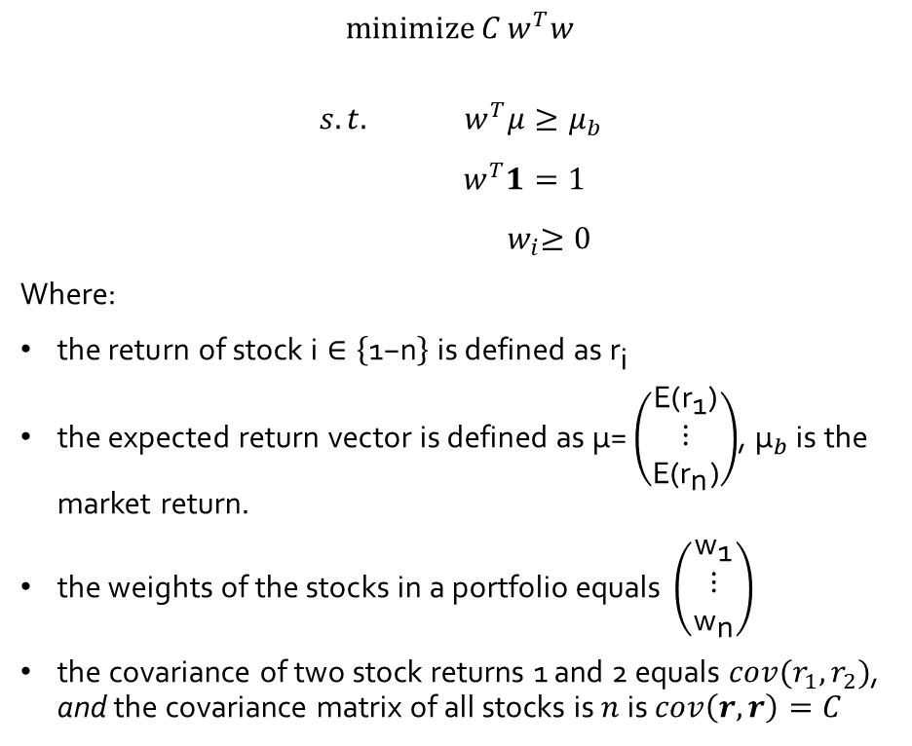
Literature Review
Modern portfolio theory (MPT) (Markowitz, 1952)
$$\operatorname{minimize}{C}w^{T}w$$
$$s.t.{ w}^{T}μ≥μ_{b}$$
$$w^{T}1=1$$
$${ w}_{i}≥0$$
Where:
$\text{the} \text{return} \text{of} \text{stock} \text{i}∈\left\{\text{1−}\text{n}\right\} \text{is} \text{defined} \text{as}{ \text{r}}_{\text{i}}$
$\text{the} \text{expected} \text{return} \text{vector} \text{is} \text{defined} \text{as} \text{μ}\text{=}\left(\begin{matrix}\text{E}\text{(}{\text{r}}_{\text{1}}\text{)} \\ \text{⋮} \\ \text{E}\text{(}{\text{r}}_{\text{n}}\text{)}\end{matrix}\right)$, ${\text{μ}}_{b}$ is the market return.
$\text{the} \text{weights} \text{of} \text{the} \text{stocks} \text{in} \text{a} \text{portfolio} \text{equals} \left(\begin{matrix}{\text{w}}_{\text{1}} \\ \text{⋮} \\ {\text{w}}_{\text{n}}\end{matrix}\right)$
the covariance of two stock returns 1 and 2 equals $cov(r_{1},r_{2})$, and the covariance matrix of all stocks is $n$ is $cov\left(r,r\right)=C$
Source: https://medium.com/datadriveninvestor/simple-portfolio-optimization-harry-markowitz-mean-variance-model-using-excel-part-1-efc3f19a347

Slide 10
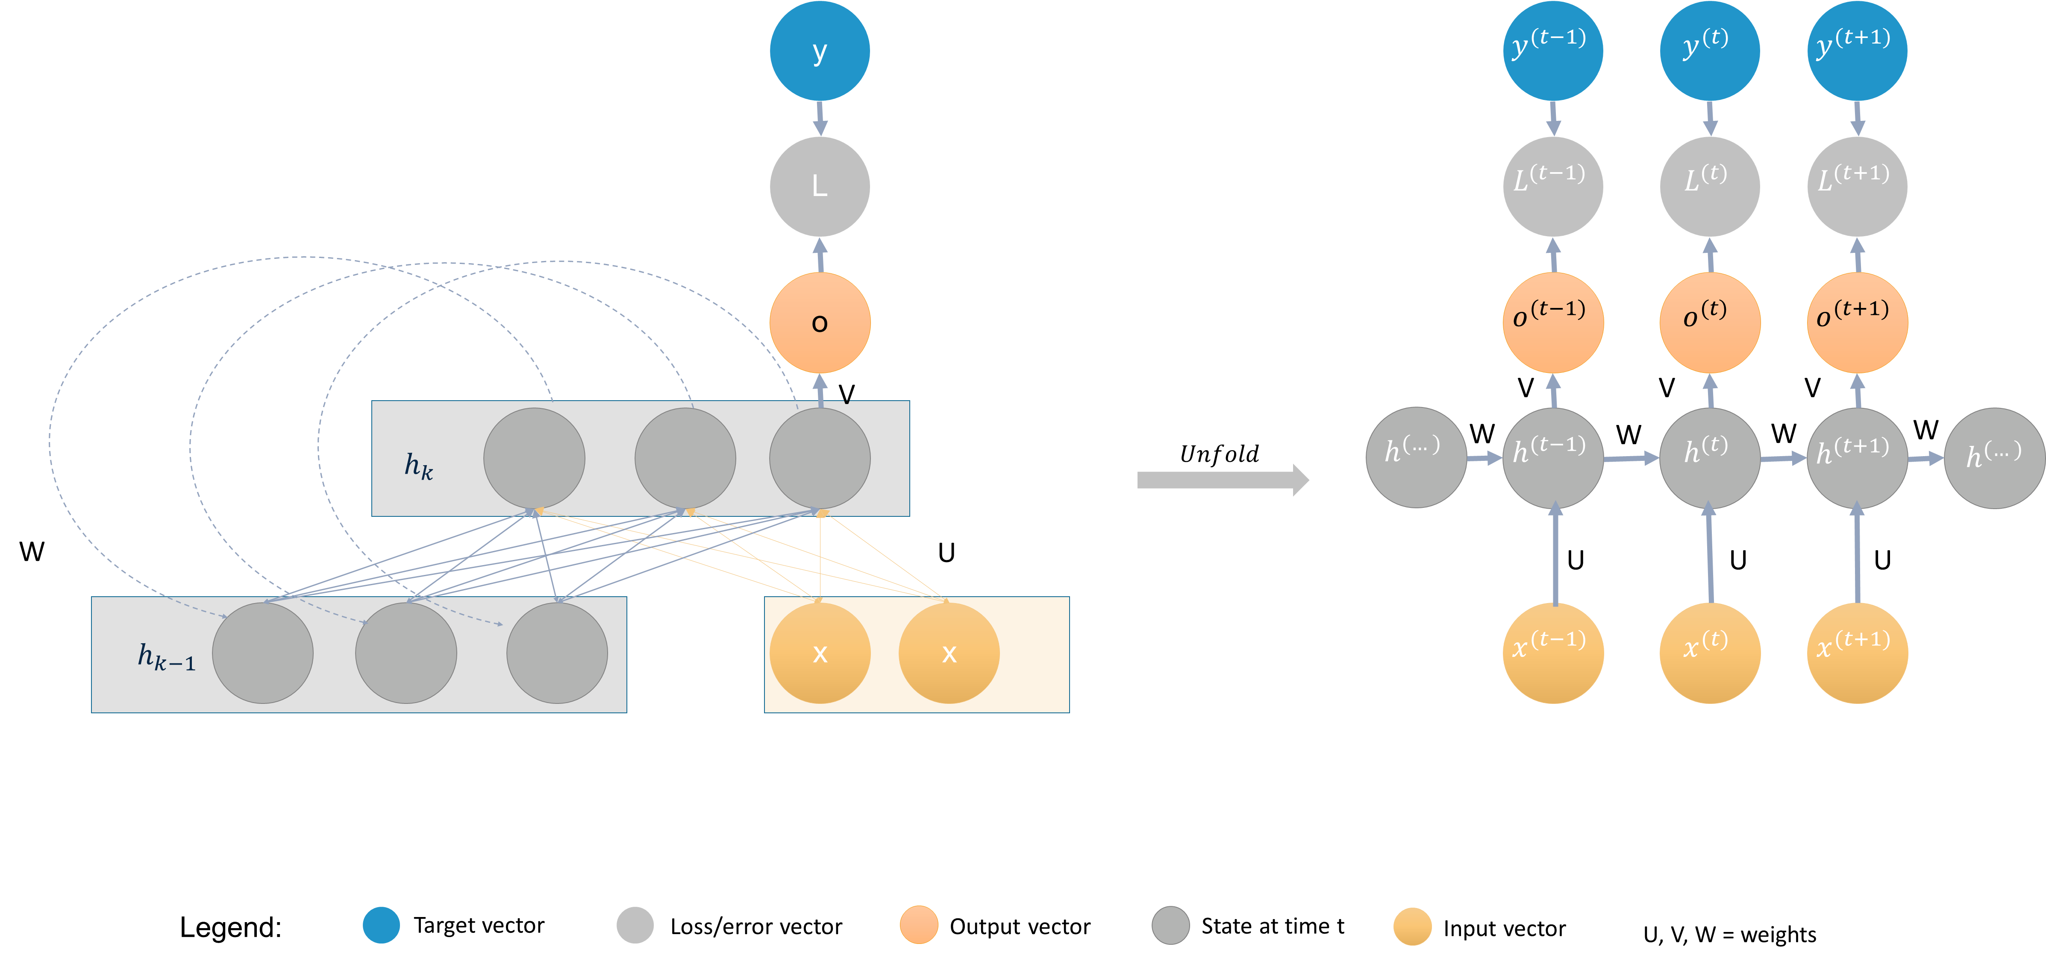
Literature Review
How do Recurrent neural networks work?
Recurrent neural networks (RNNs) process sequential data.
Each state of the RNN is therefore a function depending on its previous states.
An example of a folded and unfolded RNN.

Slide 11
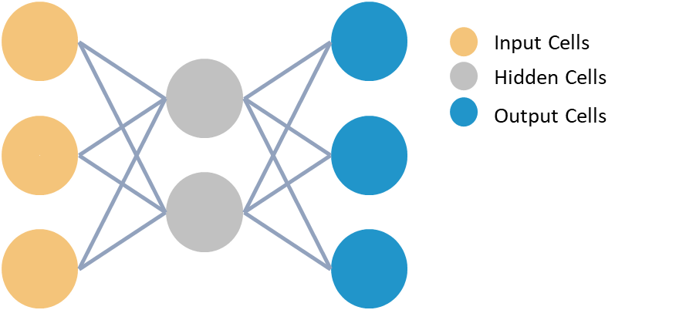




Literature Review
What are Autoencoders?
$$x$$
z
$$\acute{x}$$
An autoencoder is an unsupervised neural network that is trained to attempt to copy its input to its output [Goodfellow et al., 2016].
Autoencoders are used for:
dimensionality reduction
removing structural noise
feature learning
outlier detection
$$Encoding$$
$$Decoding$$
An example of a folded and unfolded RNN.
Example of an undercomplete autoencoder with three input and output layers and two hidden layers.

Slide 12
Data, Methodology & Results

Slide 13
Data, Methodology & Results
Which stocks to analyze? → Apply an autoencoder model and filter stocks that can be recreated best
Does forecasting improve the portfolio? → Forecast the next 10-days of a stock closing value into the future using Recurrent Neural networks
How to improve the risk calculation of a stock? → Apply latent features of an autoencoder model to clean the sample covariance matrix
How to calculate an optimal portfolio? → Apply Markowitz portfolio optimization and find the optimal stocks for the portfolio

Slide 14
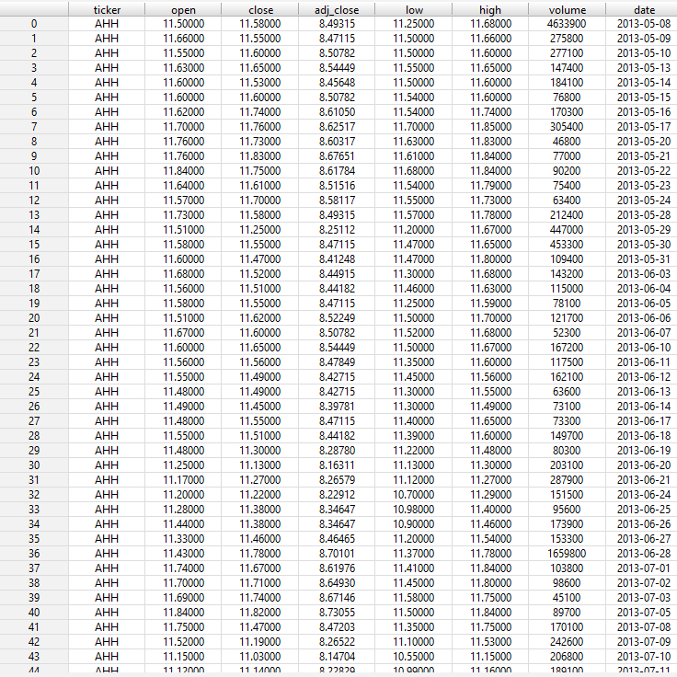
Dataset
Dataset: daily-historical-stock-prices-1970-2018
Source: Kaggle
Stock exchanges NYSE and NASDAQ
Dataset dimension: [20973889 rows x 8 columns]
Tickers: 5685
Original stock dataset

Slide 15
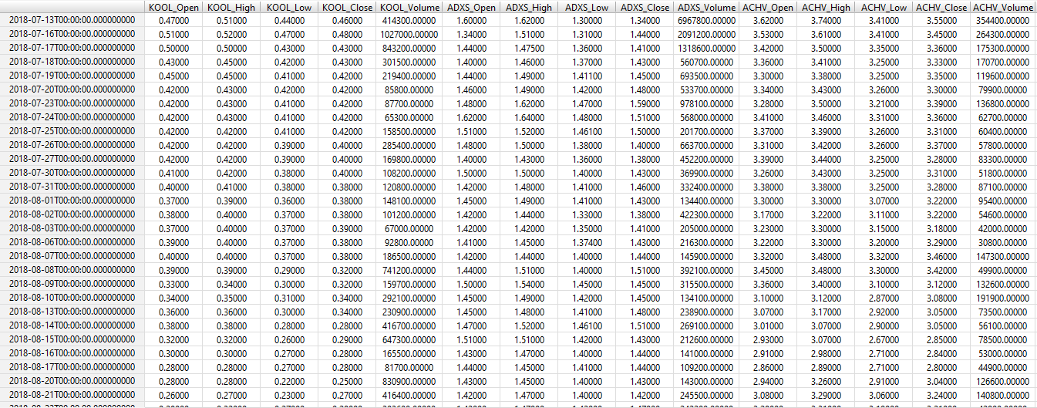
Dataset
Selected last 1000 days from 2014 -2018
Transformed each ticker into columns
Final dataset: [1000 rows x 13925 columns]
Transformed stock dataset

Slide 16
Which stocks to analyze?
1
Focus on stocks that move the market!
s1
…
S_n
t1
0.3
0.2
0.1
0.1
0.3
0.2
0.4
0.1
-2
0.3
0.4
Intuition:
The stocks with the lowest recreation error (L2-norm) represent the market better. They are less volatile and are considered to be similar to large cap stocks.
Returns
0.1
Returns
Input Cells
Hidden Cells
Output Cells
t_n
Top 500
Calculate L2-Norm and select best recreated stocks
Autoencoder model with ranked recreation error.

Slide 17
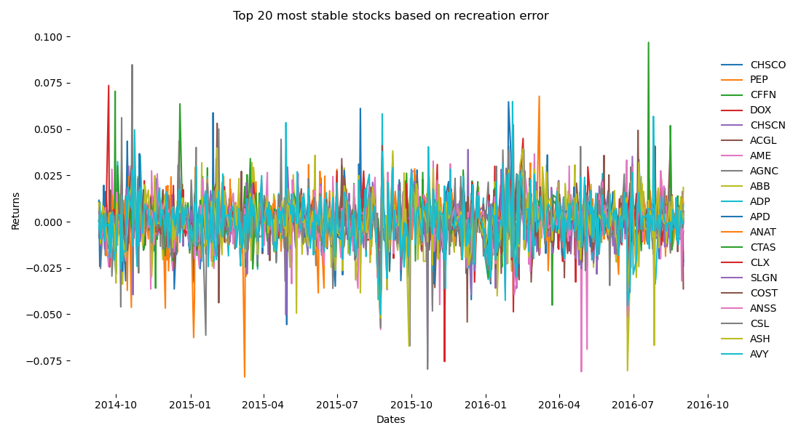
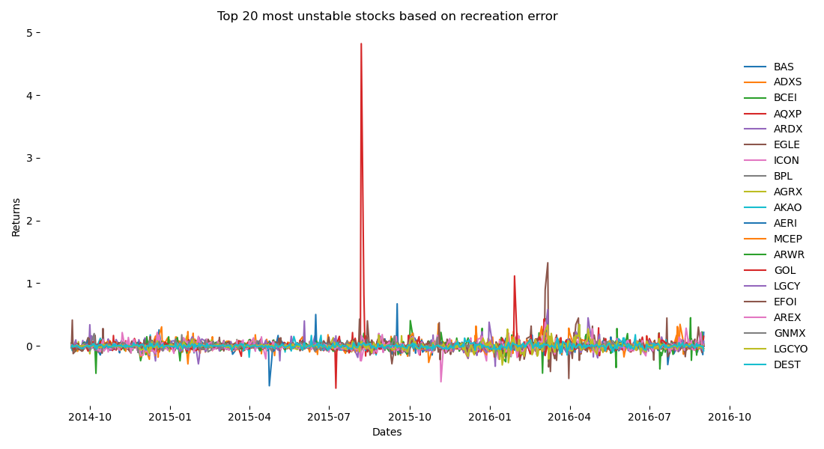
Which stocks to analyze?
1
Unstable stocks tend to be more volatile and have more unexpected spikes!
Top 20 most stable and most unstable stocks ranked by recreation error.

Slide 18
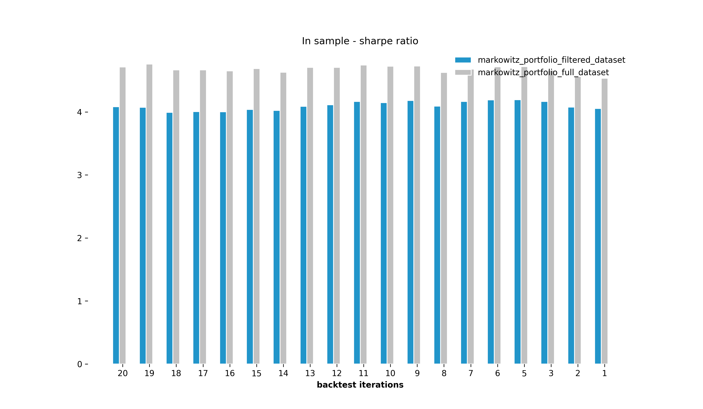
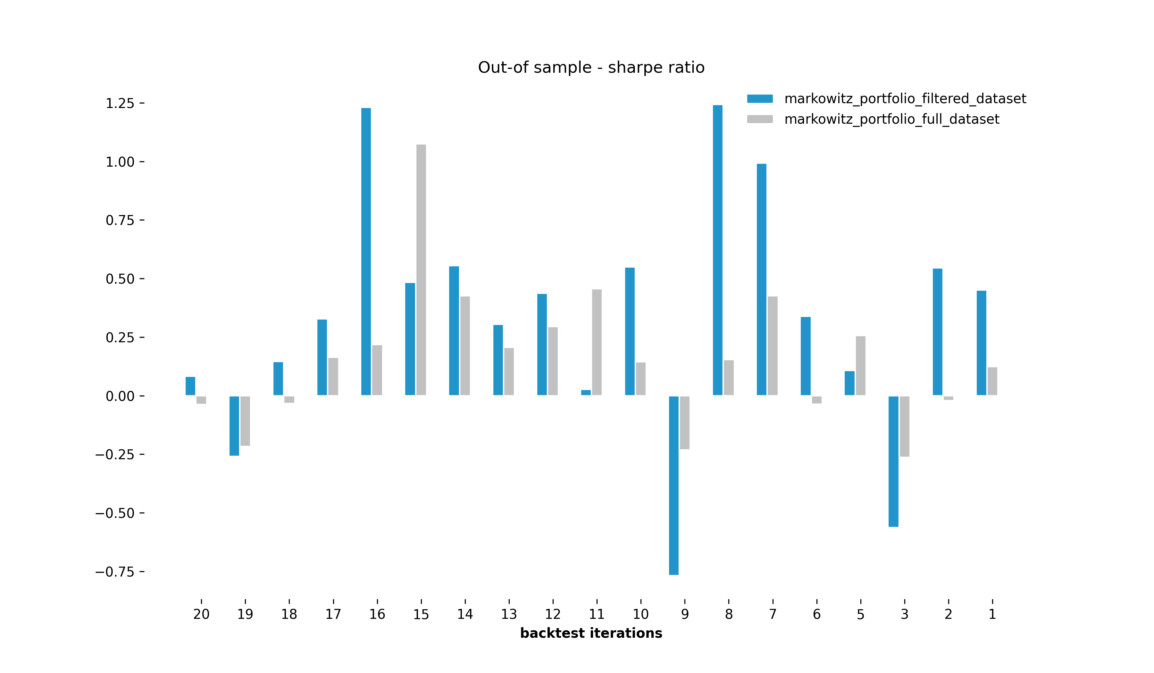
Which stocks to analyze?
1
Filtering based on recreation error improves out-of sample performance!
In-sample and out-of-sample sharpe ratio of models trained on full dataset and filtered dataset.

Slide 19
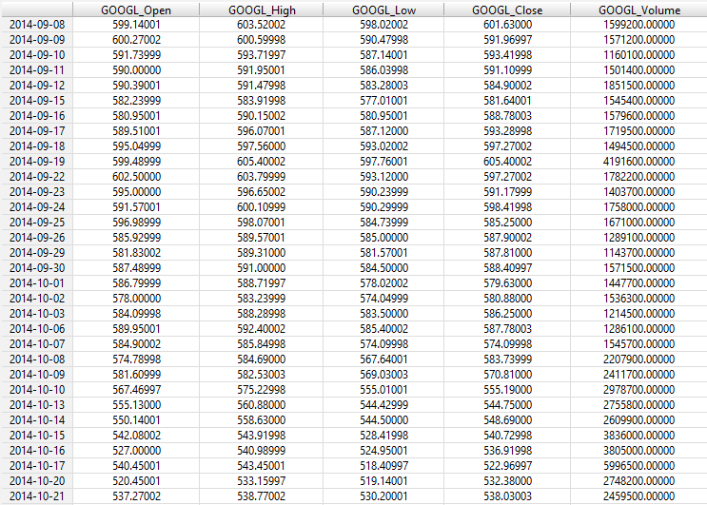
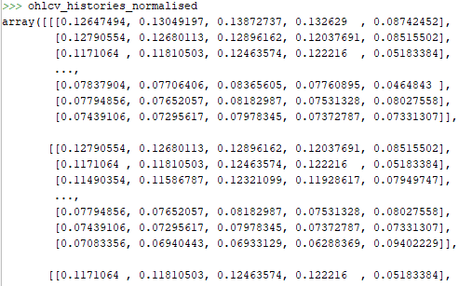
Does forecasting improve the portfolio?
2
Data transformation is still part of the job!
50 days sliding window
50 day sliding window example for RNN model.

Slide 20
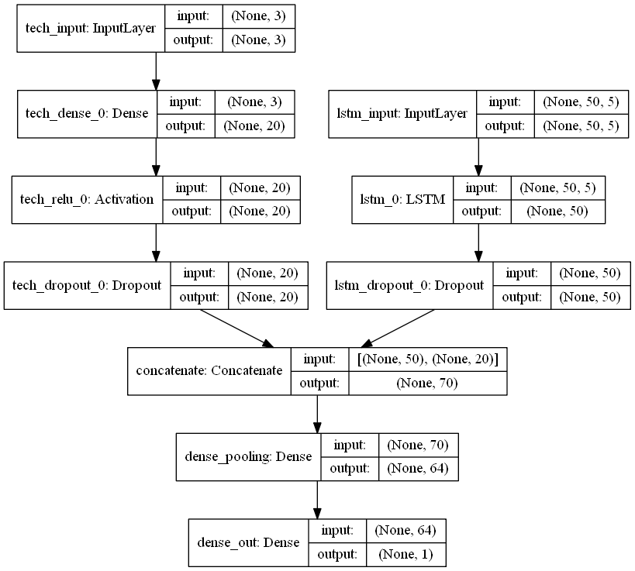
Does forecasting improve the portfolio?
2
Using a multi-input model is a good way to improve accuracy!
Model Design:
A multi-input model has been applied using Keras functional API, to include:
historic stock prices (ohlcv)
additional technical indicators e.g. exponential moving average
Keras RNN model.

Slide 21
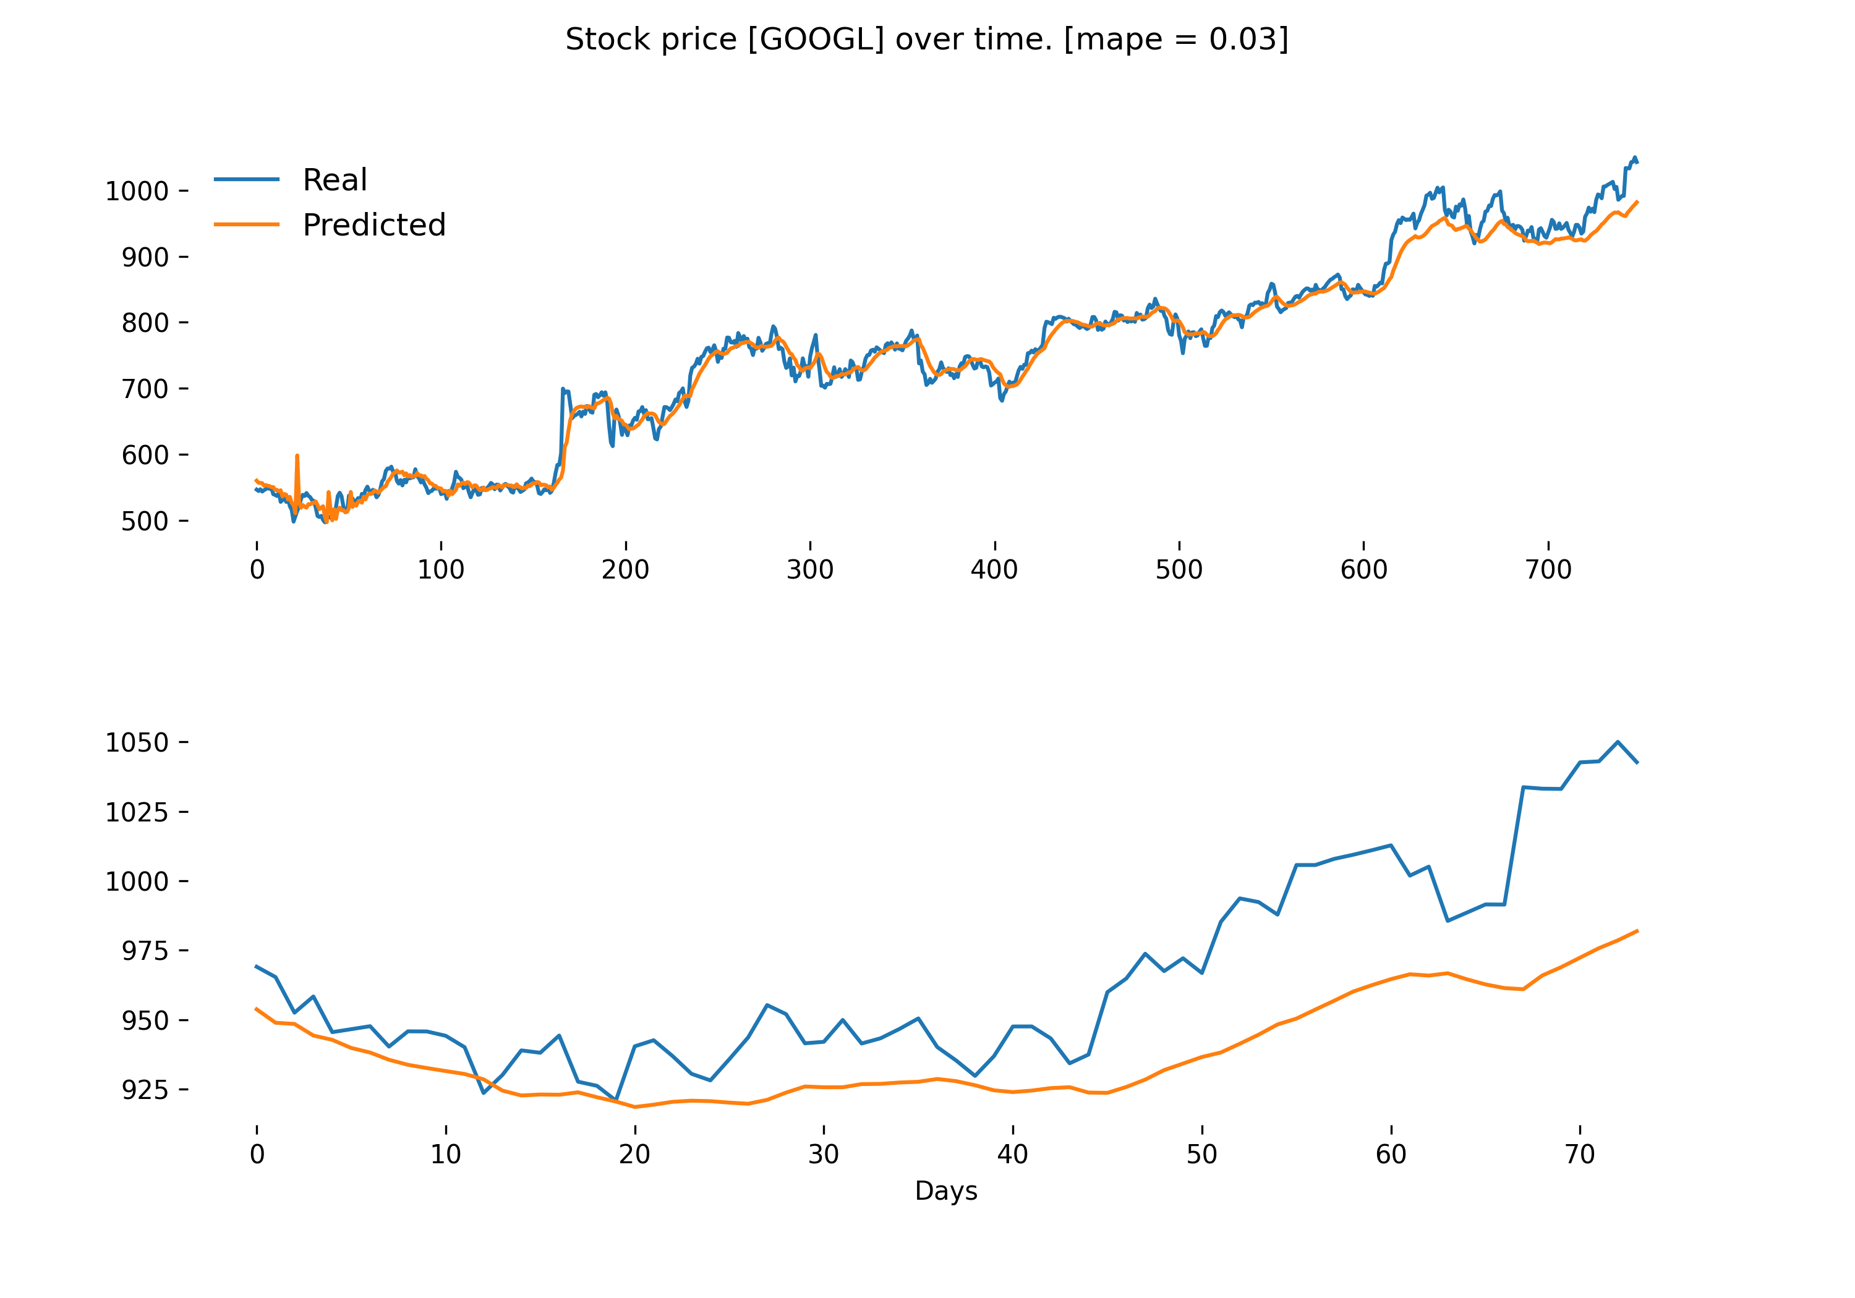
Does forecasting improve the portfolio?
2
Testing your model is still a must when doing forecasting!
Model Evaluation:
Model performance was measured using the mean absolute percentage error (MAPE).
A MAPE value of 0.03 implies that there is a deviation between actual and predicted values of 3%.
RNN model results fit on in-sample and out-of-sample dataset.

Slide 22
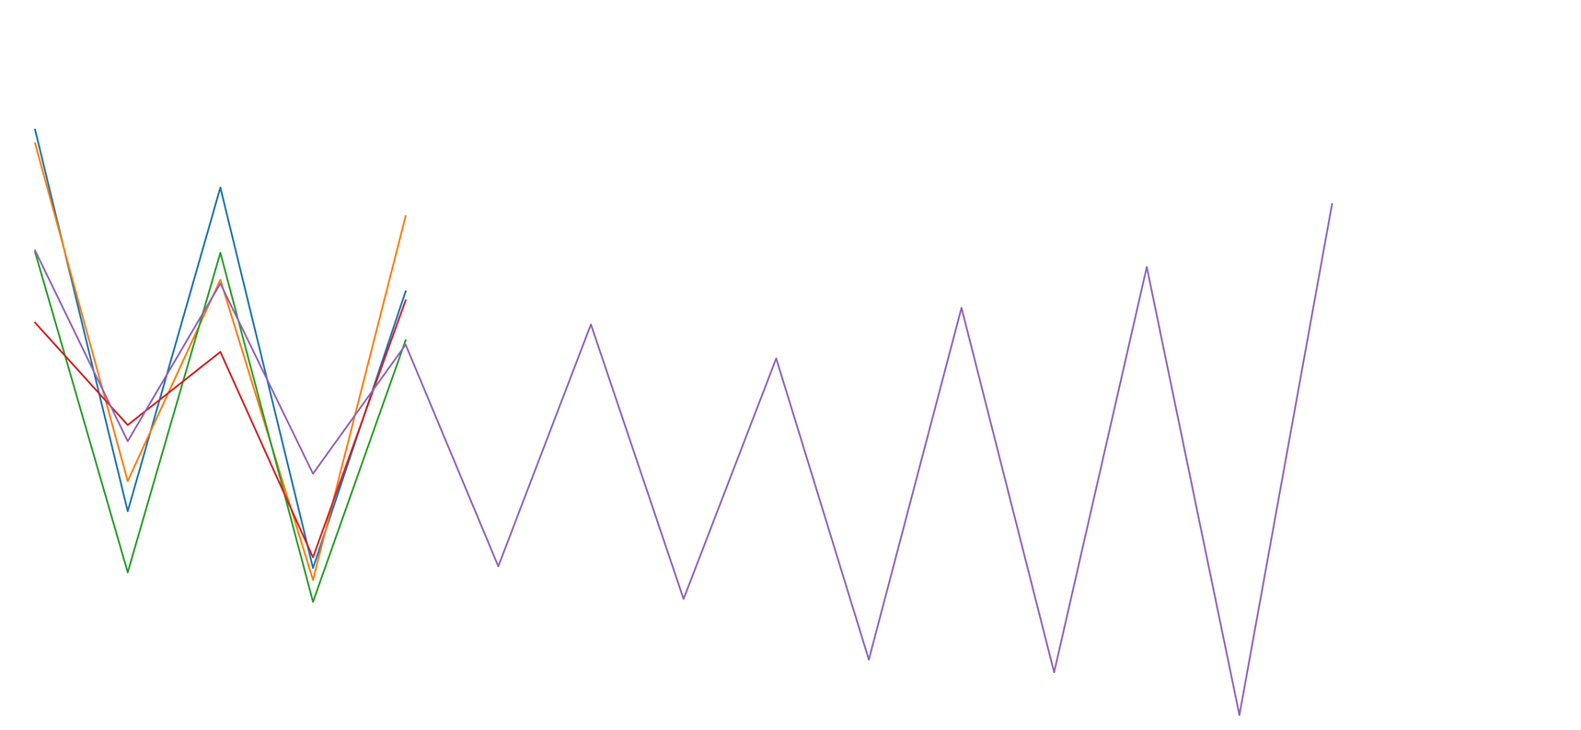
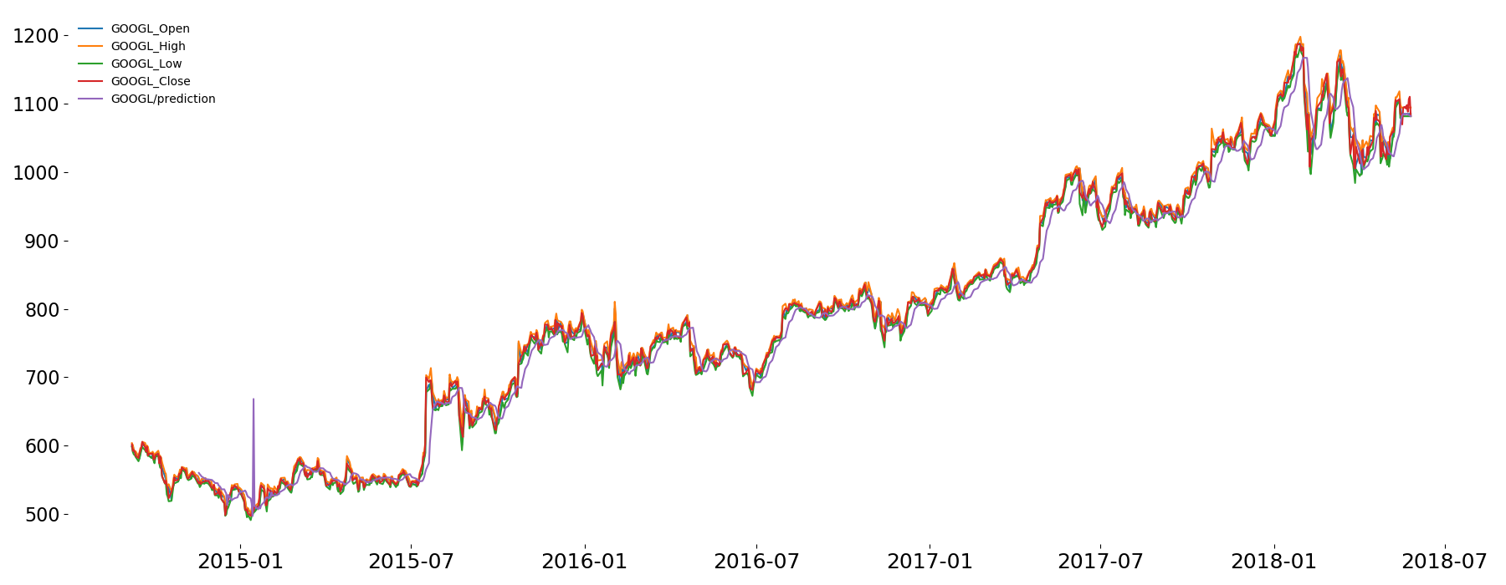
Does forecasting improve the portfolio?
2
RNNs do a great job at forecasting timeseries data!
RNN model results fit on entire dataset with 10-days out-of-sample forecast.

Slide 23
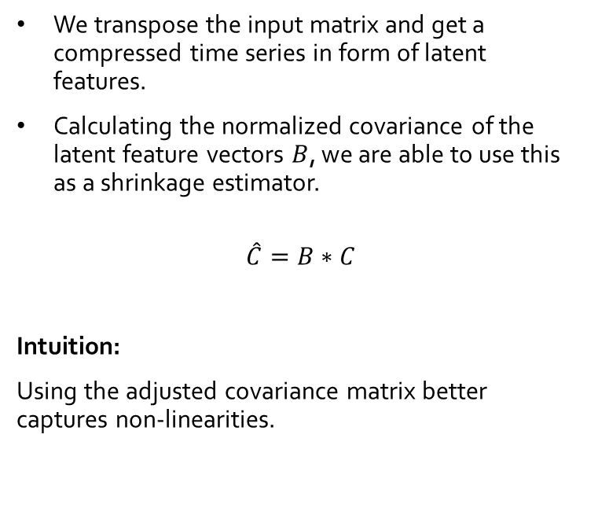
How to improve the risk calculation of a stock?
3
Latent features catch non-linearities and can be used to improve the sample covariance matrix!
Returns
We transpose the input matrix and get a compressed time series in form of latent features.
Calculating the normalized covariance of the latent feature vectors $B$, we are able to use this as a shrinkage estimator.
$$\hat{C}=B∗C$$
Intuition:
Using the adjusted covariance matrix better captures non-linearities.
Stocks
0.3
0.4
0.1
0.1
0.2
Input Cells
0.1
-2
0.3
Hidden Cells
Calculate normalized covariance matrix of latent features and multiply it with the original covariance matrix
Autoencoder model with calculated covariance of latent features.

Slide 24
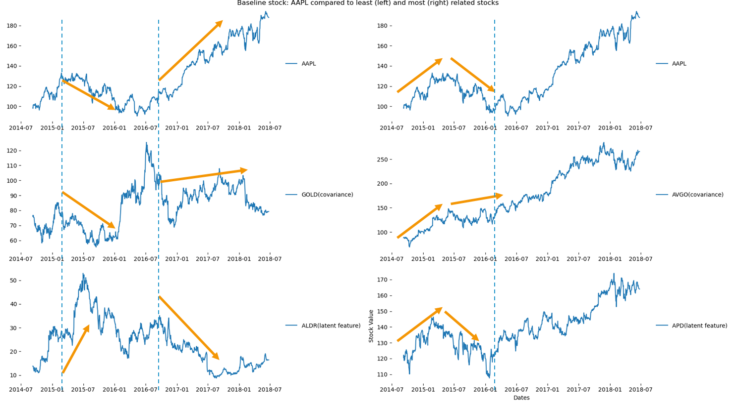
How to improve the risk calculation of a stock?
3
Latent features catch non-linearities and can be used to improve the sample covariance matrix!
Baseline stock : APPL (Apple) compared to least (left) and most (right) related stocks

Slide 25
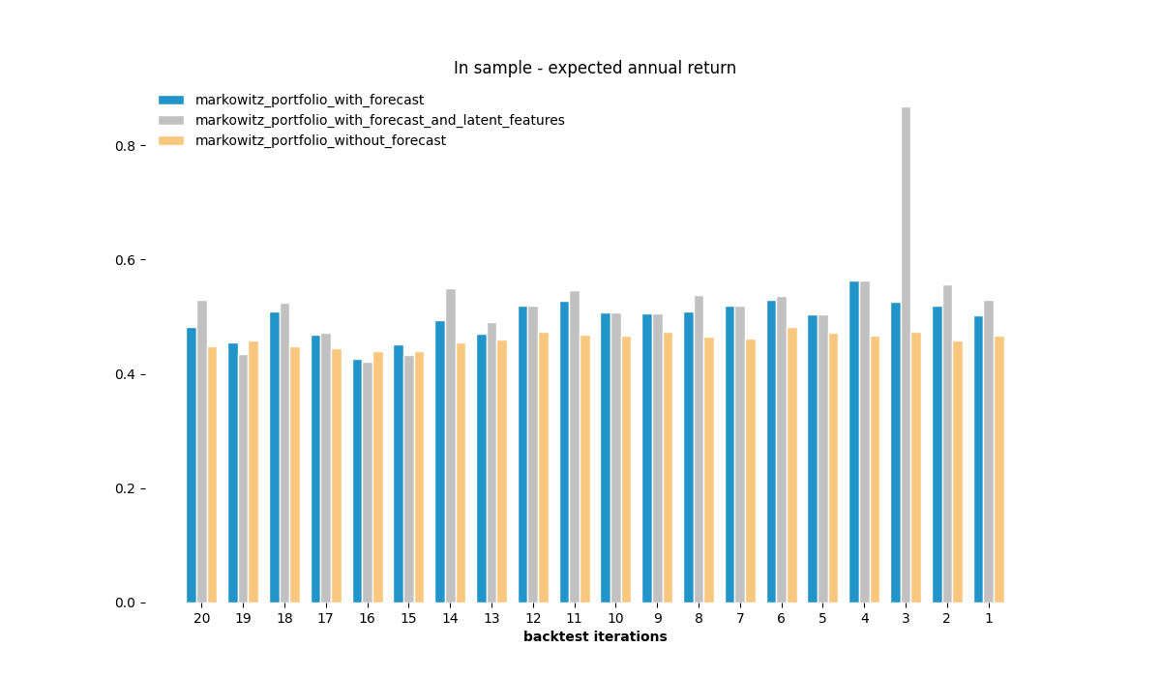
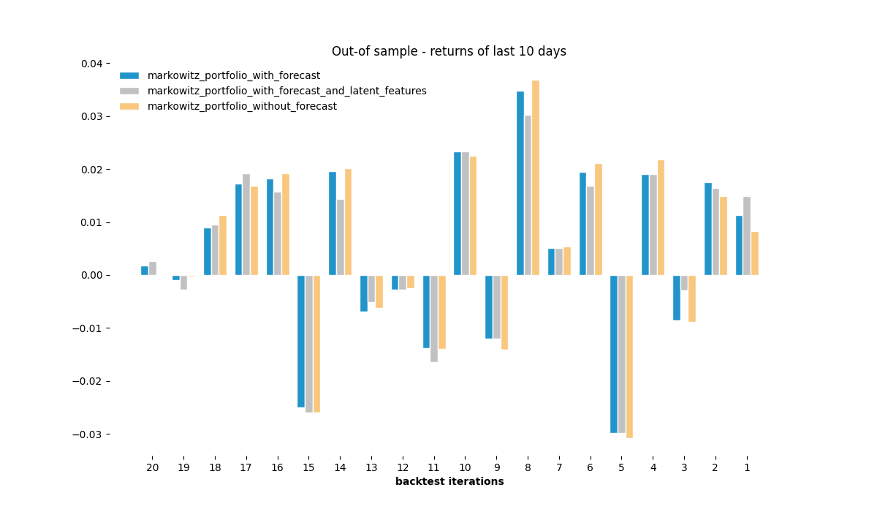
How to calculate an optimal portfolio?
4
In-Sample results look good, out-of sample results do not look indicative.
Expected annual return of Markowitz optimization using different input data (covariance matrix and returns)

Slide 26
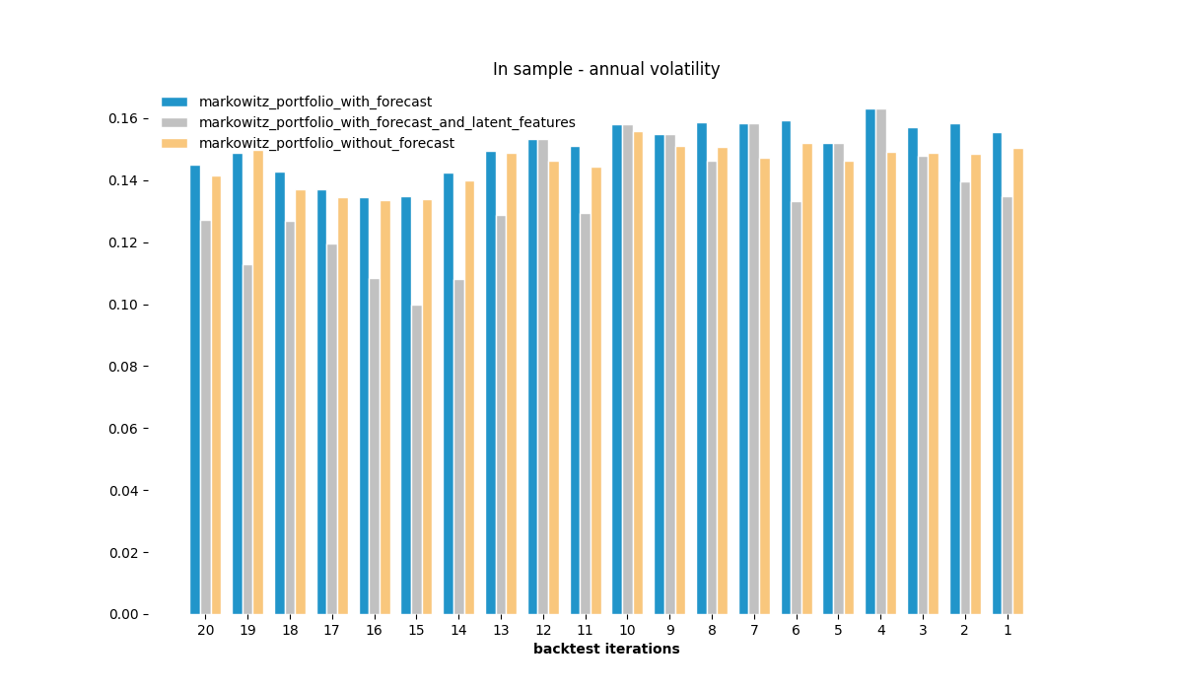
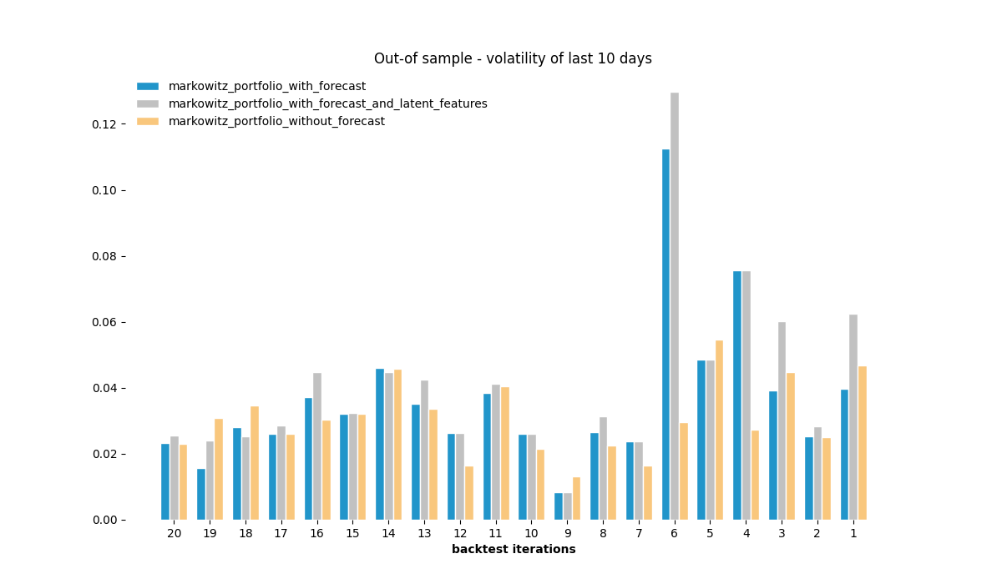
How to calculate an optimal portfolio?
4
Annual volatility of Markowitz optimization using different input data (covariance matrix and returns)

Slide 27
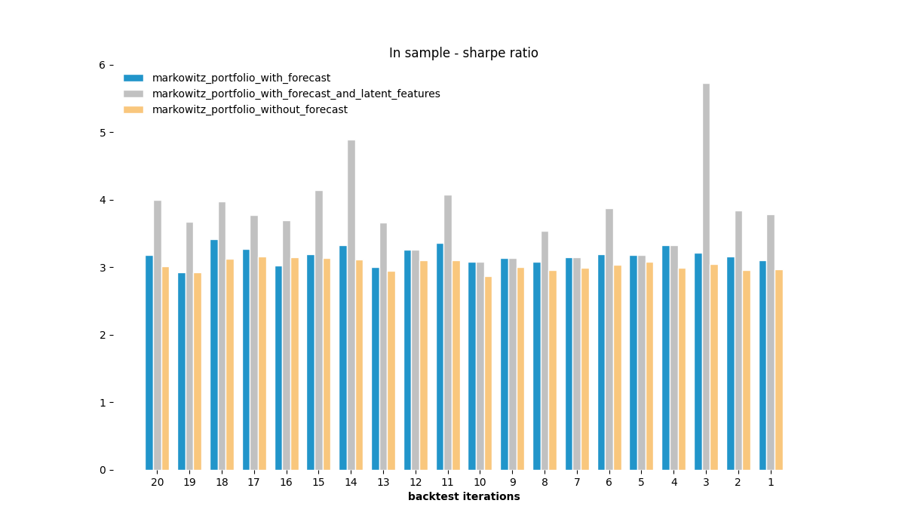
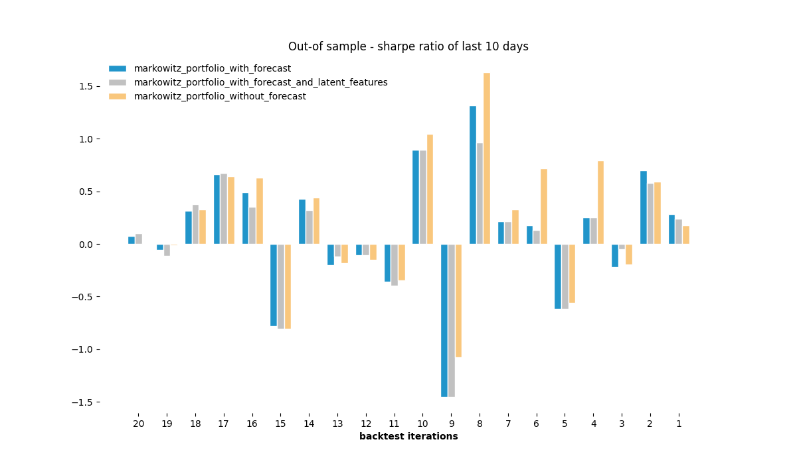
How to calculate an optimal portfolio?
4
Sharpe ratio of Markowitz optimization using different input data (covariance matrix and returns)

Slide 28
Conclusion and Future Research

Slide 29
Conclusion and Future Research
Which stocks to analyze?
→ Selecting stocks with the lowest reconstruction error improves calculation time and shows better out-of-sample results.
Does forecasting improve the portfolio?
→ Extending the dataset with a 10-day forecast leads to overall higher portfolio results.
How to improve the risk calculation of a stock?
→ Calculating the covariance of the latent features reduces annual portfolio volatility with similar or increased stock returns.
How to calculate an optimal portfolio?
→ The proposed model shows superior results on the in-sample dataset. The out-of-sample results may not be indicative.
1
2
3
4

Slide 30
References
J. B. Heaton, N. G. Polson, & J. H. Witte. (2016). Deep Portfolio Theory.
Werbos, P. (1990): Backpropagation Through Time: What It does and How to Do It. https://doi.org/10.1109/5.58337 Retrieved from http://axon.cs.byu.edu/~martinez/classes/678/Papers/Werbos_BPTT.pdf
https://towardsdatascience.com/getting-rich-quick-with-machine-learning-and-stock-market-predictions-696802da94fe
Olivier Ledoit & Michael Wolf, 2003. "Honey, I shrunk the sample covariance matrix," Economics Working Papers 691, Department of Economics and Business, Universitat Pompeu Fabra.

Slide 31
Q & A
Yes, my code is on github. https://github.com/QUER01/FinanceModule

