Slide 2
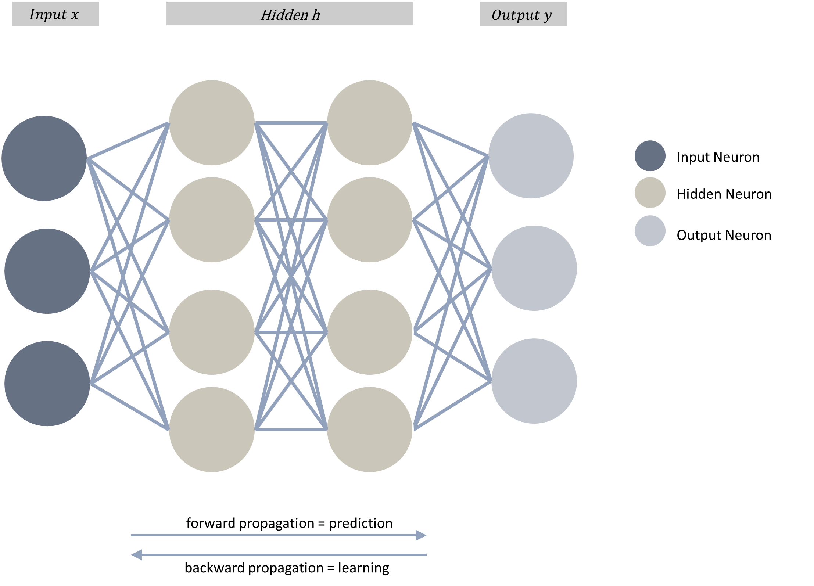


Data Modelling Slide 115
$$Input x$$
Hidden h
$$Output y$$
Input Neuron
Hidden Neuron
Output Neuron
forward propagation = prediction
backward propagation = learning

Slide 3
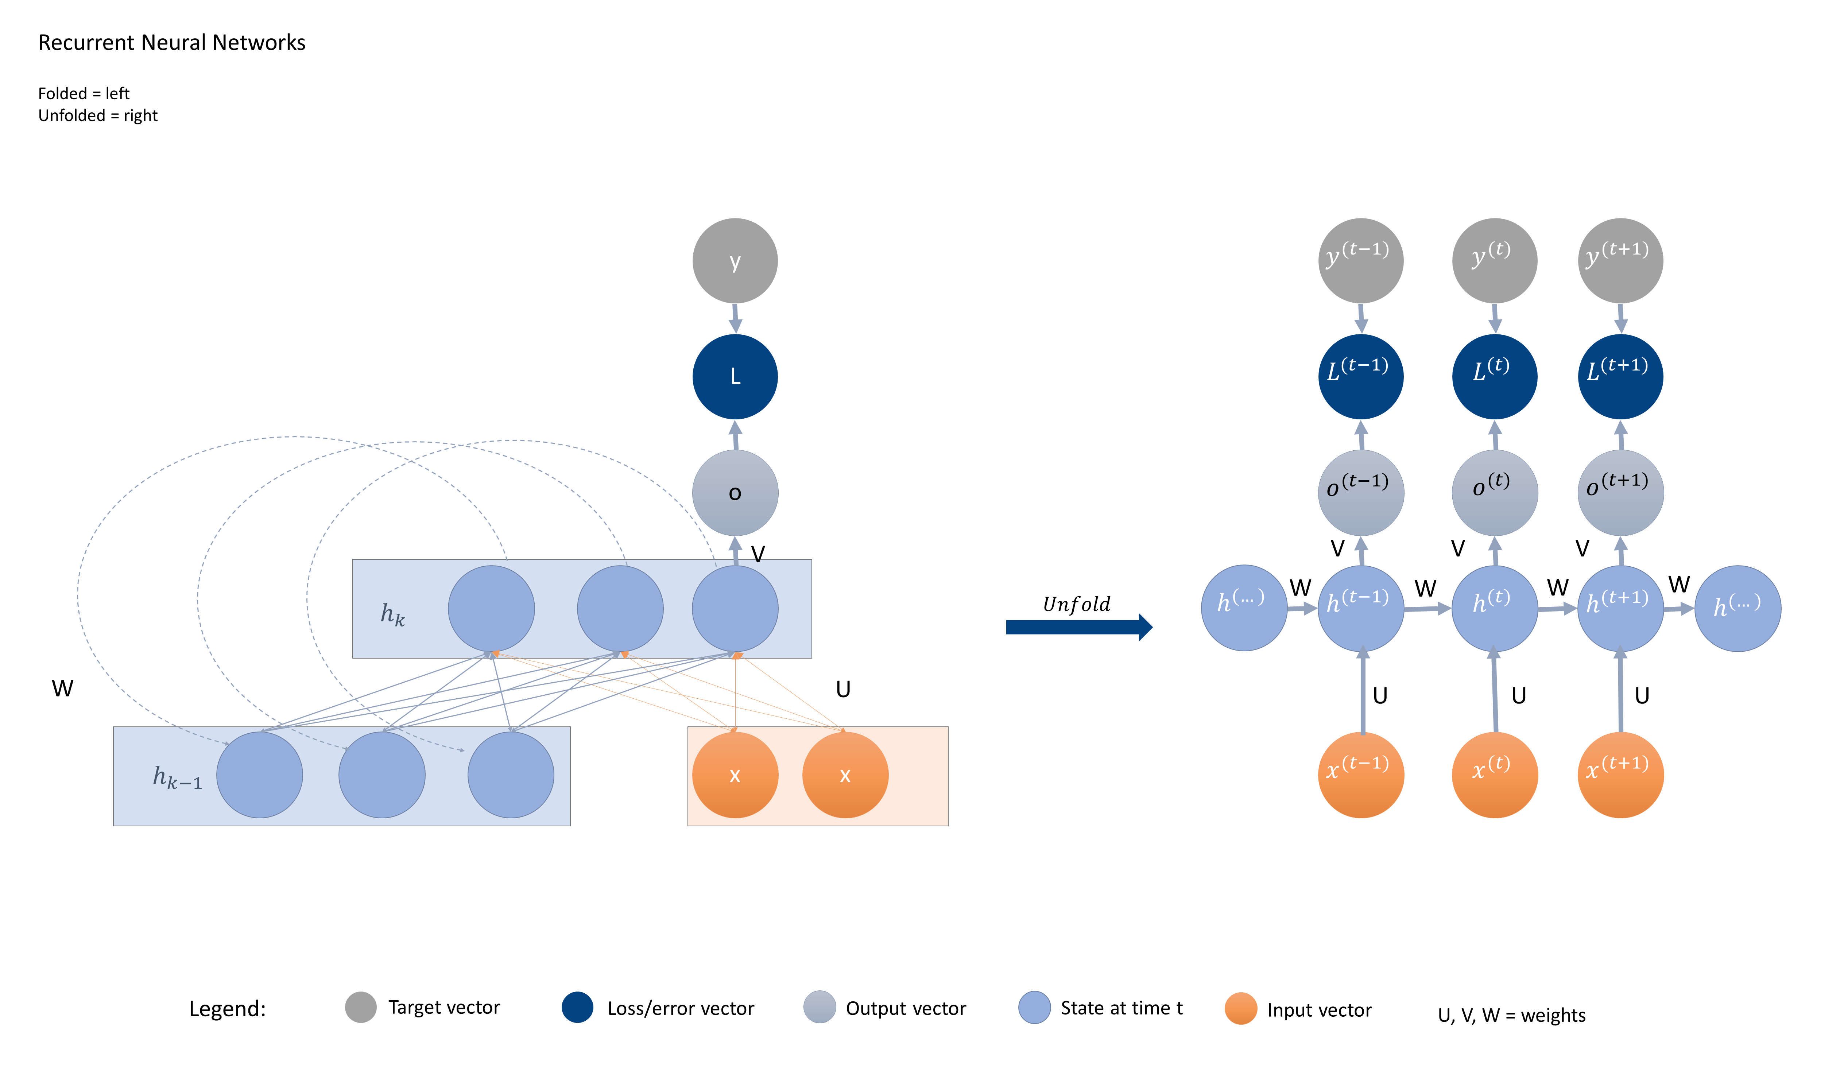




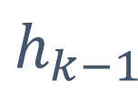















Data Modelling slide 133
Recurrent Neural Networks
Folded = left
Unfolded = right
y
$$y^{(t−1)}$$
$$y^{(t)}$$
$$y^{(t+1)}$$
L
$$L^{(t−1)}$$
$$L^{(t)}$$
$$L^{(t+1)}$$
o
$$o^{(t−1)}$$
$$o^{(t)}$$
$$o^{(t+1)}$$
V
V
V
V
$$h^{(…)}$$
W
$$h^{(t−1)}$$
W
$$h^{(t)}$$
W
$$h^{(t+1)}$$
W
$$h^{(…)}$$
$$h_{k}$$
$$Unfold$$
W
U
U
U
U
x
x
$$x^{(t−1)}$$
$$x^{(t)}$$
$$x^{(t+1)}$$
$$h_{k−1}$$
Legend:
Target vector
Loss/error vector
Output vector
State at time t
Input vector
U, V, W = weights

Slide 4
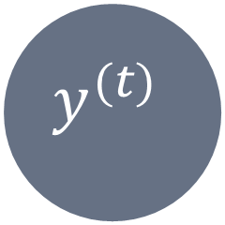
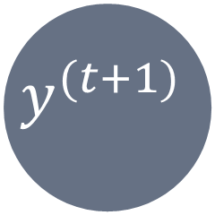
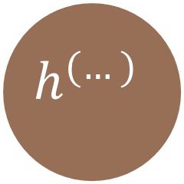
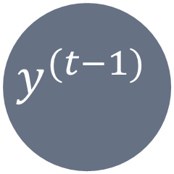
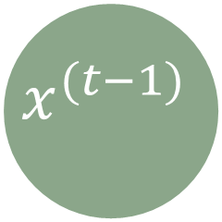
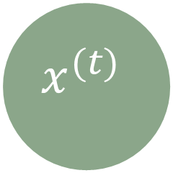
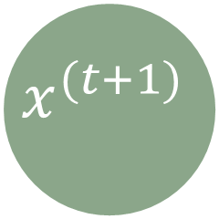

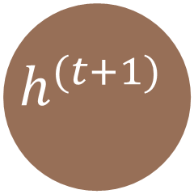
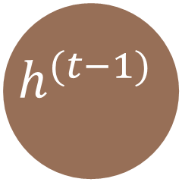
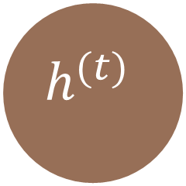
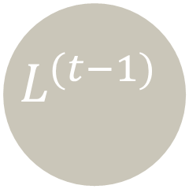
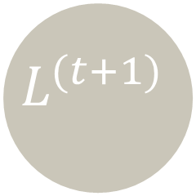

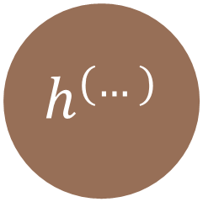
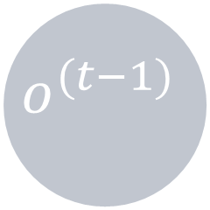
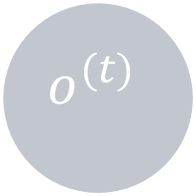
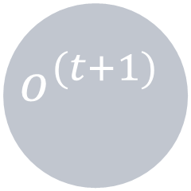
Data Modelling slide 133
$$Folded RNN$$
Unfolded RNN
y
$$y^{(t−1)}$$
$$y^{(t)}$$
$$y^{(t+1)}$$
Target vector
Loss/error vector
Output vector
L
$$L^{(t−1)}$$
$$L^{(t)}$$
$$L^{(t+1)}$$
State at time t
Input vector
o
$$o^{(t−1)}$$
$$o^{(t)}$$
$$o^{(t+1)}$$
U, V, W = weights
V
V
V
V
W
h
$$h^{(…)}$$
W
$$h^{(t−1)}$$
W
$$h^{(t)}$$
W
$$h^{(t+1)}$$
W
$$h^{(…)}$$
U
U
U
U
x
$$x^{(t−1)}$$
$$x^{(t)}$$
$$x^{(t+1)}$$
backward propagation = learning

