Slide 1
COMPAQT: Compressed Waveform Memory Architecture for Scalable Qubit Control
Satvik Maurya, Swamit Tannu
University of Wisconsin-Madison
MICRO 55
Notes:
Name
Challenges in scaling quantum computers from a control hardware perspective
How compression can solve these problems

Slide 2
Outline
Background
Waveform memory bottlenecks
Compressed waveform memory architecture
Key results
Cryogenic ASIC controllers
Conclusions

Slide 3
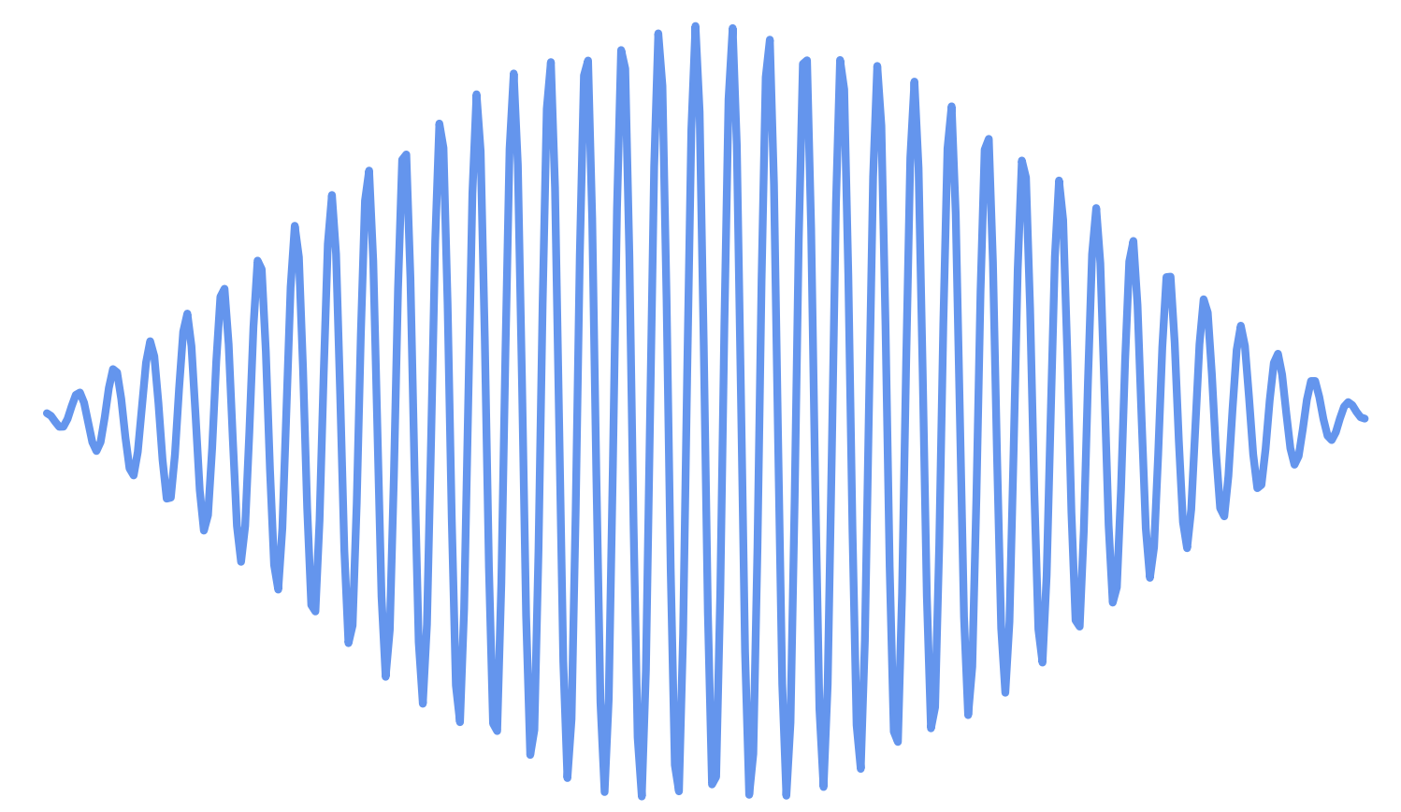
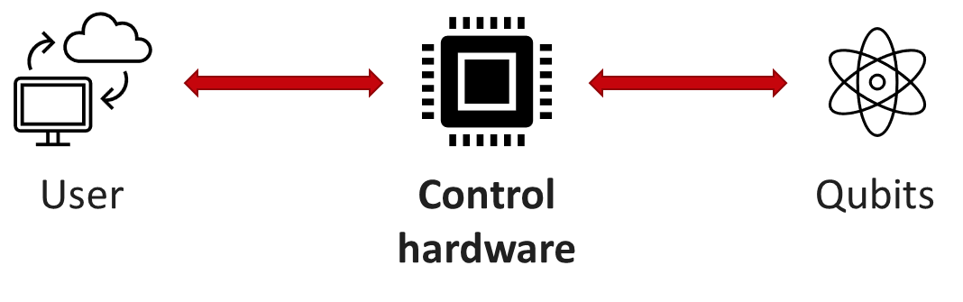
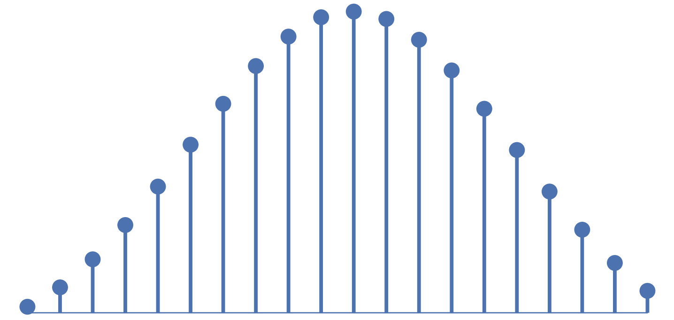
Qubit control
X
Superconducting qubits are controlled by microwave pulses (5-7GHz).
The envelopes (shapes) of these pulses are stored in the waveform memory.
Waveform Memory
DAC
Waveform: Pulse envelope
Notes:
Middleman
X gate
Inefficient to store high frequency waveforms in the control hardware
Gate reads waveform memory which passes envelope to a DAC

Slide 4
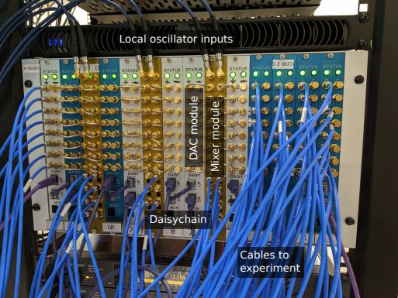
Scaling control hardware
Maximize qubits per controller
Unsustainable
Control hardware for Google Sycamore
RFSoCs
ASICs
Integrate CPUs, FPGA, and ADC/DACs on the same chip
Integrate all control electronics in a single package
Number of qubits | 53
Number of FPGAs | 30+
Number of DACs | 200+
Number of mixers | 50+
Number of cables | 200+
Arute, Frank, et al. "Quantum supremacy using a programmable superconducting processor." Nature 574.7779 (2019): 505-510
Notes:
The current brute-force approach is not sustainable for large number of qubits in terms of cost and complexity – google’s sycamore required 4 chassis, with each chassis controlling about 15 qubits; 1 chassis contained 14 DAC and/or mixer modules, with 1 DAC module containing 1 FPGA and 8 DACs.
So how will control evolve as the number of qubits increase?

Slide 5
Outline
Background
Waveform memory bottlenecks
Compressed waveform memory architecture
Key results
Cryogenic ASIC controllers
Conclusions

Slide 6

Waveform memory limits scalability
Every qubit has a unique waveform for every gate.
Waveform memory bandwidth $∝$ number of concurrent gates.
Waveform memory bandwidth ∝ number of concurrent gates.
Waveform memory capacity $∝$ number of qubits.
Waveform memory capacity ∝ number of qubits.
Notes:
Every concurrent gate will trigger a unique read of the waveform memory.
Every gate will have to be stored individually.

Slide 7
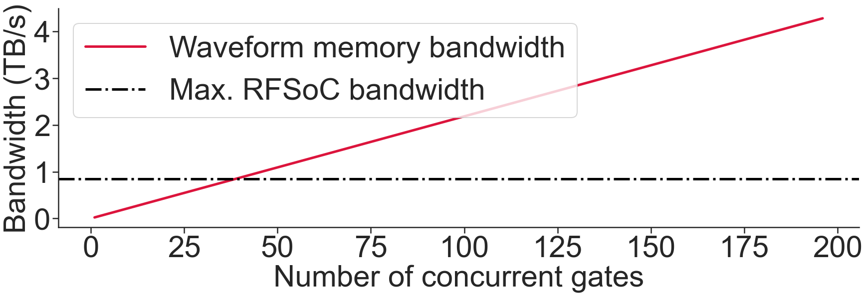
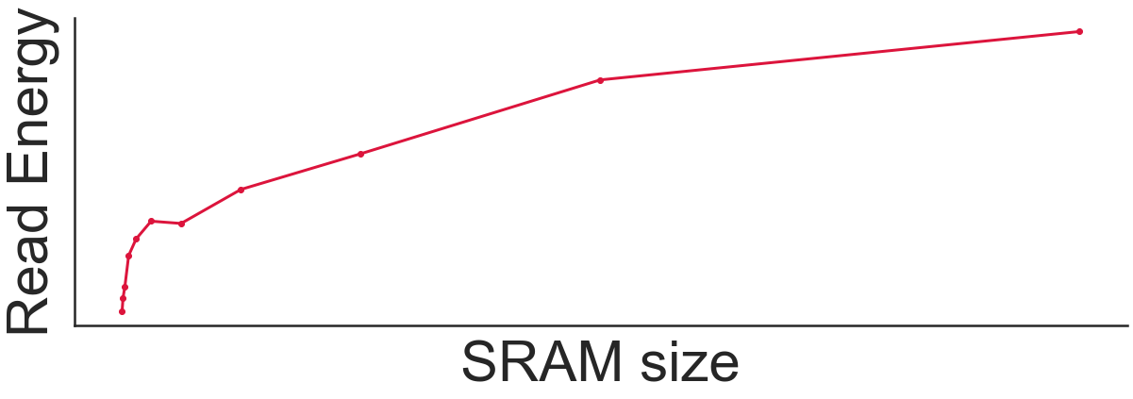
Waveform memory limits scalability
RFSoCs
ASICs
RFSoCs can store waveforms for 100+ qubits but can support less than 50 concurrent gates.
Increasing qubits increases power dissipated per read in cryogenic CMOS ASICs.
Notes:
Every concurrent gate will trigger a unique read of the waveform memory.
Every gate will have to be stored individually.

Slide 8
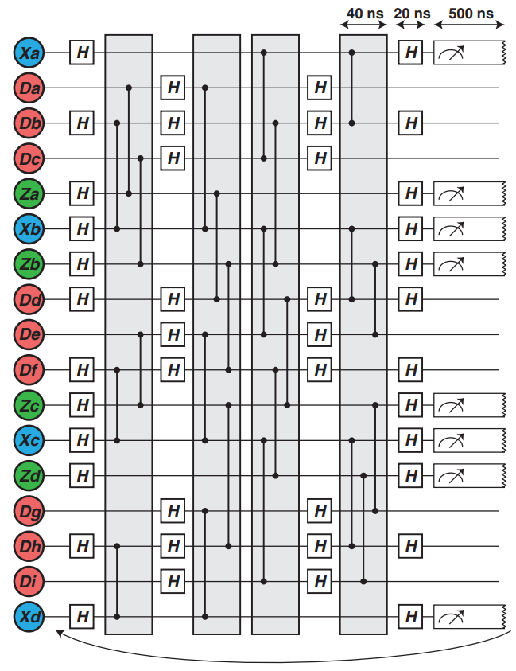
Concurrency
Concurrency is crucial for both near-term and long-term applications.
Versluis, Richard, et al. "Scalable quantum circuit and control for a superconducting surface code." Physical Review Applied 8.3 (2017): 034021.

Slide 9
Outline
Background
Bandwidth bottleneck
Compressed waveform memory architecture
Key results
ASIC controllers
Conclusions

Slide 10
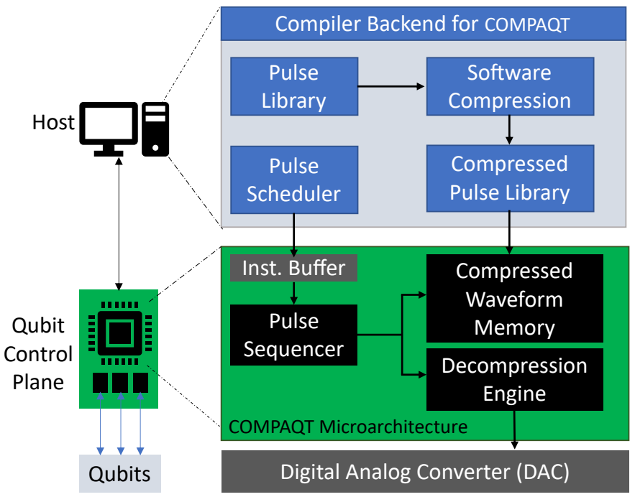
Compressed waveform memory architecture
High compression ratio
Low hardware cost
Minimum impact on fidelity

Slide 11
Waveform compression (software)
Input waveform
Divide waveform into windows
Use discrete cosine transform to transform waveform samples
W | W | W | W | W | W | W | W
DCT
S | S | S | S | S | S | S | S
Set insignificant DCT samples to 0.
Thresholding
Lossy compression!
Replace all continuous zeros with a single codeword.
S | S | S | 0 | 0 | 0 | 0 | 0
Run-length encode(RLE)
S | S | S | CW

Slide 12
Waveform decompression (hardware)
S | S | S | CW
Run-length decode
Bandwidth boost
S | S | S | 0 | 0 | 0 | 0 | 0
Inverse DCT
W | W | W | W | W | W | W | W
DAC

Slide 13
Window size selection
Smaller window size
Larger window size
Higher compression
Higher hardware cost of decompression

Slide 14
Outline
Background
Bandwidth bottleneck
Compressed waveform memory architecture
Key results
Cryogenic ASIC controllers
Conclusions

Slide 15
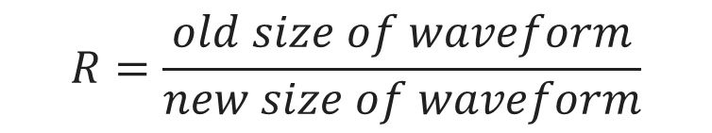
Compression ratio
$$R=\frac{old size of waveform}{new size of waveform}$$
Waveforms highly compressible!
Machine | Compression ratio (R)
 | Minimum | Maximum | Average
IBM Toronto | 5.33 | 8.11 | 6.49
IBM Montreal | 5.33 | 8.02 | 6.45
IBM Mumbai | 5.33 | 8.05 | 6.47
IBM Guadalupe | 5.33 | 8.02 | 6.48
IBM Lima | 5.33 | 7.92 | 6.33

Slide 16
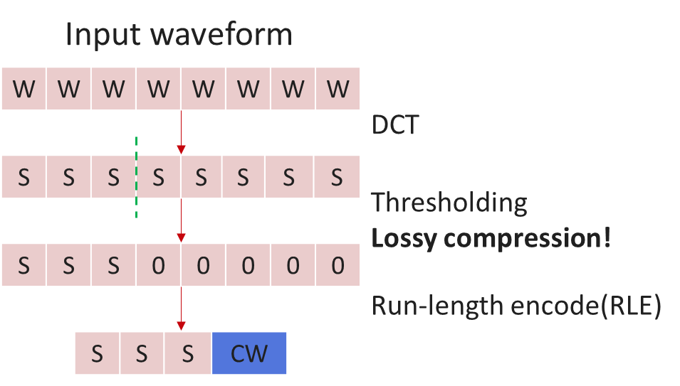
Impact of lossy compression
Thresholding results in a loss of information.
Decompressed waveform not the same as the original.
Notes:
Reiterating over the compression algorithm, the lossy compression scheme means that the decompressed waveform will be slightly different than the original. This makes studying the impact on fidelity, or correctness, very important for our work.

Slide 17
Fidelity
Negligible loss in fidelity.

Slide 18
Scalability of RFSoCs
> 5x
> 5x

Slide 19
Outline
Background
Bandwidth bottleneck
Compressed waveform memory architecture
Key results
Cryogenic ASIC controllers
Conclusions

Slide 20
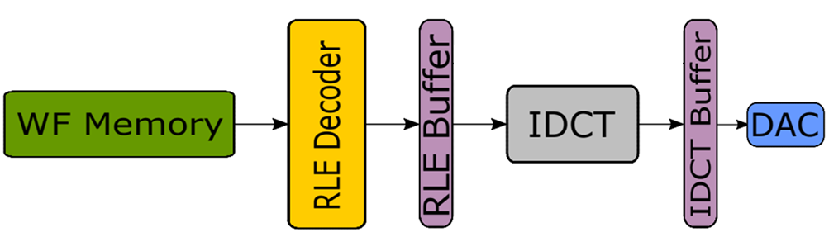
Scalability of CMOS ASICs
> 2.5x reduction

Slide 21
Outline
Background
Bandwidth bottleneck
Compressed waveform memory architecture
Key results
Cryogenic ASIC controllers
Conclusions

Slide 22
Conclusions
Waveform memory bandwidth and capacity limit scalability of control hardware.
We propose a compressed waveform memory architecture (COMPAQT) to improve the scalability of control hardware.
Waveforms are highly compressible, >6x decrease in size across multiple IBM machines via lossy compression.
Little or no degradation in fidelity despite using a lossy compression algorithm.
>2.5x decrease in power dissipated by cryogenic ASICs and >5x increase in number of qubits supported by RFSoCs.
Notes:
Memory bandwidth and capacity limit scalability
… and our compressed memory architecture helps improve these limitations
We see 6x decrease in waveform size across different IBM machines with a loss compression algorithm and little to no degradation to fidelity
And improvements in power dissipated by cryogenic ASICs and the number of concurrent operations supported by RFSoCs

Slide 23
Questions?

Slide 24
Backup

Slide 25
Fidelity experiments
Design | 2Q RB Fidelity IBM Bogota | 2Q RB Fidelity IBM Guadalupe | 2Q RB Fidelity IBM Hanoi
Baseline | 0.98 | 0.978 | 0.987
DCT-N | 0.982 | 0.977 | 0.989
DCT-W | 0.983 | 0.976 | 0.986
int-DCT-W | 0.983 | 0.975 | 0.988

Slide 26
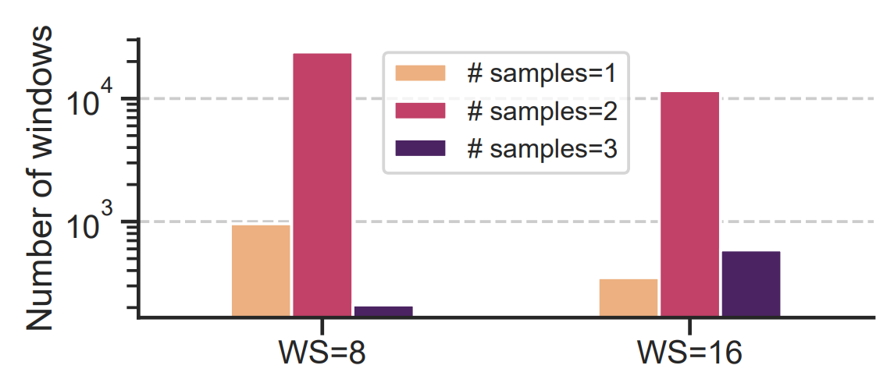
Compression ratio

Slide 27
Hardware overhead
Variant | Window size | Multipliers | Adders | Shifters
DCT-W | 8 | 11 | 29 | 0
Int-DCT-W |  | 0 | 50 | 26
DCT-W | 16 | 26 | 81 | 0
Int-DCT-W |  | 0 | 186 | 128
Design | LUT Utilization | FF Utilization
Baseline | 3386 (1.4%) | 6448 (1.4%)
Int-DCT-W (window size=8) | 601 (0.26%) | 266 (0.05%)
Int-DCT-W (window size=16) | 1954 (0.85%) | 671 (0.15%)
Int-DCT-W (window size=32) | 9063 (3.93%) | 1197 (0.26%)

Slide 28
Input waveform
W | W | W | W | W | W | W | W
DCT
S | S | S | S | S | S | S | S
Thresholding
S | S | S | 0 | 0 | 0 | 0 | 0
Run-length encode(RLE)
S | S | S | CW

Slide 29
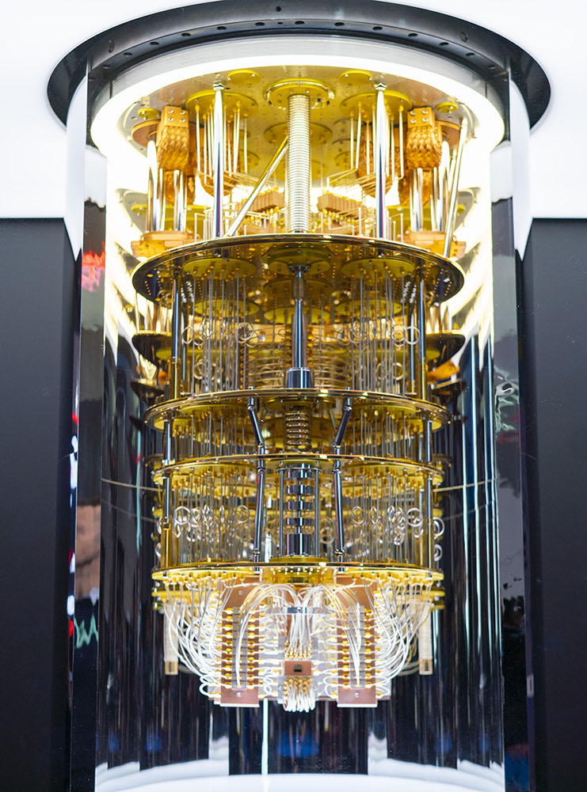

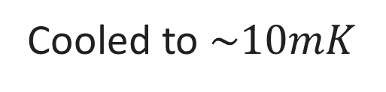
Superconducting qubits
Long coherence times
High gate fidelities
Fast gates
Cooled to $\sim 10mK$
https://newsroom.ibm.com/media-quantum-innovation
Notes:
Superconducting qubits are the most popular variants of qubits in use today. Apart from these features that make them attractive for long-term use, the relative ease of manufacturing these qubits is also a major factor in their popularity. Superconducting qubits are highly sensitive to thermal noise, which is why they are placed in dilution refrigerators and cooled to nearly absolute zero.

