Slide 1
TABLE OF CONTENTS
01.
02.
03.
04.
Methods
RESULTS
PROBLEMS
WHAT’S NEXT?

Slide 2
01.
methods
As can be seen from outputs of last week’s models, such deterministic models are not applicable to be used directly to estimate the prevalence of the disease. Due to the fact that we suspect the underreporting issues occurred in the first days of the pandemic (noisy data), the direct application on these datasets might impede the correct estimation of the true coronavirus incidents

Slide 3

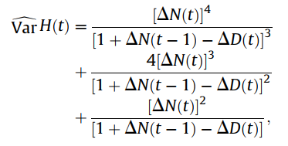
CAPTURE-RECAPTURE
SII Modelling with MCMC Sampling
To estimate the real infected population in the first period
After the initial infected population from Capture-Recapture Method, I will simulate the pandemic using SII modelling.
MCMC Sampling is a good choice for parameter estimation since we don’t know the ‘real’ distribution of the fully reported data, MCMC
NOTE: We cannot use parameter outputs from other literature since they are created based on the novel dataset
General Formula
Variance
Monte Carlo methods were used to sample parameter uncertainty. An ensemble with 10000 iteration (2000 burnin) as generated with random draws from within the uncertainty range for each parameter beta (infection rate) , gamma (recovery rate), theta (reporting rate)], using a Uniform probability distribution and Binomial Distribution
Initially we set β = 0.2, γ = 0.3, k = 10
Capture-Recapture Estimation with Samples of Size One Using Frequency Data in 1992
Parameter estimation will be sent to you by the end of this week
Notes:
The method can be interpreted that each capture (or we can say each days with new cases) are separate samples, the overlapping data would be the cases before that

Slide 4
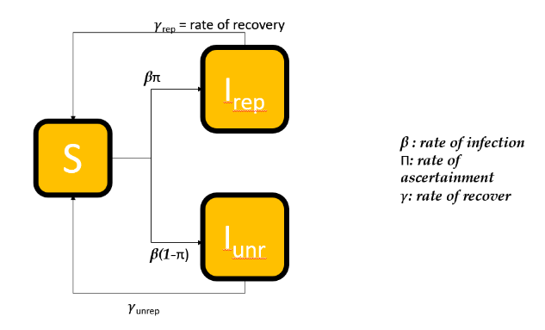
02. RESULTS
One condition of Capture Recapture method is that the population is fixed, therefore, our experiment interval should not be longer than the infection period (12-15 days Richard et al). It explains why I chose the first 10 days of the pandemic (from January 20th to 1st February) as the scope of this research

Slide 5
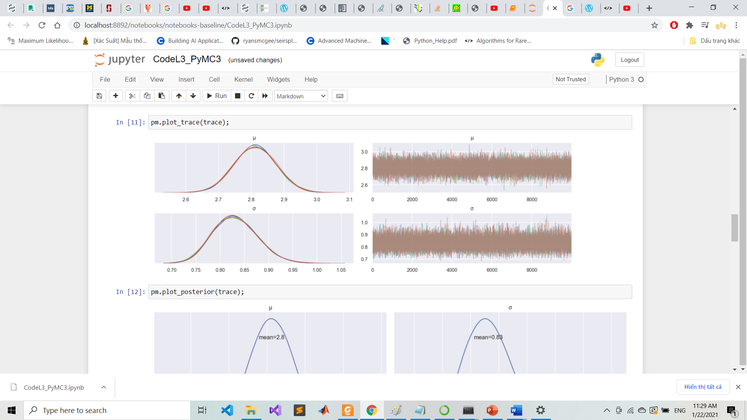
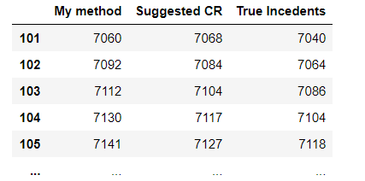
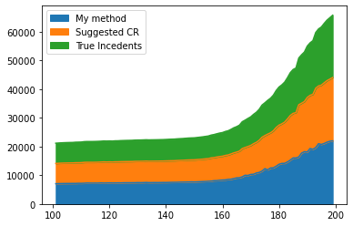
Results
Parameters | Mean | Quantile 5th | Quantile 95th
𝛍 (infection rate) | 2.85 | 2.732 | 2.89
a | 0.82 | 0.77 | 0.86
𝜸 | 0.02 | 0.022 | 0.024444
Fig 1. Outputs of underreporting for the given period

Slide 6


Problems
The Accuracy
LIMITATION OF Capture-Recapture
It can be agreed from these figures that the CR + MCMC approach also heavily relies on the official statistics to generate new models (it means that for the given phase . The final output does not show much different from the actual data we had (very very high bias)
CR will generate the output that have an identical distribution with the sample data (which may not be true for underreporting problems)

Slide 7
What’s NEXT? 2 things I will continue to work on after this meeting
1. Improved CR method
2. Probabilistic Social Interaction Graph
Instead of Capture-Recapture on the data of infectees, I will use CR method for the overlapped number of DEATH cases among 3 datasets: Covid Death, Pneumonia Death, Influenza Death.
=> Generate the total COVID death to compute another SIR modelling
Because not many people attempted to unravel the underestimation issue in Australia, therefore, it is required to have another approach (should be distinct from this one) for comparison.

