Slide 1
SSVEP

Slide 2
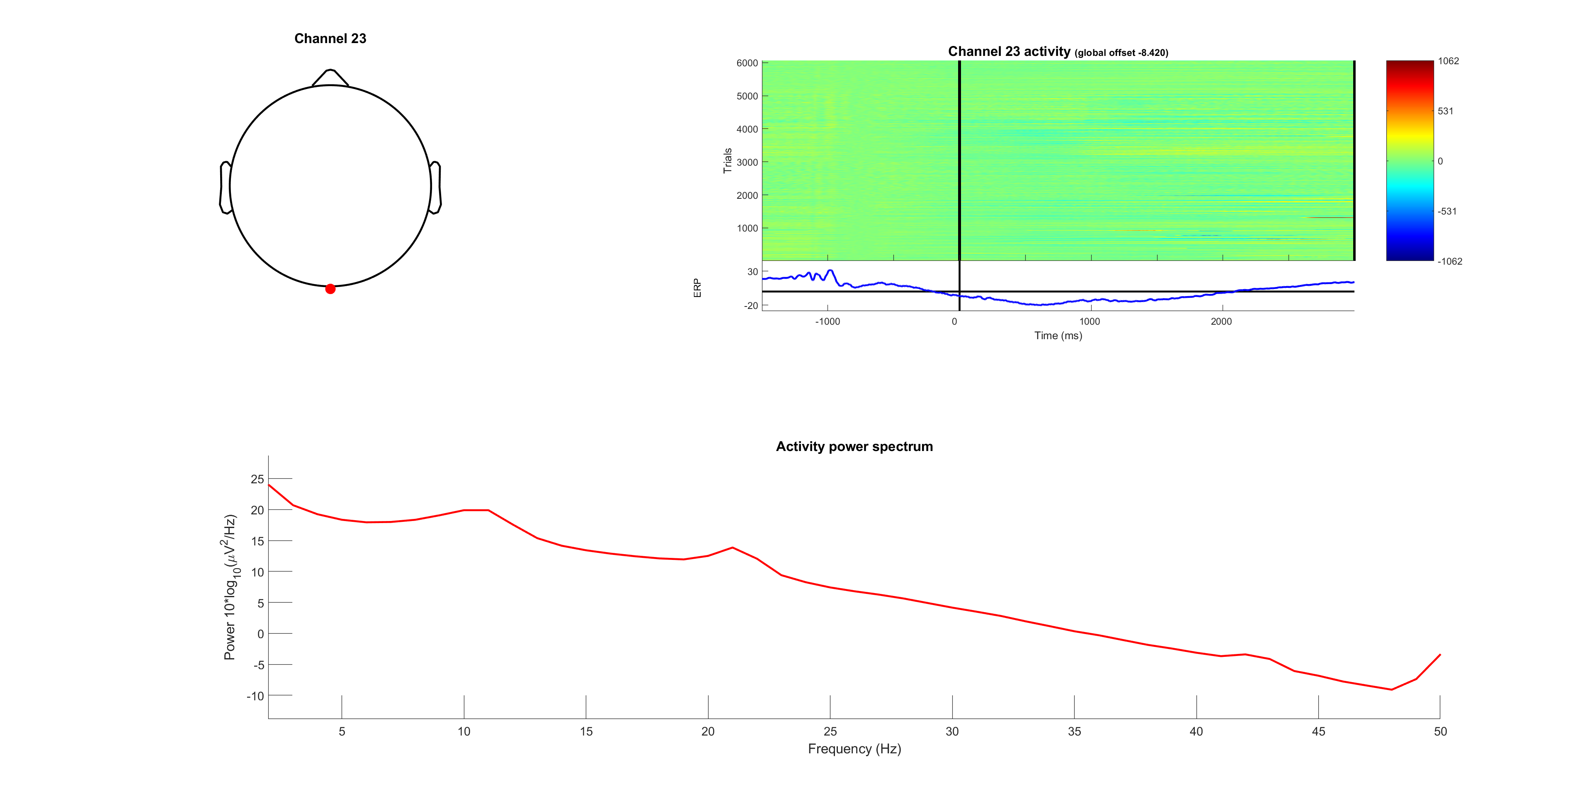



Slide 3
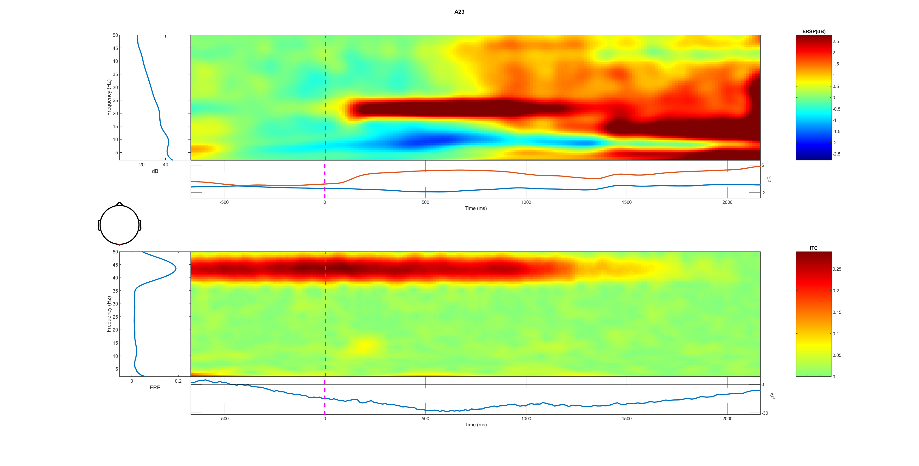
A23 all trail 0-50Hz

Slide 4
Low vs high
bright first and dim first are opposite phase

Slide 7
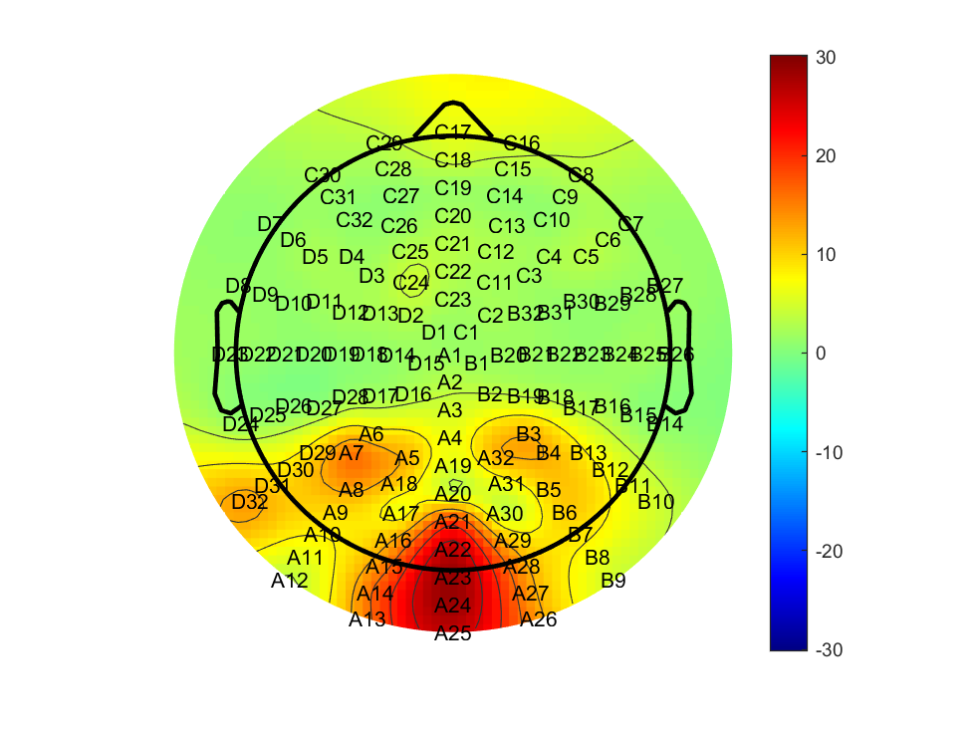

Slide 8
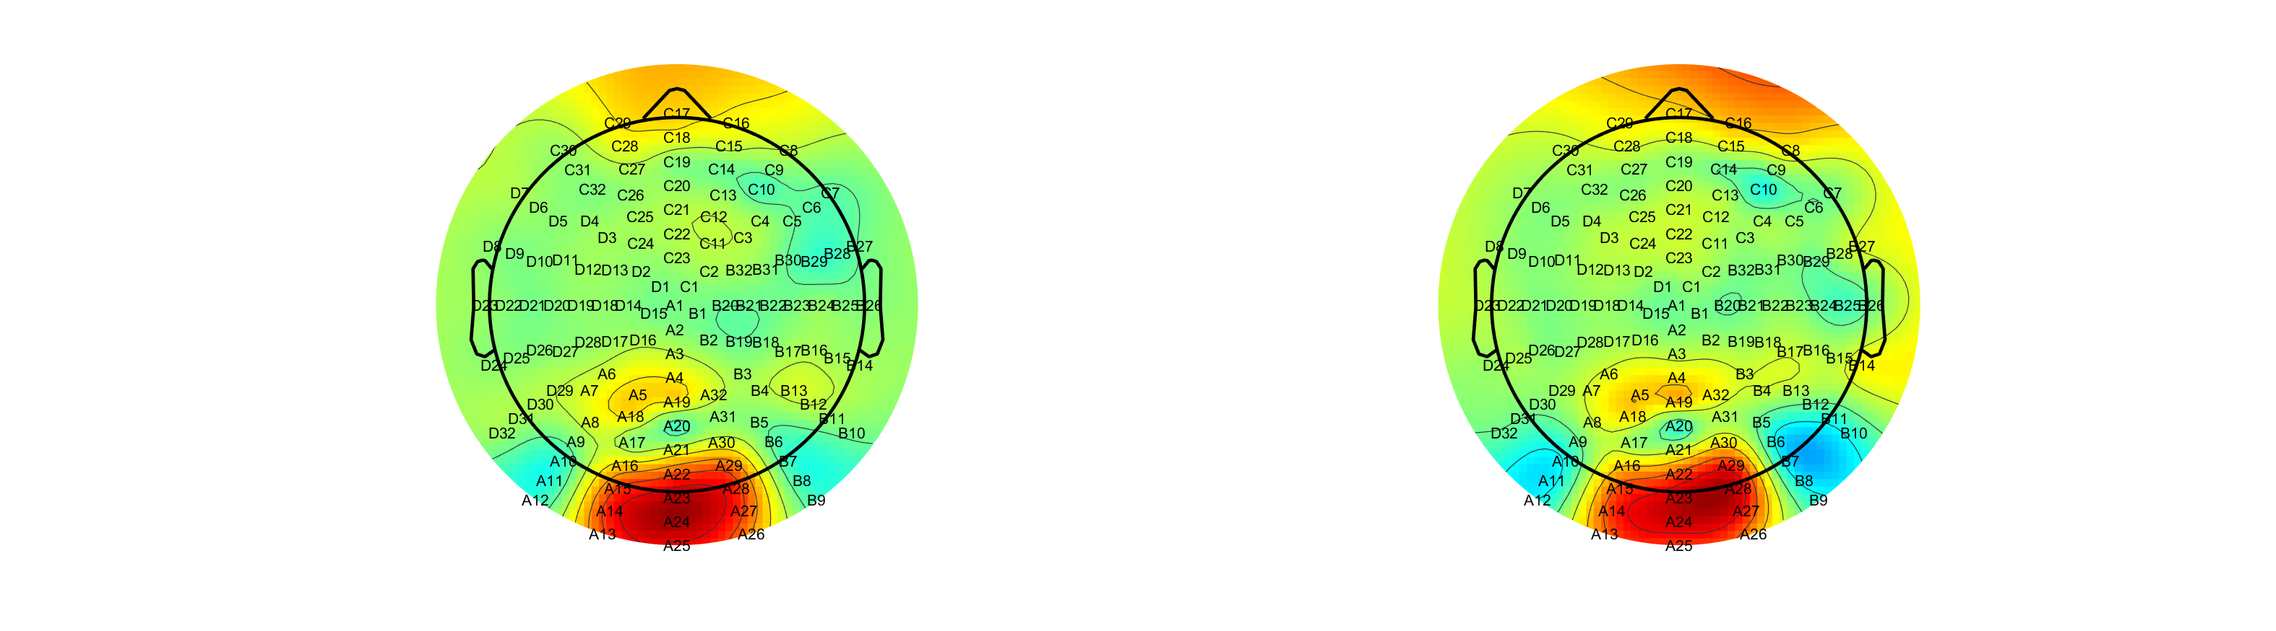
Low A24; High A23 (correct- wrong)

Slide 9
Low vs high(correct vs wrong)

Slide 11
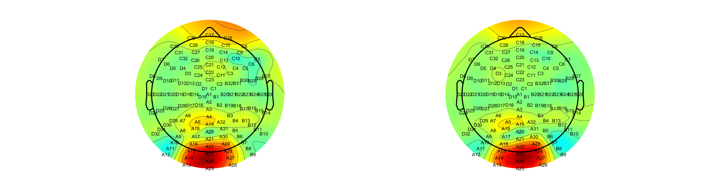
FDI vs BCP (correct -wrong) both A24

Slide 12
BCP (2) slightly higher at first but lower slop, lasting longer FDI higher in the steady stage

