Slide 1
SSVEP

Slide 2
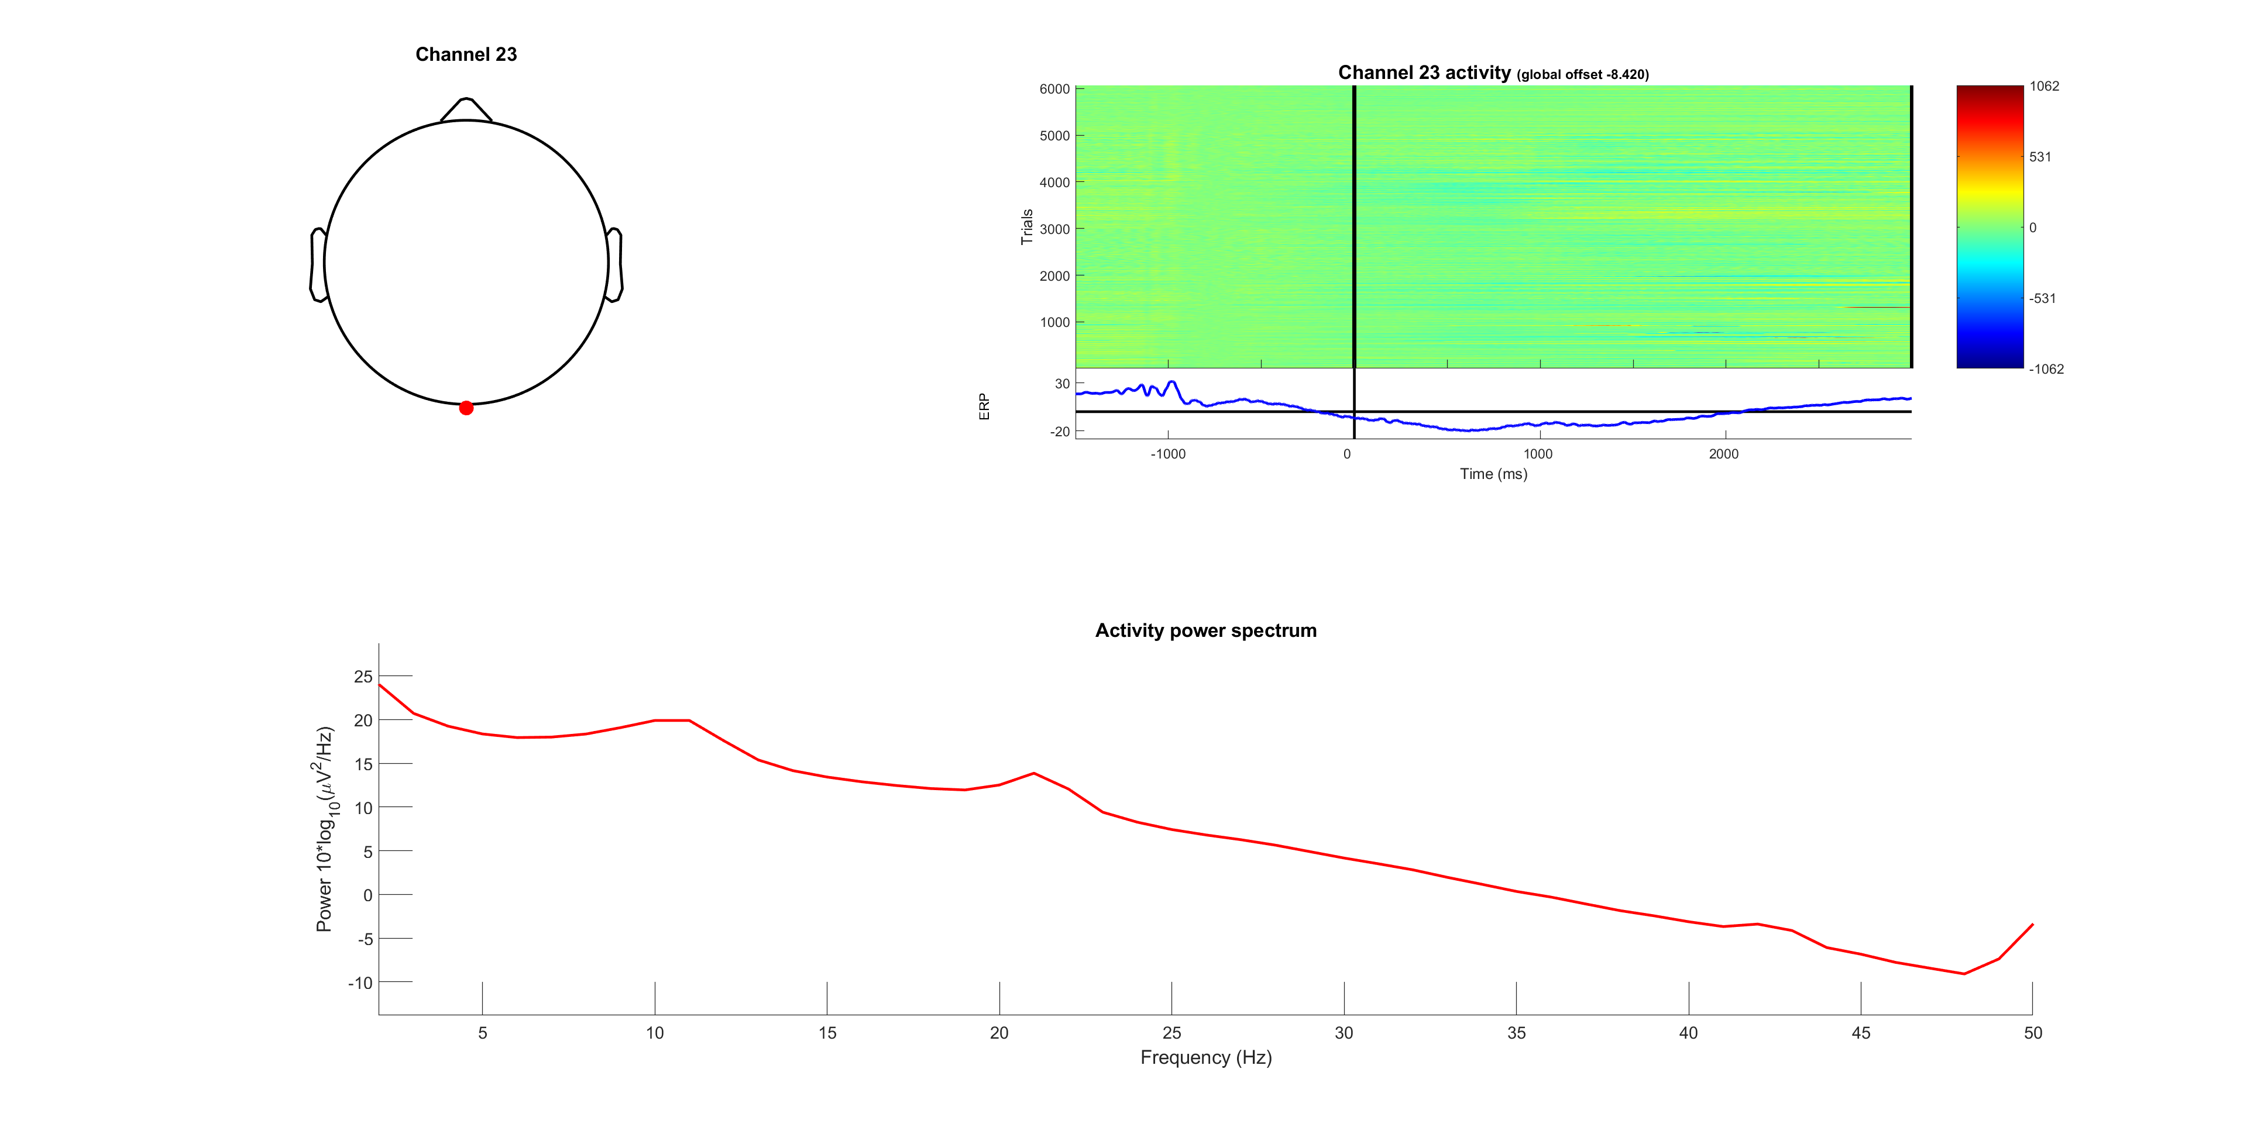



Slide 3
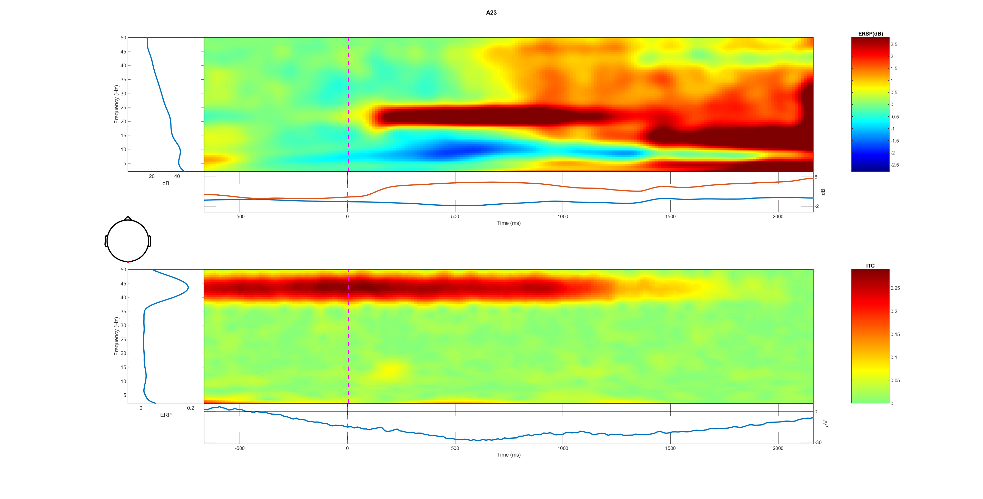
A23 all trail 0-50Hz

