Slide 1











The influence of response effector on decision adaptations
23/04/2024
Lab meeting- Nov 2024
School of Electrical and Electronic Engineering
University College Dublin,
Biomedical Engineering, Dublin, Ireland,
liang.tong2@ucdconnect.ie
Liang Tong
17208987

Slide 9
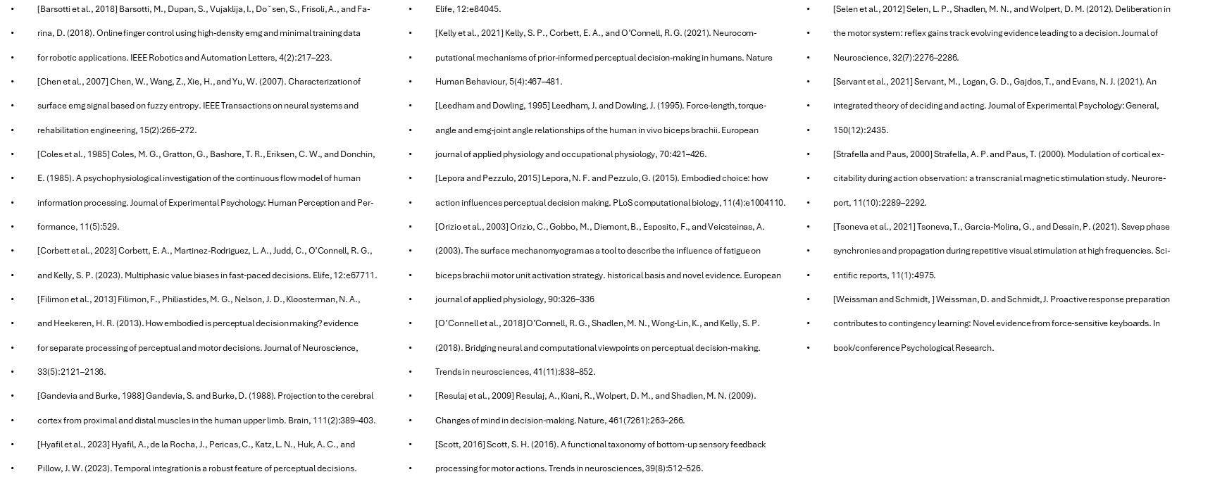

Reference
Notes:
Thanks for listening

