Slide 1
Delay before (30 trials *3) 60ms

Slide 2
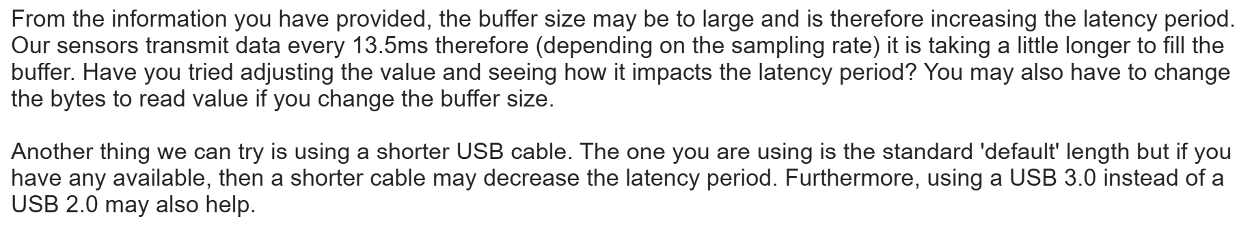

Slide 3
Delay after 5ms

Slide 4
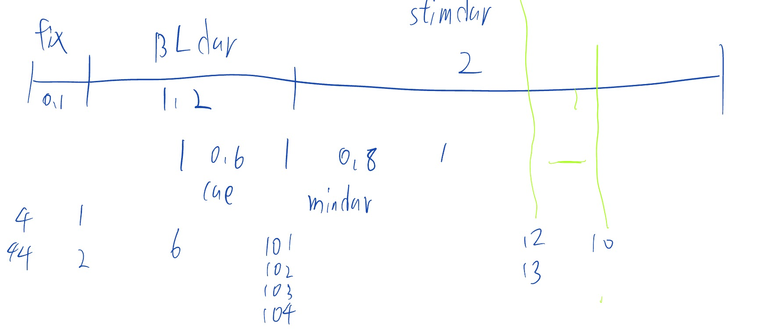
10-12/13 should <200ms

Slide 5
Trigger 10 – 12/13
Because a lot ‘wait time 0.004’+ matlab delay? (232 most should be 200)
if par.recordEEG, fwrite(EEG.port_ioObj, par.CD_FB); WaitSecs(par.eeg_waitTime); fwrite(EEG.port_ioObj,0);

Slide 6
1-4 should be 100ms

Slide 7
6-1 should around 600?

Slide 8
10x-6should be 600

