Slide 1
DDM modelling test
28 Feb 2025

Slide 2
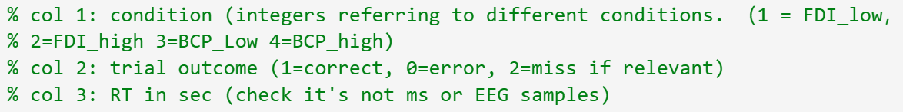
1) constant bounds and one drift rate free parameter (3 free parameters)
2) constant bounds but with 4 free drift rate parameters (6 free parameters)
3) time-varying bounds and one drift rate free parameter (4)
4) time-varying bounds but with 4 free drift rate parameters (7)

Slide 3
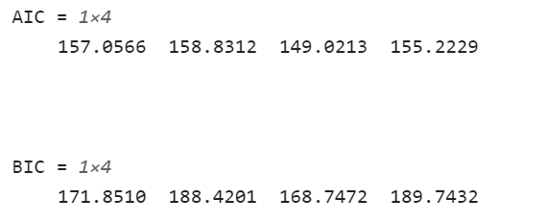
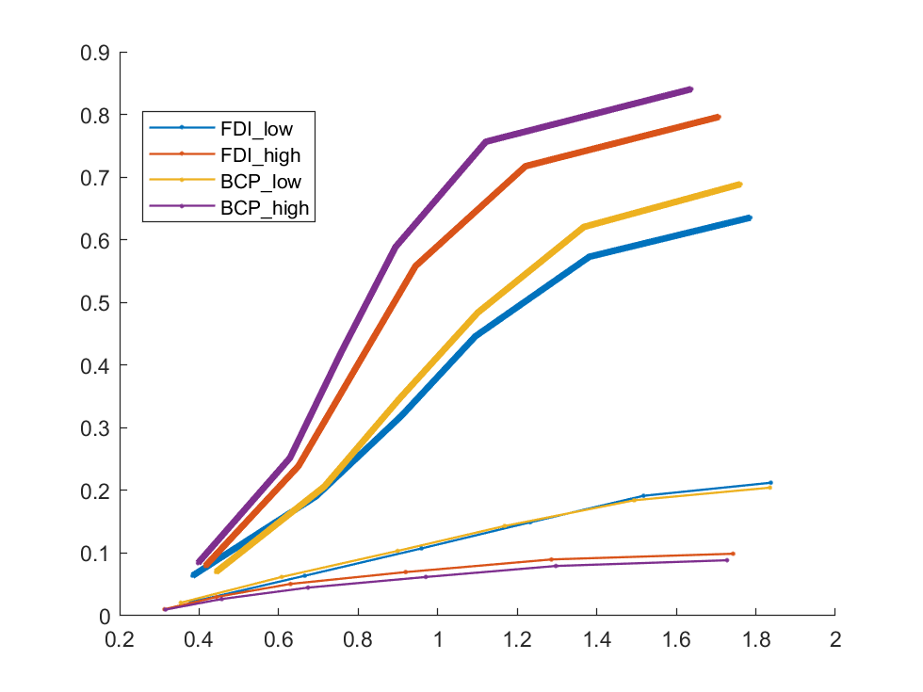
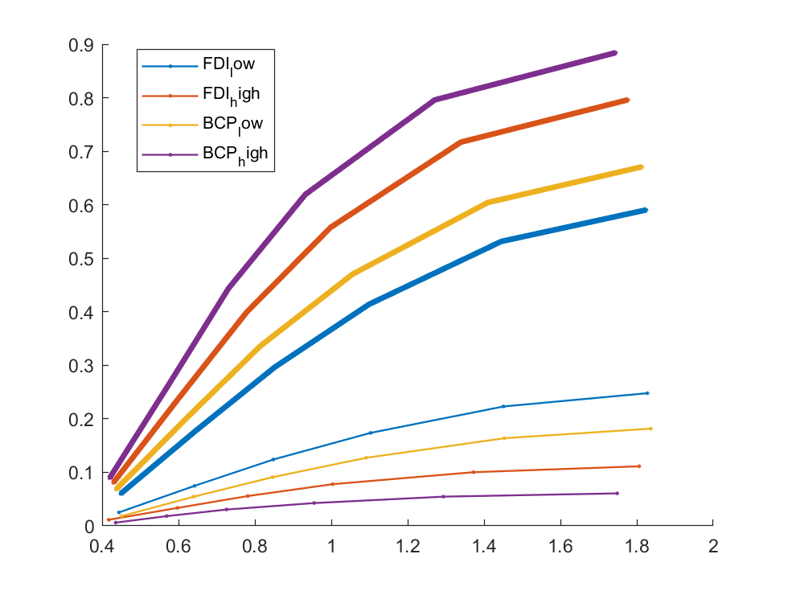


Coh=[0.07 0.14] ; ddl=[0.15 2]; RT

Slide 4
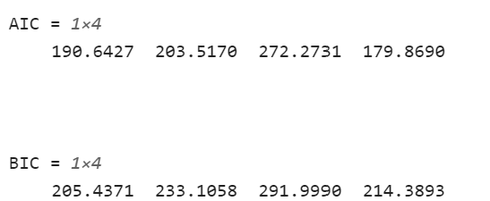
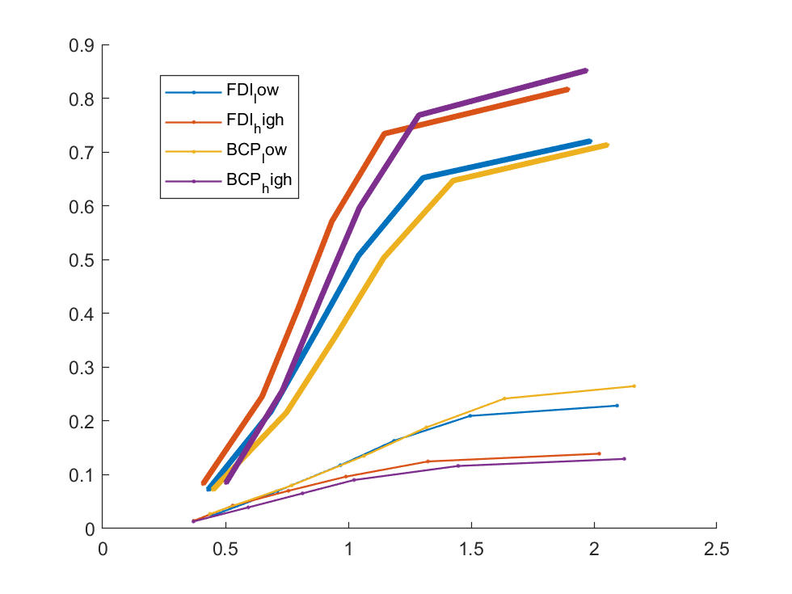
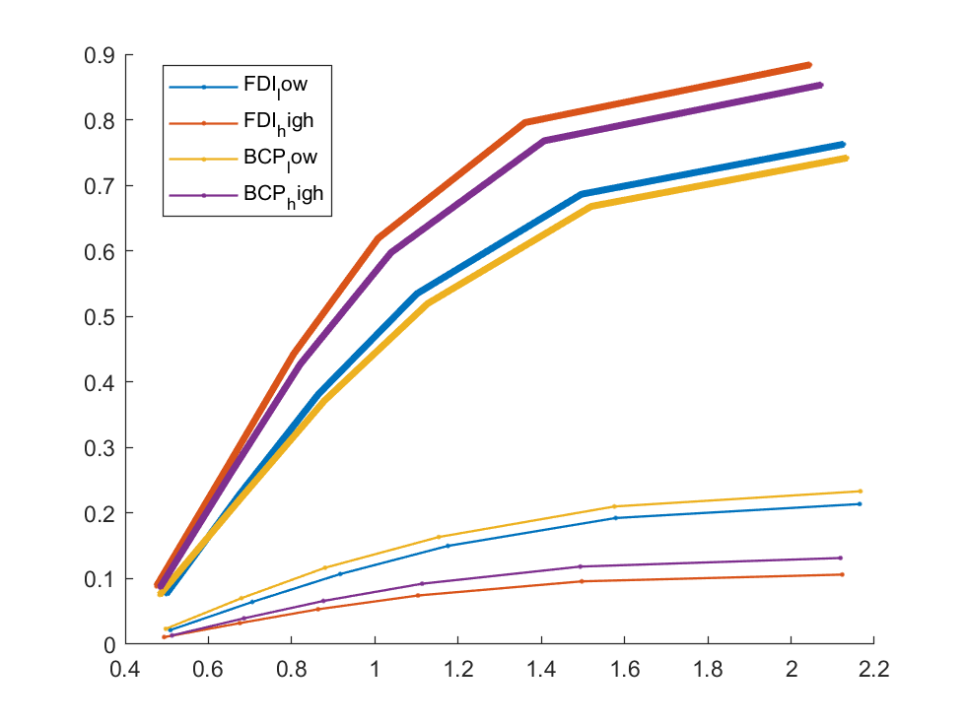


Coh=[0.05 0.1] ; ddl=[0.15 2.5]; RT

Slide 5
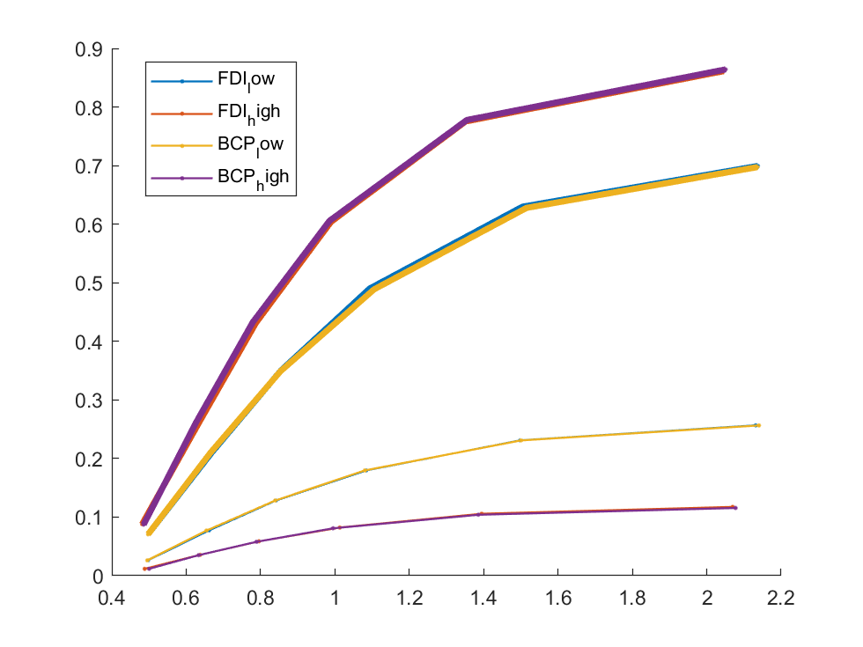
constant bounds and one drift rate free parameter

Slide 6
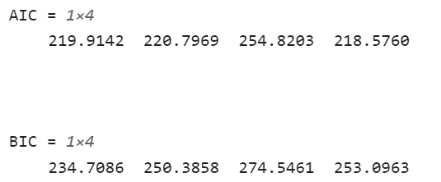
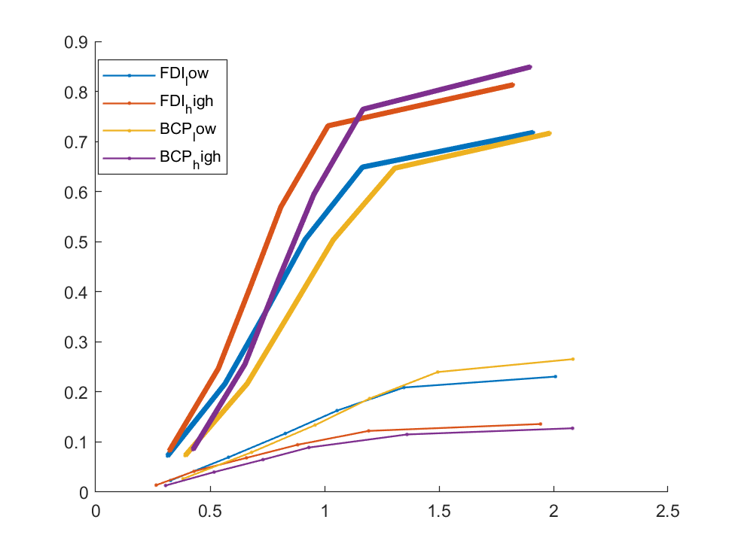
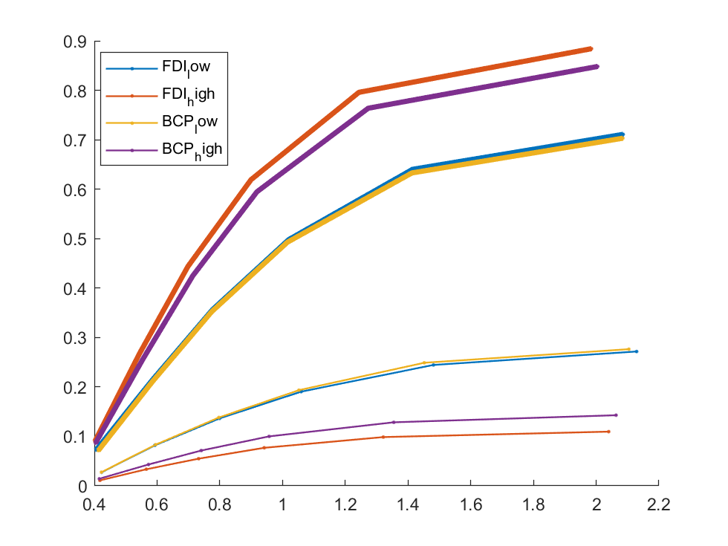


Coh=[0.05 0.1] ; ddl=[0.1 2.5]; EMG_onsite

Slide 7
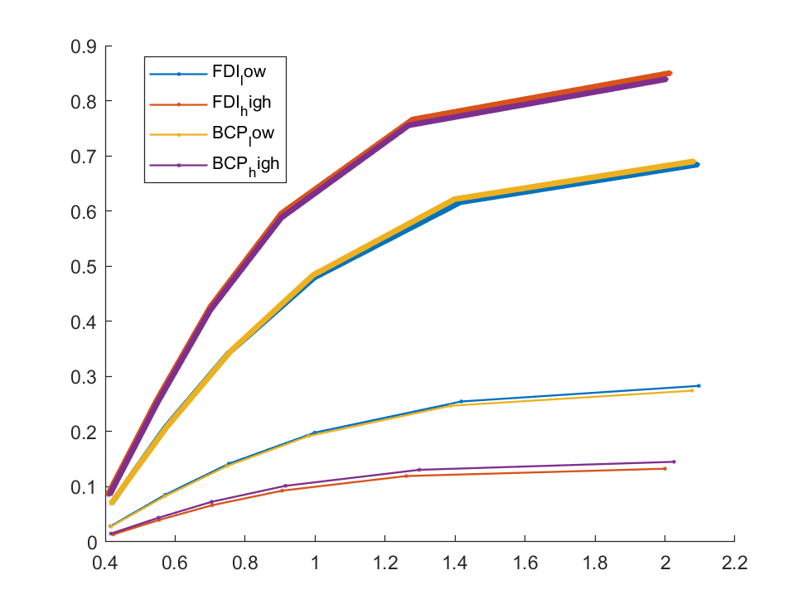
constant bounds and one drift rate free parameter

