Slide 1

Predicting Used Car Prices In Singapore
CZ1016 Project:
Jeremy Pong Zhi Jun
Neo Qi Xiang
Ricardo Rodrigues
Objectives
Conclusion
Data Collection
& Cleaning
Exploratory Data Analysis
Prediction
Notes:
NEO
JEREMY
RICARDO
Hello everyone and good afternoon. We’d like to take this opportunity to thank you for the time taken to listen to our presentation.
As part our project, our group, Jeremy, Ricardo and I, focused on the creation of a forecasting model to predict the prices of used cars in Singapore.
This presentation will begin by outlining the objectives of the project. We will then discuss the exploratory data analysis, followed by the prediction of car prices using machine learning models. Finally, we will conclude this presentation by describing the limitations of the model and discuss the potential improvements.

Slide 2



Objective
 | Singapore | Malaysia
Price of a new Toyota Corolla Altis | S$ 110,888 (Altis 1.6) | RM 117,361 (Altis 1.8E)
Down payment | S$55,444 (50%) | RM 11,736 (10%)
Monthly instalment | S$ 1,062.70 | RM 2,024.50
Car loan over 5 years at 3% interest rate | S$ 63,761 | RM 121,470
Road tax for 10 years | S$7,420 | RM 2,792
Insurance for 10 year period | S$ 21,000 | RM 9,235
Total price of owning car over a 10 year period | S$ 147,625 | RM 145,233
Total price | S$ 147,625 | RM 147,659.37
Total price (S$) | S$ 147,625 | S$ 49,219.65
To help Singaporeans determine whether the purchase price of a certain vehicle is reasonable.
But what did we use to collect and abstract all our data?
Notes:
The expense surrounding the ownership and maintenance of a car in Singapore is among the highest in the world. Despite the fact as locals we are accustomed to this, to the outside world they seem absurd.
To really help emphasise the inflated price of having a car in Singapore we have developed a comparison between the expenses associated with car maintenance in Singapore vs malaysia.
It is evident that the price of owning a car in Singapore is almost 3 times compared to that of the price in malaysia .
Therefore, In our project we made it our aim to help Singaporeans navigate the used car market.
In order to accomplish this, data analytics techniques were employed to create price forecasting models for pre-owned vehicles,
with the aim of helping Singaporeans determine whether the price of their desired car is reasonable.
In order to meet our objective we extracted data from SGCarMart, a popular car listing site in Singapore. To collate our data from SGCarMart we used the web scraper package, Beautiful soup.

Slide 3

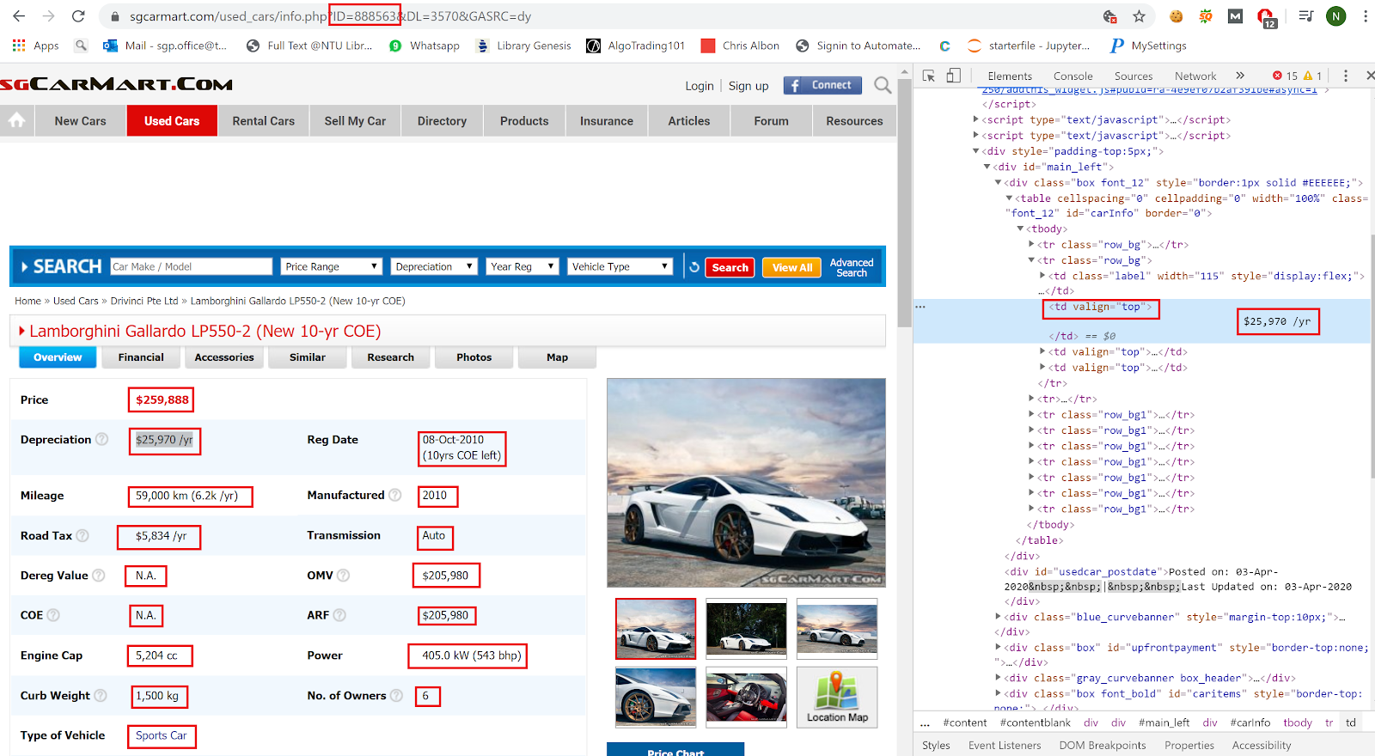
Data Collection and Cleaning
Web Scraping of SGCarMart:
Notes:
Here we can see a page from SGCarMart, showing the listing of a used car. On the right of this we see the HTML source code for this particular page.
Web scraping manually can be a very time consuming and laborious process; So we wanted to find a way to automate this.
The solution to this was found in the URL of the car listings. We noticed that the listing follows a certain ID as seen from the red box at the URL. We iterate through a range of numbers using a loop to change the IDs so that we can access different listings.
To collect our data, we made use of the source code as seen on the right and also beautifulsoup to extract the information. We achieved this by creating a function which could be reused for every page.

Slide 4


Data Collection & Cleaning
Our Datasets
Predictors and Response
After Cleaning:
1291 datasets
15 Predictors:
Brand, Type, Reg_date, Coe_left, Dep, Mileage, Road Tax, Dereg Value, COE, Engine Cap, Curb Weight, Manufactured, Transmission, OMV, ARF, Power, No. of Owners
Response:
Price
Notes:
We collected and cleaned a total of 1291 datasets. The data consists of a total of 15 predictors, 3 of which are categorical and the rest numerical. Lastly our response or predictant is the car price itself. Ricardo will now go on to discuss the exploratory data analysis in order to better understand our data.

Slide 5
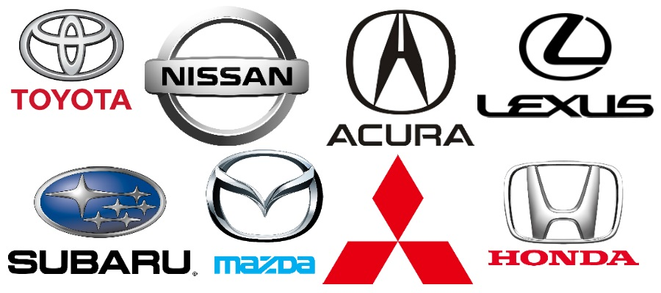
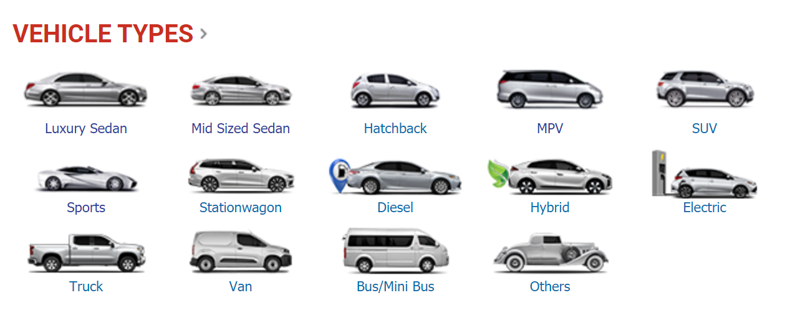
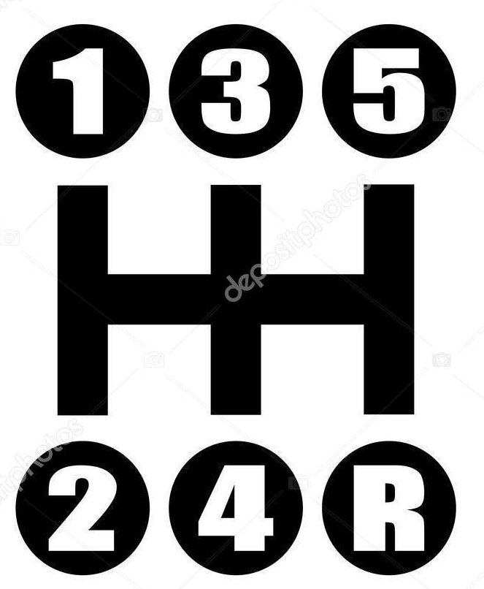
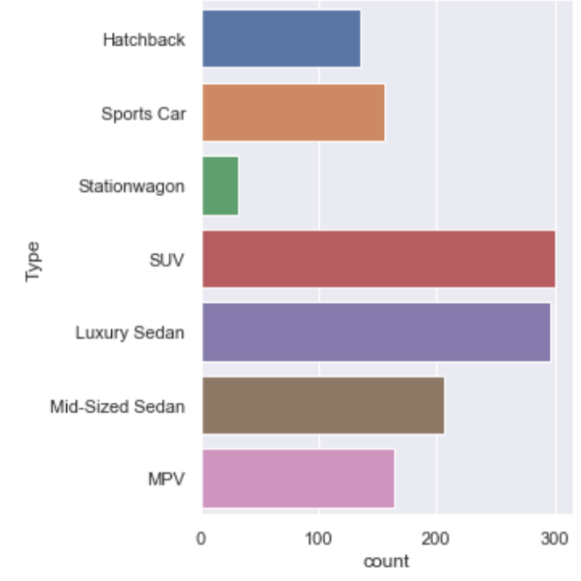
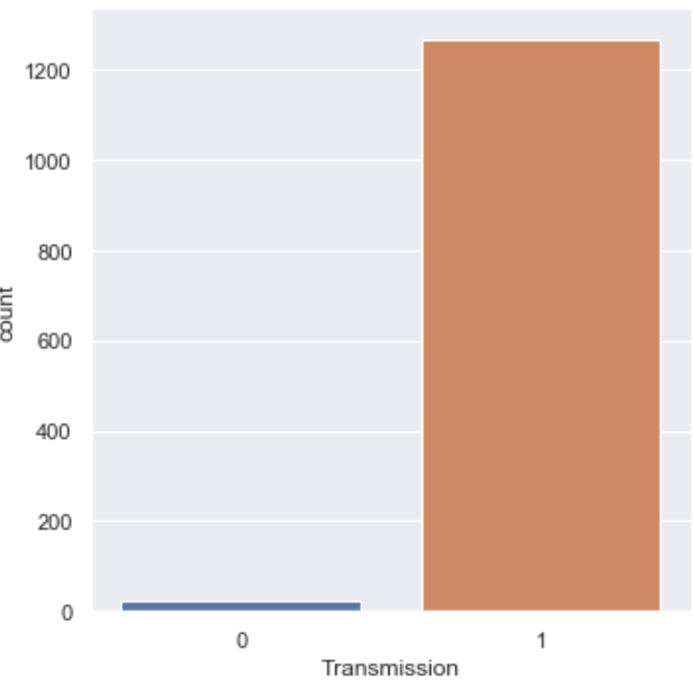
Exploratory Data Analysis
Categorical data
Vehicle Brand
Vehicle Type
Transmission
Car Brand | Number of cars
Mercedes Benz | 214
Toyota | 183
Honda | 162
BMW | 155
Audi | 71
Mazda | 62
Notes:
My contribution to this project was the exploratory data analysis.
These are the categorical variables. There are 38 vehicle brands in our dataset, here you can see the top 6 most common brand of vehicle in our dataset. Together they represent 65.6% of the total number of vehicle in the data.
For vehicle type, we only managed to collect data on 7 out of 14 types of vehicle listed in SGCarMart. This is a major limitation. Luxury sedan and SUV is the most common type of vehicle, not surprising as the more frequent car brands in our data set are Mercedes and BMW, which mainly manufacture these two types of vehicles.
The majority of cars in the modern era now run an Automatic transmission, hence it is not surprising that most of our data consist of Automatic vehicle.

Slide 6
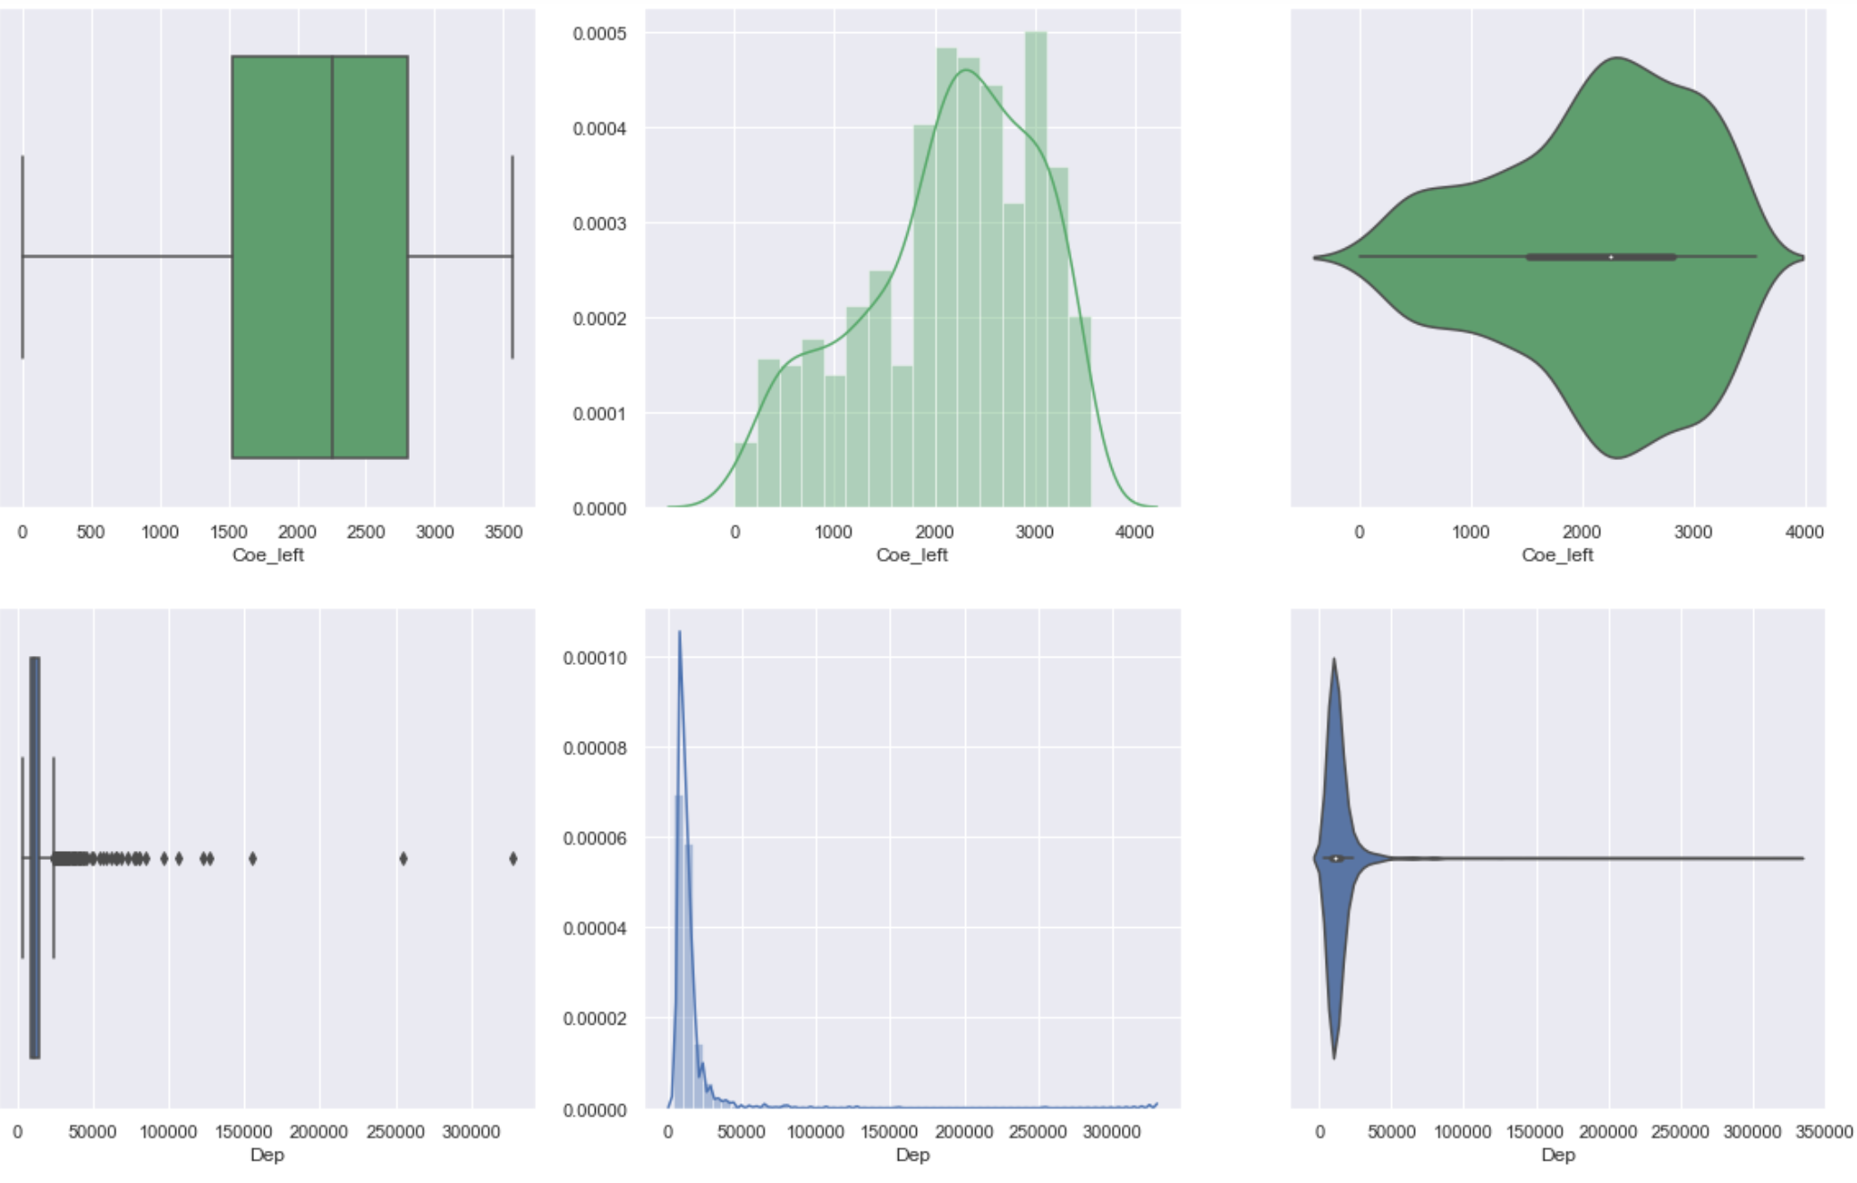
Exploratory Data Analysis
Numerical data
Notes:
These are numerical variables, we have 13 numerical variables including price. As seen from the image above, we have box plot, histogram and violin plot for COE_left and Depreciation.
The number of days of COE left is the only predictor which is skewing slightly left out of the 13 numerical variables. It is likely that the number of years of COE left is not directly related to the open market value of that car.
Depreciation value, similar to the rest of our numerical data, are skewed towards the right, due to the presence of vehicles in our data set with unusually high values of the numerical predictors.
The main contributors to the skewing are the luxury cars and sports cars.
It is a valid hypothesis to say luxury cars will depreciate more than cheaper cars, as they have more "room" for depreciation. For example, a 90K car is unlikely to depreciate to $0, because the owner might as well scrap it as he could earn more this way. While on the other hand a 300k car is very likely to devalue to 210k.

Slide 7
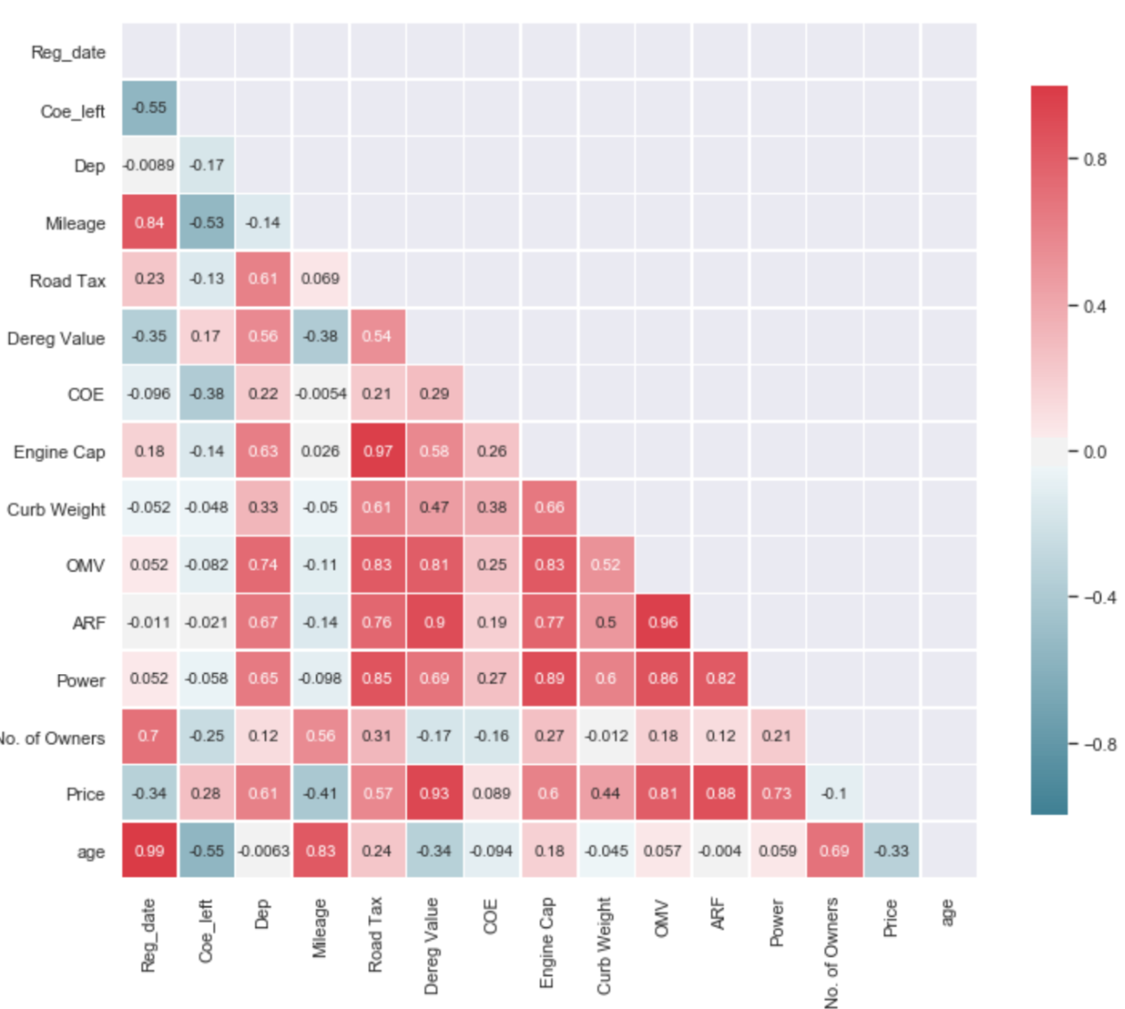
Exploratory Data Analysis
Numerical data
Notes:
From the correlation table above, we can see that there are a few predictors with high correlation with each other, such as Open Market Value and Additional Registration Fee. In this case, Open Market Value is calculated based on a value of Additional Registration Fee, leading to the high correlation between these 2 predictors. Combined with the skew in data from the previous slide, the high correlation between predictors may impact the performance of the machine learning model. I will now pass my time over to Jeremy to show you how we predict car prices.

Slide 8



Prediction
Price Prediction Using Regression
UNIVARIATE REGRESSION
MULTIVARIATE REGRESSION USING ALL THE PREDICTORS
MULTIVARIATE REGRESSION AFTER REMOVING PREDICTORS WITH MULTICOLLINEARITY
Notes:
My contribution to this project was the prediction of the used car prices. Using the predictors that we collected. We have split our prediction into 3 steps . Firstly, we performed a univariate regression using linear regression, base on the predictor with the highest correlation with price, the deregistration value. Next, we did a multivariate regression with all the predictors, without adjusting any predictors, and lastly, a third regression with some transformation of the predictors which I will explain later on.

Slide 9
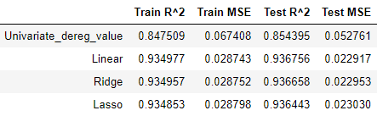
Prediction
Comparing The Results
Notes:
In order to set a benchmark for our predictions, we took deregistration value as the predictor for price, because it had the highest correlation of 0.92. After performing a linear regression, the results are as seen, with an explained variance of 0.85 and a mean-squared error of 0.05
Step 2 we did a multivariate prediction using linear, ridge and lasso regression and here are the results. As compared to using only deregistration value, there was an improvement in MSE of about 0.03. Furthermore, we noticed that using linear regression had slightly better performances compared to ridge and lasso.

Slide 10
Data Cleaning cont.
Data Cleaning Procedure
1
Drop selected predictors with high correlation with one another
2
Log transform for 3 predictors (OMV, depreciation, deregistration value) and the response price.
3
Standardise remaining predictors using StandardScaler
Notes:
Looking at the predictors used, we realised that there were some improvements that could be made to the data points. Firstly, there were some predictors with high correlation with one another, hence we dropped selected predictors in order to reduce multicollinearity. Then, we used log transformation to normalize some of the predictors which had a right skew, followed by standardization for the rest of the predictors.

Slide 11
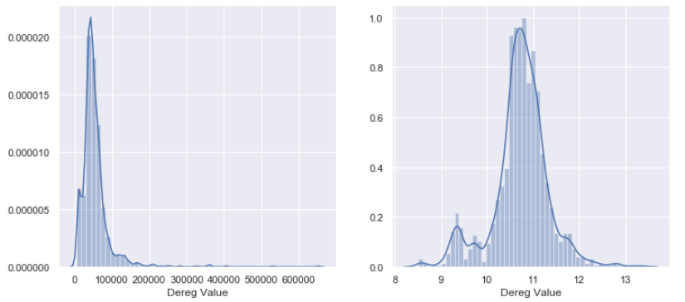
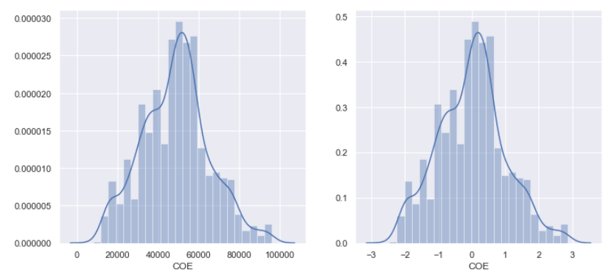
Data Cleaning cont.
Log Transformation
Standardization using StandardScaler
Notes:
As seen from the example above, the log transformation helped remedy the right skew of the curve, using deregistration curve as an example, and after using standardscaler, for example, the COE curve is shifted to within a range of -1 to 1.

Slide 12
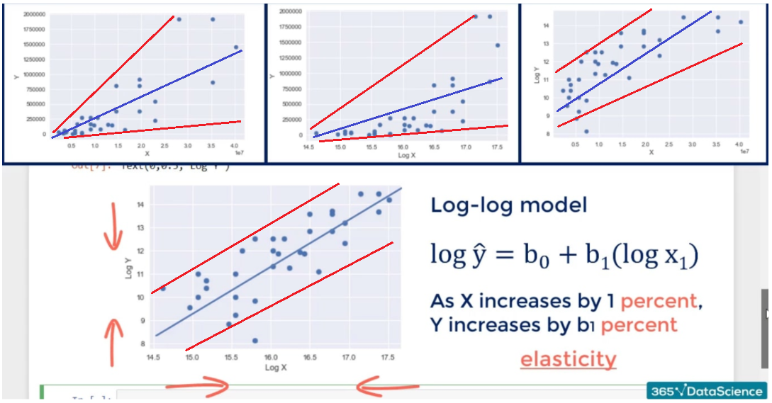
Data Cleaning cont.
Notes:
So why did we choose to log transform some of our data? From the first scatterplot, notice that there is a big variance within the data points. As we log transform the predictor or the result, the variance of the points will be reduced. This may improve our results as it brings us closer to the assumption made for OLS.

Slide 13
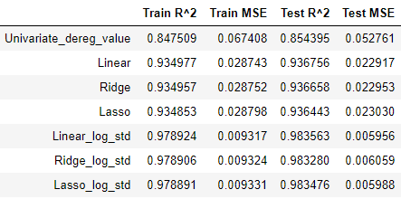
Prediction
Comparing The Results
Notes:
Looking from the results, standardization of the predictors helped us improve the performances of all the models by a decrease of about 0.15 in MSE.

Slide 14
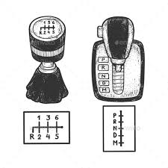


Conclusion
Brand
Type
Mileage
COE left
Age
Engine Capacity
Transmission
No. of owners
How Practical Is This Model?
R^2: 0.89879
MSE: 0.03667
 | Price | PredPrice | Error | Price | PredPrice | Error
3637 | 11.83 | 11.98 | 1.28 | 136800.0 | 159142.78 | 16.33
217 | 10.74 | 10.97 | 2.21 | 46000.0 | 58317.74 | 26.78
1893 | 10.95 | 11.03 | 0.78 | 56800.0 | 61890.68 | 8.96
Notes:
We have looked at how accurate the prediction can be when we have all the predictors we need. However, can this really be applied all the time? Say, for example, when someone wants to buy their car, they may not have values like depreciation. Therefore, we decided to try a prediction using the predictors like brand, type of car and mileage predictors that people can easily obtain. The model had an explained variance of 0.89 and MSE of 0.036. The table below shows us a sample of 3 cars, with a prediction error of about 10% to 30% deviation from actual car price. Looking at the results, without sufficient variables, the prediction is not very accurate at predicting the actual prices of used cars I will now hand the time back to Ricardo to conclude our presentation

Slide 15



Conclusion
Limitations And Improvements
Missing Data
MEAN ?
MEDIAN ?
MODE ?
Notes:
Though we saw a high accuracy in the results, we recognize that there are some limitations in our data collection and cleaning. As mentioned before, we noticed that a large proportion of the vehicles are luxury sedans and SUVs. In addition, we only have 7 vehicles types in our dataset, when SGCarMart has 14 different types of vehicle. Almost half of the vehicle types are not involved in the prediction.
Another limitation was that we decided to drop data with missing values because we felt that most of the missing data points cannot be jus simply replaced with mean or median of the column. For example, we felt that depreciation of a car is dependent on a lot of factors like the customization, economic situation of any particular year, thus making it unsuitable for missing values to just be filled in by mean or median.

Slide 16



Conclusion
Limitations And Improvements
Notes:
Looking at the limitations, what could we have done better next time round? In order to fill in missing data such as COE, Open Market Value prices, or Vehicle Emission Scheme rebates, we would need to access government websites, this is because these variables are data which change with time. An example of these government websites are one motoring and Land Transport Authority, they provide updated and accurate information. Because such websites are not static and require a lot of page interaction to access different information, we could have explored the use of selenium to systemically scrape these webpages to update our missing data. This way we could collect a more diversified and proportionate dataset as we can control the frequency of the the types of data collected such as car brands and types of vehicles.

Slide 17
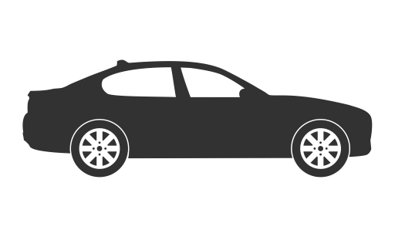
Conclusion
Q&A
Thank You!
Contributions :
Qi Xiang - Data collection
Ricardo - Exploratory Data Analysis
Jeremy - Prediction

