Slide 1

Welcome
Introduction
Machine Learning

Slide 3
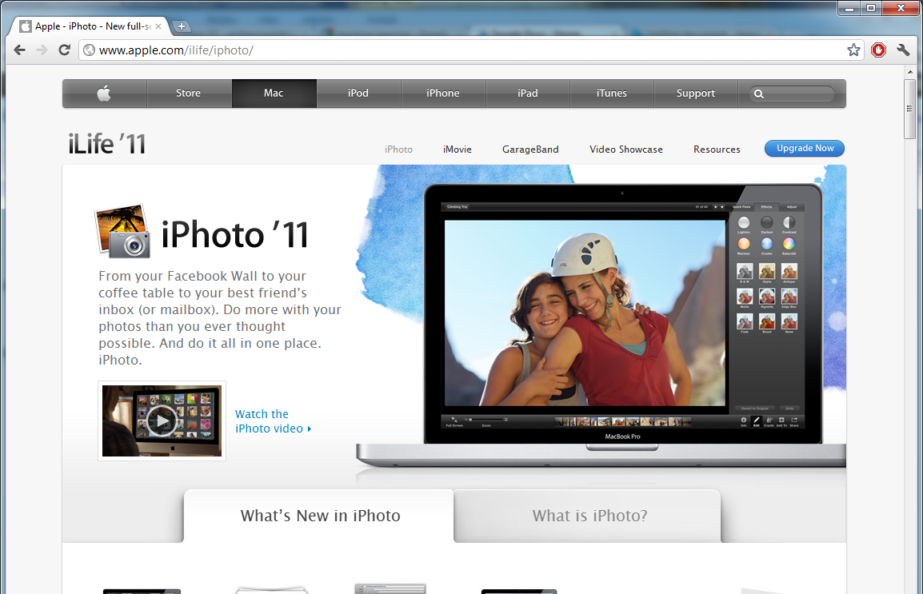

Slide 4
SPAM

Slide 5


Machine Learning
  Grew out of work in AI
  New capability for computers
Examples:
  Database mining
    Large datasets from growth of automation/web.
    E.g., Web click data, medical records, biology, engineering
    Applications can’t program by hand.
    E.g., Autonomous helicopter, handwriting recognition, most of Natural Language Processing (NLP), Computer Vision.

Slide 6
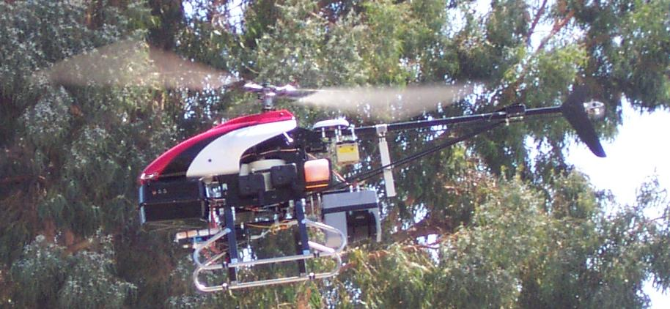
Machine Learning
  Grew out of work in AI
  New capability for computers
Examples:
  Database mining
    Large datasets from growth of automation/web.
    E.g., Web click data, medical records, biology, engineering
  Applications can’t program by hand.
    E.g., Autonomous helicopter, handwriting recognition, most of Natural Language Processing (NLP), Computer Vision.
  Self-customizing programs
    E.g., Amazon, Netflix product recommendations
  Understanding human learning (brain, real AI).

Slide 7
What is machine learning
Introduction
Machine Learning

Slide 8


Machine Learning definition
Arthur Samuel (1959). Machine Learning: Field of study that gives computers the ability to learn without being explicitly programmed.
Tom Mitchell (1998) Well-posed Learning Problem: A computer program is said to learn from experience E with respect to some task T and some performance measure P, if its performance on T, as measured by P, improves with experience E.

Slide 9
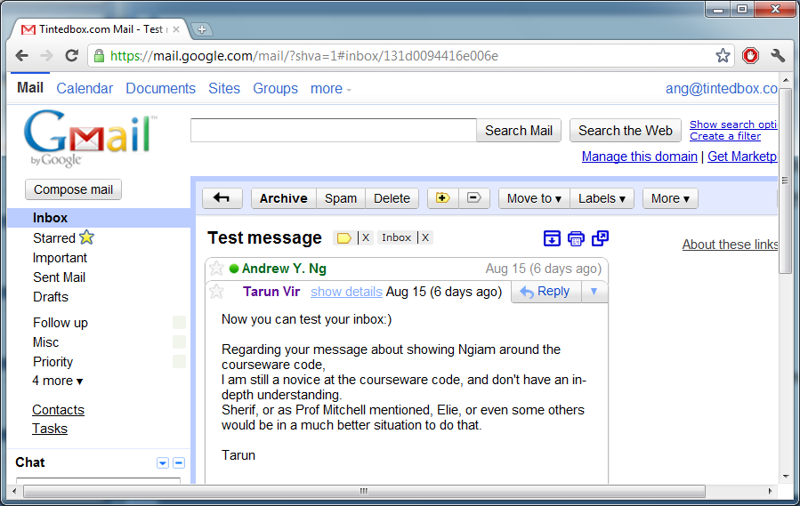
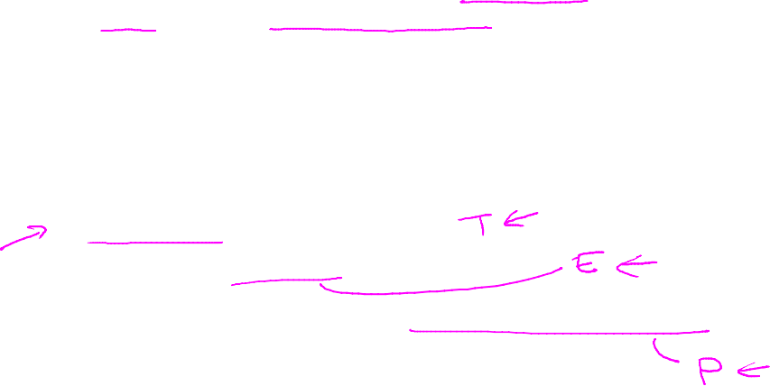
“A computer program is said to learn from experience E with respect to some task T and some performance measure P, if its performance on T, as measured by P, improves with experience E.”
Suppose your email program watches which emails you do or do not mark as spam, and based on that learns how to better filter spam. What is the task T in this setting?
Classifying emails as spam or not spam.
Watching you label emails as spam or not spam.
The number (or fraction) of emails correctly classified as spam/not spam.
None of the above—this is not a machine learning problem.

Slide 10

Machine learning algorithms:
Supervised learning
Unsupervised learning
Others: Reinforcement learning, recommender systems.
Also talk about: Practical advice for applying learning algorithms.

Slide 11
Supervised Learning
Introduction
Machine Learning

Slide 12

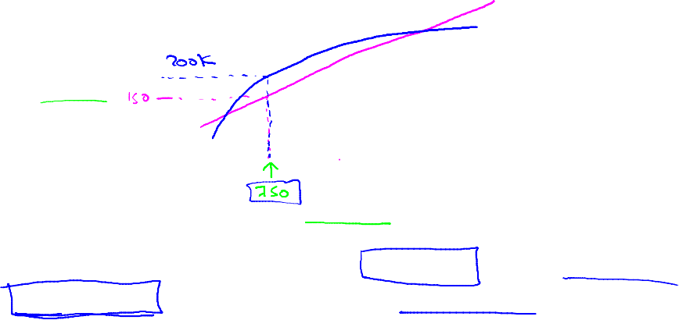
Housing price prediction.
Price ($)
in 1000’s
Size in feet²
Supervised Learning
“right answers” given
Regression: Predict continuous valued output (price)

Slide 13
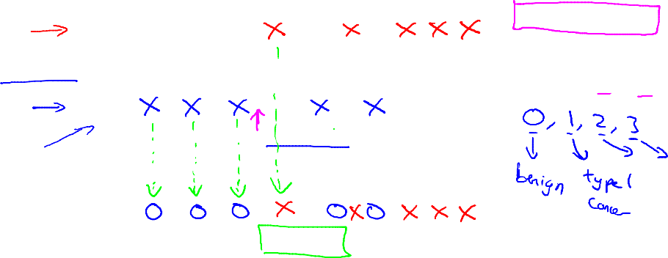
Breast cancer (malignant, benign)
Classification
Discrete valued output (0 or 1)
1(Y)
Malignant?
0(N)
Tumor Size
Tumor Size

Slide 14
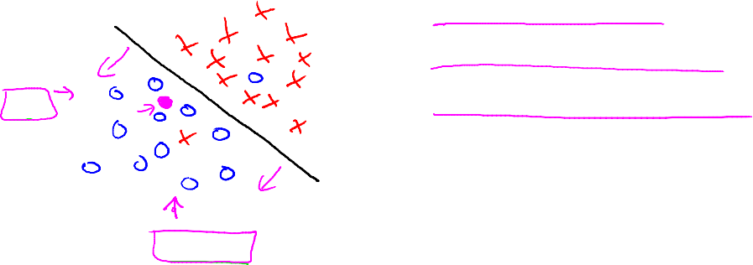
Clump Thickness
Uniformity of Cell Size
Uniformity of Cell Shape
…
Age
Tumor Size

Slide 15
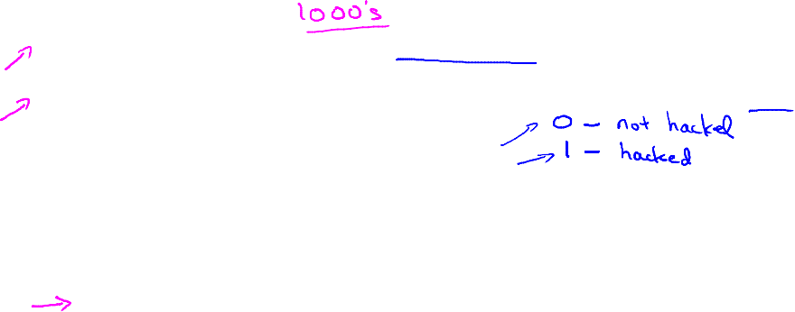
You’re running a company, and you want to develop learning algorithms to address each of two problems.
Problem 1: You have a large inventory of identical items. You want to predict how many of these items will sell over the next 3 months.
Problem 2: You’d like software to examine individual customer accounts, and for each account decide if it has been hacked/compromised.
Should you treat these as classification or as regression problems?
Treat both as classification problems.
Treat problem 1 as a classification problem, problem 2 as a regression problem.
Treat problem 1 as a regression problem, problem 2 as a classification problem.
Treat both as regression problems.

Slide 16
Unsupervised Learning
Introduction
Machine Learning

Slide 17
Supervised Learning
x₂
x₁

Slide 18

Unsupervised Learning
x₂
x₁

Slide 19
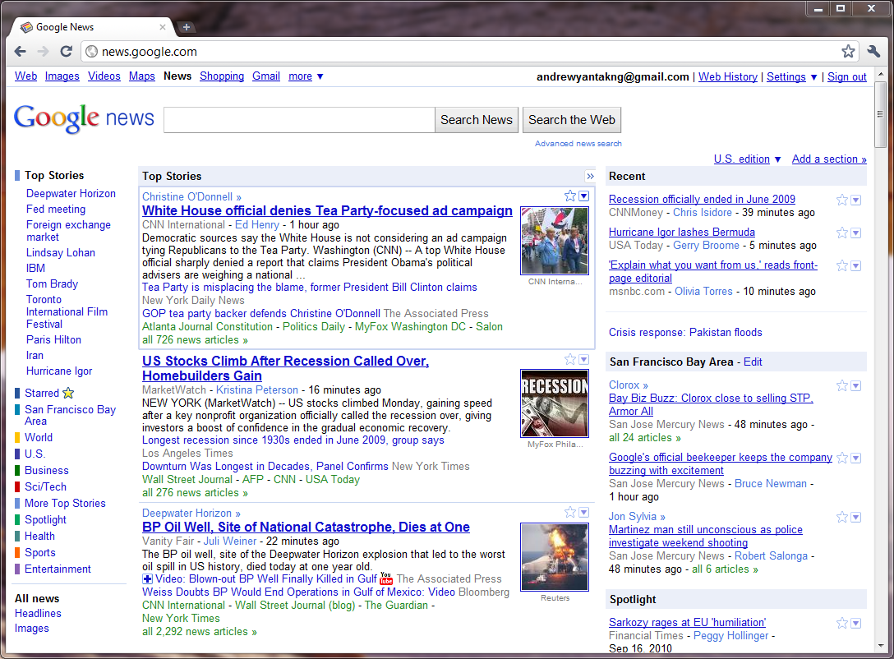



Slide 20
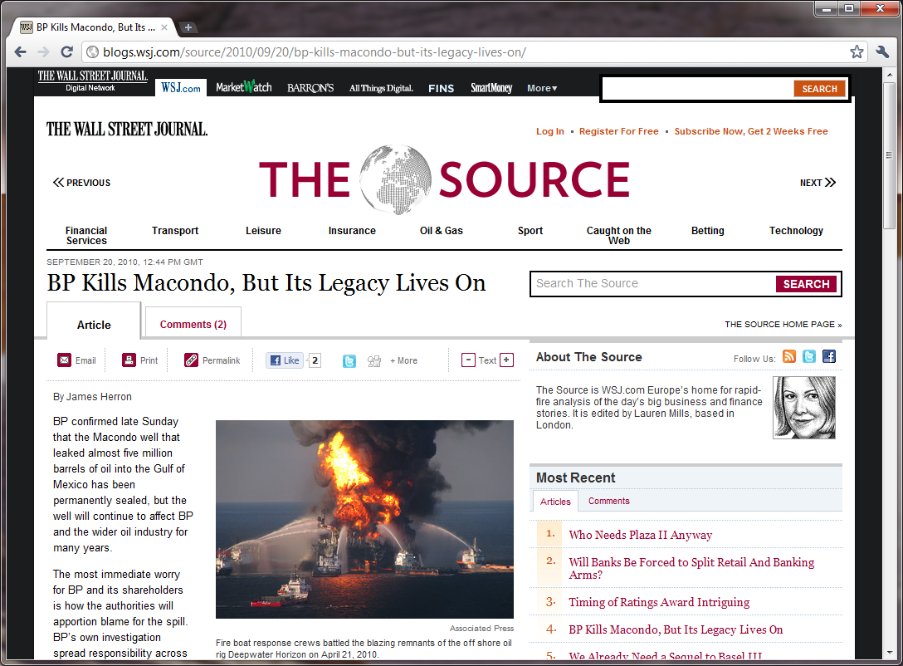
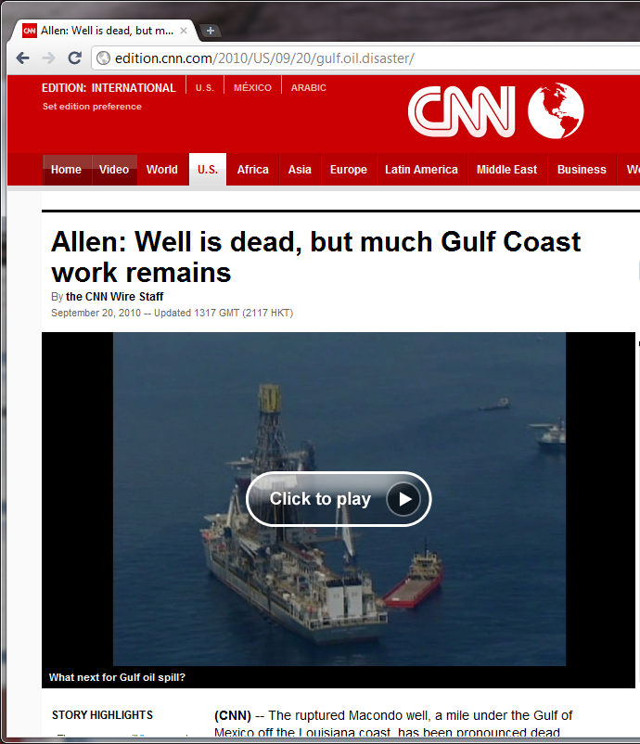
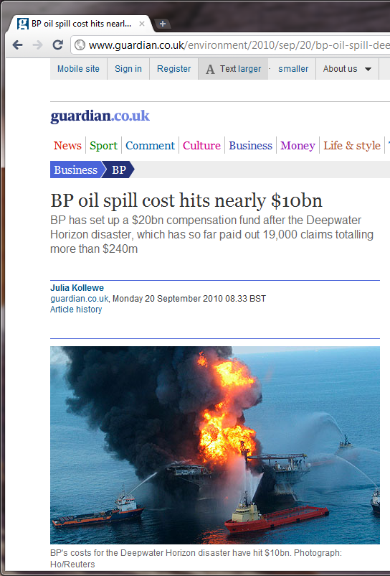


Slide 21
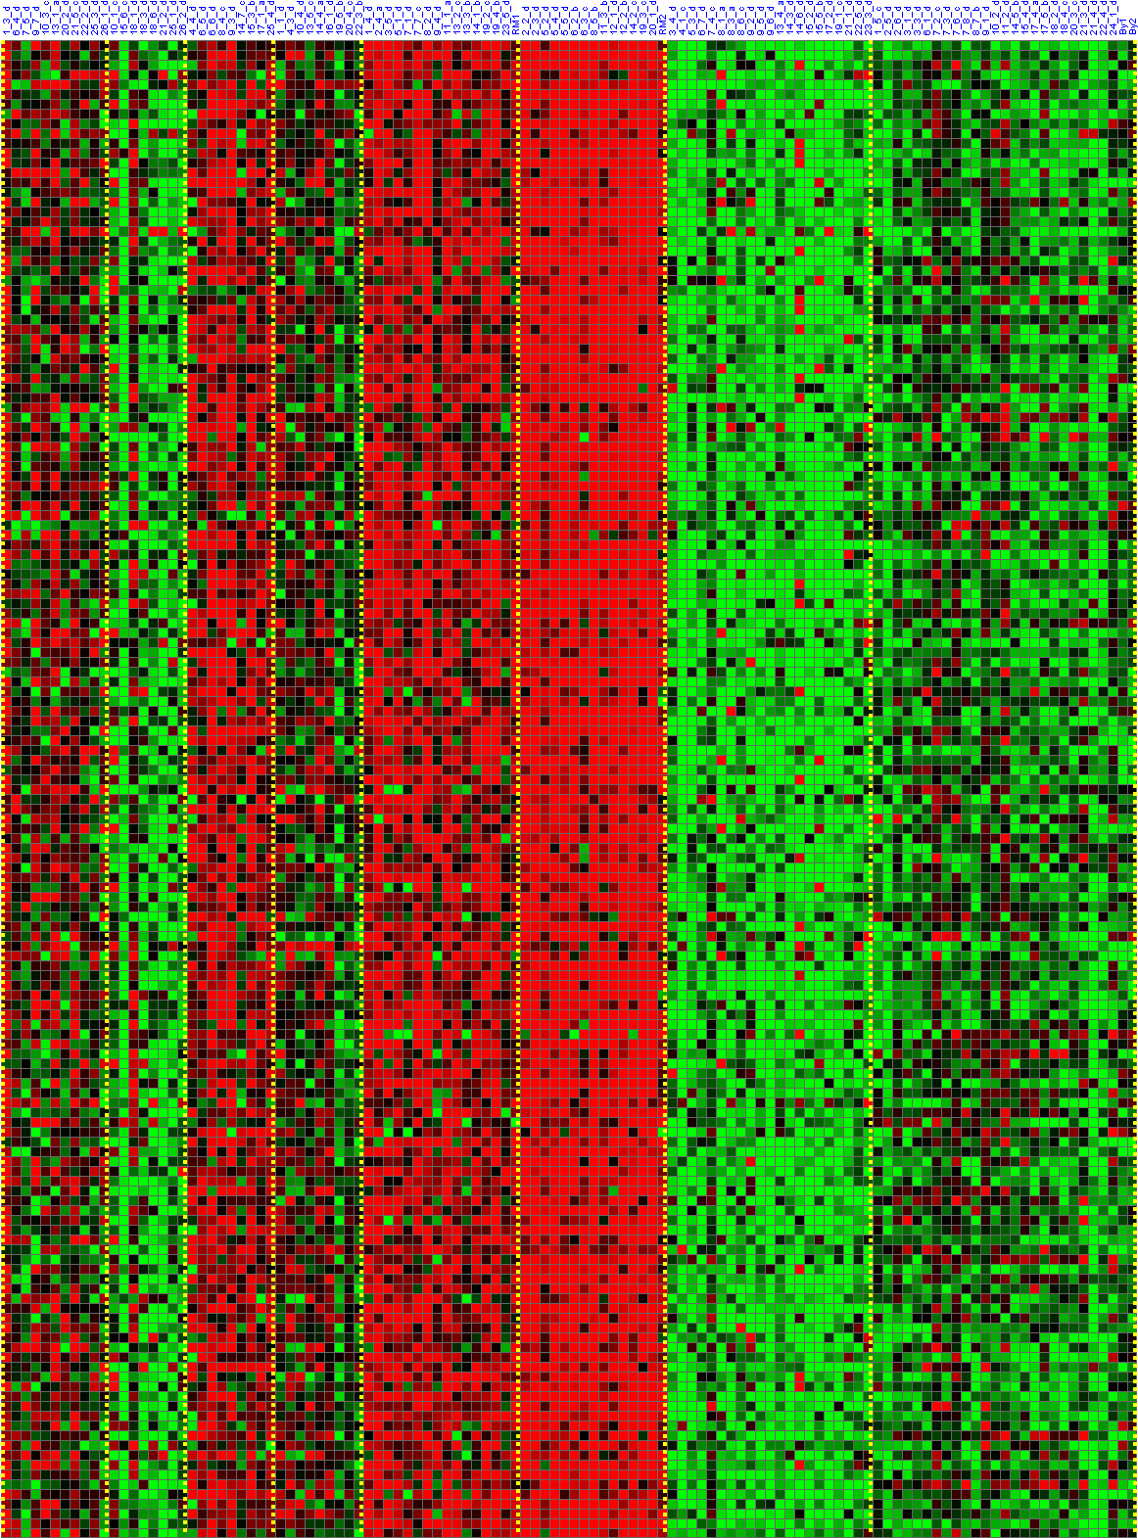
Genes
Individuals
[Source: Daphne Koller]

Slide 22
Genes
Individuals
[Source: Daphne Koller]

Slide 23

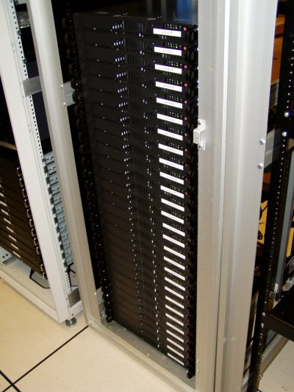
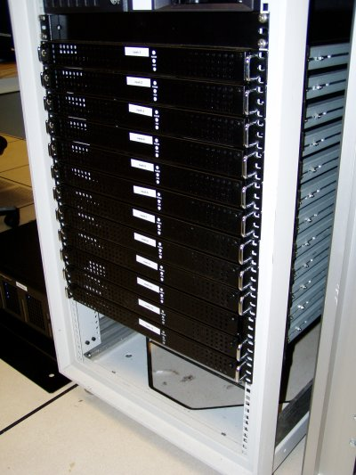

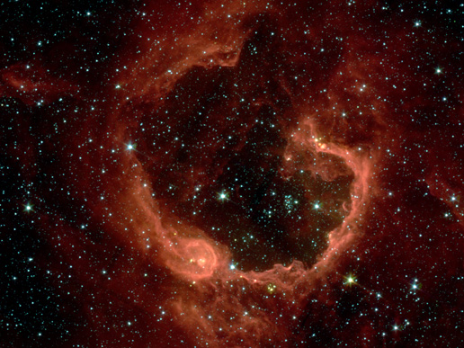

Organize computing clusters
Social network analysis
Image credit: NASA/JPL-Caltech/E. Churchwell (Univ. of Wisconsin, Madison)
Market segmentation
Astronomical data analysis
Notes:
Astronomical data analysis image obtained from NASA website.
http://www.nasa.gov/multimedia/imagegallery/image_feature_874.html
RCW 79 is seen in the southern Milky Way, 17,200 light-years from Earth in the constellation Centaurus. The bubble is 70-light years in diameter, and probably took about one million years to form from the radiation and winds of hot young stars.
The balloon of gas and dust is an example of stimulated star formation. Such stars are born when the hot bubble expands into the interstellar gas and dust around it. RCW 79 has spawned at least two groups of new stars along the edge of the large bubble. Some are visible inside the small bubble in the lower left corner. Another group of baby stars appears near the opening at the top.
NASA's Spitzer Space Telescope easily detects infrared light from the dust particles in RCW 79. The young stars within RCW79 radiate ultraviolet light that excites molecules of dust within the bubble. This causes the dust grains to emit infrared light that is detected by Spitzer and seen here as the extended red features.
Image credit: NASA/JPL-Caltech/E. Churchwell (Univ. of Wisconsin, Madison)
--------------------
From NASA use guidelines:
http://www.nasa.gov/multimedia/guidelines/index.html
Using NASA Imagery and Linking to NASA Web Sites
10.13.05
Still Images, Audio Files and Video
NASA still images, audio files and video generally are not copyrighted. You may use NASA imagery, video and audio material for educational or informational purposes, including photo collections, textbooks, public exhibits and Internet Web pages. This general permission extends to personal Web pages.
This general permission does not extend to use of the NASA insignia logo (the blue "meatball" insignia), the retired NASA logotype (the red "worm" logo) and the NASA seal. These images may not be used by persons who are not NASA employees or on products (including Web pages) that are not NASA sponsored.
If the NASA material is to be used for commercial purposes, especially including advertisements, it must not explicitly or implicitly convey NASA's endorsement of commercial goods or services. If a NASA image includes an identifiable person, using the image for commercial purposes may infringe that person's right of privacy or publicity, and permission should be obtained from the person. Any questions regarding application of any NASA image or emblem should be directed to:
Photo Department
NASA Headquarters
300 E St. SW
Washington, DC 20546
Tel: (202)358-1900
Fax: (202)358-4333
Linking to NASA Web Sites
NASA Web sites are not copyrighted, and may be linked to from other Web sites, including individuals' personal Web sites, without explicit permission from NASA. However, such links may not explicitly or implicitly convey NASA's endorsement of commercial goods or services.
NASA images may be used as graphic "hot links" to NASA Web sites, provided they are used within the guidelines above. This permission does not extend to use of the NASA insignia, the retired NASA logotype or the NASA seal.
Restrictions
Please be advised that:
1) NASA does not endorse or sponsor any commercial product, service, or activity.
2) The use of the NASA name, initials, any NASA emblems (including the NASA insignia, the NASA logo and the NASA seal) which would express or imply such endorsement or sponsorship is strictly prohibited.
3) Use of the NASA name or initials as an identifying symbol by organizations other than NASA (such as on foods, packaging, containers, signs, or any promotional material) is prohibited.
4) NASA does permit the use of the NASA logo and insignia on novelty and souvenir-type items. However, such items may be sold and manufactured only after a proposal has been submitted to and approved by a Visual Identity representative from the Public Outreach Division (Phone: 202/358-1750) in accordance with 14 CFR (Code of Federal Regulations) Part 1221. Permission is granted on a nonexclusive basis as it is not NASA's policy to grant exclusive rights to use any of the agency identities.
5) No approval for use is authorized by NASA when the use can be construed as an endorsement by NASA of a product, service or activity.
6) NASA emblems should be reproduced only from original reproduction proofs, transparencies, or computer files available from NASA Headquarters. Please be advised that approval must be granted by a Visual Identity representative from the Public Outreach Division ( Tel: 202/358-1750) before any reproduction materials can be obtained.

Slide 24



Cocktail party problem
Speaker #1
Microphone #1
Speaker #2
Microphone #2

Slide 25

Microphone #1:
Microphone #2:
Output #1:
Output #2:
Microphone #1:
Microphone #2:
Output #1:
Output #2:
[Audio clips courtesy of Te-Won Lee.]

Slide 26
Cocktail party problem algorithm
[W,s,v] = svd((repmat(sum(x.*x,1),size(x,1),1).*x)*x');
[Source: Sam Roweis, Yair Weiss & Eero Simoncelli]

Slide 27



Of the following examples, which would you address using an unsupervised learning algorithm? (Check all that apply.)
Given email labeled as spam/not spam, learn a spam filter.
Given a set of news articles found on the web, group them into set of articles about the same story.
Given a database of customer data, automatically discover market segments and group customers into different market segments.
Given a dataset of patients diagnosed as either having diabetes or not, learn to classify new patients as having diabetes or not.

