Slide 1



Optimization objective
Support Vector
Machines
Machine Learning

Slide 2
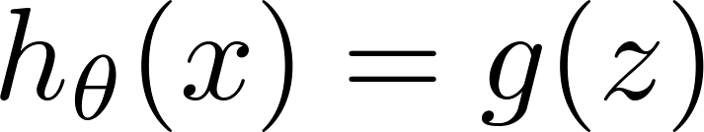
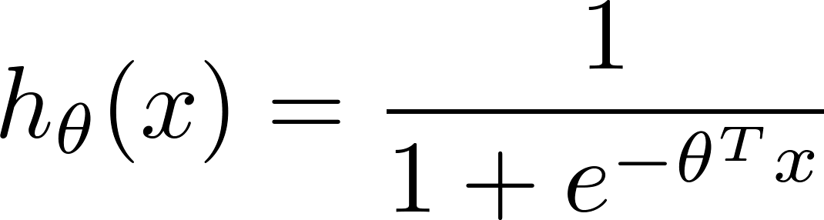
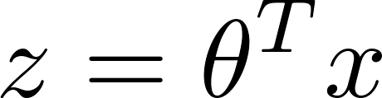
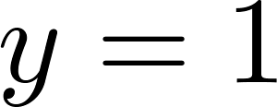
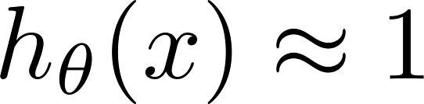
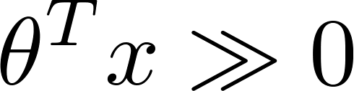
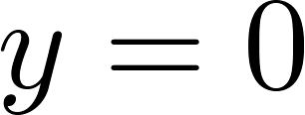
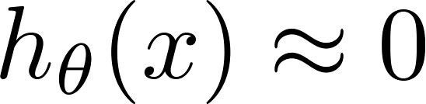
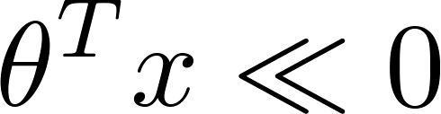
Alternative view of logistic regression
If , we want ,
If , we want ,

Slide 3
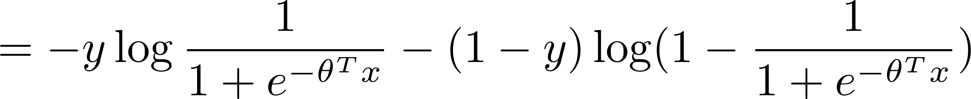


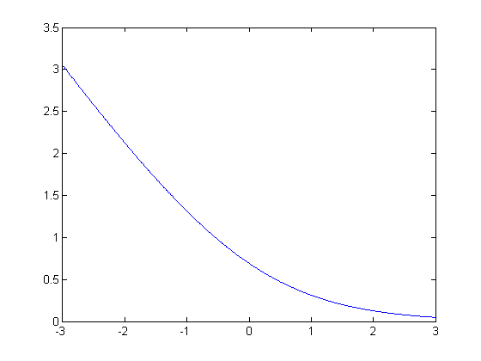
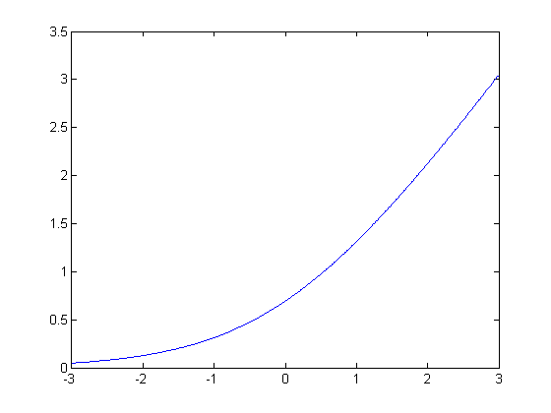







Alternative view of logistic regression
Cost of example:
If (want ):
If (want ):

Slide 4
Support vector machine
Logistic regression:
Support vector machine:

Slide 5

SVM hypothesis
Hypothesis:

Slide 6
Large Margin
Intuition
Support Vector
Machines
Machine Learning

Slide 7
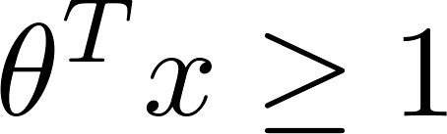

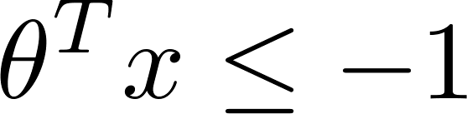


Support Vector Machine
-1
1
-1
1
If , we want (not just )
If , we want (not just )

Slide 8
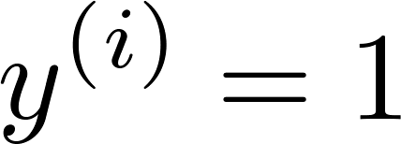
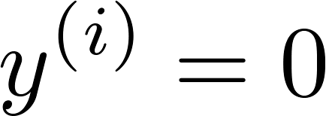
SVM Decision Boundary
Whenever :
-1
1
Whenever :
-1
1

Slide 9
SVM Decision Boundary: Linearly separable case
x₂
x₁
Large margin classifier

Slide 10


Large margin classifier in presence of outliers
x₂
x₁

Slide 11
The mathematics behind large margin classification (optional)
Support Vector
Machines
Machine Learning

Slide 12
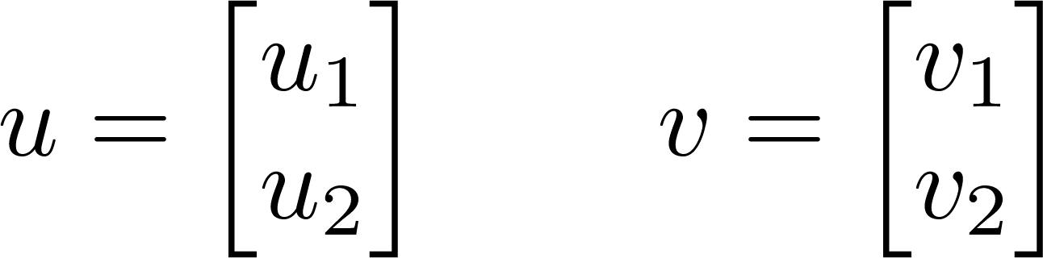
Vector Inner Product

Slide 13
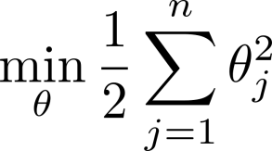
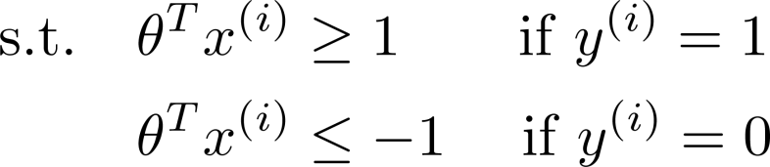
SVM Decision Boundary

Slide 14
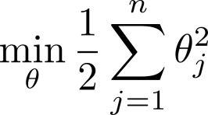
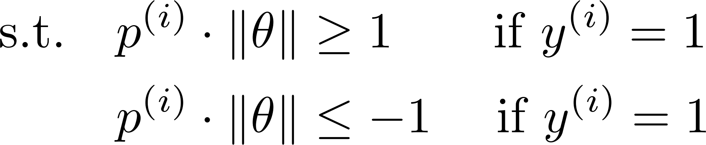
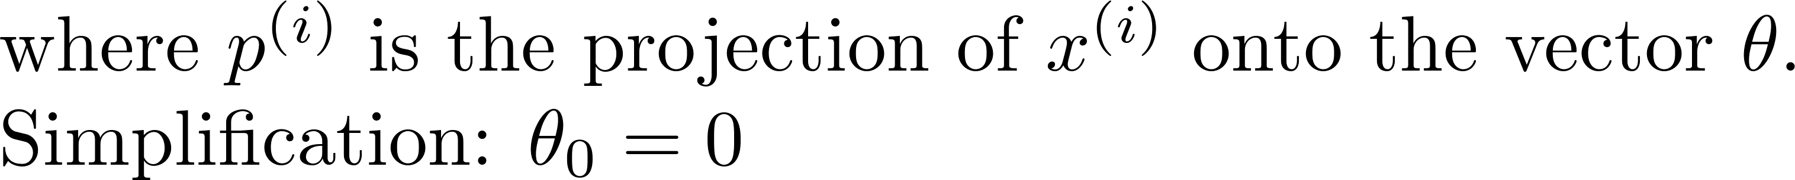

SVM Decision Boundary

Slide 15
Kernels I
Support Vector
Machines
Machine Learning

Slide 16

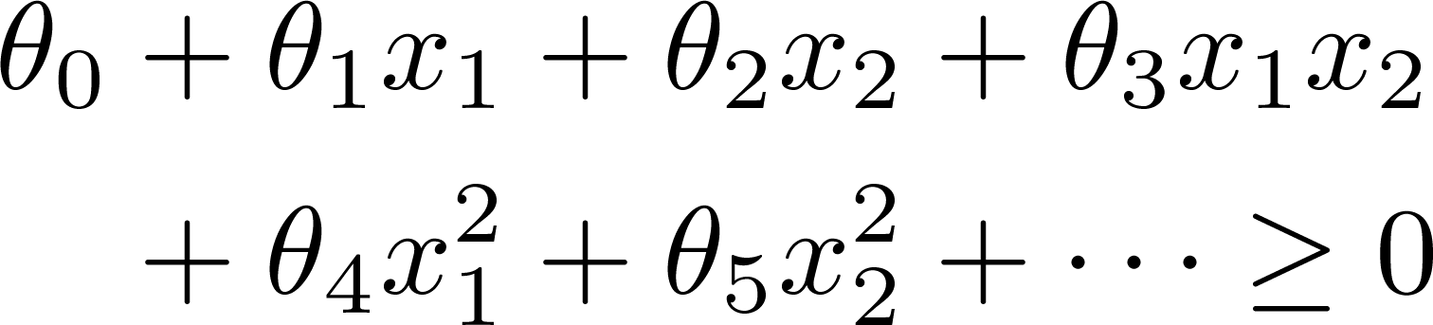
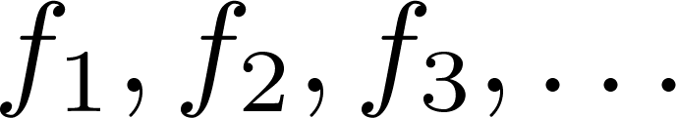
Non-linear Decision Boundary
x₂
x₁
Is there a different / better choice of the features ?

Slide 17
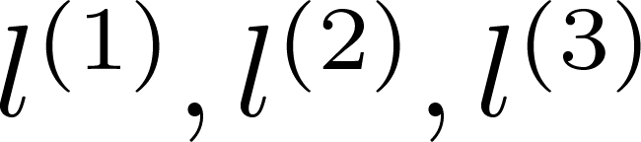
Kernel
Given , compute new feature depending
on proximity to landmarks
x₂
x₁

Slide 18


Kernels and Similarity

Slide 19
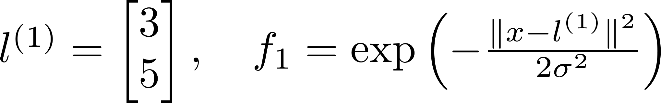
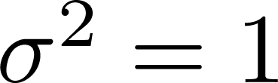
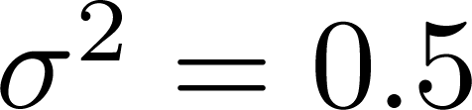

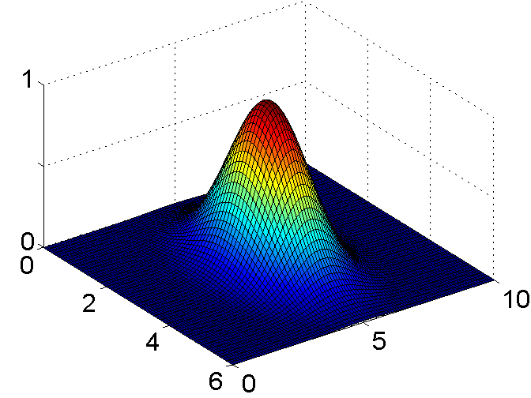
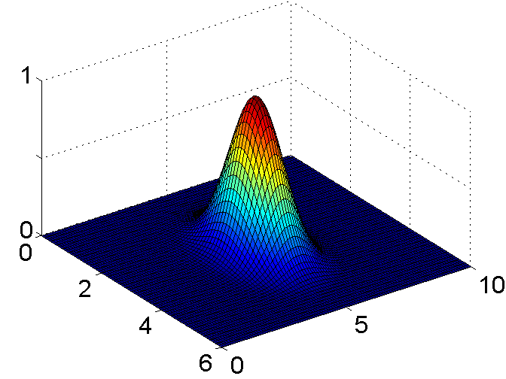
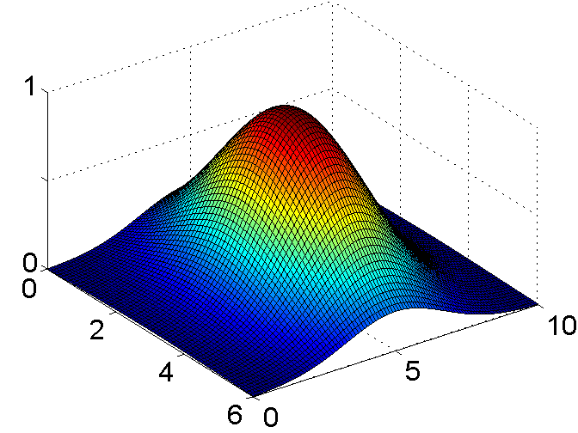
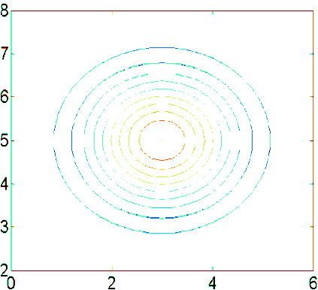
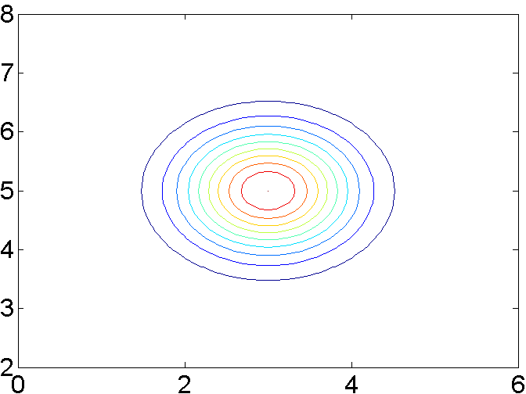
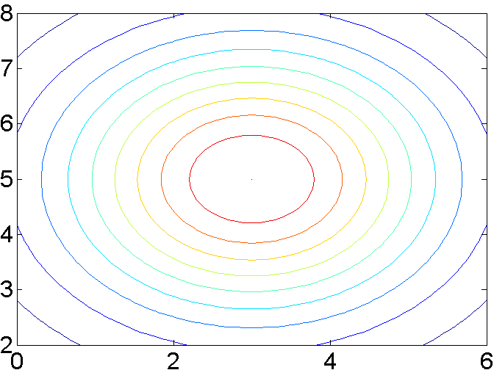
Example:

Slide 20



x₂
x₁

Slide 21
Kernels II
Support Vector
Machines
Machine Learning

Slide 22

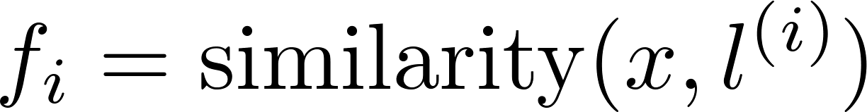
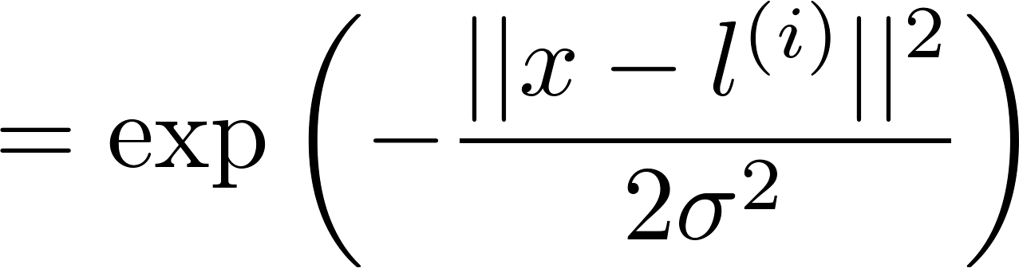

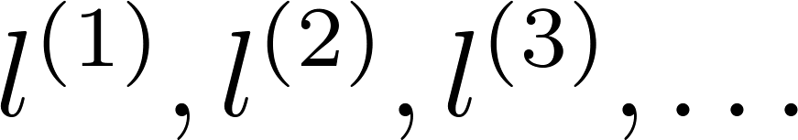
Choosing the landmarks
Given :
x₂
x₁
Predict if
Where to get ?

Slide 23
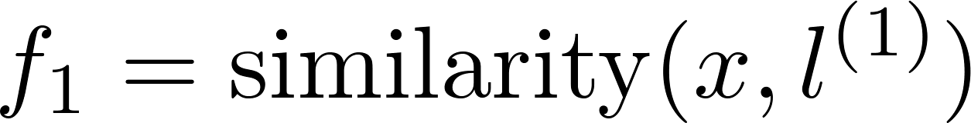
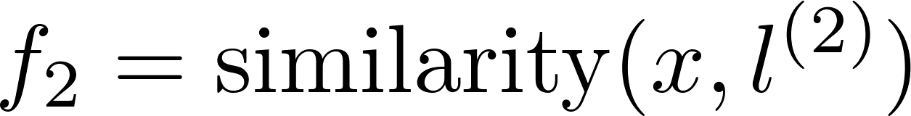
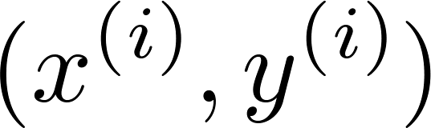
SVM with Kernels
Given
choose
Given example :
For training example :

Slide 24
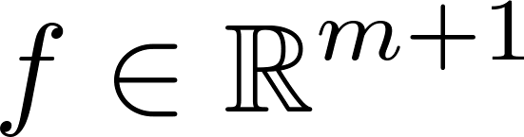
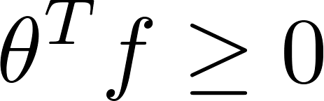
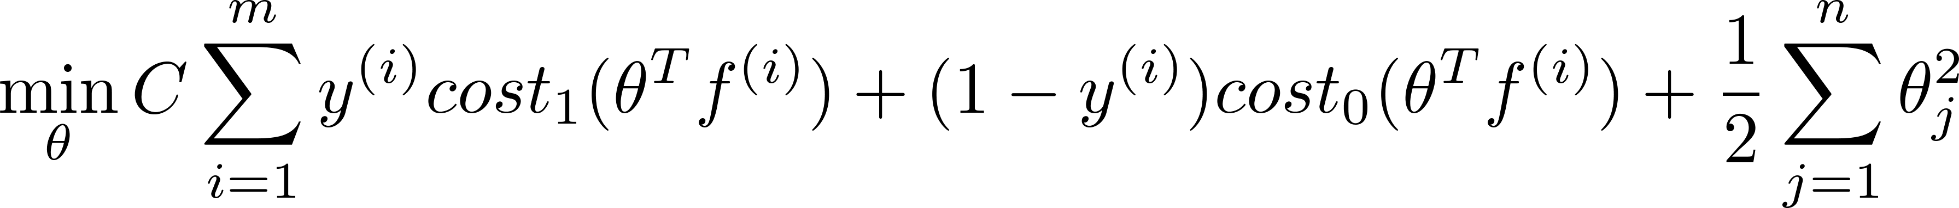
SVM with Kernels
Hypothesis: Given , compute features
  Predict “y=1” if
Training:

Slide 25



SVM parameters:
C ( ). Large C: Lower bias, high variance.
Small C: Higher bias, low variance.
Large : Features vary more smoothly.
Higher bias, lower variance.
Small : Features vary less smoothly.
Lower bias, higher variance.

Slide 26
Using an SVM
Support Vector Machines
Machine Learning

Slide 27

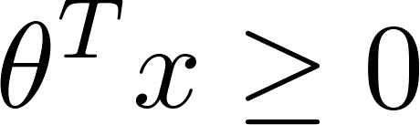
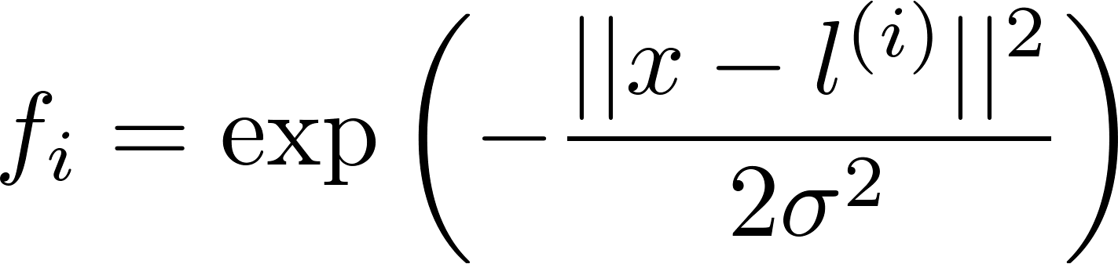
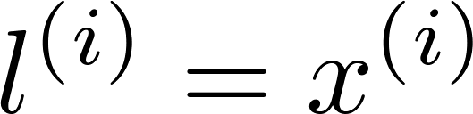

Use SVM software package (e.g. liblinear, libsvm, …) to solve for parameters .
Need to specify:
  Choice of parameter C.
  Choice of kernel (similarity function):
E.g. No kernel (“linear kernel”)
  Predict “y = 1” if
Gaussian kernel:
  , where .
  Need to choose .

Slide 28
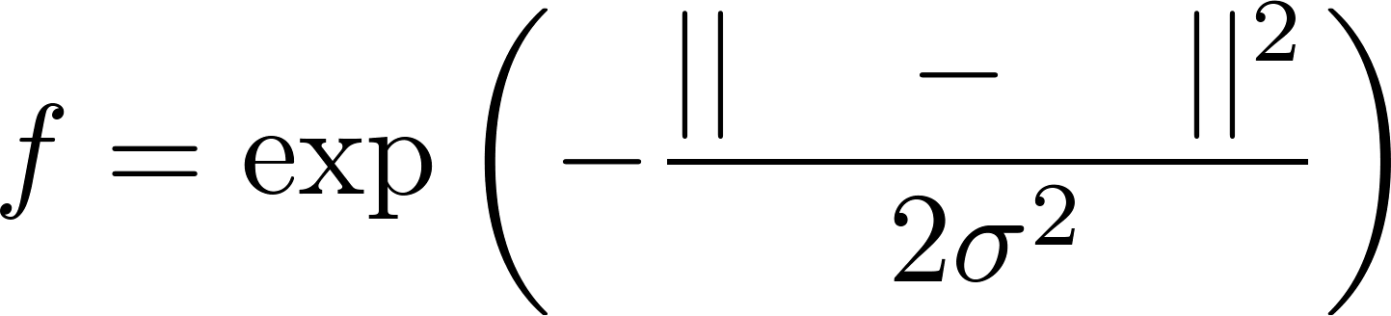
Kernel (similarity) functions:
function f = kernel(x1,x2)
return
x1 x2
Note: Do perform feature scaling before using the Gaussian kernel.

Slide 29
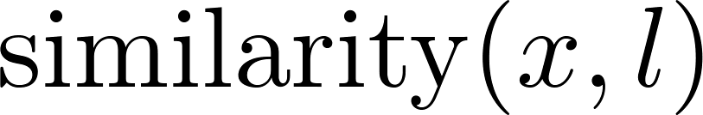
Other choices of kernel
Note: Not all similarity functions make valid kernels.
(Need to satisfy technical condition called “Mercer’s Theorem” to make sure SVM packages’ optimizations run correctly, and do not diverge).
Many off-the-shelf kernels available:
  Polynomial kernel:
  More esoteric: String kernel, chi-square kernel, histogram intersection kernel, …

Slide 30
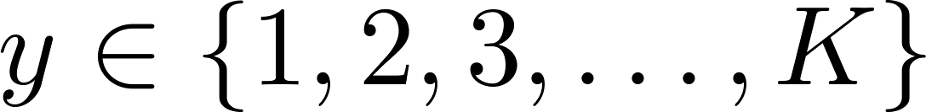

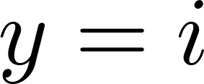



Multi-class classification
Many SVM packages already have built-in multi-class classification functionality.
Otherwise, use one-vs.-all method. (Train SVMs, one to distinguish
from the rest, for ), get
Pick class with largest

Slide 31





Logistic regression vs. SVMs
number of features ( ), number of training examples
If is large (relative to ):
Use logistic regression, or SVM without a kernel (“linear kernel”)
If is small, is intermediate:
  Use SVM with Gaussian kernel
If is small, is large:
  Create/add more features, then use logistic regression or SVM without a kernel
Neural network likely to work well for most of these settings, but may be slower to train.

