Slide 1

Problem motivation
Anomaly detection
Machine Learning

Slide 2
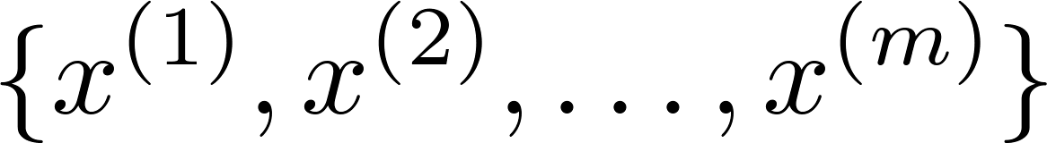





Anomaly detection example
Aircraft engine features:
= heat generated
= vibration intensity
…
Dataset:
New engine:
(vibration)
(heat)

Slide 3
Density estimation
Dataset:
Is anomalous?
(vibration)
(heat)

Slide 4


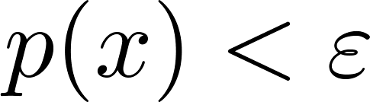


Anomaly detection example
Fraud detection:
= features of user ’s activities
  Model from data.
  Identify unusual users by checking which have
Manufacturing
Monitoring computers in a data center.
  = features of machine
  = memory use, = number of disk accesses/sec,
  = CPU load, = CPU load/network traffic.
  …

Slide 5
Gaussian distribution
Anomaly detection
Machine Learning

Slide 6



Gaussian (Normal) distribution
Say . If is a distributed Gaussian with mean , variance .
Notes:
Add dots

Slide 7
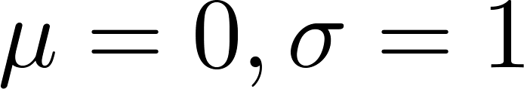
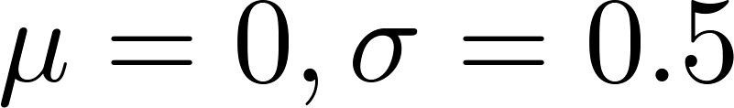
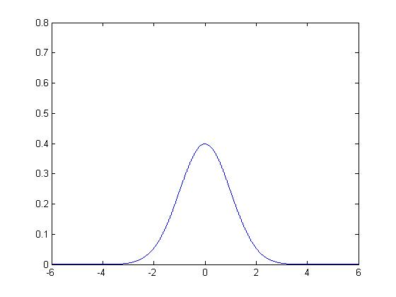
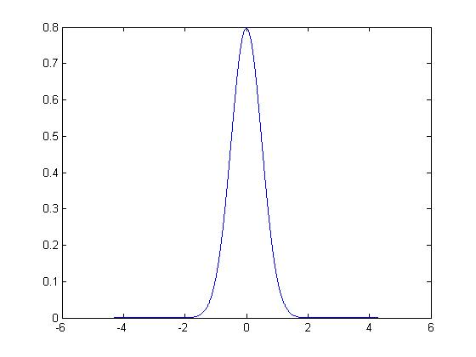
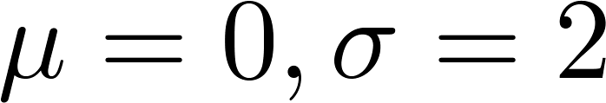
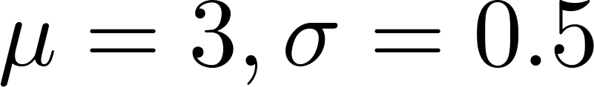
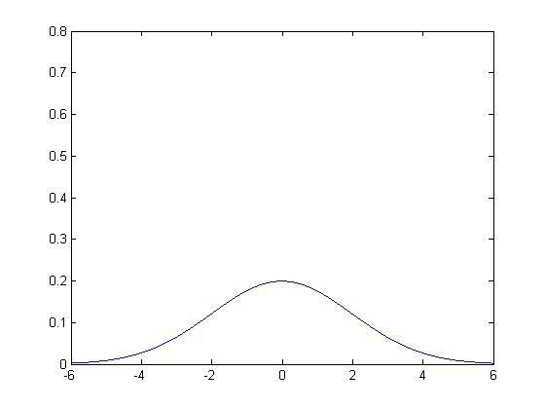
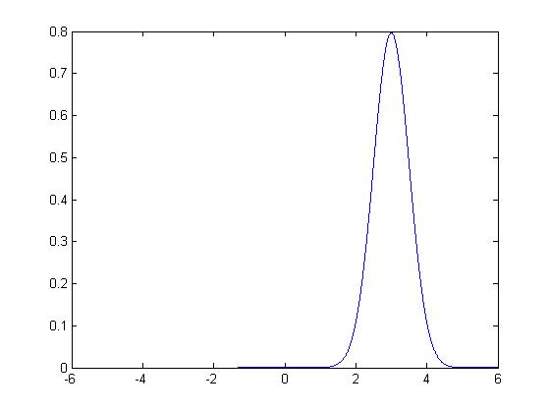
Gaussian distribution example

Slide 8
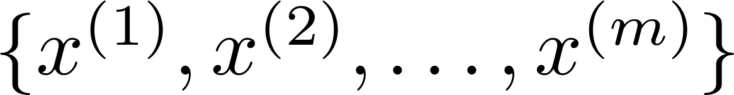
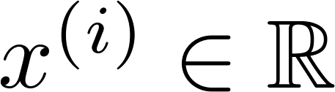
Parameter estimation
Dataset:

Slide 9
Algorithm
Anomaly detection
Machine Learning

Slide 10
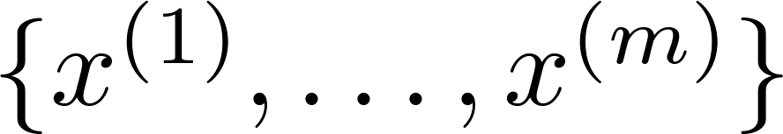

Density estimation
Training set:
Each example is
Notes:
Change numbers to LATEX as well

Slide 11

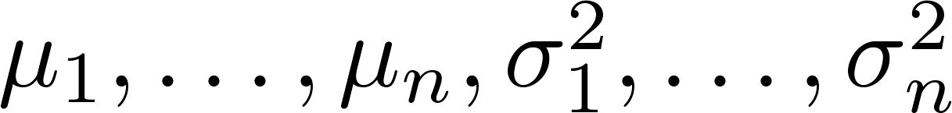
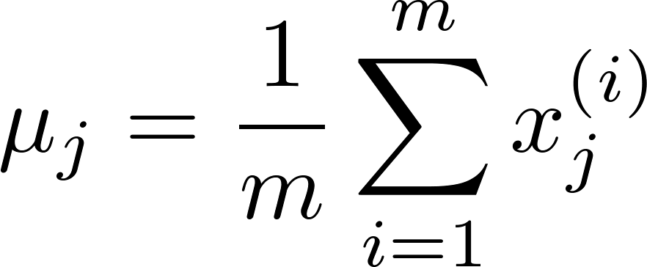
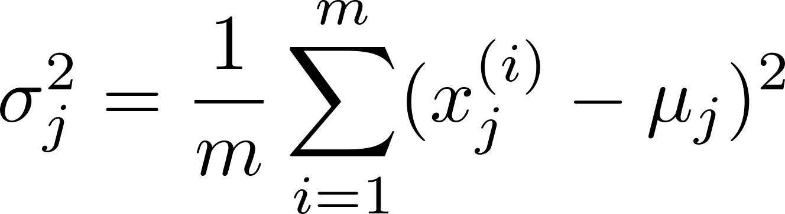

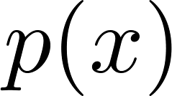
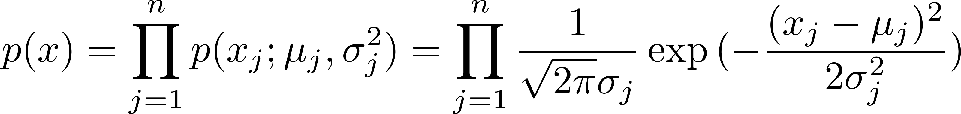
Anomaly detection algorithm
Choose features that you think might be indicative of anomalous examples.
Fit parameters
Given new example , compute :
Anomaly if
Notes:
Change numbers to LATEX as well

Slide 12
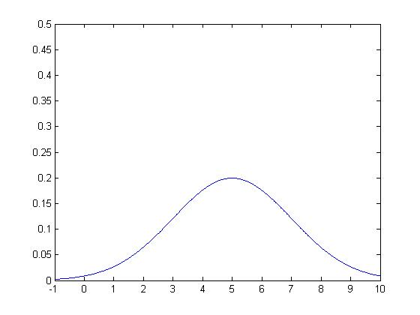
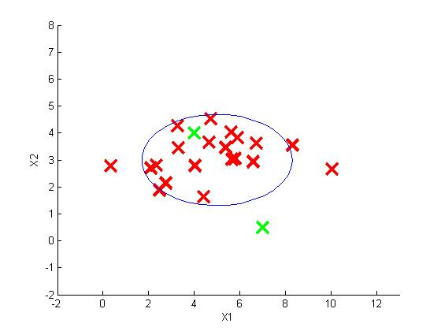
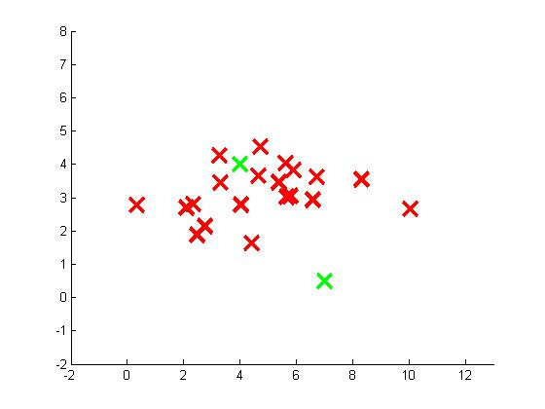
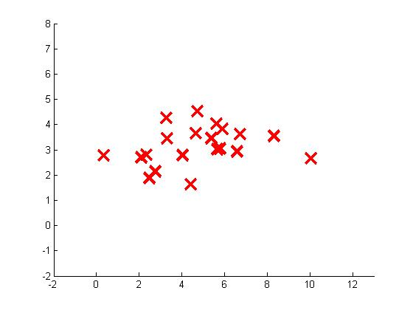
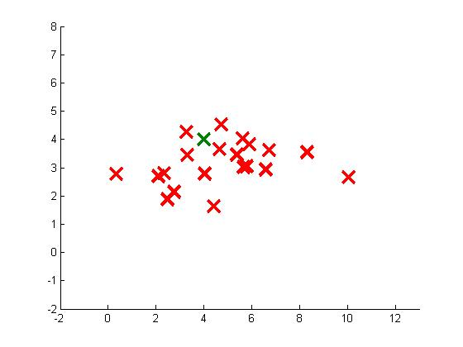

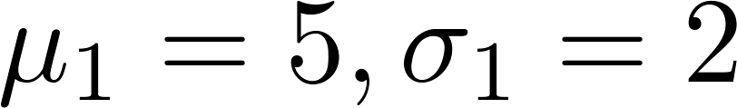


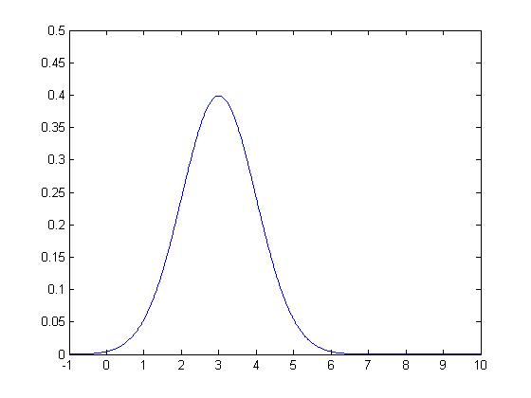
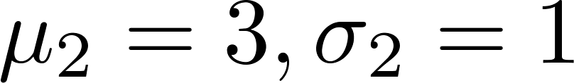
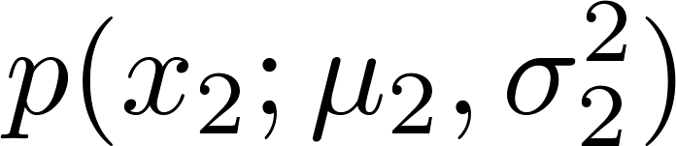
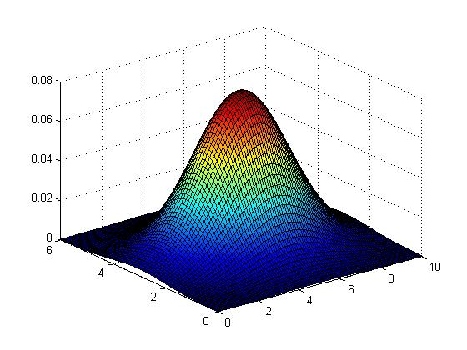

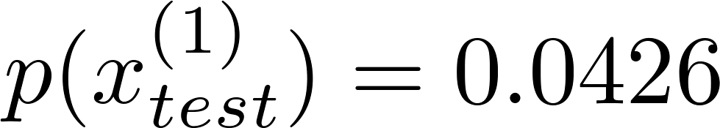
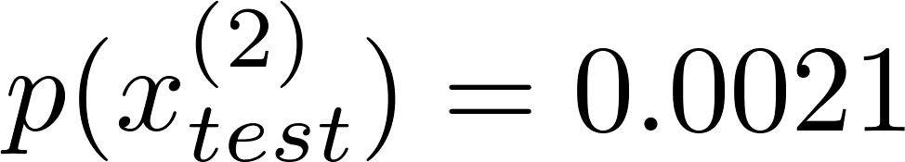
Anomaly detection example
Notes:
Add animation to block left graph

Slide 13
Developing and evaluating an anomaly detection system
Anomaly detection
Machine Learning

Slide 14
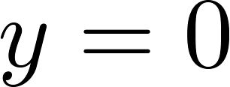
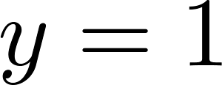
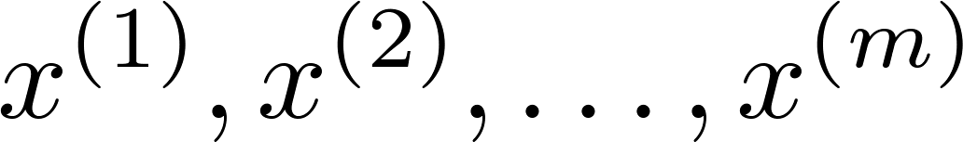
The importance of real-number evaluation
When developing a learning algorithm (choosing features, etc.), making decisions is much easier if we have a way of evaluating our learning algorithm.
Assume we have some labeled data, of anomalous and non-anomalous examples. ( if normal, if anomalous).
Training set: (assume normal examples/not anomalous)
Cross validation set:
Test set:
Notes:
Replace as previous; change spacing to fill page

Slide 15
Aircraft engines motivating example
10000 good (normal) engines
20 flawed engines (anomalous)
Training set: 6000 good engines
CV: 2000 good engines ( ), 10 anomalous ( )
Test: 2000 good engines ( ), 10 anomalous ( )
Alternative:
Training set: 6000 good engines
CV: 4000 good engines ( ), 10 anomalous ( )
Test: 4000 good engines ( ), 10 anomalous ( )

Slide 16
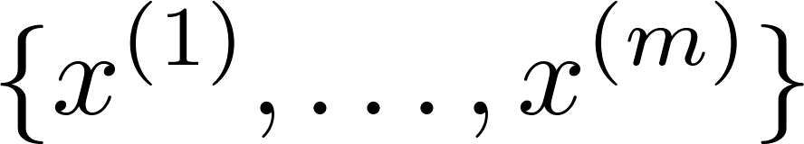
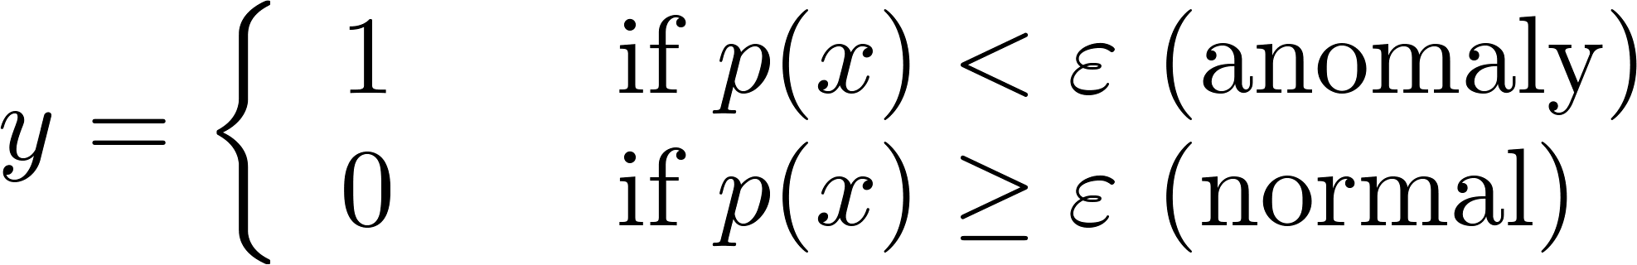

Algorithm evaluation
Fit model on training set
On a cross validation/test example , predict
Possible evaluation metrics:
- True positive, false positive, false negative, true negative
- Precision/Recall
- F₁-score
Can also use cross validation set to choose parameter

Slide 17
Anomaly detection vs. supervised learning
Anomaly detection
Machine Learning

Slide 18


Anomaly detection
vs.
Supervised learning
Very small number of positive examples ( ). (0-20 is common).
Large number of negative ( ) examples.
Many different “types” of anomalies. Hard for any algorithm to learn from positive examples what the anomalies look like; future anomalies may look nothing like any of the anomalous examples we’ve seen so far.
Large number of positive and negative examples.
Enough positive examples for algorithm to get a sense of what positive examples are like, future positive examples likely to be similar to ones in training set.
Notes:
Make points have 0 mean on x1 and x2

Slide 19


Anomaly detection
vs.
Supervised learning
Fraud detection
Manufacturing (e.g. aircraft engines)
Monitoring machines in a data center
Email spam classification
Weather prediction (sunny/rainy/etc).
Cancer classification
Notes:
Make points have 0 mean on x1 and x2

Slide 20
Choosing what features to use
Anomaly detection
Machine Learning

Slide 21
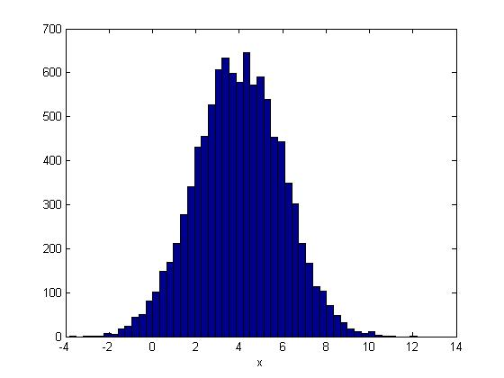
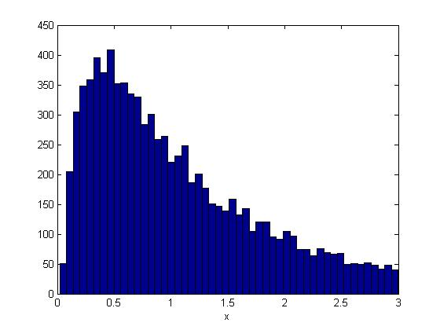
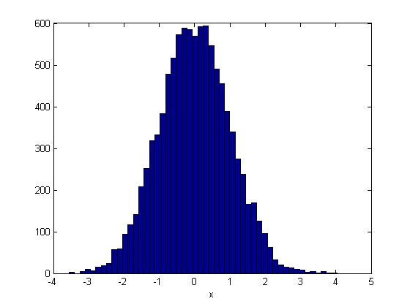

Non-gaussian features

Slide 22
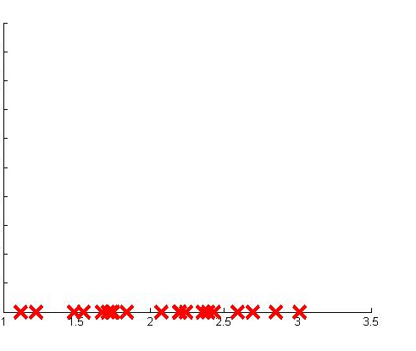
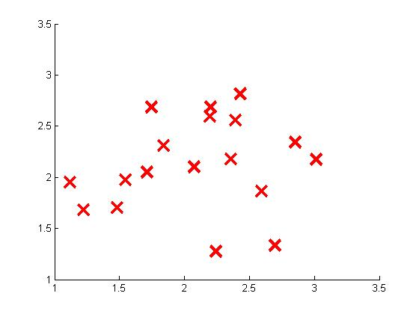






Error analysis for anomaly detection
Want large for normal examples .
small for anomalous examples .
Most common problem:
is comparable (say, both large) for normal and anomalous examples

Slide 23









Monitoring computers in a data center
Choose features that might take on unusually large or small values in the event of an anomaly.
= memory use of computer
= number of disk accesses/sec
= CPU load
= network traffic

Slide 24
Multivariate Gaussian distribution
Anomaly detection
Machine Learning

Slide 25
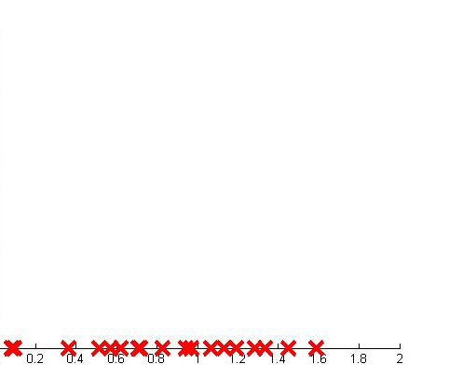
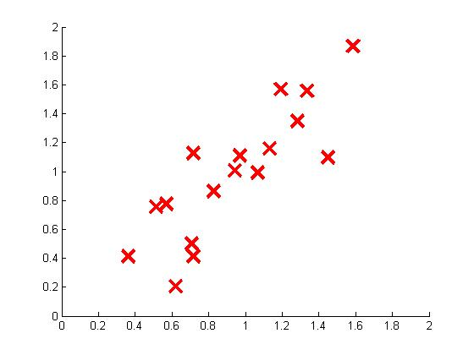
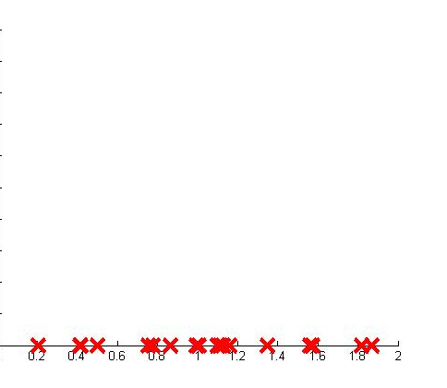




Motivating example: Monitoring machines in a data center
(Memory Use)
(CPU Load)
(CPU Load)
(Memory Use)

Slide 26
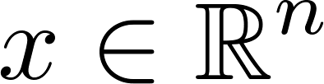
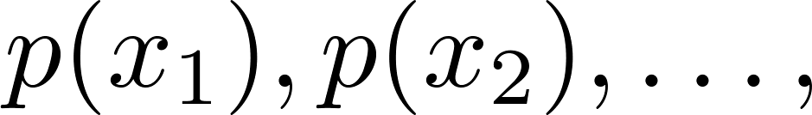
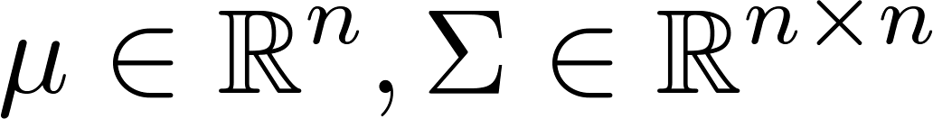

Multivariate Gaussian (Normal) distribution
. Don’t model etc. separately. Model all in one go.
Parameters: (covariance matrix)

Slide 27
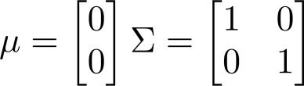
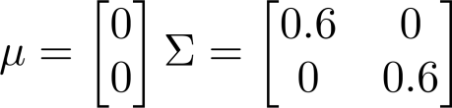
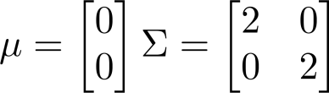
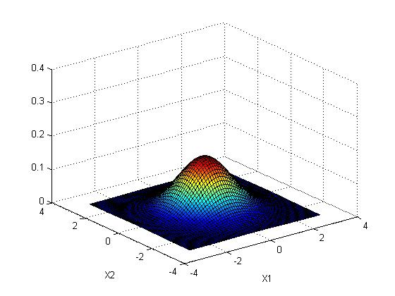







Multivariate Gaussian (Normal) examples

Slide 28






Multivariate Gaussian (Normal) examples

Slide 29






Multivariate Gaussian (Normal) examples

Slide 30







Multivariate Gaussian (Normal) examples

Slide 31







Multivariate Gaussian (Normal) examples

Slide 32






Multivariate Gaussian (Normal) examples

Slide 33
Anomaly detection using the multivariate Gaussian distribution
Anomaly detection
Machine Learning

Slide 34







Multivariate Gaussian (Normal) distribution
Parameters
Parameter fitting:
Given training set

Slide 35


Anomaly detection with the multivariate Gaussian
1. Fit model by setting
2. Given a new example , compute
Flag an anomaly if

Slide 36








Relationship to original model
Original model:
Corresponds to multivariate Gaussian
where

Slide 37








Original model
vs.
Multivariate Gaussian
Manually create features to capture anomalies where take unusual combinations of values.
Automatically captures correlations between features
Computationally cheaper (alternatively, scales better to large
)
Computationally more expensive
OK even if (training set size) is small
Must have , or else is non-invertible.
Notes:
Make points have 0 mean on x1 and x2

