Slide 1

Multiple features
Linear Regression with multiple variables
Machine Learning

Slide 2


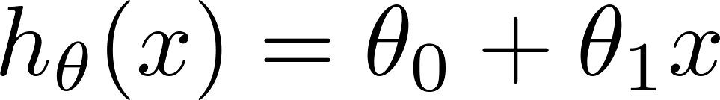
Multiple features (variables).
Size (feet²) | Price ($1000)
2104 | 460
1416 | 232
1534 | 315
852 | 178
… | …

Slide 3
Multiple features (variables).
Size (feet²) | Number of bedrooms | Number of floors | Age of home (years) | Price ($1000)
2104 | 5 | 1 | 45 | 460
1416 | 3 | 2 | 40 | 232
1534 | 3 | 2 | 30 | 315
852 | 2 | 1 | 36 | 178
… | … | … | … | …

Slide 4





Multiple features (variables).
Size (feet²) | Number of bedrooms | Number of floors | Age of home (years) | Price ($1000)
2104 | 5 | 1 | 45 | 460
1416 | 3 | 2 | 40 | 232
1534 | 3 | 2 | 30 | 315
852 | 2 | 1 | 36 | 178
… | … | … | … | …
Notation:
    = number of features
    = input (features) of training example.
    = value of feature in training example.
Notes:
Pop-up Quiz

Slide 5
Hypothesis:
Previously:

Slide 6
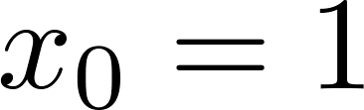
For convenience of notation, define .
Multivariate linear regression.

Slide 8
Gradient descent for multiple variables
Linear Regression with multiple variables
Machine Learning

Slide 9
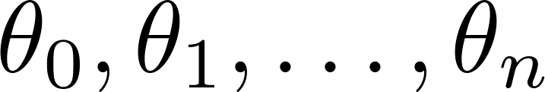
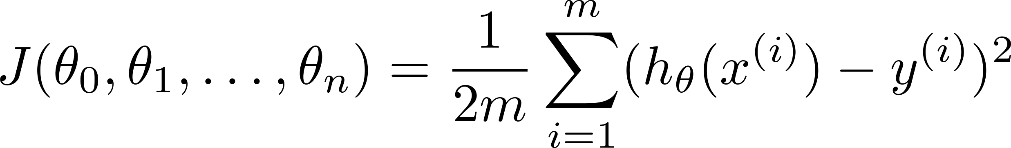

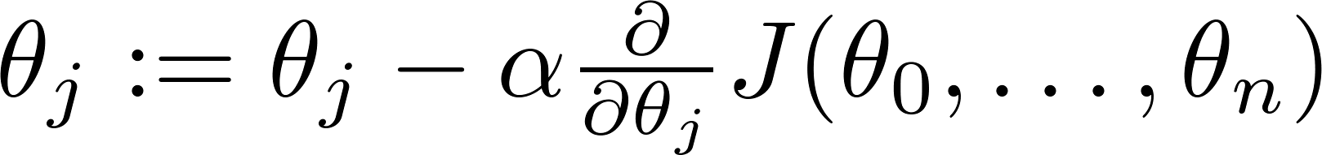

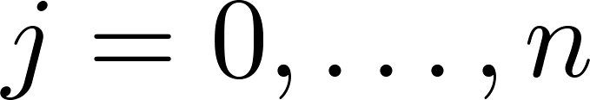
Hypothesis:
Parameters:
Cost function:
Gradient descent:
Repeat
(simultaneously update for every )

Slide 10

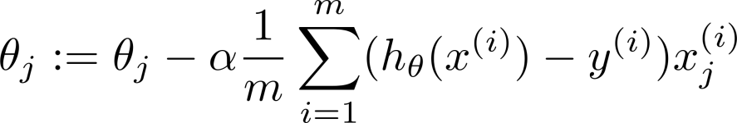
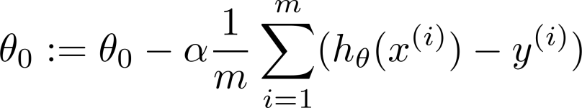



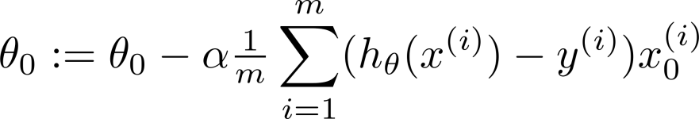
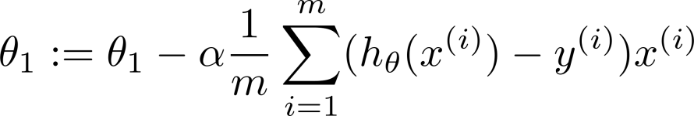
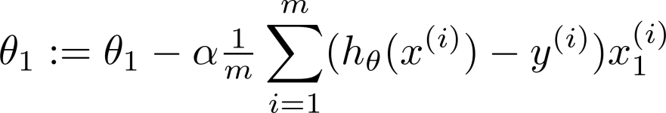

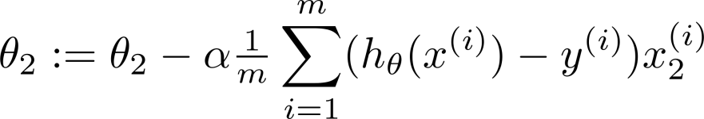
New algorithm :
Gradient Descent
Repeat
Previously (n=1):
Repeat
(simultaneously update for
)
(simultaneously update )

Slide 12
Gradient descent in practice I: Feature Scaling
Linear Regression with multiple variables
Machine Learning

Slide 13
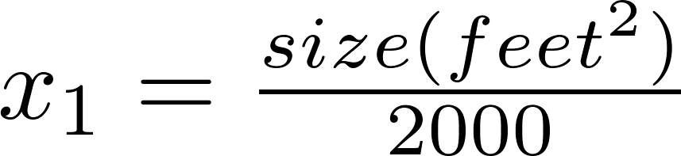


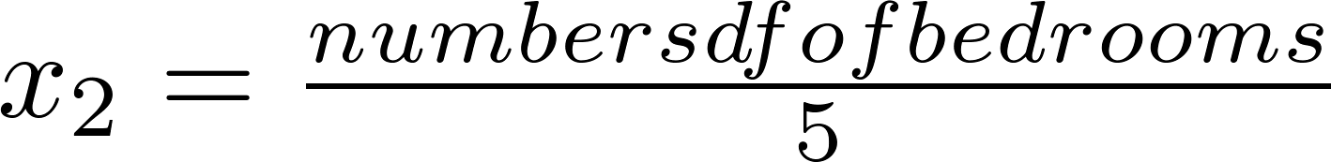
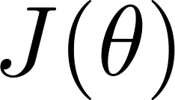



Feature Scaling
Idea: Make sure features are on a similar scale.
E.g. = size (0-2000 feet²)
= number of bedrooms (1-5)
size (feet²)
number of bedrooms

Slide 14
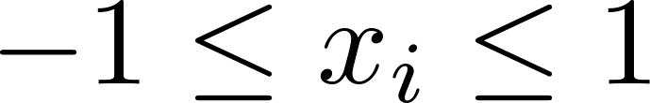
Feature Scaling
Get every feature into approximately a range.

Slide 15



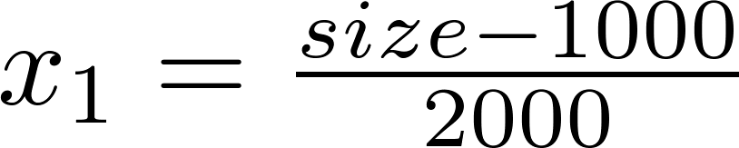
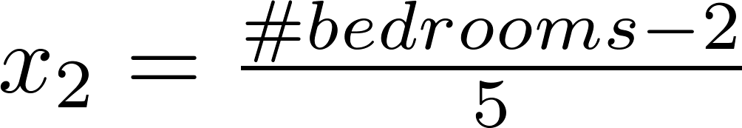



Mean normalization
Replace with to make features have approximately zero mean (Do not apply to ).
E.g.

Slide 17
Gradient descent in practice II: Learning rate
Linear Regression with multiple variables
Machine Learning

Slide 18
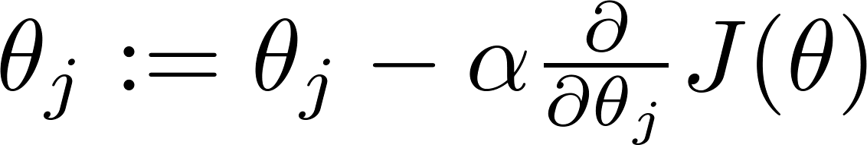



Gradient descent
“Debugging”: How to make sure gradient descent is working correctly.
How to choose learning rate .

Slide 19
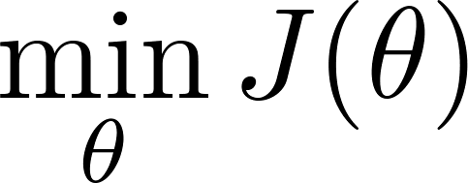
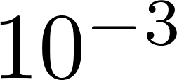
Making sure gradient descent is working correctly.
Example automatic convergence test:
Declare convergence if decreases by less than in one iteration.
No. of iterations

Slide 20

Making sure gradient descent is working correctly.
Gradient descent not working.
Use smaller .
No. of iterations
No. of iterations
No. of iterations
For sufficiently small , should decrease on every iteration.
But if is too small, gradient descent can be slow to converge.

Slide 21



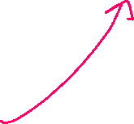
Summary:
If is too small: slow convergence.
If is too large: may not decrease on every iteration; may not converge.
To choose , try

Slide 23
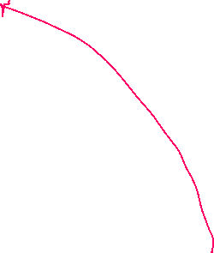
Features and polynomial regression
Linear Regression with multiple variables
Machine Learning

Slide 24
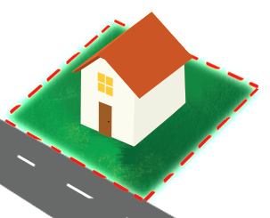
Housing prices prediction

Slide 25
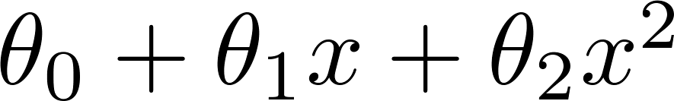
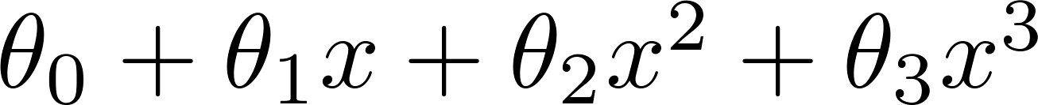
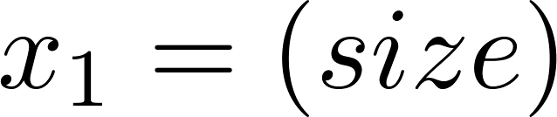
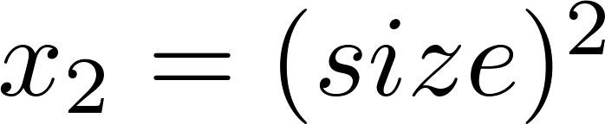
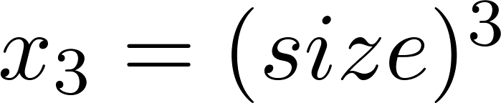

Polynomial regression
Price
(y)
Size (x)

Slide 26
Choice of features
Price
(y)
Size (x)

Slide 28
Normal equation
Linear Regression with multiple variables
Machine Learning

Slide 29



Gradient Descent
Normal equation: Method to solve for
analytically.

Slide 30
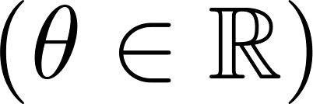
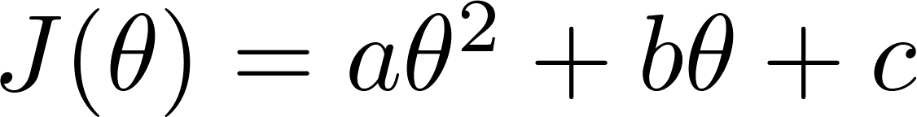

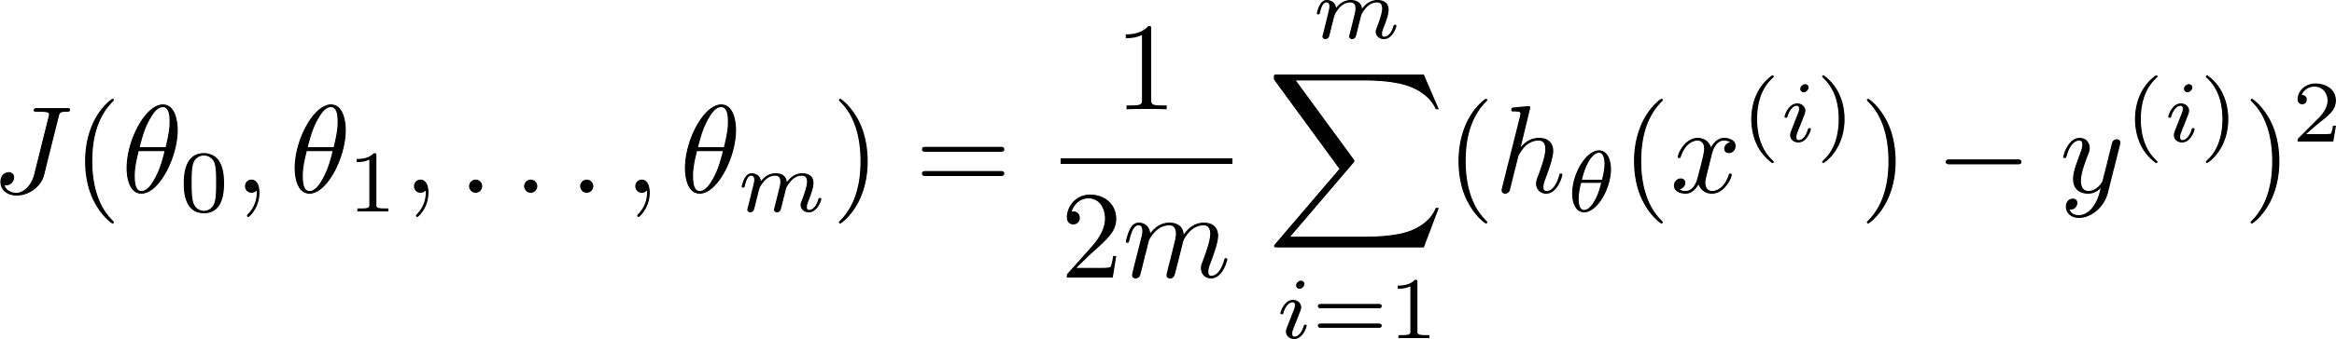
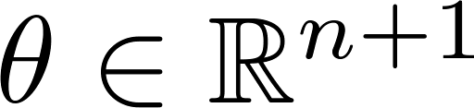
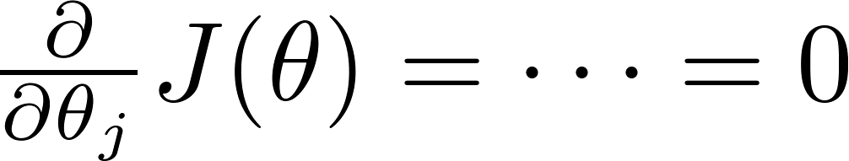

Intuition: If 1D
(for every )
Solve for

Slide 31






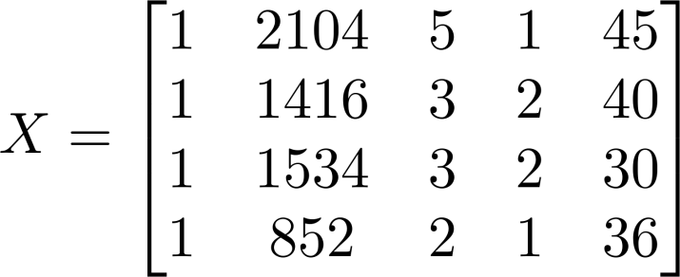
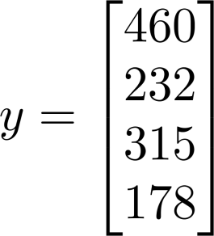
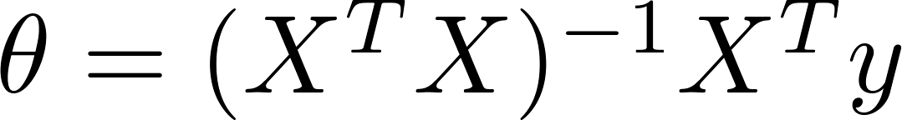
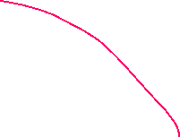


Examples:
 | Size (feet²) | Number of bedrooms | Number of floors | Age of home (years) | Price ($1000)
1 | 2104 | 5 | 1 | 45 | 460
1 | 1416 | 3 | 2 | 40 | 232
1 | 1534 | 3 | 2 | 30 | 315
1 | 852 | 2 | 1 | 36 | 178
Size (feet²) | Number of bedrooms | Number of floors | Age of home (years) | Price ($1000)
2104 | 5 | 1 | 45 | 460
1416 | 3 | 2 | 40 | 232
1534 | 3 | 2 | 30 | 315
852 | 2 | 1 | 36 | 178
Notes:
Pop-up Quiz

Slide 32

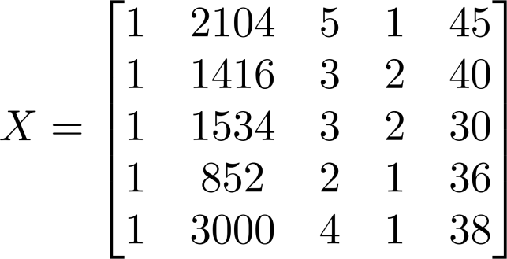
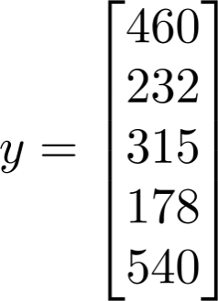
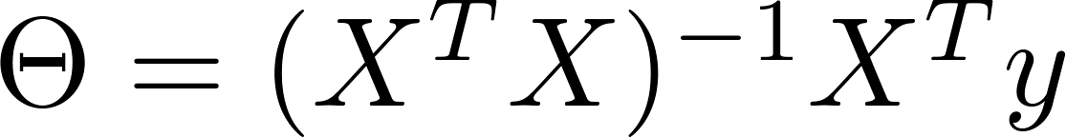
Examples:
 | Size (feet²) | Number of bedrooms | Number of floors | Age of home (years) | Price ($1000)
1 | 2104 | 5 | 1 | 45 | 460
1 | 1416 | 3 | 2 | 40 | 232
1 | 1534 | 3 | 2 | 30 | 315
1 | 852 | 2 | 1 | 36 | 178
1
Size (feet²) | Number of bedrooms | Number of floors | Age of home (years) | Price ($1000)
2104 | 5 | 1 | 45 | 460
1416 | 3 | 2 | 40 | 232
1534 | 3 | 2 | 30 | 315
852 | 2 | 1 | 36 | 178
3000 | 4 | 1 | 38 | 540
Notes:
Pop-up Quiz

Slide 33


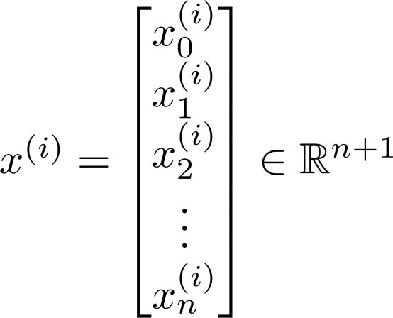
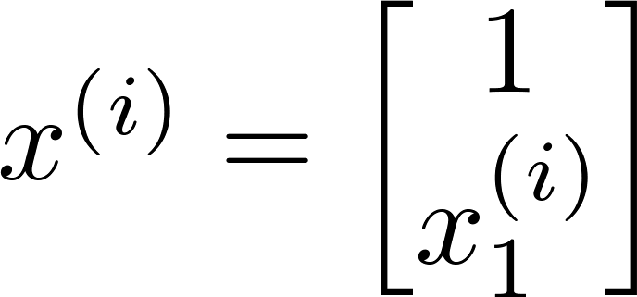
examples ; features.
E.g. If

Slide 34
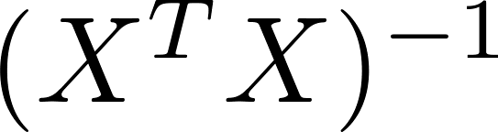

is inverse of matrix .
Octave:
pinv(X’*X)*X’*y

Slide 35
training examples, features.
Gradient Descent
Normal Equation
Need to choose .
Needs many iterations.
No need to choose .
Don’t need to iterate.
Works well even when is large.
Need to compute
Slow if is very large.

Slide 37
Normal equation and non-invertibility (optional)
Linear Regression with multiple variables
Machine Learning

Slide 38



Normal equation
What if is non-invertible? (singular/ degenerate)
Octave:
pinv(X’*X)*X’*y

Slide 39


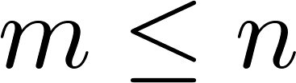



What if is non-invertible?
Redundant features (linearly dependent).
  E.g. size in feet²
  size in m²
Too many features (e.g. ).
Delete some features, or use regularization.

Slide 41
























