Slide 1



Classification
Logistic
Regression
Machine Learning

Slide 2
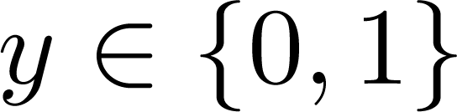
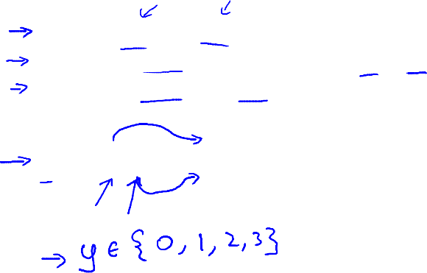


Classification
Email: Spam / Not Spam?
Online Transactions: Fraudulent (Yes / No)?
Tumor: Malignant / Benign ?
0: “Negative Class” (e.g., benign tumor)
1: “Positive Class” (e.g., malignant tumor)

Slide 3

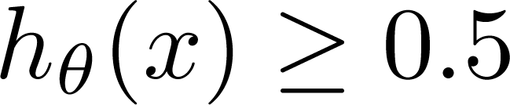
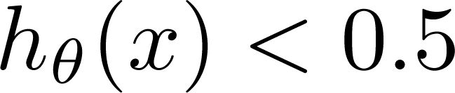
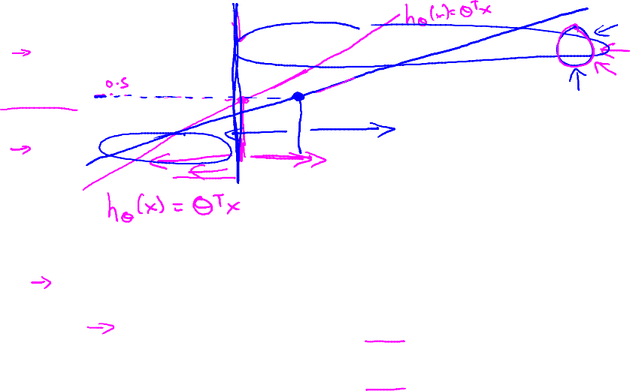

(Yes) 1
Malignant ?
(No) 0
Tumor Size
Tumor Size
Threshold classifier output at 0.5:
If , predict “y = 1”
If , predict “y = 0”

Slide 4
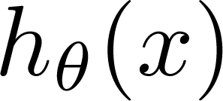
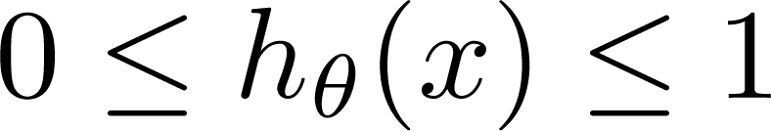
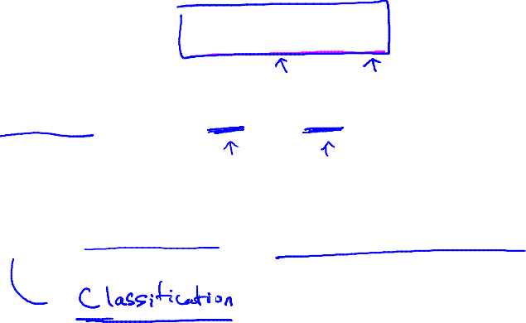
Classification: y = 0 or 1
can be > 1 or < 0
Logistic Regression:

Slide 5
Hypothesis
Representation
Logistic
Regression
Machine Learning

Slide 6
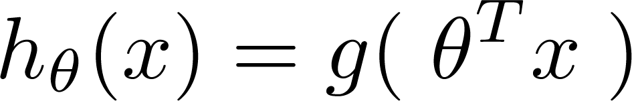
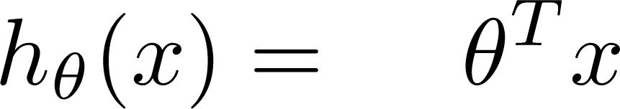
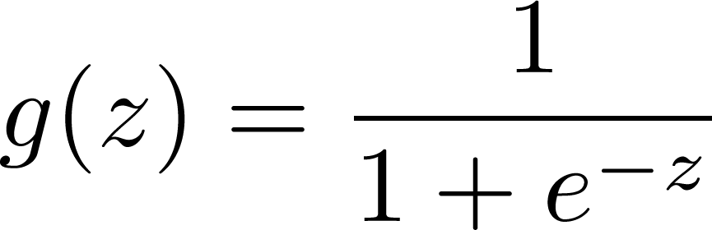

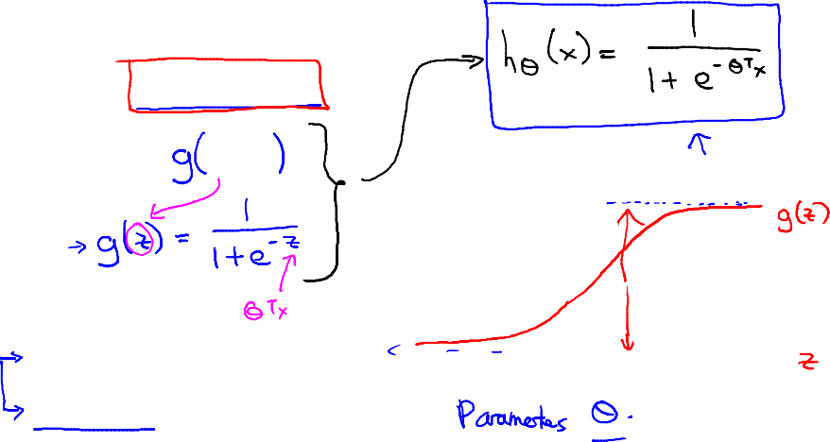



Logistic Regression Model
Want
1
0.5
g(x) is the sigmod function!!!
Sigmoid function
Logistic function
0

Slide 7
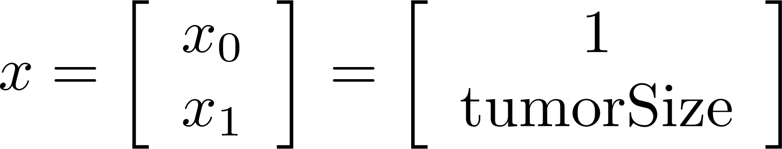
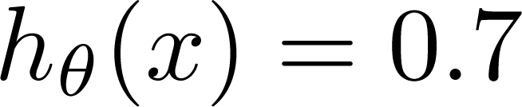
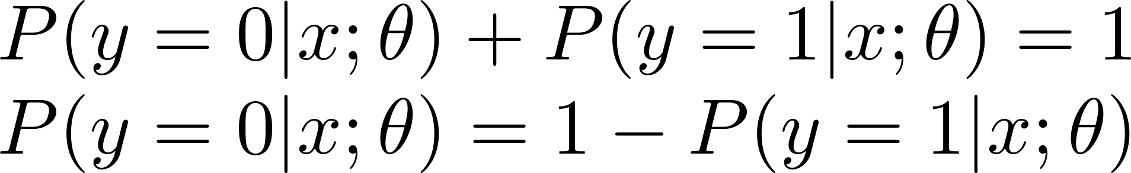
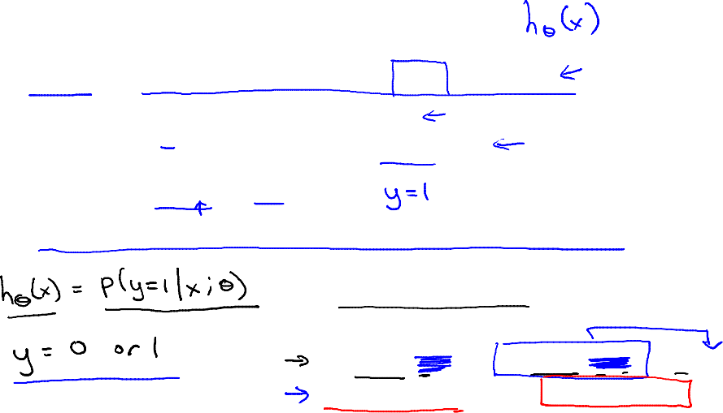
Interpretation of Hypothesis Output
= estimated probability that y = 1 on input x
Example: If
Tell patient that 70% chance of tumor being malignant
“probability that y = 1, given x,
parameterized by ”

Slide 8
Decision boundary
Logistic
Regression
Machine Learning

Slide 9

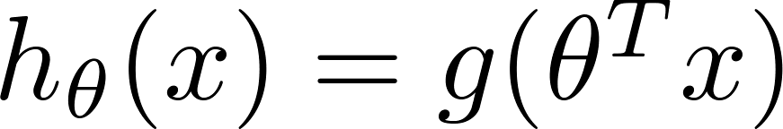
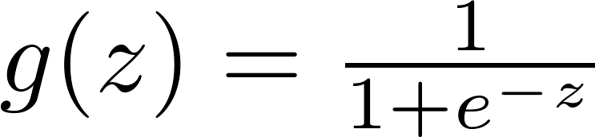

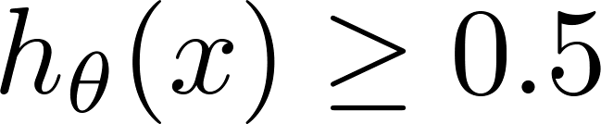

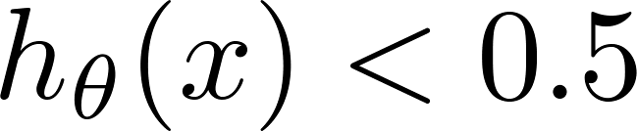


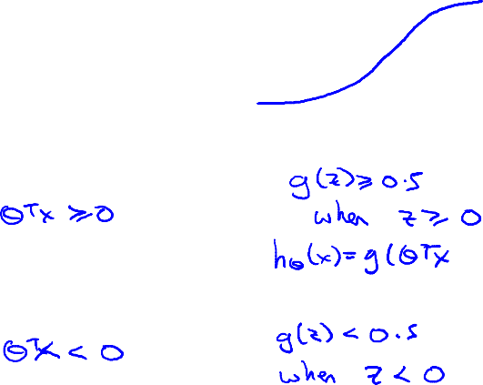
Logistic regression
1
z
Suppose predict “ “ if
  predict “ “ if

Slide 10
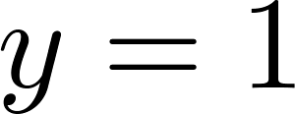
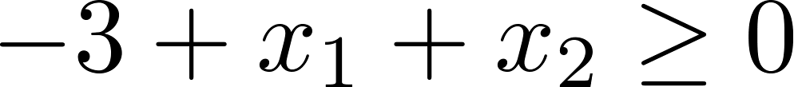

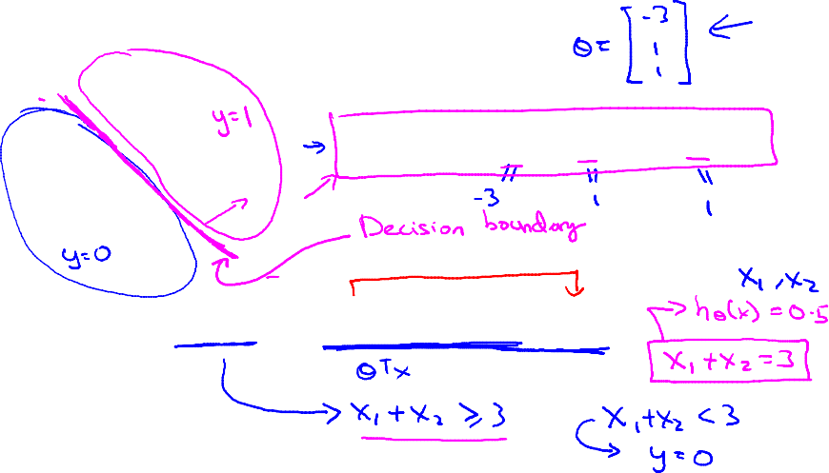
Decision Boundary
x₂
3
2
1
1
2
3
x₁
Predict “ “ if

Slide 11
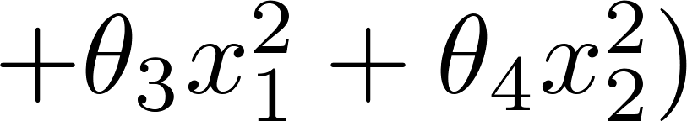
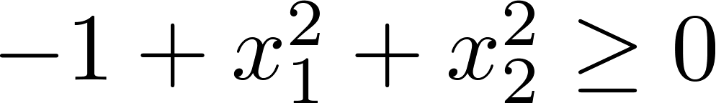
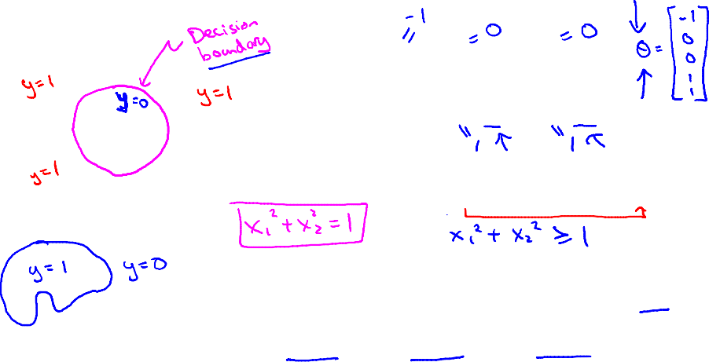
Non-linear decision boundaries
x₂
1
x₁
-1
1
-1
Predict “ “ if
x₂
x₁

Slide 12
Cost function
Logistic
Regression
Machine Learning

Slide 13
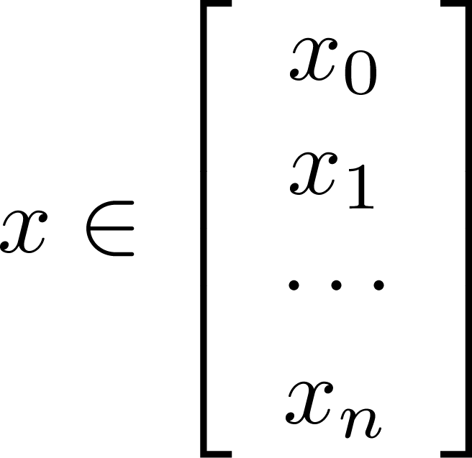
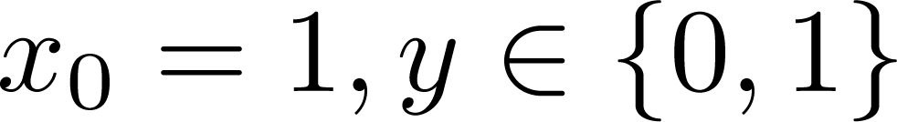
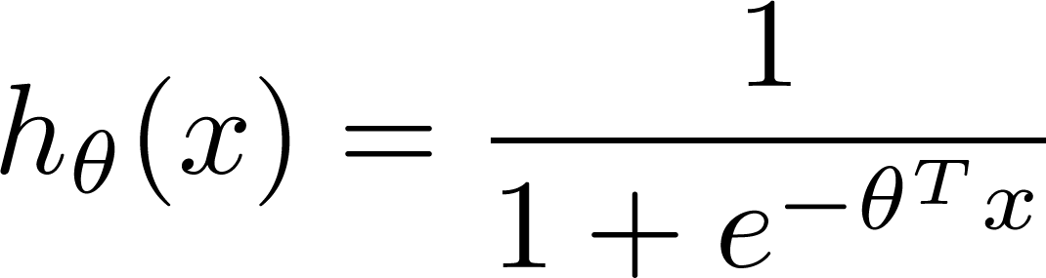

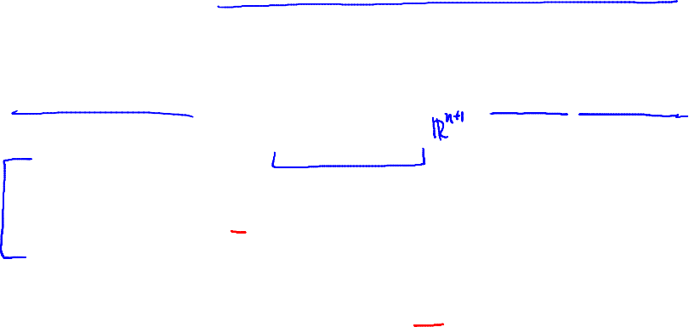
Training set:
m examples
How to choose parameters ?

Slide 14
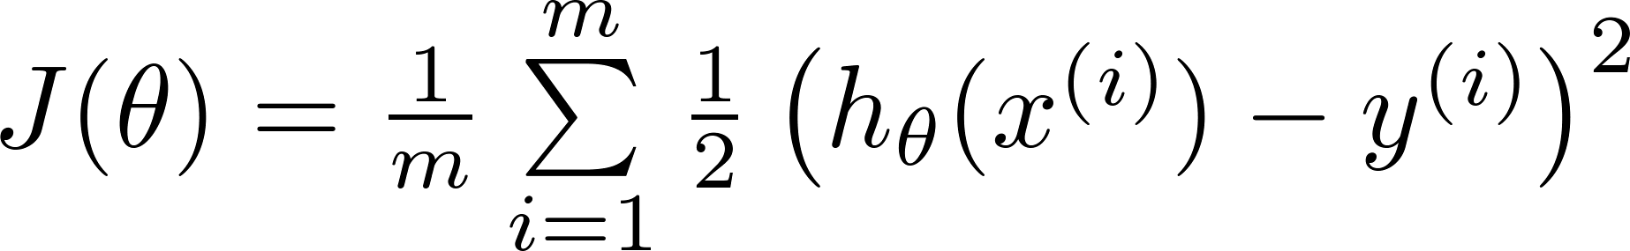


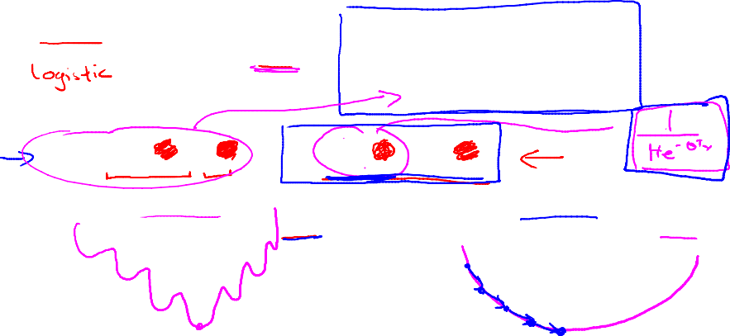
Cost function
Linear regression:
“non-convex”
“convex”
在逻辑回归中，不能直接套用线性回归的损失函数。因为我们不能保证损失函数是一个凸函数。如果不能保证函数是一个凸函数，就不能保证局部最小点就是全局最小点。例如这里对于sigmoid function的损失函数就不是关于theta的凸函数

Slide 15
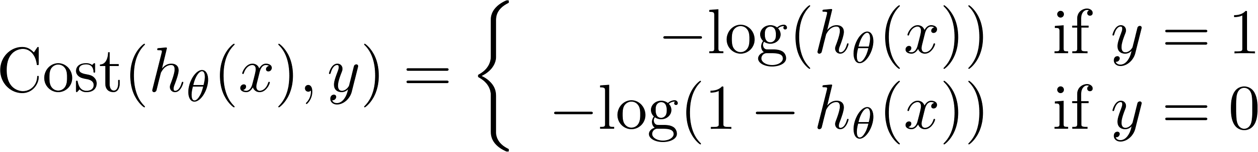
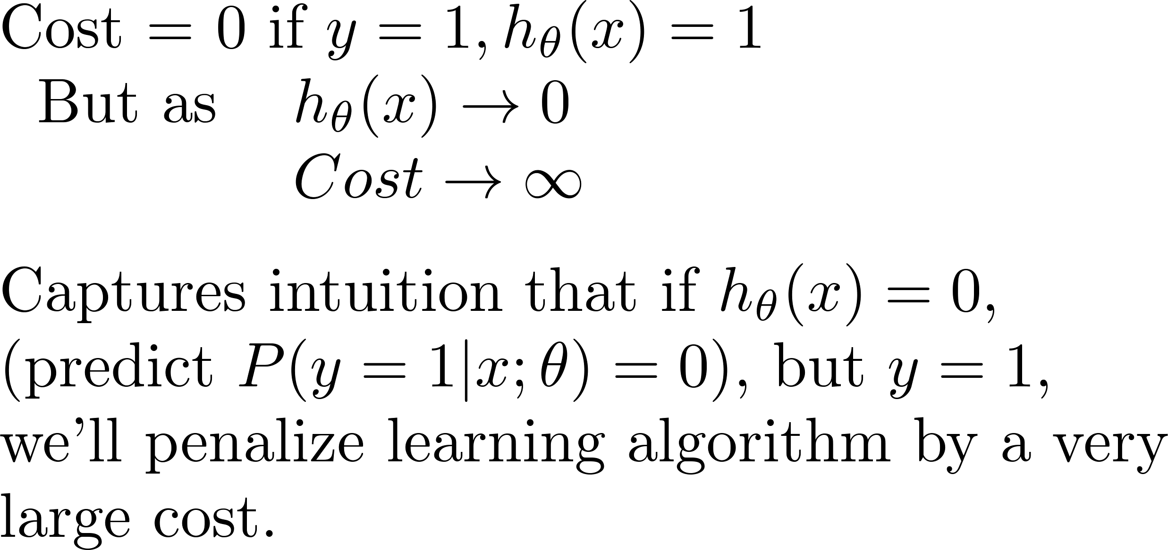
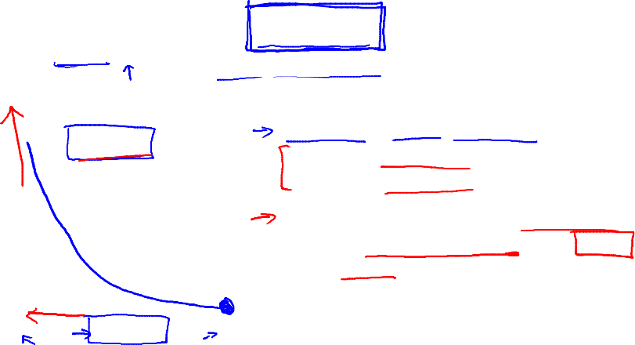
Logistic regression cost function
If y = 1
0
1

Slide 16
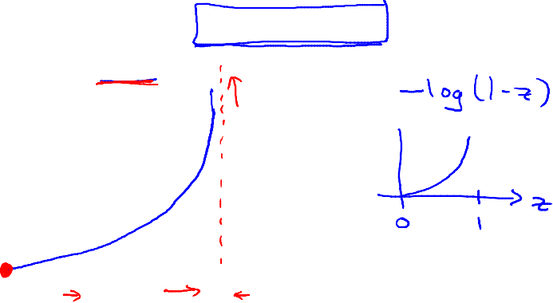

Logistic regression cost function
If y = 0
0
1

Slide 17
Simplified cost function and gradient descent
Logistic
Regression
Machine Learning

Slide 18
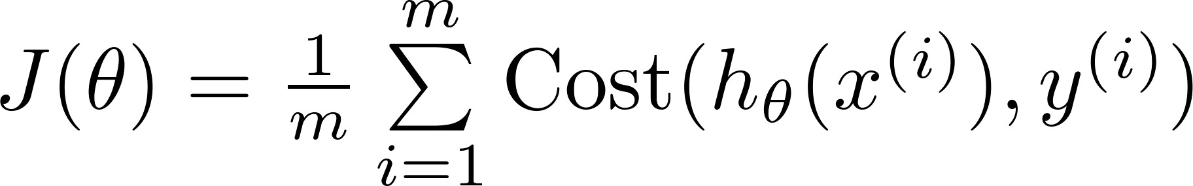
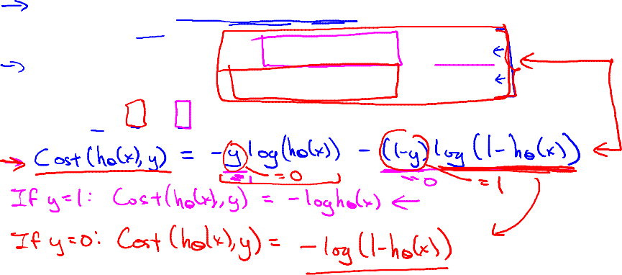
对于这个两端函数合并成一段的思想也很简单，就是当y=0时，让y=1那段恒为0，y=0那一段不变；当y=1时，让y=0那段恒为0，y=1那一段不变。我们可以直接在函数前面添加一个y或(1-y)就能实现这一点。
Logistic regression cost function
这里，得到这个cost函数的思想是从统计学中的“极大似然法”得来的。

Slide 19

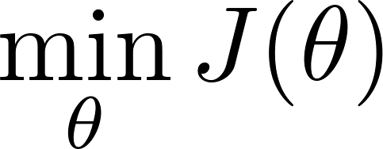

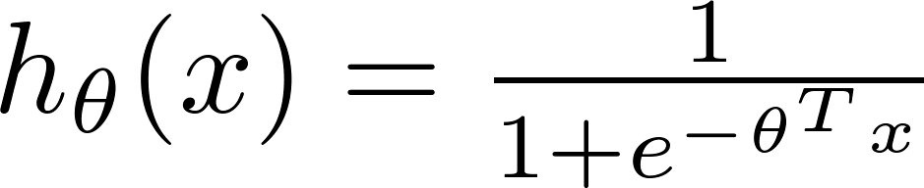

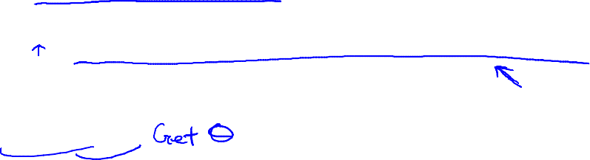
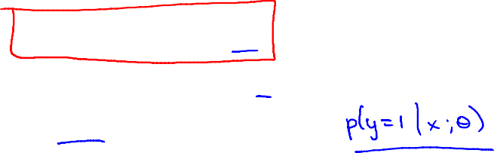
Logistic regression cost function
To fit parameters :
To make a prediction given new :
Output

Slide 20


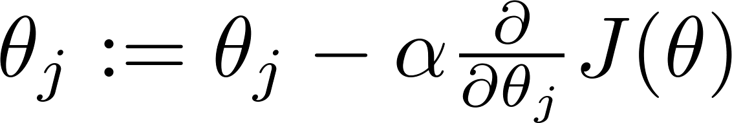



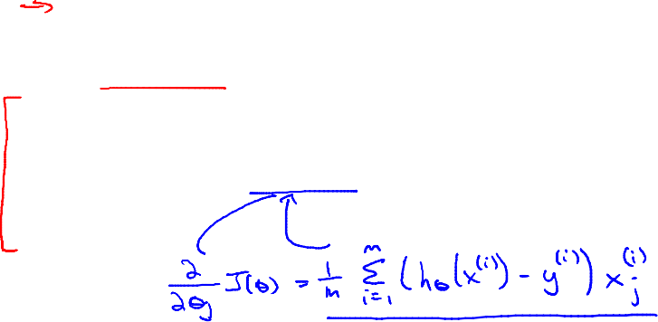
Gradient Descent
Want :
Repeat
(simultaneously update all )

Slide 21
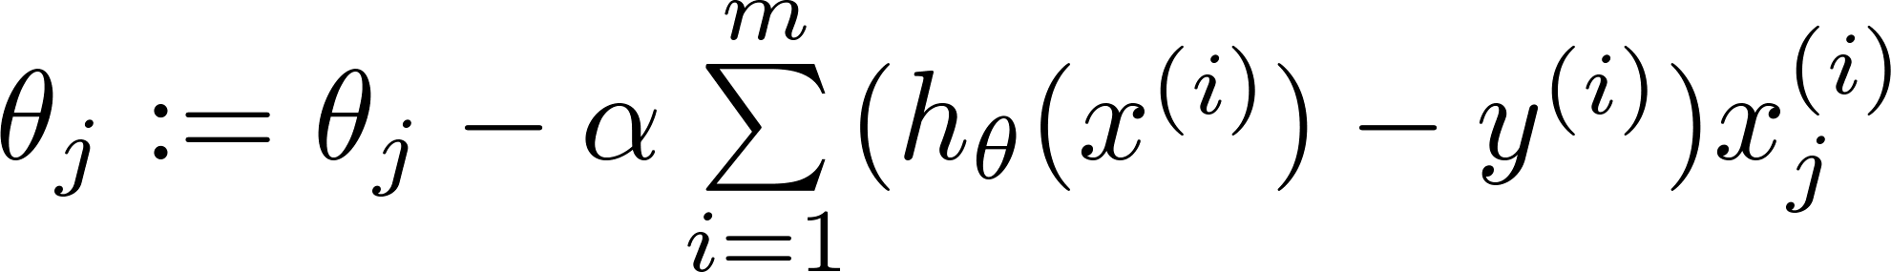
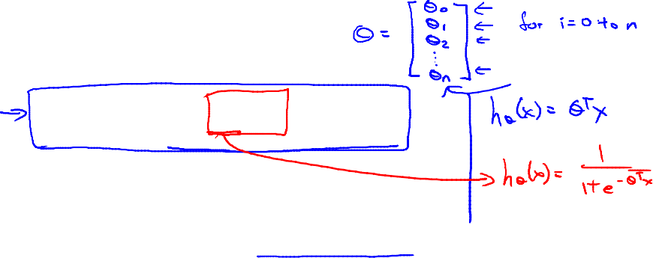
Gradient Descent
Want :
Repeat
(simultaneously update all )
Algorithm looks identical to linear regression!

Slide 22
Advanced optimization
Logistic
Regression
Machine Learning

Slide 23
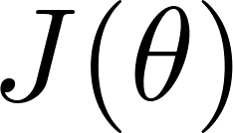
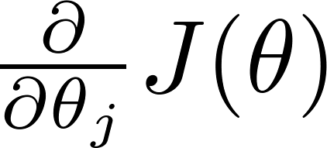
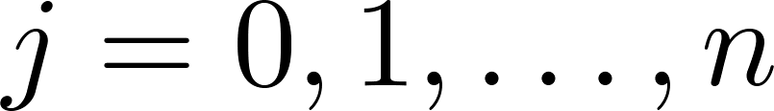


Optimization algorithm
Cost function . Want .
Given , we have code that can compute
(for )
Gradient descent:
Repeat

Slide 24


Optimization algorithm
Given , we have code that can compute
(for )
Optimization algorithms:
  Gradient descent
Advantages:
  No need to manually pick
  Often faster than gradient descent.
Disadvantages:
  More complex
  Conjugate gradient
  BFGS
  L-BFGS
局部优化法：Broyden Fletcher Goldfarb Shann
L：Limited

Slide 25





Example:
function [jVal, gradient]
= costFunction(theta)
  jVal = (theta(1)-5)^2 + ... (theta(2)-5)^2;
  gradient = zeros(2,1);
  gradient(1) = 2*(theta(1)-5);
  gradient(2) = 2*(theta(2)-5);
options = optimset(‘GradObj’, ‘on’, ‘MaxIter’, ‘100’);
initialTheta = zeros(2,1);
[optTheta, functionVal, exitFlag] ...
= fminunc(@costFunction, initialTheta, options);

Slide 26





theta =
function [jVal, gradient] = costFunction(theta)
code to compute
jVal = [ ];
code to compute
gradient(1) = [ ];
code to compute
gradient(2) = [ ];
code to compute
gradient(n+1) = [ ];

Slide 27
Multi-class classification: One-vs-all
Logistic
Regression
Machine Learning

Slide 28

Multiclass classification
Email foldering/tagging: Work, Friends, Family, Hobby
Medical diagrams: Not ill, Cold, Flu
Weather: Sunny, Cloudy, Rain, Snow

Slide 29

Binary classification:
Multi-class classification:
x₂
x₂
x₁
x₁

Slide 30



x₂
One-vs-all (one-vs-rest):
x₁
x₂
x₂
x₁
x₁
Class 1:
Class 2:
Class 3:
x₂
x₁

Slide 31






One-vs-all
Train a logistic regression classifier for each class to predict the probability that .
On a new input , to make a prediction, pick the class that maximizes
$h_{θ}^{\left(i\right)}\left(x\right)$：对于输入 $x$，它属于类别 $i$的概率

