Slide 1

Deciding what to try next
Advice for applying machine learning
Machine Learning

Slide 2
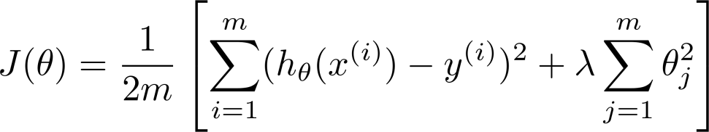
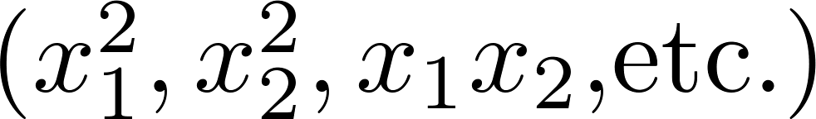
Debugging a learning algorithm:
Suppose you have implemented regularized linear regression to predict housing prices.
However, when you test your hypothesis on a new set of houses, you find that it makes unacceptably large errors in its predictions. What should you try next?
Get more training examples
Try smaller sets of features
Try getting additional features
Try adding polynomial features
Try decreasing
Try increasing

Slide 3

Machine learning diagnostic:
Diagnostic: A test that you can run to gain insight what is/isn’t working with a learning algorithm, and gain guidance as to how best to improve its performance.
Diagnostics can take time to implement, but doing so can be a very good use of your time.

Slide 4
Evaluating a hypothesis
Advice for applying machine learning
Machine Learning

Slide 5




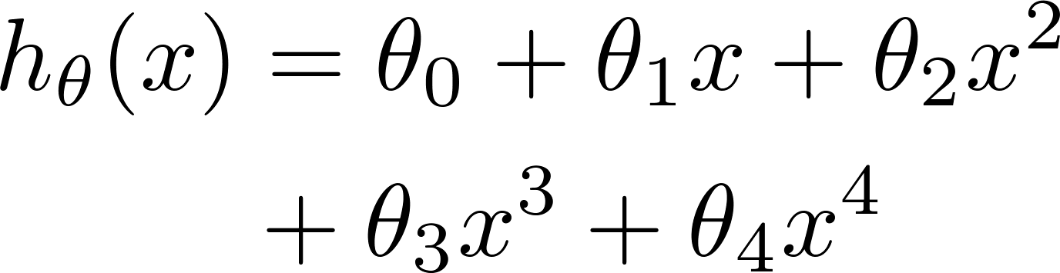


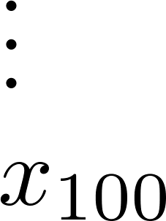
Evaluating your hypothesis
Fails to generalize to new examples not in training set.
price
size of house
no. of bedrooms
no. of floors
size
age of house
average income in neighborhood
kitchen size

Slide 6






Evaluating your hypothesis
Dataset:
Size | Price
2104 | 400
1600 | 330
2400 | 369
1416 | 232
3000 | 540
1985 | 300
1534 | 315
1427 | 199
1380 | 212
1494 | 243

Slide 7

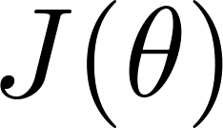
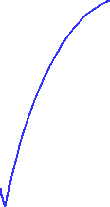
Training/testing procedure for linear regression
Learn parameter from training data (minimizing training error )
Compute test set error:

Slide 8
Training/testing procedure for logistic regression
Learn parameter from training data
Compute test set error:
Misclassification error (0/1 misclassification error):

Slide 9



Model selection and training/validation/test sets
Advice for applying machine learning
Machine Learning

Slide 10
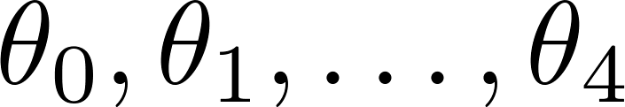
Overfitting example
Once parameters
were fit to some set of data (training set), the error of the parameters as measured on that data (the training error xxxxx) is likely to be lower than the actual generalization error.
price
size

Slide 11
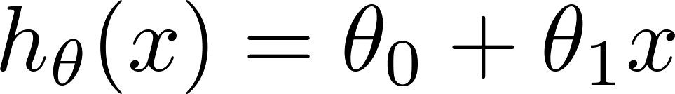
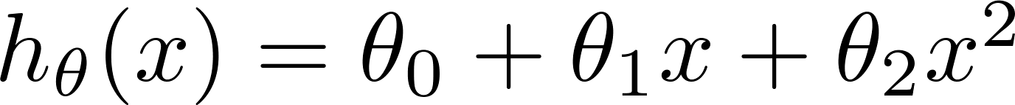
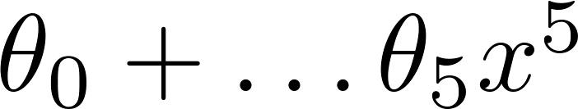
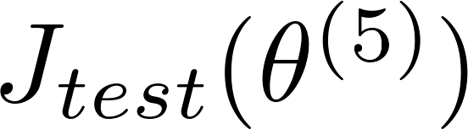

Model selection
1.
2.
3.
10.
Choose
How well does the model generalize? Report test set error .
Problem: is likely to be an optimistic estimate of generalization error. I.e. our extra parameter ( = degree of polynomial) is fit to test set.

Slide 12
训练集、交叉验证集、测试集
划分数据集的原因很简单。简而言之，为了防止过度拟合。如果我们把所有数据都用来训练模型的话，建立的模型自然是最契合这些数据的，测试表现也好。但换了其它数据集测试这个模型效果可能就没那么好了。
在机器学习中，将数据集划分为训练集和测试集是为了有效评估模型的泛化能力，确保模型不仅在训练数据上表现良好，也能在未见数据上保持良好的性能。这种划分可以帮助我们检测模型是否出现了过拟合或欠拟合问题，并提供更可靠的性能评估。
然而当将数据分为训练集和测试集时，模型的性能评估很可能受单次数据划分的影响。例如，如果测试集中数据分布不均或包含特殊的样本，测试结果可能不能真实反映模型的泛化能力。
因此，又添加了一个交叉验证集，在测试集之前提前评估模型的性能，并同时调整超参数。引入交叉验证集的目的在于更准确和公平地评估模型的性能，特别是解决数据划分带来的偶然性问题。
一些常见的交叉验证集形式有：
1. Holdout验证：静态划分数据集
2. k折交叉验证：初始采样分割成K个子样本，一个单独的子样本被保留作为验证模型的数据，其他K-1个样本用来训 练。交叉验证重复K次，每个子样本验证一次，平均K次的结果或者使用其它结合方式，最终得到一个 单一估测。这个方法的优势在于，同时重复运用随机产生的子样本进行训练和验证，每次的结果验证 一次，10折交叉验证是最常用的。
3. 留一验证：只使用原本样本中的一个样本来当做验证集，而剩余的则留下来当做训练资料。

Slide 13





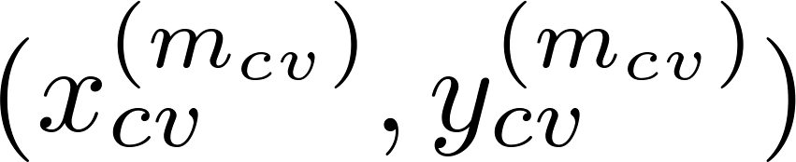
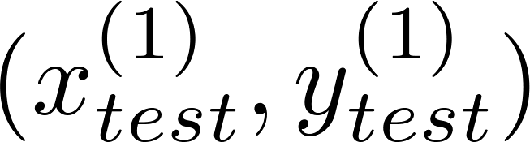
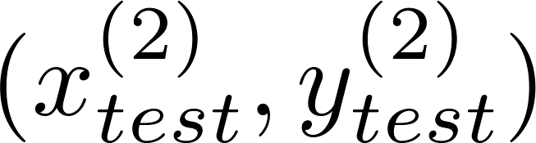
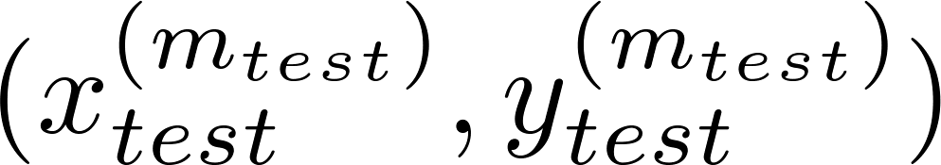
Evaluating your hypothesis
Dataset:
Size | Price
2104 | 400
1600 | 330
2400 | 369
1416 | 232
3000 | 540
1985 | 300
1534 | 315
1427 | 199
1380 | 212
1494 | 243

Slide 14
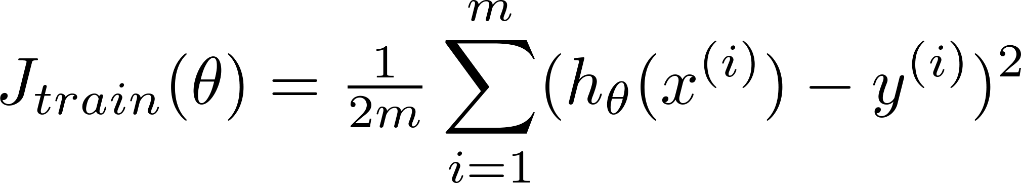
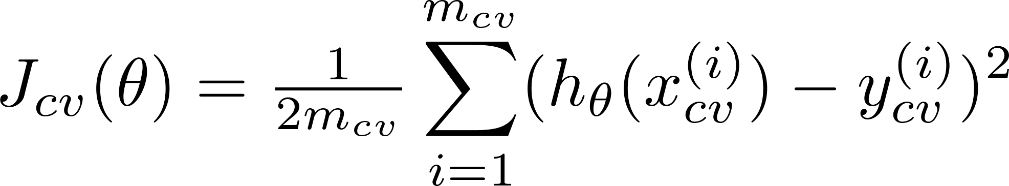
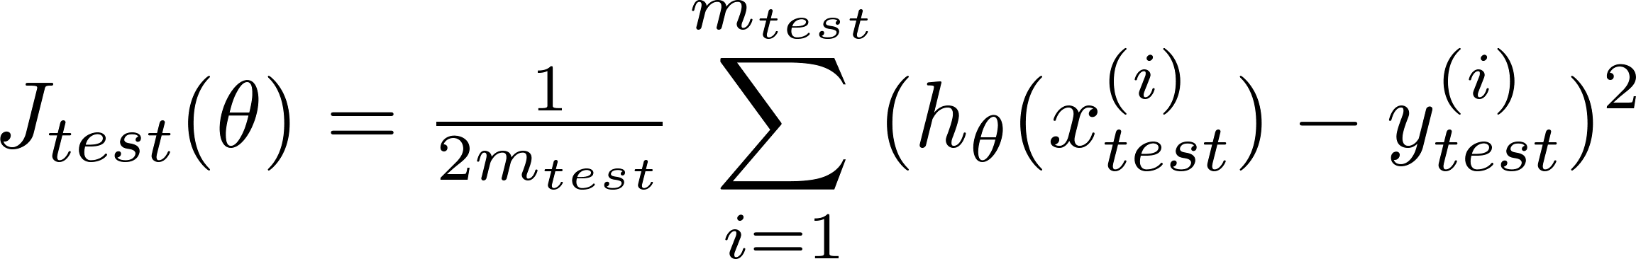
Train/validation/test error
Training error:
Cross Validation error:
Test error:

Slide 15
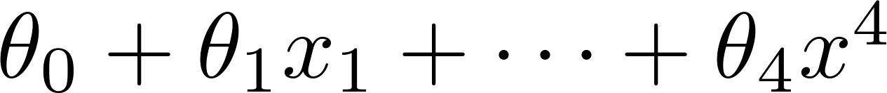
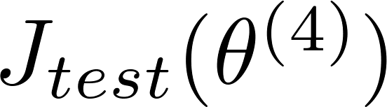
Model selection
1.
2.
3.
10.
Pick
Estimate generalization error for test set

Slide 16
Diagnosing bias vs. variance
Advice for applying machine learning
Machine Learning

Slide 17
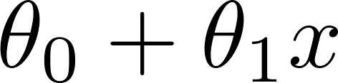
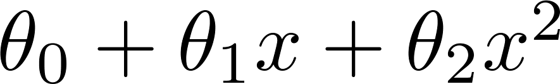
Bias/variance
Price
Price
Price
Size
Size
Size
High bias
(underfit)
“Just right”
High variance
(overfit)

Slide 18
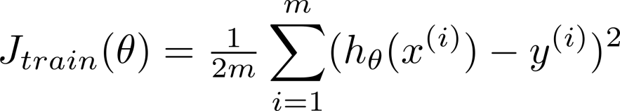
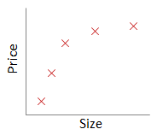
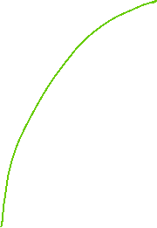
Bias/variance
Training error:
Cross validation error:
error
price
size
degree of polynomial d

Slide 19
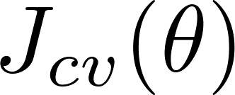
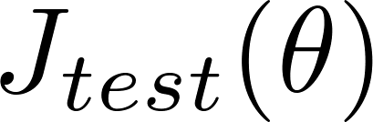


Diagnosing bias vs. variance
Suppose your learning algorithm is performing less well than you were hoping. ( or is high.) Is it a bias problem or a variance problem?
Bias (underfit):
(cross validation
error)
error
Variance (overfit):
(training error)
degree of polynomial d

Slide 20
Regularization and bias/variance
Advice for applying machine learning
Machine Learning

Slide 21
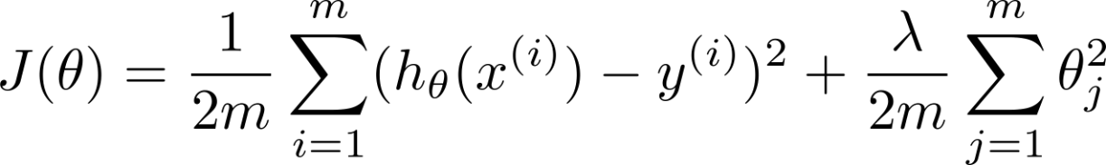




Linear regression with regularization
Model:
Price
Price
Price
Size
Size
Size
Large xx
High bias (underfit)
Intermediate xx
“Just right”
Small xx
High variance (overfit)

Slide 22
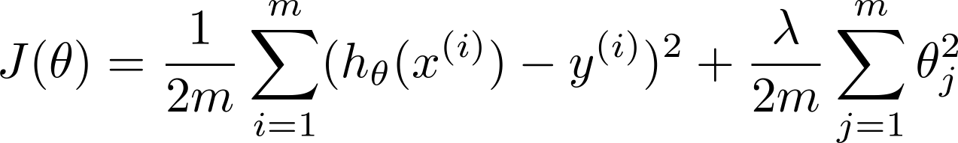
Choosing the regularization parameter

Slide 23
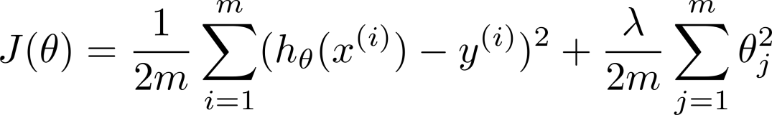







Choosing the regularization parameter
Model:
Try
Try
Try
Try
Try
Try
Pick (say) . Test error:

Slide 24



Bias/variance as a function of the regularization parameter

Slide 25
Learning curves
Advice for applying machine learning
Machine Learning

Slide 26

Learning curves
error
(training set size)

Slide 27

High bias
price
error
size
(training set size)
price
If a learning algorithm is suffering from high bias, getting more training data will not (by itself) help much.
size

Slide 28
High variance
(and small )
error
price
size
(training set size)
price
If a learning algorithm is suffering from high variance, getting more training data is likely to help.
size

Slide 29
Deciding what to try next (revisited)
Advice for applying machine learning
Machine Learning

Slide 30
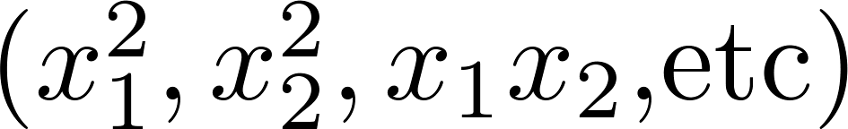
Debugging a learning algorithm:
Suppose you have implemented regularized linear regression to predict housing prices. However, when you test your hypothesis in a new set of houses, you find that it makes unacceptably large errors in its prediction. What should you try next?
Get more training examples
Try smaller sets of features
Try getting additional features
Try adding polynomial features
Try decreasing
Try increasing

Slide 31
Neural networks and overfitting
“Small” neural network
(fewer parameters; more prone to underfitting)
“Large” neural network
(more parameters; more prone to overfitting)
Computationally cheaper
Computationally more expensive.
Use regularization ( ) to address overfitting.

