Slide 1

Motivation I:
Data Compression
Dimensionality Reduction
Machine Learning

Slide 2


Data Compression
Reduce data from
2D to 1D
(inches)
(cm)

Slide 3
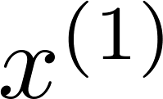
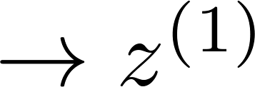
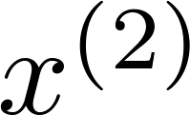
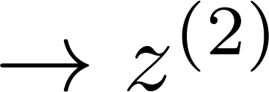
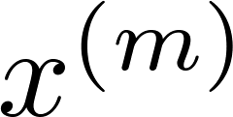
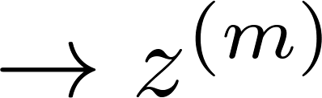

Data Compression
Reduce data from
2D to 1D
(inches)
(cm)
Notes:
Add more unique colors (3-4)

Slide 4
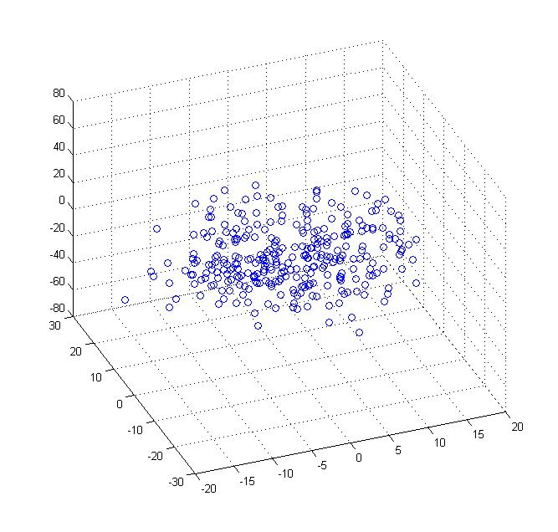
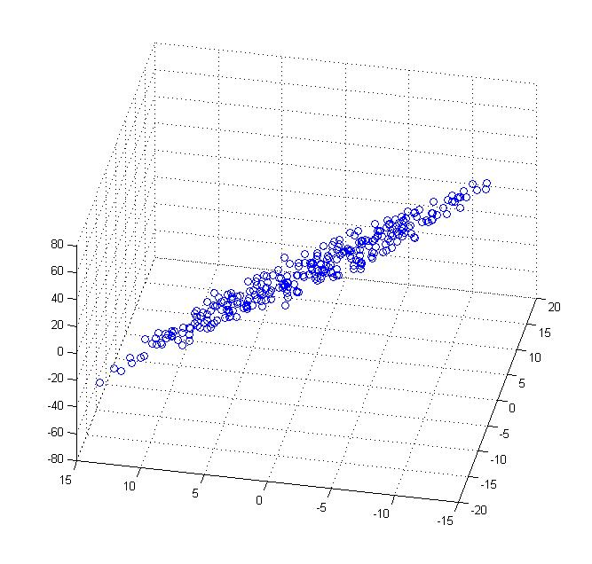
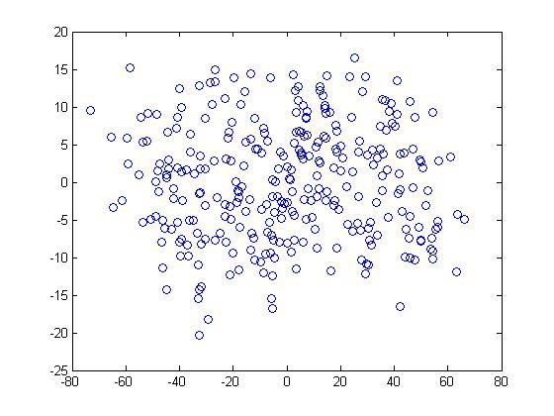


Data Compression
Reduce data from 3D to 2D
Notes:
Pca3d2d in lecture-slides/assets/pca/
Label axes

Slide 5
Motivation II:
Data Visualization
Dimensionality Reduction
Machine Learning

Slide 6
Data Visualization
Country | GDP (trillions of US$) | Per capita GDP (thousands of intl. $) | Human Develop-ment Index | Life expectancy | Poverty Index (Gini as percentage) | Mean household income (thousands of US$) | …
Canada | 1.577 | 39.17 | 0.908 | 80.7 | 32.6 | 67.293 | …
China | 5.878 | 7.54 | 0.687 | 73 | 46.9 | 10.22 | …
India | 1.632 | 3.41 | 0.547 | 64.7 | 36.8 | 0.735 | …
Russia | 1.48 | 19.84 | 0.755 | 65.5 | 39.9 | 0.72 | …
Singapore | 0.223 | 56.69 | 0.866 | 80 | 42.5 | 67.1 | …
USA | 14.527 | 46.86 | 0.91 | 78.3 | 40.8 | 84.3 | …
… | … | … | … | … | … | …
[resources from en.wikipedia.org]
Notes:
Add dots

Slide 7
Data Visualization
Country
Canada | 1.6 | 1.2
China | 1.7 | 0.3
India | 1.6 | 0.2
Russia | 1.4 | 0.5
Singapore | 0.5 | 1.7
USA | 2 | 1.5
… | … | …

Slide 8
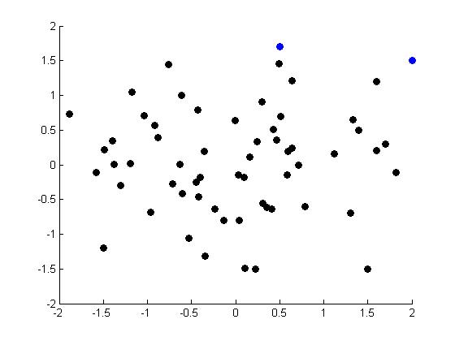
Data Visualization
Notes:
Make points look uncorrelated
US, Singapore in blue

Slide 9
Principal Component Analysis problem formulation
Dimensionality Reduction
Machine Learning

Slide 10
Principal Component Analysis (PCA) problem formulation
Notes:
Change numbers to LATEX as well

Slide 11

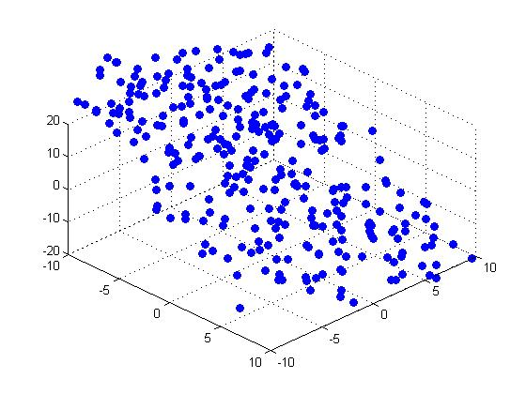


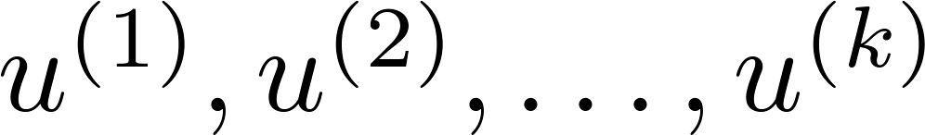
Principal Component Analysis (PCA) problem formulation
Reduce from 2-dimension to 1-dimension: Find a direction (a vector )
onto which to project the data so as to minimize the projection error.
Reduce from n-dimension to k-dimension: Find vectors
onto which to project the data, so as to minimize the projection error.
Notes:
Change numbers to LATEX as well

Slide 12
PCA is not linear regression
Notes:
Add animation to block left graph

Slide 13
PCA is not linear regression
Notes:
Add animation to block left graph

Slide 14
Principal Component Analysis algorithm
Dimensionality Reduction
Machine Learning

Slide 15
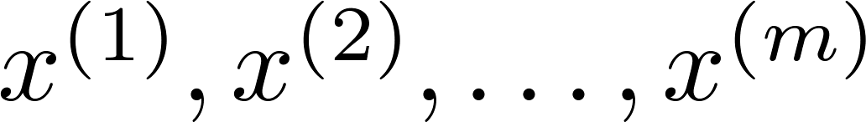
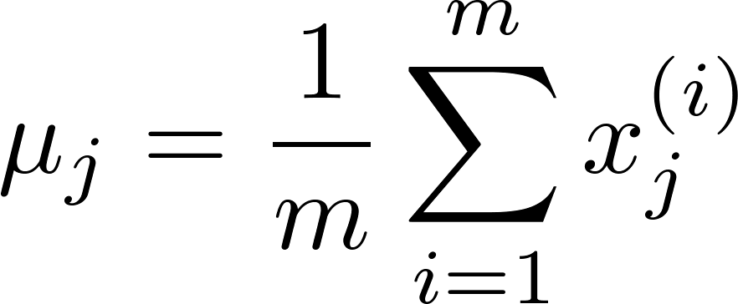
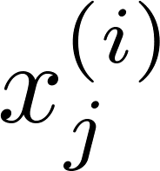



Data preprocessing
Training set:
Preprocessing (feature scaling/mean normalization):
Replace each with .
If different features on different scales (e.g., size of house,
number of bedrooms), scale features to have comparable range of values.
Notes:
Replace as previous; change spacing to fill page

Slide 16


Principal Component Analysis (PCA) algorithm
Reduce data from 2D to 1D
Reduce data from 3D to 2D
Notes:
Replace as previous; change spacing to fill page

Slide 17


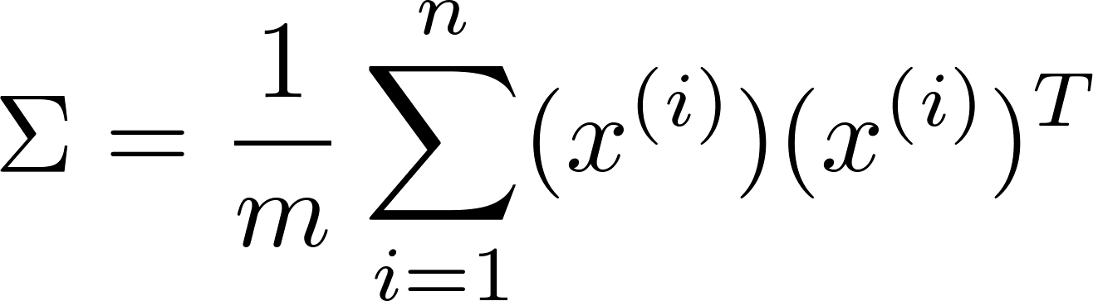

Principal Component Analysis (PCA) algorithm
Reduce data from -dimensions to -dimensions
Compute “covariance matrix”:
Compute “eigenvectors” of matrix :
[U,S,V] = svd(Sigma);

Slide 18
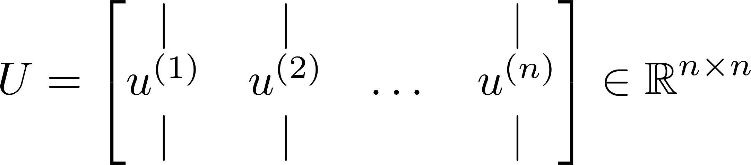
Principal Component Analysis (PCA) algorithm
From , we get:
[U,S,V] = svd(Sigma)

Slide 19
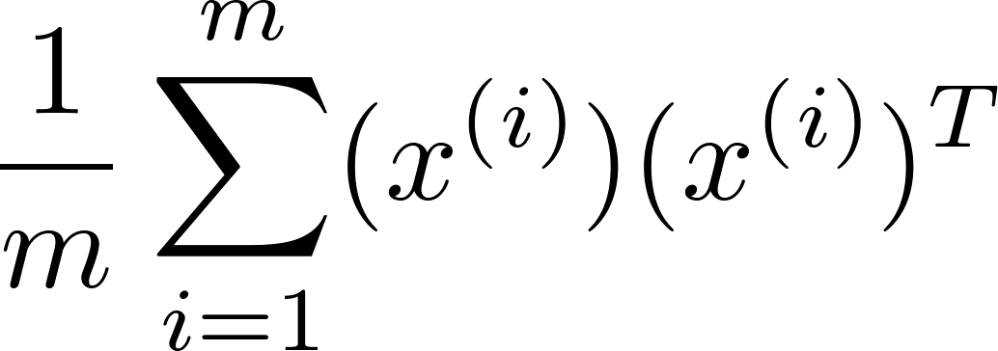
Principal Component Analysis (PCA) algorithm summary
After mean normalization (ensure every feature has zero mean) and optionally feature scaling:
Sigma =
[U,S,V] = svd(Sigma);
Ureduce = U(:,1:k);
z = Ureduce’*x;

Slide 20
Reconstruction from compressed representation
Dimensionality Reduction
Machine Learning

Slide 21
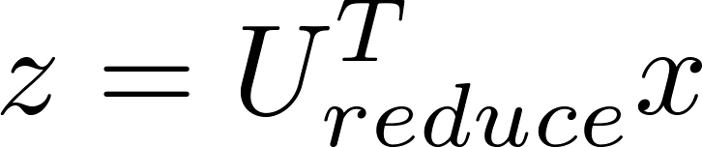
Reconstruction from compressed representation
Notes:
Make points have 0 mean on x1 and x2

Slide 22
Choosing the number of principal components
Dimensionality Reduction
Machine Learning

Slide 23
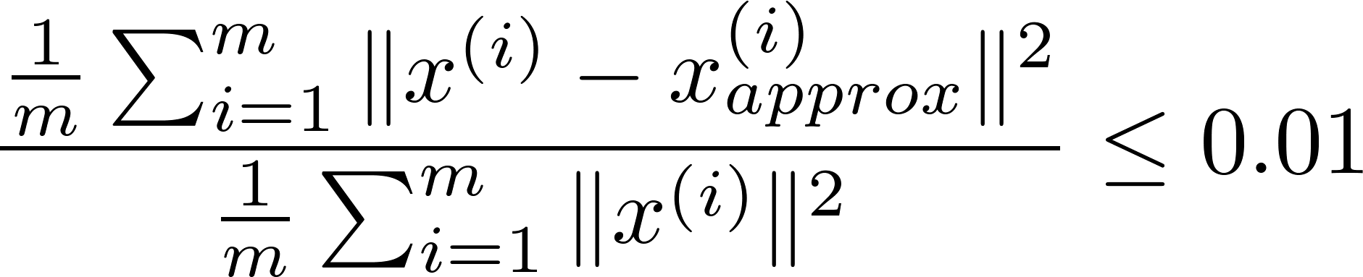
Choosing (number of principal components)
Average squared projection error:
Total variation in the data:
Typically, choose to be smallest value so that
“99% of variance is retained”
(1%)

Slide 24



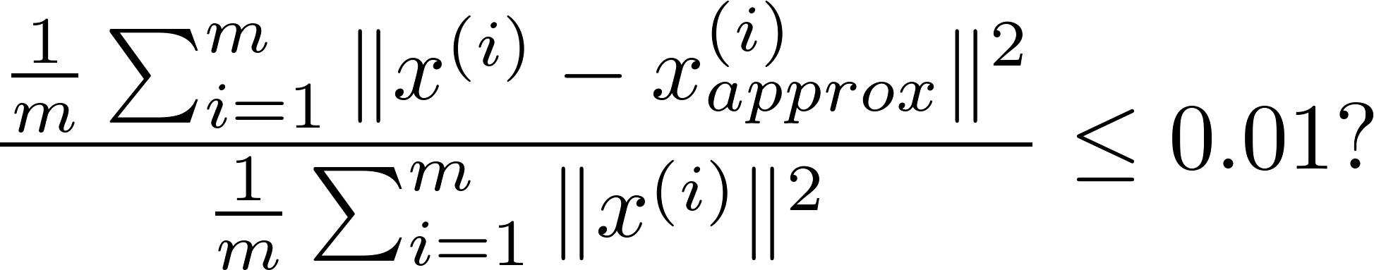
Choosing (number of principal components)
Algorithm:
Try PCA with
Compute
Check if
[U,S,V] = svd(Sigma)

Slide 25
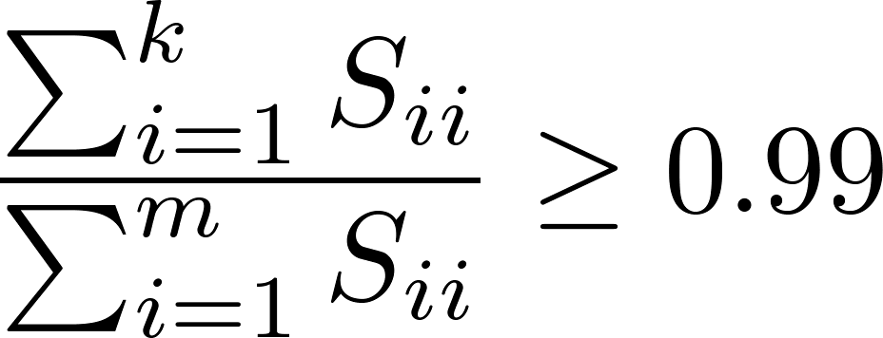
Choosing (number of principal components)
[U,S,V] = svd(Sigma)
Pick smallest value of for which
(99% of variance retained)

Slide 26
Advice for applying PCA
Dimensionality Reduction
Machine Learning

Slide 27

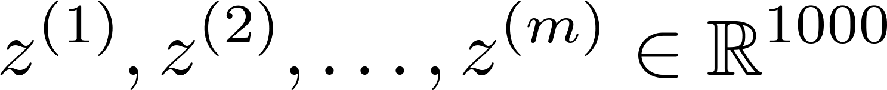
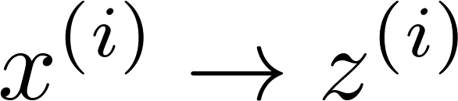
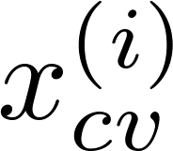
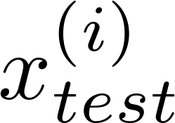
Supervised learning speedup
Extract inputs:
Unlabeled dataset:
New training set:
Note: Mapping should be defined by running PCA only on the training set. This mapping can be applied as well to the examples and in the cross validation and test sets.

Slide 28
Application of PCA
Compression
  Reduce memory/disk needed to store data
  Speed up learning algorithm
Visualization

Slide 29
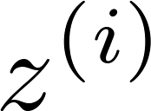
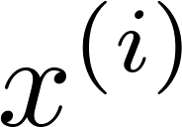

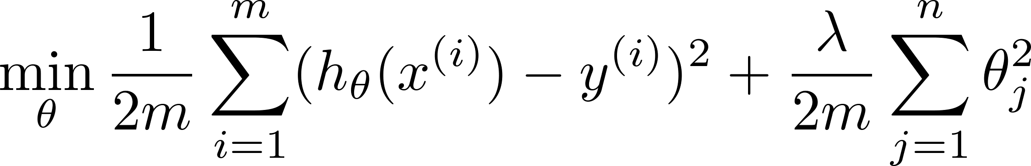
Bad use of PCA: To prevent overfitting
Use instead of to reduce the number of features to
Thus, fewer features, less likely to overfit.
This might work OK, but isn’t a good way to address overfitting. Use regularization instead.

Slide 30





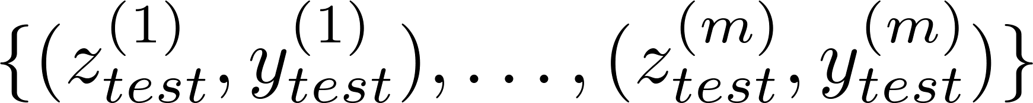
PCA is sometimes used where it shouldn’t be
Design of ML system:
  Get training set
  Run PCA to reduce in dimension to get
  Train logistic regression on
  Test on test set: Map to . Run on
How about doing the whole thing without using PCA?
Before implementing PCA, first try running whatever you want to do with the original/raw data . Only if that doesn’t do what you want, then implement PCA and consider using .

