Slide 1

The problem of overfitting
Regularization
Machine Learning

Slide 2
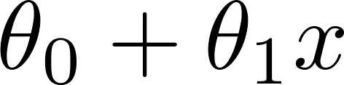
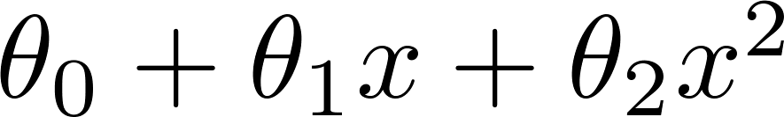
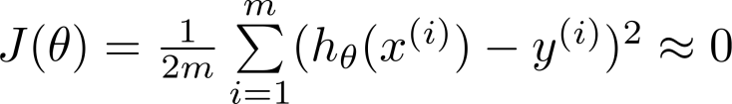
Example: Linear regression (housing prices)
Price
Price
Price
Size
Size
Size
Overfitting: If we have too many features, the learned hypothesis may fit the training set very well ( ), but fail to generalize to new examples (predict prices on new examples).

Slide 3
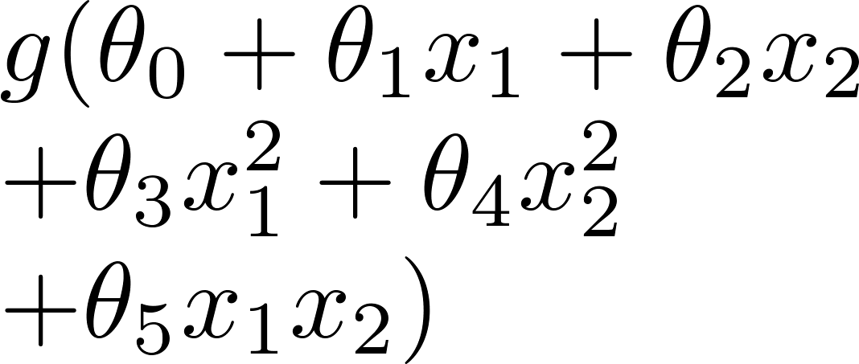
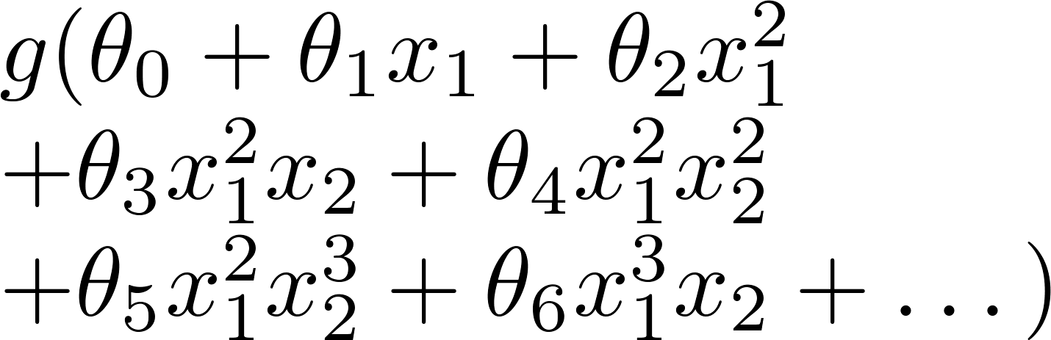
Example: Logistic regression
x₂
x₂
x₂
x₁
x₁
x₁
( = sigmoid function)

Slide 4






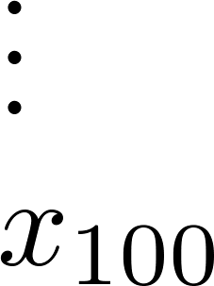

Addressing overfitting:
size of house
no. of bedrooms
Price
no. of floors
age of house
average income in neighborhood
Size
kitchen size
过拟合是指模型在训练集上表现很好，但在测试集或新数据上表现较差的现象。其本质原因是模型过度拟合了训练数据中的噪声或特征，使得模型过于复杂，无法泛化到未见过的数据。以下是过拟合产生的主要原因：
训练数据不足
模型过于复杂（精细），导致与训练数据完全匹配
训练轮次过多
数据噪声
缺少正则化

Slide 5





Addressing overfitting:
Options:
  Reduce number of features.
    Manually select which features to keep.
    Model selection algorithm (later in course).
  Regularization.
    Keep all the features, but reduce magnitude/values of parameters .
    Works well when we have a lot of features, each of which contributes a bit to predicting .

Slide 7
Cost function
Regularization
Machine Learning

Slide 8


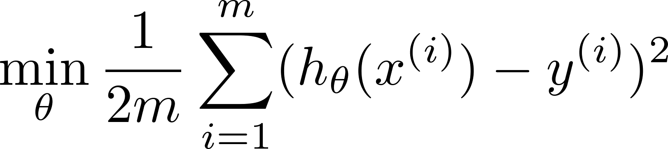

Intuition
Price
Price
Size of house
Size of house
Suppose we penalize and make , really small.

Slide 9
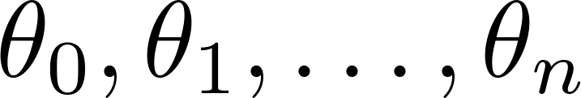
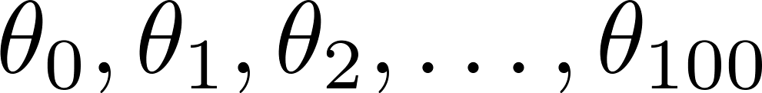
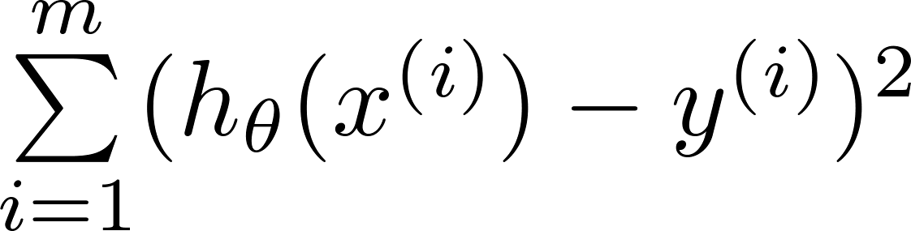
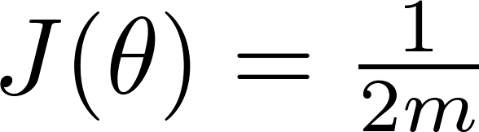

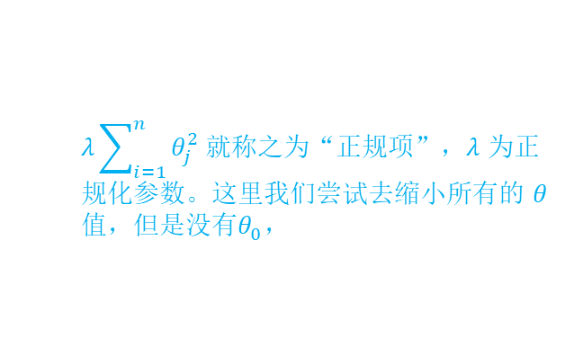
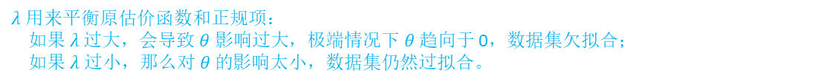
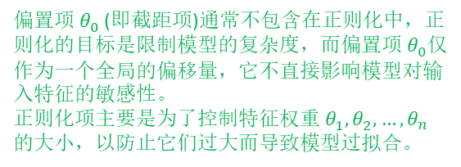
$λ$ 用来平衡原估价函数和正规项：
如果$λ$过大，会导致$θ 影响过大$，极端情况下$θ$ 趋向于 0，数据集欠拟合；
如果$λ 过小，那么对 θ 的$影响太小，数据集仍然过拟合。
Regularization.
偏置项 $θ_{0}^{ }$​(即截距项)通常不包含在正则化中，正则化的目标是限制模型的复杂度，而偏置项 $θ_{0}^{ }$仅作为一个全局的偏移量，它不直接影响模型对输入特征的敏感性。
正则化项主要是为了控制特征权重 $θ_{1}^{ },θ_{2}^{ },…,θ_{n}^{ }$​ 的大小，以防止它们过大而导致模型过拟合。
Small values for parameters
  “Simpler” hypothesis
  Less prone to overfitting
Housing:
  Features:
  Parameters:
$λ\sum_{i=1}^{n}{θ_{j}^{2}}$ 就称之为“正规项”，$λ$ 为正规化参数。这里我们尝试去缩小所有的 $θ$值，但是没有$θ_{0}^{ }，$

Slide 10
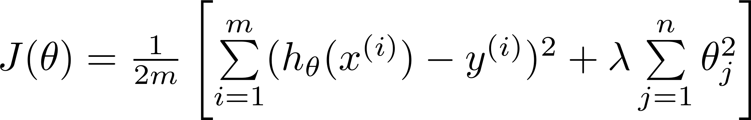
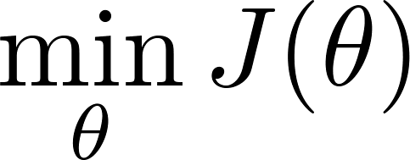



Regularization.
Price
Size of house

Slide 11


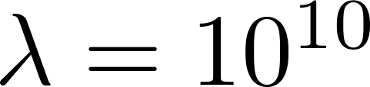
In regularized linear regression, we choose to minimize
What if is set to an extremely large value (perhaps for too large for our problem, say )?
Algorithm works fine; setting to be very large can’t hurt it
Algortihm fails to eliminate overfitting.
Algorithm results in underfitting. (Fails to fit even training data well).
Gradient descent will fail to converge.

Slide 12
In regularized linear regression, we choose to minimize
What if is set to an extremely large value (perhaps for too large for our problem, say )?
Price
Size of house

Slide 14
Regularized linear regression
Regularization
Machine Learning

Slide 15
Regularized linear regression

Slide 16

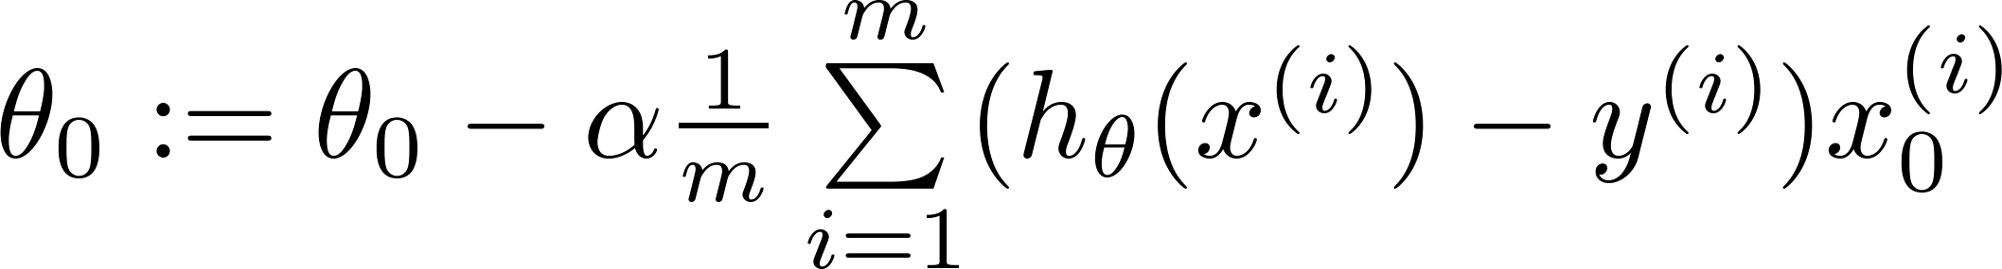
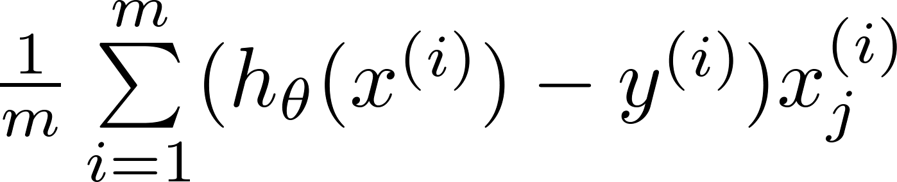
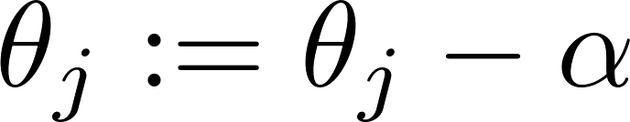


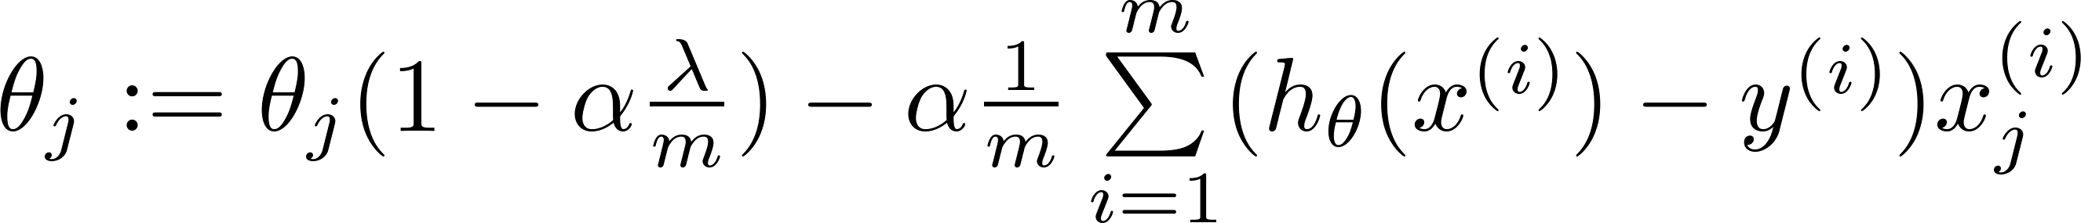
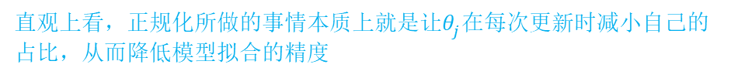


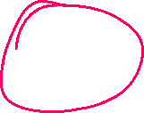

直观上看，正规化所做的事情本质上就是让$θ_{j}^{ }$在每次更新时减小自己的占比，从而降低模型拟合的精度
Gradient descent
Repeat

Slide 17
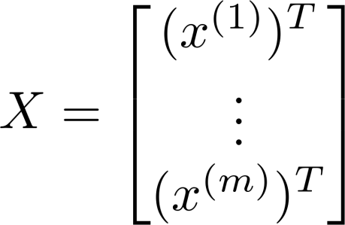
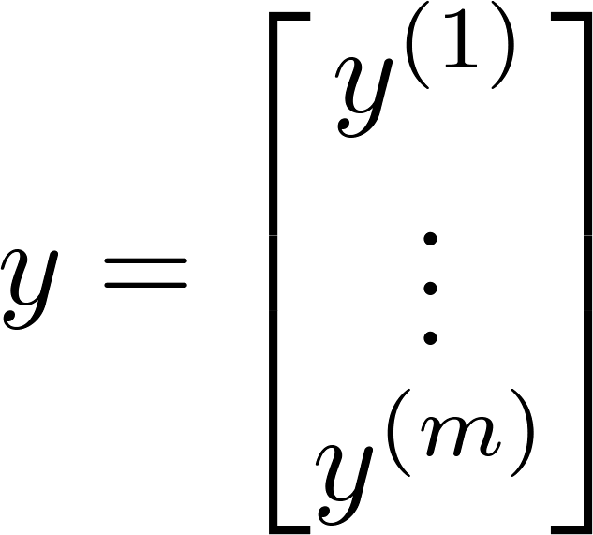

Normal equation

Slide 18
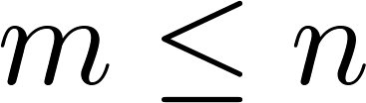
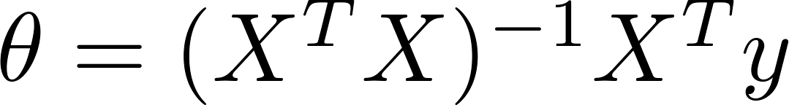

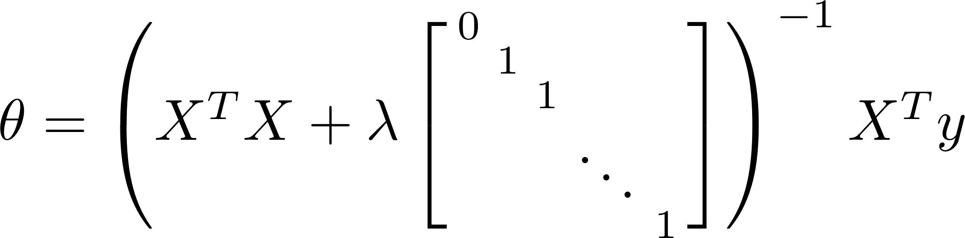



Non-invertibility (optional/advanced).
Suppose ,
(#examples) (#features)
If ,

Slide 20
Regularized logistic regression
Regularization
Machine Learning

Slide 21
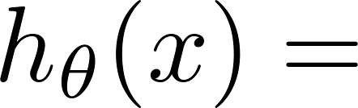
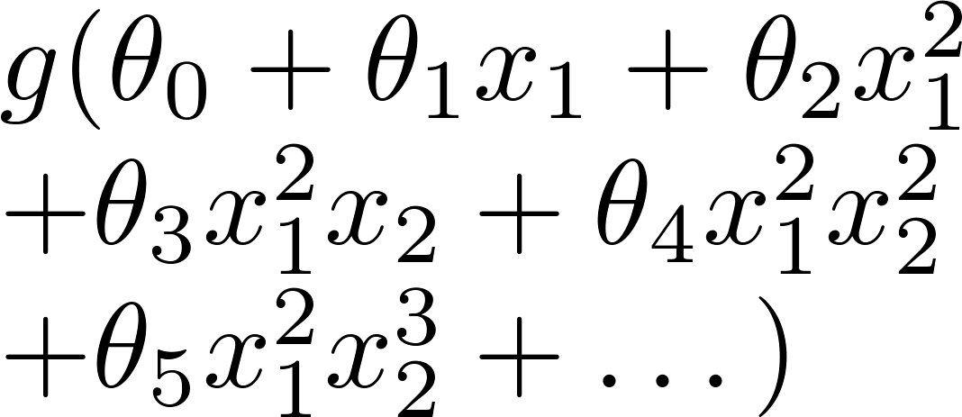
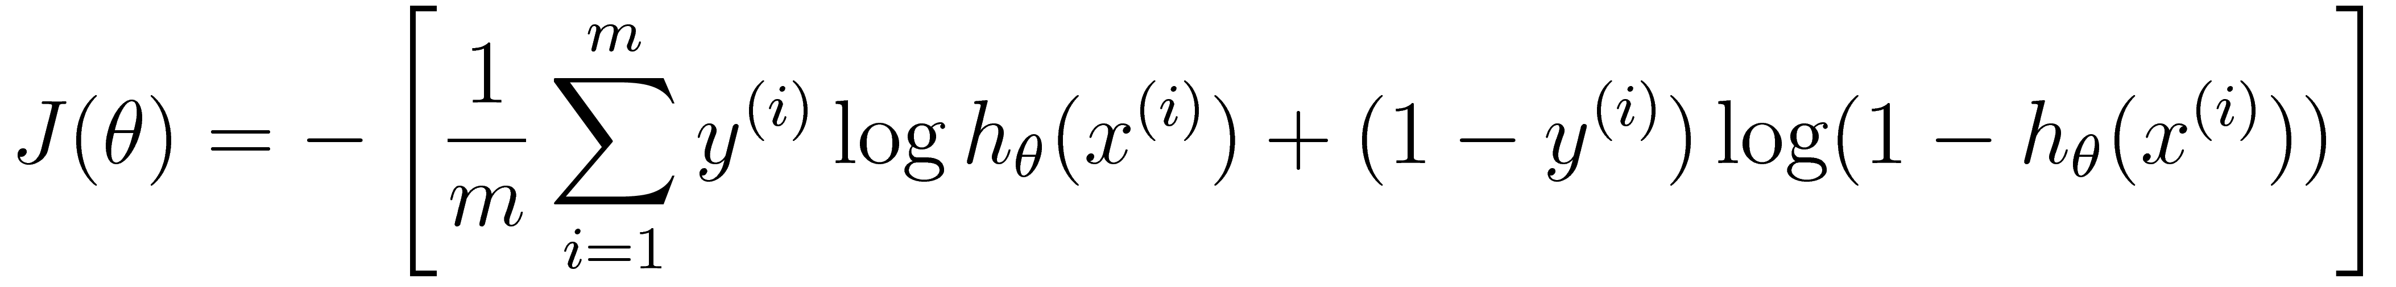

Regularized logistic regression.
x₂
x₁
Cost function:

Slide 22
Gradient descent
Repeat

Slide 23


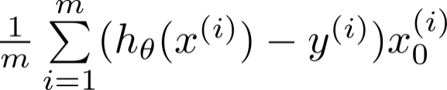

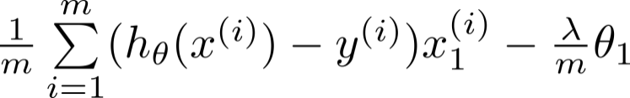

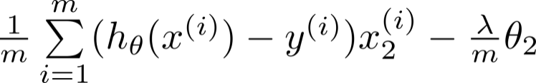

Advanced optimization
function [jVal, gradient] = costFunction(theta)
code to compute
jVal = [ ];
code to compute
gradient(1) = [ ];
code to compute
gradient(2) = [ ];
code to compute
gradient(3) = [ ];
code to compute
gradient(n+1) = [ ];

