Slide 1


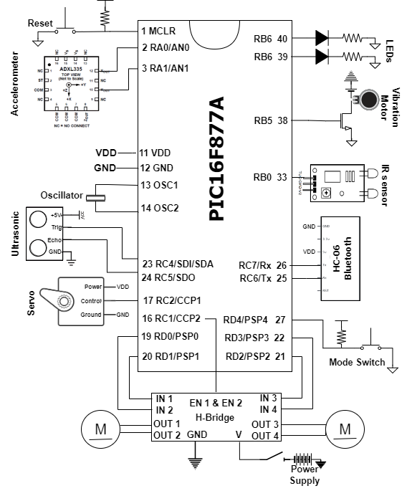
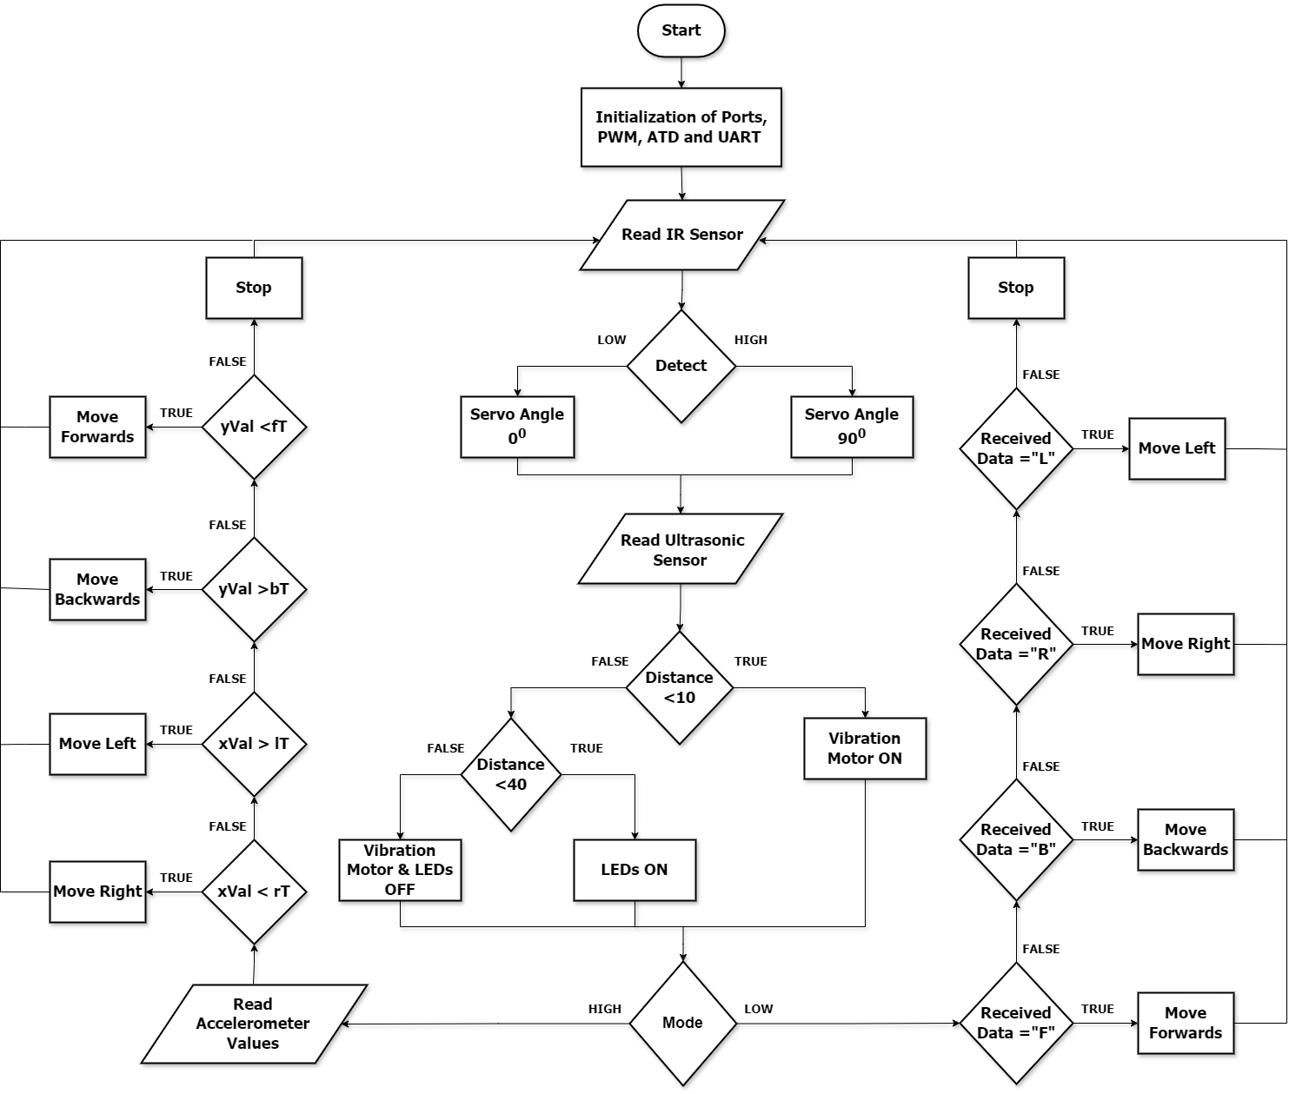
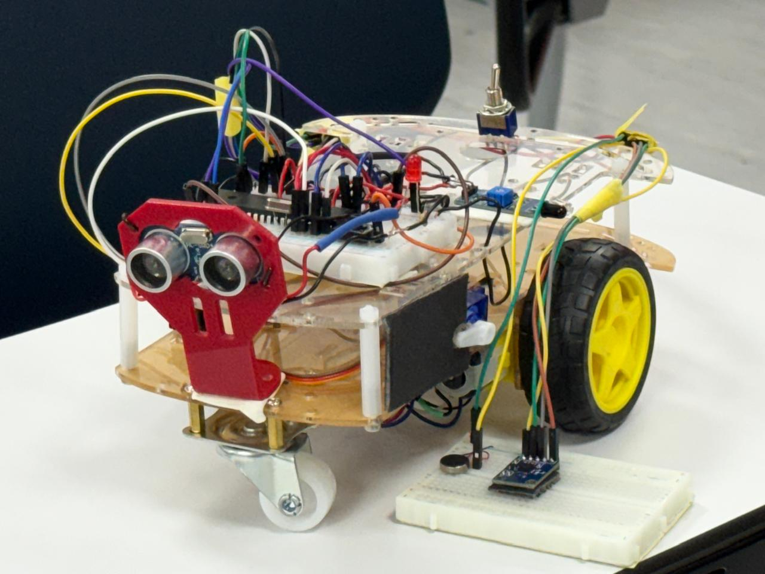
Gesture-Controlled Robot
Q. Al-Kaissi, L. Hamdan, and O. Mustafa
Supervisor: Dr. Belal Sababha, Dr. Esam Qaralleh Embedded Systems Final Design Project, Fall 2024 King Abdullah II School of Engineering
Princess Sumaya University for Technology
Introduction
Meet Gesturon, the hand gesture-controlled robotic vehicle designed to make life easier and tasks smarter! As a gesture-controlled robot, it empowers individuals with physical disabilities, providing enhanced mobility and independence. Powered by the PIC16F877A microcontroller and using a glove with an accelerometer for gesture detection and a vibration motor for obstacle alerts, Gesturon offers intuitive, real-time control.
It operates in two modes: Bluetooth-based serial communication, where the robot is controlled using a phone, and parallel mode, where gestures directly adjust speed using PWM control. Designed for mobility assistance, industrial automation, and healthcare, Gesturon combines innovation with practicality to address real-world challenges.
Results
Gesturon excelled in testing, with smooth Bluetooth control in serial mode and real-time gesture-based adjustments in parallel mode using PWM. The ultrasonic sensor detected obstacles effectively, lighting LEDs and triggering the vibration motor for close alerts. The infrared sensor operated the servo motor reliably for hands-free tasks, while the two-wheel system ensured stable and precise movement.
Design
Gesturon uses a PIC16F877A microcontroller to control two DC motors driving its two-wheel system, powered by two 3.7V lithium-ion batteries. An H-bridge enables PWM-based speed adjustments using accelerometer inputs, while the HC-06 Bluetooth module handles commands in serial mode, and the system includes an on/off button and a reset switch for easy operation.
In serial mode, commands like "F" for forward or "R" for right are sent from the phone via the HC-06 Bluetooth module. Interrupt-based control ensured real-time responses.
The ultrasonic sensor lights up LEDs for obstacles within 40 cm and activates the glove’s vibration motor for objects closer than 10 cm. The infrared sensor triggers a servo motor, adjusting the compartment angle between 0° and 90° for hands-free tasks. Gesturon’s integration of sensors and controls ensures smooth, responsive operation.
Figure 2: Gesturon’s block diagram.
Figure 1: Gesturon’s flow diagram.
Figure 3: Gesturon’s Mechanical Design
Conclusion
Gesturon showcases the potential of robotics to transform daily life by addressing real-world challenges in mobility assistance, industrial automation, and healthcare. As a wheelchair aide gesture-controlled robot, it demonstrates how intuitive hand-gesture systems can empower individuals with physical disabilities, offering greater independence and ease of use.
Beyond its immediate applications, Gesturon highlights the broader significance of accessible robotics—bridging advanced technology with practical solutions that improve safety, efficiency, and quality of life. By integrating innovation with usability, Gesturon paves the way for future advancements in assistive and industrial robotics, making technology smarter, simpler, and more impactful.

