Slide 1
Database Management System
Lecture No : 01

Slide 2
What is Data?
Data can be facts related to any object.
Example
Name
Age
Address
Contact number

Slide 3
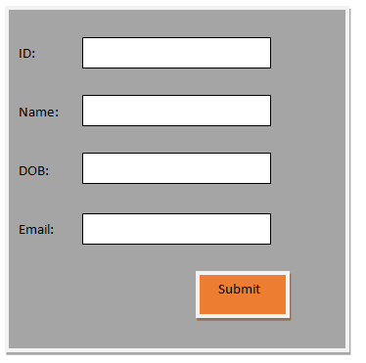
What is Database? (cont…)
A database is a collection of data stored in such a format which can be accessed easily.

Slide 4
What is DBMS?
It is a software to manage the database.
It enables the users to store, modify and extract the data from the database.
Examples:
Oracle
MySQL
MS SQL Server
PostgreSQL
MongoDB

Slide 5
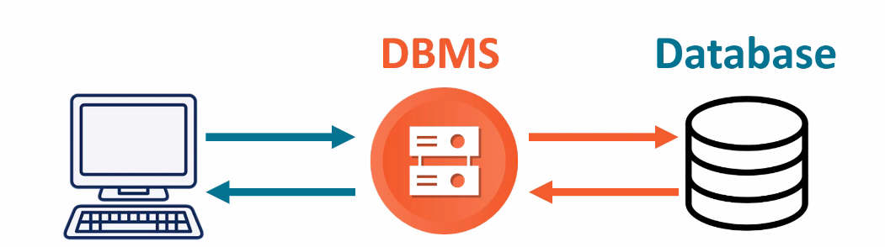
How DBMS Works?

Slide 6
Types of Database:
Relational DB
NoSQL DB

Slide 7
Relational Database
Different tables are created in Relational Database.
A special language known as SQL is used by RDBMS to access the data in the Relational Database.
SQL stands for Structured Query language.

Slide 8
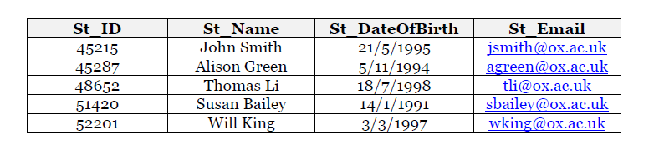
Relational Database (cont…)
It has a collection of tables.
Each table has records and fields.
Example
A table that contains student’s information

Slide 9
NoSQL Database
It is not a table-based database
While it is a document based
Example
MongoDB

Slide 10
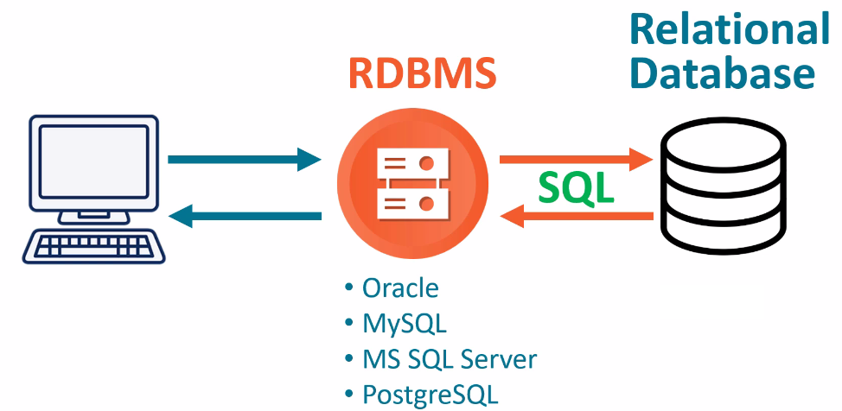
Relational Database Management System

Slide 11
Advantages of MySQL
Cross Platform
Used with multiple languages (PHP, C#, Python)
It is an Open Source software
Fast, reliable, scalable and easy to use

Slide 12
Popular Websites Using MySQL
Facebook
Twitter
Google
Wikipedia
YouTube

