Slide 1
Data Base Management System
Lecture No : 02

Slide 2
Constraints in MySQL
Here we have a list of constraints used in MySQL:
NOT NULL
UNIQUE
DEFAULT
CHECK
FOREIGN KEY
PRIMARY KEY

Slide 3
Constraints in MySQL (cont.)
Table without constraint
Roll No. | Student Name | Email address | Department | Marks(%)
1 | ABC | abc123@yahoo.com | CS | 57
2 | DEF | def555@gmail.com | CS | 67
3 | xyz | xyz786@yahoo.com | CS | 90
4 |  | qrs999@gmail.com | CS | 66
5 | ijk | abc123@yahoo.com | CS | 45
2 | mno | mno777@gmail.com | CS | 70

Slide 4
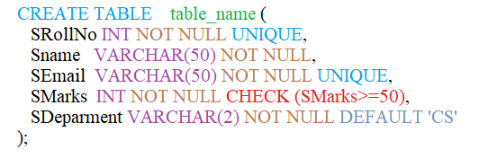
Constraints in MySQL (cont.)
Syntax of creating a TABLE in MySQL by using constraints:

Slide 5


SELECT Command Syntax
To select specific columns
To select all the columns

Slide 6
SELECT Command (cont.)
SELECT command with AND operator:
Example:
WHERE Age>=18 AND Age<=21

Slide 7
SELECT Command (cont.)
SELECT command with OR operator:
Example:
WHERE Age= 20 OR Age=50

Slide 8
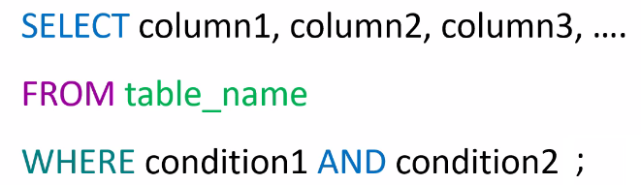
SELECT Command (cont.)
SELECT with AND Operator Syntax:

Slide 9
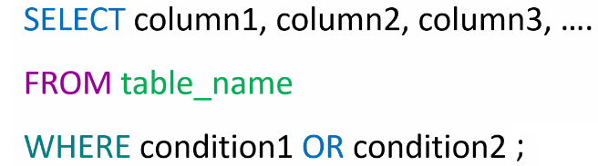
SELECT Command (cont.)
SELECT with OR Operator Syntax:

Slide 10
THANK
YOU

