Slide 1
DataBase Management System
Lecture No : 03

Slide 2
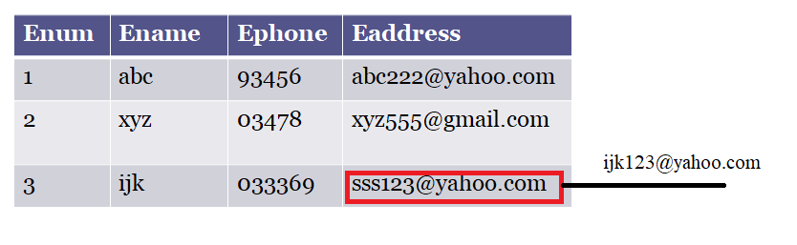
UPDATE Command

Slide 3
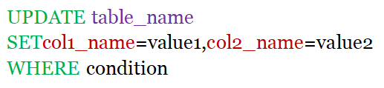
UPDATE Syntax

Slide 4

SELECT Command with IN Operator
IN Operator
OR Operator

Slide 5
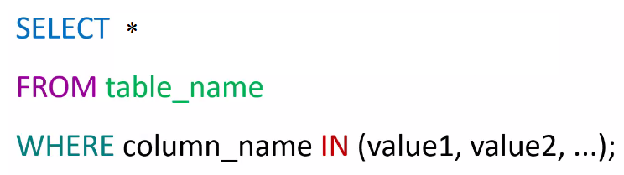
SELECT command with IN Operator Syntax

Slide 6
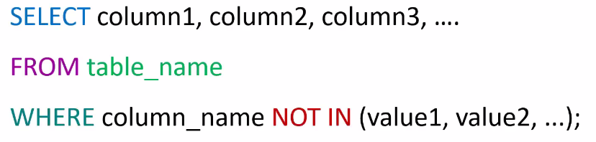
SELECT command with NOT IN Operator Syntax

Slide 7
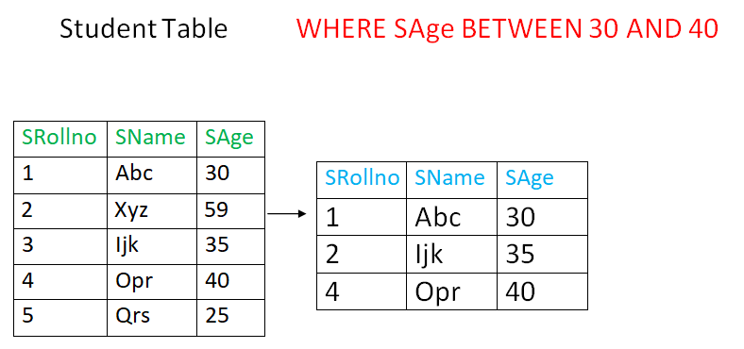
SELECT command with BETWEEN Operator Syntax

Slide 8
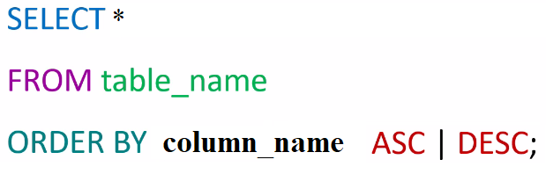
SELECT with ORDER BY Syntax

Slide 9
THANK
YOU

