Slide 1
DBMS
Lecture No : 04

Slide 2



Truncate Command
Here we have records in the table.
Truncate command is used to delete all the records from the table.

Slide 3
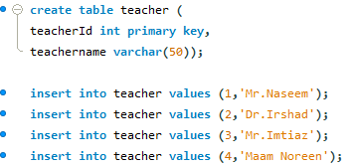
Primary key
A combination of NOT NULL and UNIQUE
Uniquely identifies each row in a table.

Slide 4

Primary key (Cont.)

Slide 5
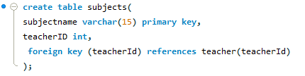
Foreign Key
Syntax

Slide 6
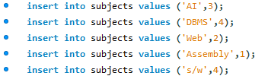
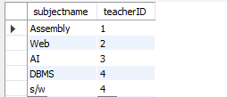
Foreign Key (cont…)

Slide 7

Foreign Key (cont…)
Error occurs as teacherId ‘5’ does not exist in the table “teacher”

Slide 8
Foreign Key (cont…)
Foreign key can be NULL or Duplicate.
We can not insert a such teacherId in the table “subject” which is not present in the table “teacher”.
We can not delete a teacherId from the table “teacher” which is present in the table “subject” as a foreign key.

Slide 9
THANK
YOU

