Slide 1
dBMS
Lecture No : 05

Slide 2
DataBase Models in DBMS
Database model shows the logical structure of a database
Represents the relationships between the data and determine how the data can be stored and accessed.
Based upon some rules and concepts the individual database models are designed.

Slide 3
Traditional Models
Hierarchical Model
Network Model
Relational Model

Slide 4
Hierarchical Model
In this model each entity has only one parent but can have several children
At the top of hierarchy there is only one entity which is called “Root”.

Slide 5
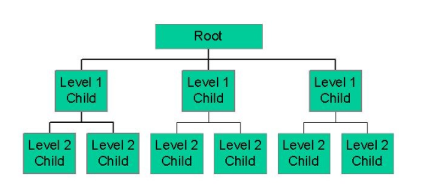
Hierarchical Model (cont…)

Slide 6
Network Model
The network model expands the hierarchical structure, allowing many to many relationships in a tree-like structure that allows multiple parents. It was most popular before being replaced by the relational model.

Slide 7
Relational Model
The basic data structure of the relational model is the table, where information about a particular entity (e.g. student) is represented in rows (also called tuples) and columns.
The relation in a relational database refers to the various tables in the database.
A relation is a set of tuples, each tuple represents various attributes of a single entity.

Slide 8
THANK
YOU

