Slide 1
DBMS
Lecture No : 06

Slide 2
Entity-Relationship Diagram(ERD)
Introduced by Peter Chen in 1976
A non-technical design method works on conceptual level based on the perception of real world.
Consists of collection of basic objects called entities with their attributes and of relationships among objects
Diagrammatical representation of database easy to understand even by non technical users.

Slide 3
Entities & Attributes
The basic object that the ER model represents is an entity, which is a thing in real world with an independent existence.
The entity can be distinguished from other objects based on the values of the attributes it possess.
Each entity has attributes. They are the properties whose values are the data that are stored in the database.

Slide 4
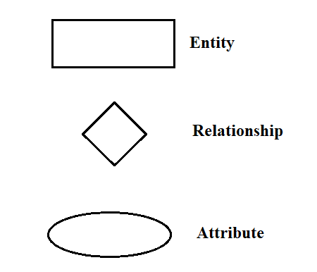
Symbols used in ER-Diagram

Slide 5
Types of Entity
Tangible
Entities which exist physically in the real world
e.g. student, teacher, book etc.
Intangible
Entities which exists logically e.g. Account

Slide 6
Types of Attributes
Atomic
Composite
Multivalued
Derived
Null
Key Attribute

Slide 7
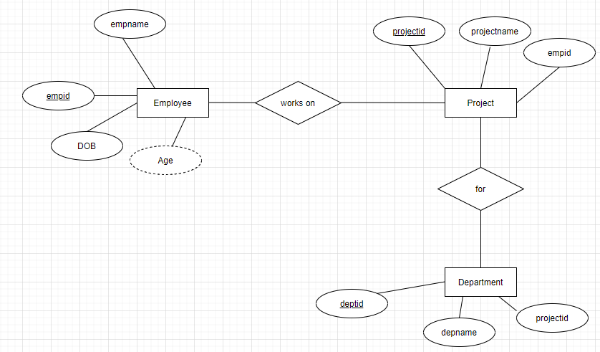
Entity-Relationship Diagram

Slide 8
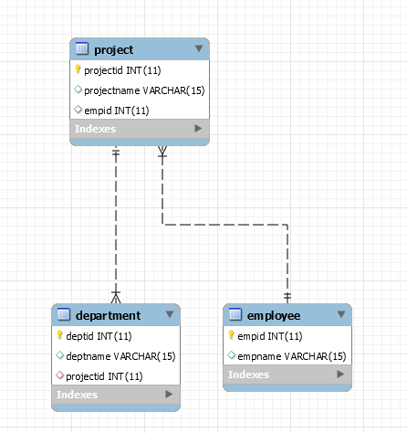
Enhanced-Entity Relationship Diagram(EER)

Slide 9
THANK
YOU

