Slide 1
DBMS
Lecture No : 08

Slide 2
Basic Types of Keys
Super Key
Candidate Key
Primary Key

Slide 3
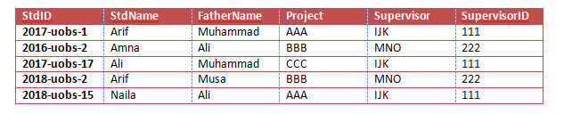
Example
R(ABCDEF)

Slide 4
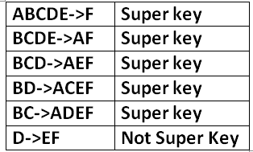
Super Key
An attribute or a set of attributes which can uniquely identify each row in a table.
Example:

Slide 5
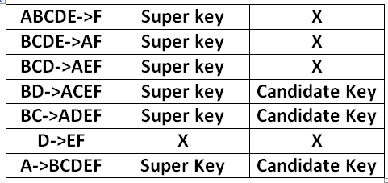
Candidate Key
Minimal or proper subset of a super key, is called candidate key
Example:

Slide 6
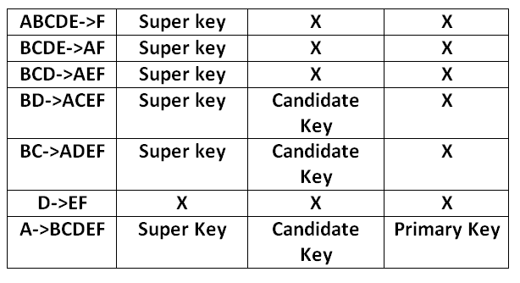
Primary Key
There is no difference between candidate and primary key
DBA can select any candidate key as a primary key

Slide 7
3NF
A relation is in Third Normal Form if it is in Second Normal Form and no non-key attribute is dependent on another non-key attribute ( No transitive dependency)
Remove all attributes from 2 NF that depend on another non-key attribute
Place them in a new relation with other attribute as a primary key

Slide 8
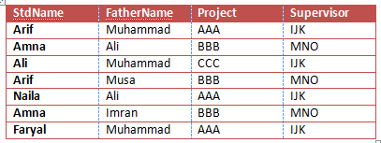
3NF
R(ABCDE)
Column D depends upon C
Non prime attribute finds another non prime attribute
Transitive dependency

Slide 9
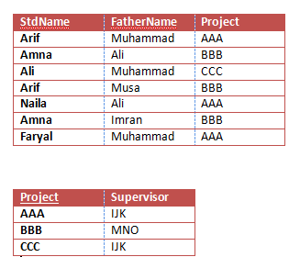
3NF
We have to remove a transitive dependency for the 3NF
There should be no partial and transitive dependency in the table for 3NF

