Slide 1
DBMS
Lecture No : 09

Slide 2
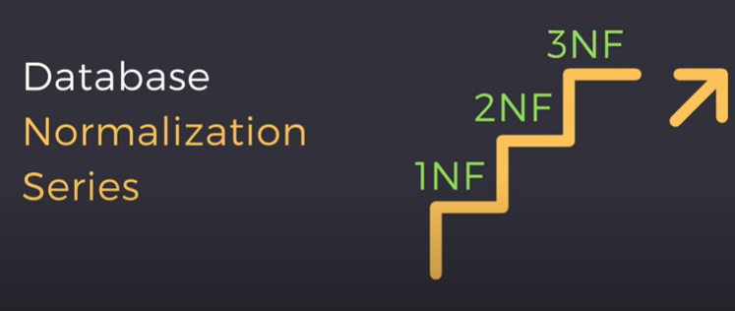
Review

Slide 3
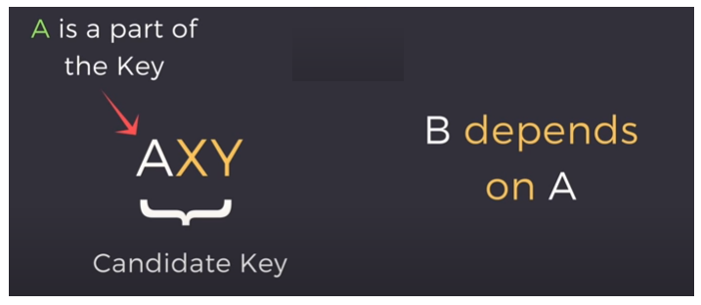
2NF
It should not have partial dependency
Partial Dependency:

Slide 4
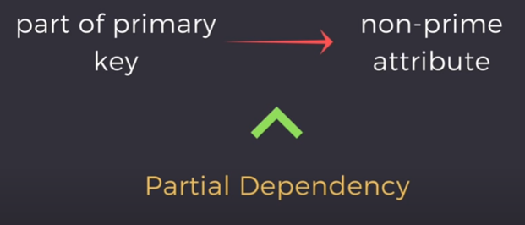
2NF(cont…)

Slide 5
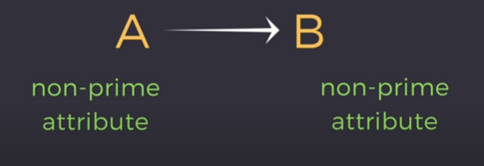
3NF
There should be no transitive dependency for 3NF.

Slide 6
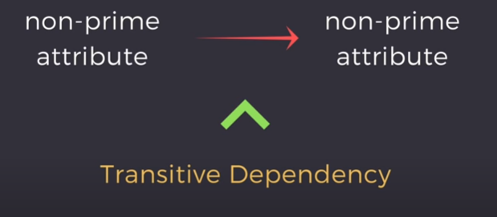
3NF(cont…)

Slide 7
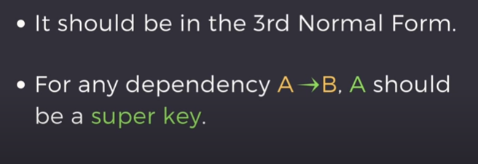
Boyce-Codd Normal Form
Also Known as 3.5 Normal Form
Upgraded version of third normal form.
A table in BCNF should satisfy the following two conditions:

Slide 8
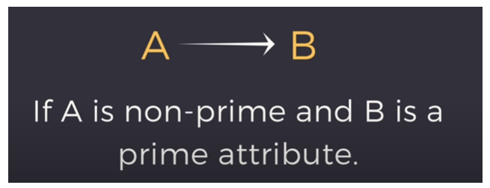
BCNF(cont…)

Slide 9
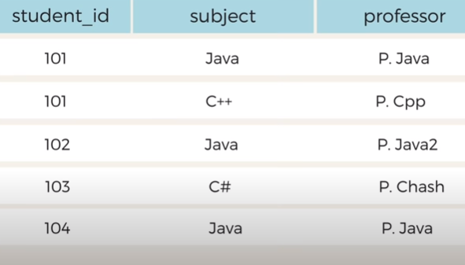
Example
College Enrollment Table

Slide 10
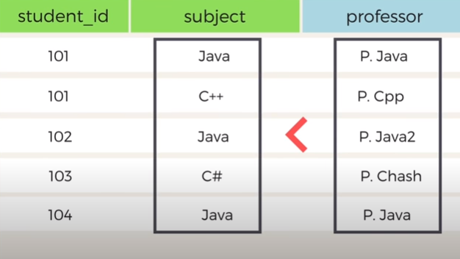
Example(cont…)

Slide 11
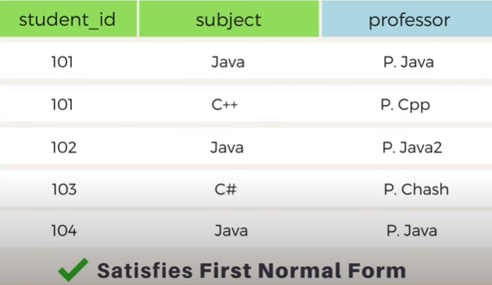
Example(cont…)

Slide 12
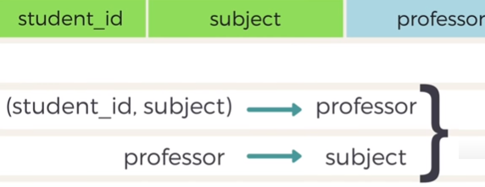
Example(cont…)
Neither partial and nor transitive dependency

Slide 13
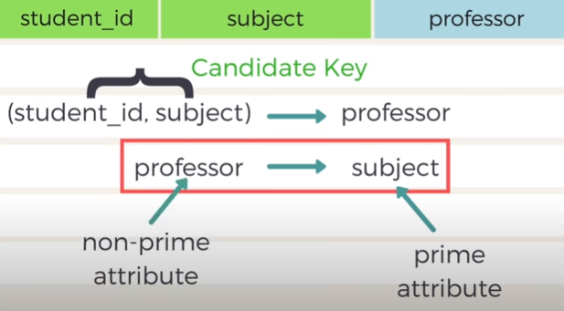
Example(cont…)

Slide 14
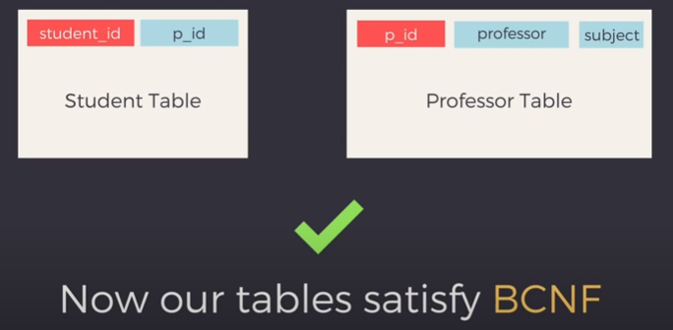
Example(cont…)
Decomposition of the table into two more tables:

