Slide 1
Database management system
Lecture No : 10

Slide 2
4 Normal Form
Condition:
A relation is in Fourth Normal (4NF) if and only if it is in BCNF and has no multi-valued dependencies.
We have to remove the multi-valued dependency when a relation has atleast three attributes, two of them are multi-valued .

Slide 3
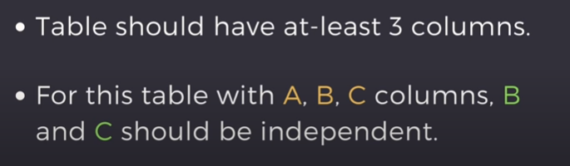
4 Normal Form (cont…)

Slide 4
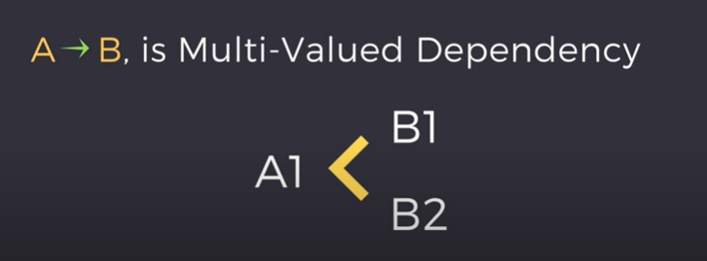
Multi-valued Dependency

Slide 5
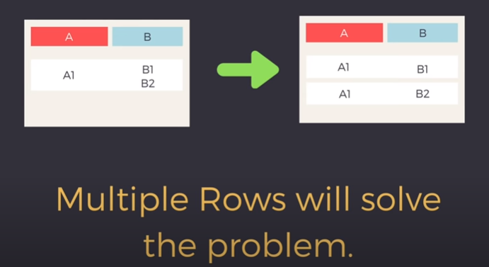
Example
In a case of two attributes:

Slide 6
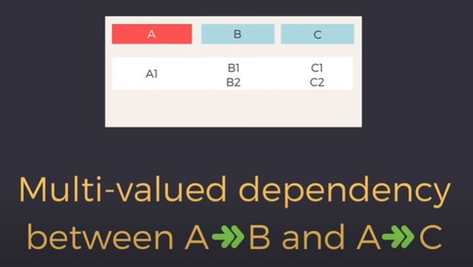
Example(cont…)
In case of three attributes:

Slide 7
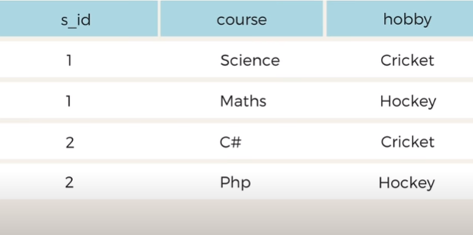
Example- Enrollment Table

Slide 8

Example- Enrollment Table (cont…)
No relationship between course and hobby.

Slide 9

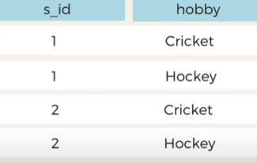
Example- Enrollment Table (cont…)
Course Table
Hobbies Table

Slide 10
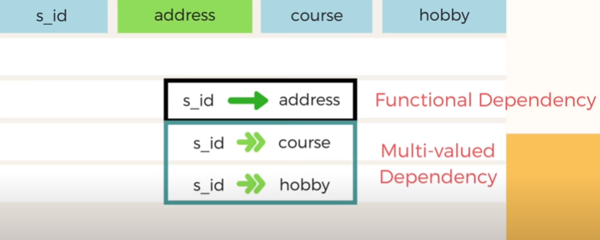
Example2

Slide 11

Example3

Slide 12
THANK YOU

